Slide 1
TOPICS
STORY BOARDING
NOW LET US LEARN ABOUT BOARDING,USE OUR SPOTIFY FOR STORY BOARDING

Slide 2

1
Scene 1: Introduction to Spotify
“Spotify, one of the world’s leading music streaming services, uses data analytics to provide a personalized music experience for millions of users.”

Slide 3
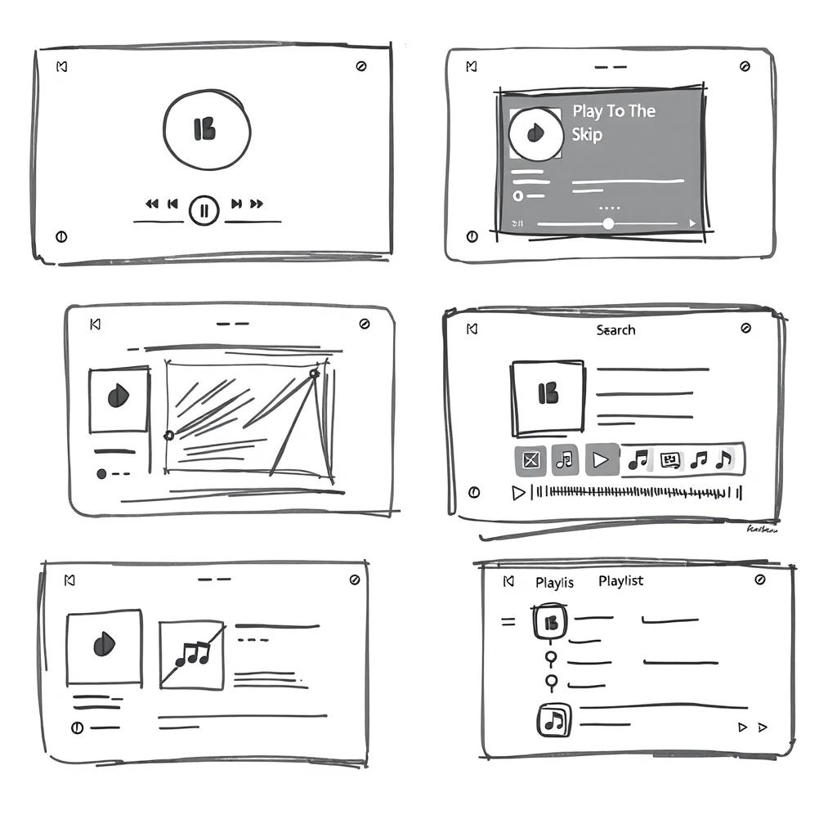
2
Data Collection
“Spotify collects data from various sources, including user preferences, listening habits, and search behavior.”

Slide 4

3
Recommendation Engine
“Using advanced machine learning algorithms, Spotify’s recommendation engine creates personalized playlists such as Discover Weekly and Release Radar, tailored to each user’s taste.”

Slide 5
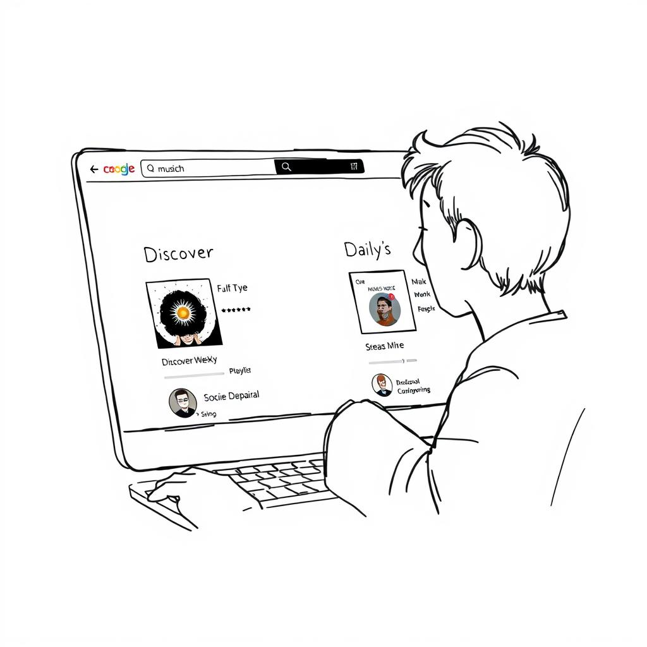
4
Discover Weekly
“Discover Weekly offers a curated playlist every Monday, introducing users to new music based on their listening history.”

Slide 6

5
Wrapped Insights
“Spotify Wrapped provides users with an annual summary of their most listened-to tracks, artists, and genres, creating a fun and engaging way to reflect on their music journey.”

Slide 7

6
Supporting Artists
“Spotify for Artists gives musicians access to real-time performance metrics, helping them understand their audience and optimize their strategies.”

Slide 8

7
Fan Study
“Through initiatives like Fan Study, Spotify helps artists analyze how fans discover and engage with their music, providing valuable insights for growth.”

Slide 9
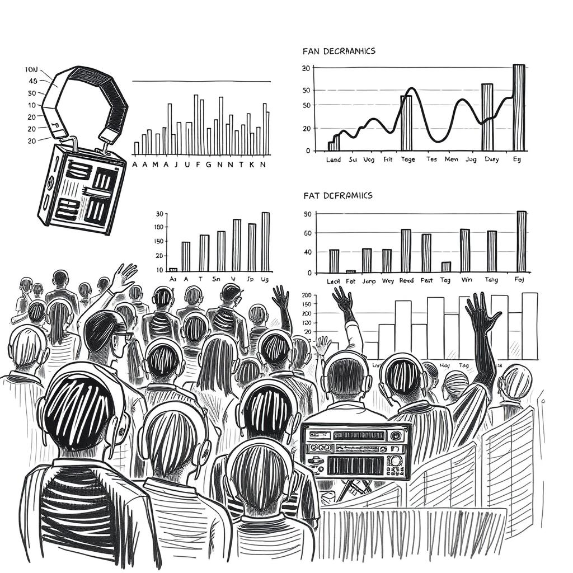
8
Advanced Analytics
“Spotify employs advanced machine learning techniques, such as the BaRT algorithm, to continuously improve content recommendations and adapt to changing user behaviors.”

Slide 10

9
Conclusion
“By leveraging data analytics, Spotify creates a seamless and personalized music experience, benefiting both users and artists alike.”

Slide 11

10 .Enjoying
"Finally enjoying the your favourite music in Spotify."

