Slide 1

Mobile Phones of a Company to be upgraded with 5G

Slide 2

Key Stakeholders for 5G Mobile Phone Upgrade
Internal Stakeholders:
Project Managers: Oversee the upgrade project, ensuring timelines and budgets are met.
R&D Team: Develop and test the 5G technology integration.
Marketing Team: Promote the new 5G capabilities to customers.
Sales Team: Sell the upgraded 5G phones to customers.
Customer Support: Handle customer inquiries and issues related to the upgrade.

Slide 3

External Stakeholders
Customers: End-users who will use the upgraded 5G phones.
Suppliers: Provide necessary components for the 5G upgrade.
Mobile Network Operators: Ensure network compatibility and performance.
Regulatory Bodies: Ensure compliance with 5G standards and regulations.
Investors: Interested in the financial performance of the upgrade.

Slide 4

Stakeholder Mapping Matrix
Here’s a graphical representation of the stakeholder mapping matrix:
+----------------+----------------+----------------+----------------+
| | High Influence | High Influence | Low Influence |
| | High Interest | Low Interest | High Interest |
+----------------+----------------+----------------+----------------+
| Project | Project | Regulatory | Customers |
| Managers | Managers | Bodies | |
+----------------+----------------+----------------+----------------+
| R&D Team | Marketing Team | Investors | Suppliers |
+----------------+----------------+----------------+----------------+
| Sales Team | | | |
+----------------+----------------+----------------+----------------+
| Customer | | | |
| Support | | | |
+----------------+----------------+----------------+----------------+

Slide 5
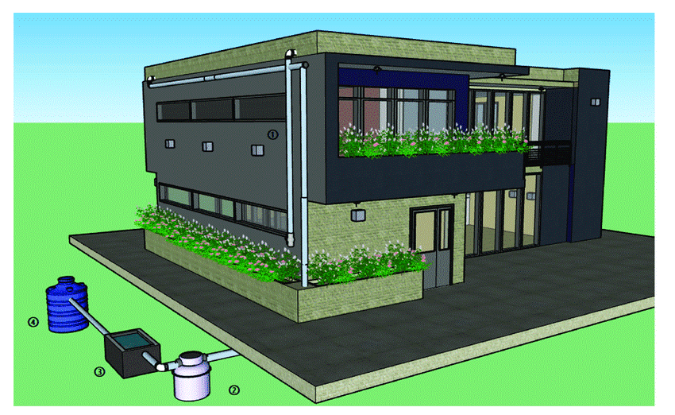
Rainwater Harvesting and Drainage Project

Slide 6
Key Stakeholders for Rainwater Harvesting and Drainage Project
Internal Stakeholders:
Residents: Primary beneficiaries who will use the harvested rainwater.
Apartment Management: Oversee the implementation and maintenance of the system.
Maintenance Staff: Responsible for the upkeep of the system.
Finance Committee: Manages the budget and funding for the project.
External Stakeholders:
Local Government: Provides regulations and possibly funding or incentives.
Environmental Organizations: Advocate for sustainable practices and may offer support or resources.
Contractors: Design and install the rainwater harvesting system.
Suppliers: Provide necessary materials and equipment.
Water Utility Companies: May offer guidance or incentives for reducing water usage.
Community Members: Interested in the environmental impact and benefits of the project.

Slide 7
Stakeholder Mapping Matrix
+--------------------+------------------------+-------------------------+----------------+
|| |High Influence | High Influence | Low Influence |
| | High Interest | Low Interest | High Interest |
+--------------------+------------------------+-------------------------+----------------+
| Apartment | Local | Water Utility | Residents |
| Management | Government | Companies | |
+--------------------+-------------------------+-----------------------+----------------+
| Maintenance | Environmental | Suppliers | Community |
| Staff | Organizations | | Members |
+--------------------+------------------------+------------------------+----------------+
| Finance | Contractors | | |
| Committee | | | |
+--------------------+-------------------------+-----------------------+----------------+

