Slide 1
NIROGI HEALTH WEB APP
This is a prototype of a Health Web App in which users can take free online mental and physical health tests and make an appointment to a doctor.
Github Link : https://github.com/shubham00jain/Health-WebApp

Slide 2
TECHNOLOGIES USED:
Node.js, Express.js (for backend server)
HTML, CSS, Bootstrap (for frontend markup and styling)
Ejs (for templating)
MongoDB (for a database to store/retrieve user's login credentials)
VERSION CONTROL:
Git and Github
Hosting Service:
Heroku

Slide 3
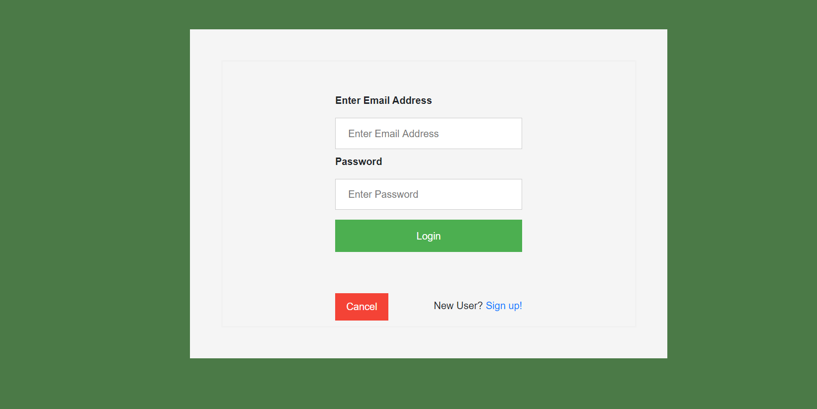
Login/Signup Page:
The login/signup page will ask user for their email address and password. If a correct password is entered, the website will redirect back to home page else an error message will ne shown.

Slide 4
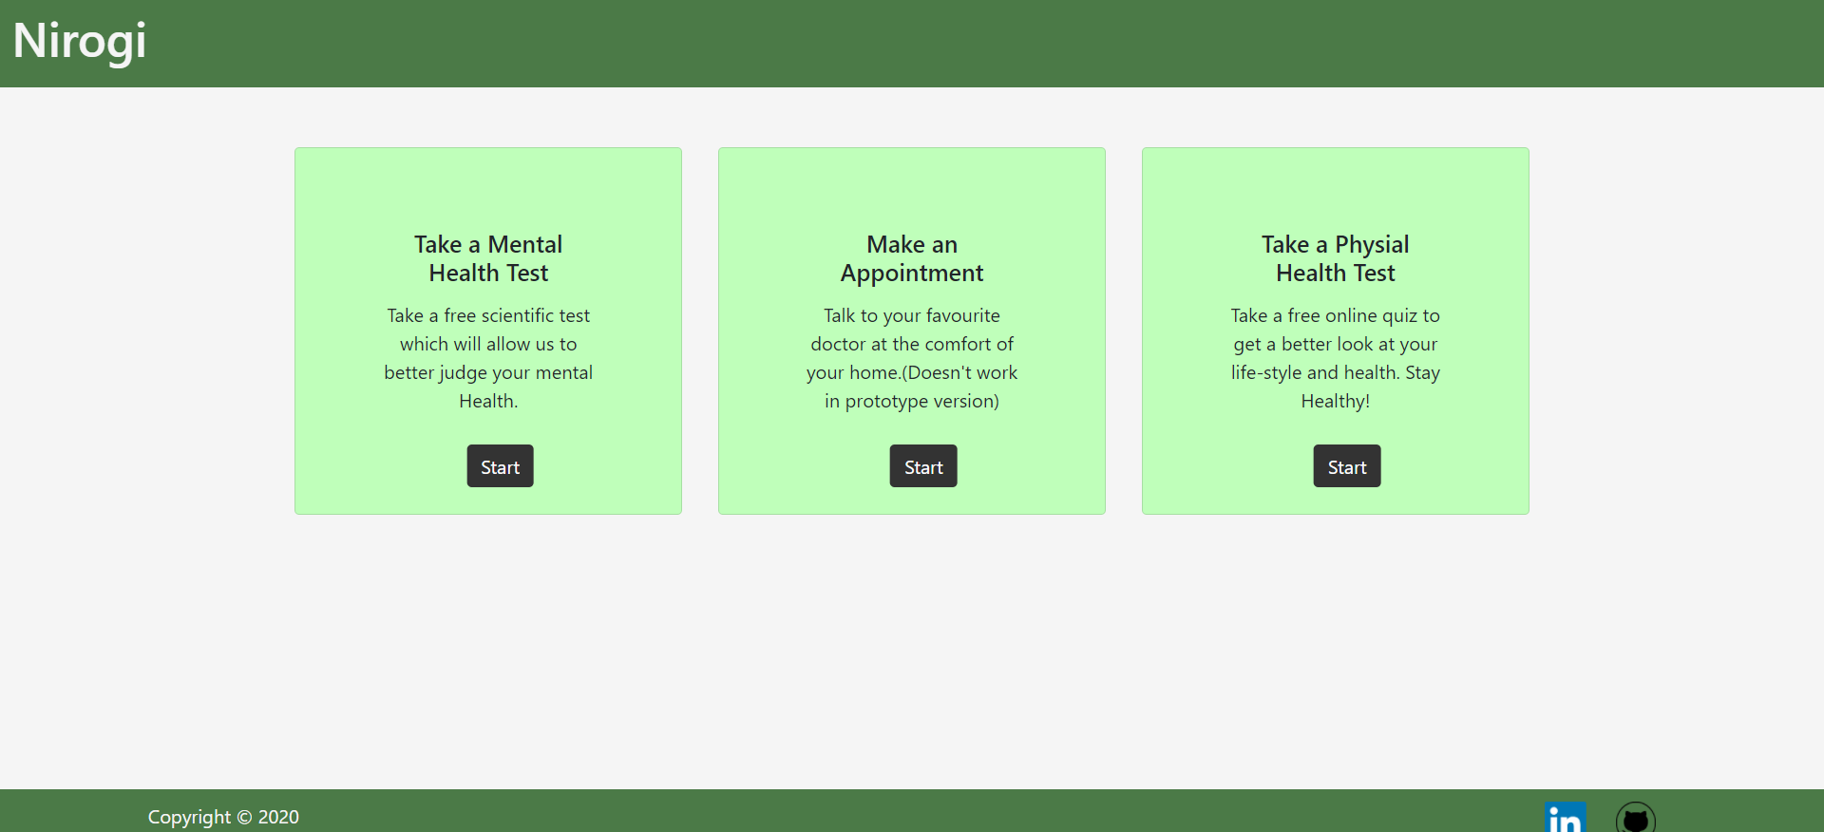
LANDING PAGE:
The landing page will have three cards:
Mental Health Test
Make an Appointment
Physical Health Test

Slide 5
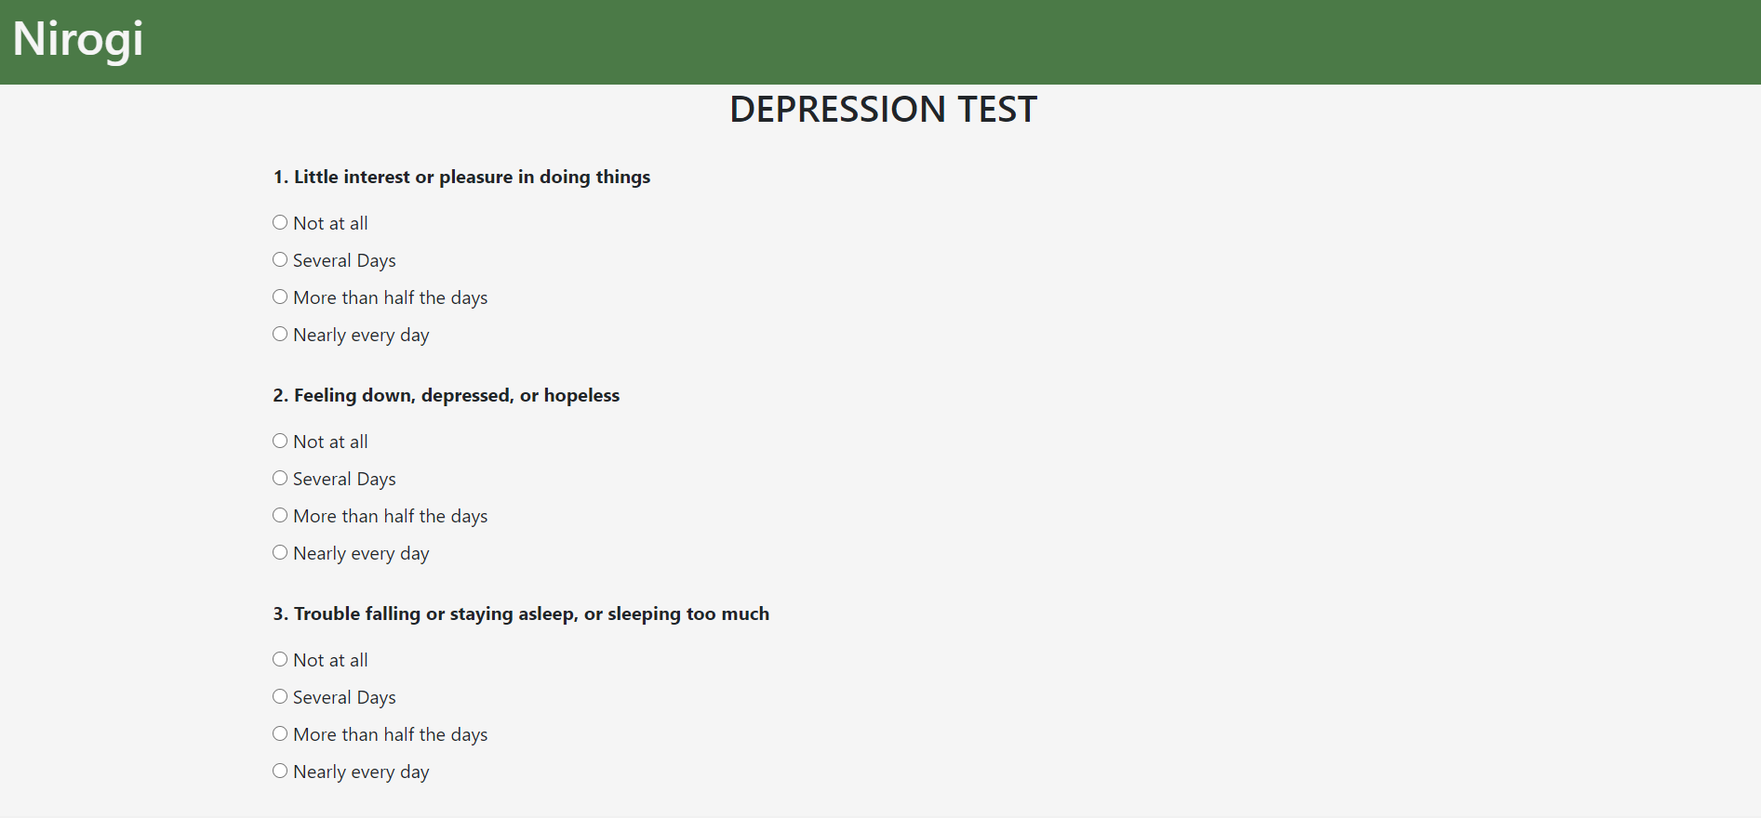
Mental Heath Test / Depression Test:
In this free online test, user has to answer 10 questions, each of which contains four choices. The user is awarded points on the basis of a pre-defined point system (see project’s github readme for details).

Slide 6
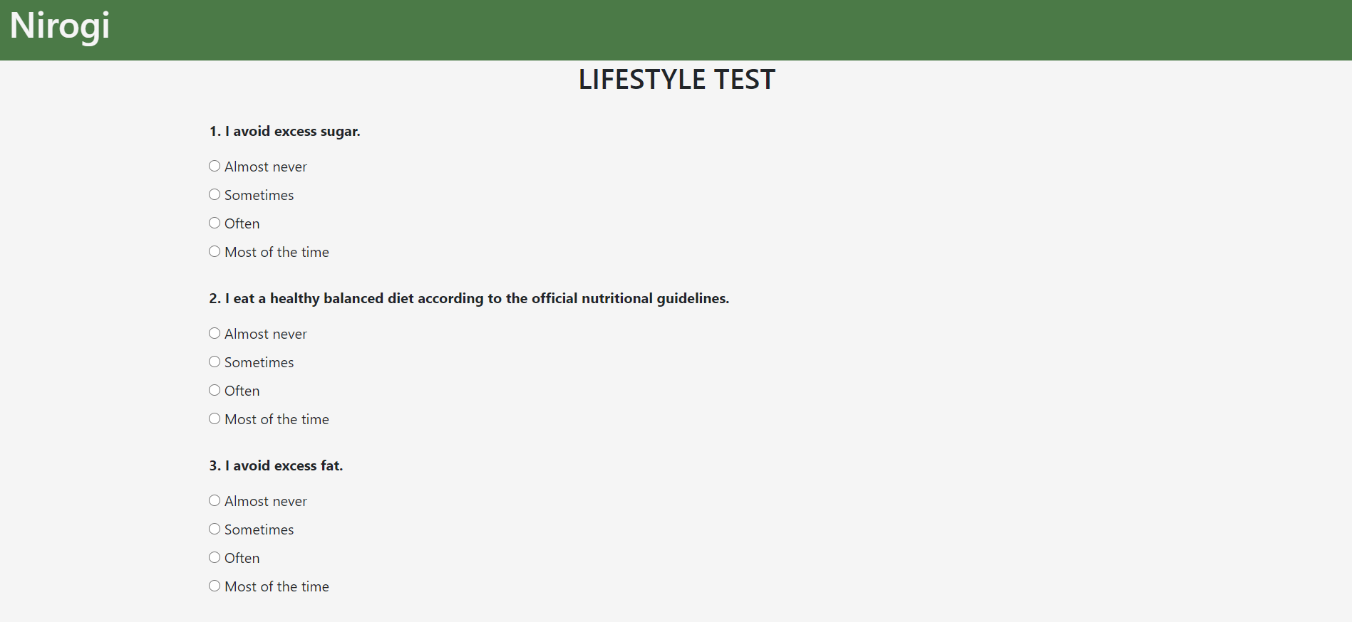
Physical Heath Test / Lifestyle Test:
In this free online test, user has to answer 10 questions, each of which contains four choices. The user is awarded points on the basis of a pre-defined point system (see project’s github readme for details).

Slide 7
THANK YOU!

