Slide 1

Secure & Scalable Hybrid Cloud Network for N-Financial Bank
Presented by:
Bhargav Kiran Surapaneni(C0930977),
Sai Akhil Perumalla (C0931253),
Sai Pragna Ramoji(C0931519),
Devesh Chowdary Chalasani(C0930151)

Slide 2
Project Overview:
This project aims to modernize the N-Financial Bank’s infrastructure by gradually migrating its legacy on-premises systems to a hybrid cloud architecture using Microsoft Azure.
Key Strategies and Tools Covered:
Migration Strategy: Step-by-step migration using microservices hosted on Azure Virtual Machines, ensuring modularity and flexibility.
Deployment Approaches: Blue-Green Deployment, Green Deployment, and Rolling Updates for zero-downtime and controlled rollouts.
Azure Tools Used:
  Compute & Networking: Azure VMs, VM Scale Sets, Application Gateway, Azure Load Balancer, Gateway Load Balancer, Azure DNS, Front Door
  Security & Identity: Microsoft Entra ID & Azure RBAC, Azure Key Vault, Azure DDoS Protection
  Monitoring & Logs: Azure Monitor (metrics, alerts), Azure Activity Log (activity tracking)
  Deployment & Automation: Azure Pipelines (deployment automation)
  Backup & Recovery: Azure Backup (policy-driven data protection)
Testing & Simulation: Cisco Packet Tracer (on-prem simulation), Azure environment (cloud testing)
Disaster Recovery & Compliance: Azure Backup and Azure Site Recovery for backup automation and readiness; aligns with PCI DSS and GDPR standards
This integrated solution delivers security, performance, scalability, and regulatory compliance.

Slide 3
On-Premises Benefits | Azure Cloud Benefits
Immediate access to legacy systems | Elastic scalability & global availability
Controlled, secure internal infrastructure | Fully managed services with automation (e.g., VM Scale Sets, Azure Monitor)
Lab simulation using Cisco Packet Tracer | High availability, fault tolerance, and cost-efficient operation
Gradual service-by-service migration | Enhanced observability, deployment automation, and compliance tools
Why a Hybrid Cloud Approach?
  A full-scale cloud migration for a banking infrastructure is often impractical due to legacy dependencies, risk, and regulatory compliance.
  The hybrid cloud model combines the control and familiarity of on-premises systems with the scalability and automation of cloud environments.

Slide 4
Migration Strategy - Phased Approach
  Migrating the entire banking infrastructure at once is complex, risky, and could interrupt essential services. Therefore, a phased approach ensures stability, minimal disruption, and better management at each stage of the transition.
Advantages:
  Minimizes disruption during migration
  Enables rollback at the microservice level without affecting the entire system
  Supports agile delivery pipelines through CI/CD best practices
Phase | Description
Phase 1 | Identify and assess core services (e.g., customer portal, transaction engine, fraud detection) to prioritize for migration
Phase 2 | Re-architect monolithic services into modular, scalable microservices for independent development and testing
Phase 3 | Deploy each microservice on separate Azure VMs with secure network boundaries (VNets, subnets, NSGs)
Phase 4 | Apply autoscale rules on VM Scale Sets and configure Azure Load Balancer / Application Gateway to handle traffic spikes and maintain high availability

Slide 5

Microservices & Cloud Resource Design
Designing a cloud-native architecture begins with decomposing the monolithic system into smaller, independently deployable units—microservices. Each component is then paired with appropriate Azure resources for performance, scalability, and isolation.
Key Components:
Microservices Architecture: Modular design pattern allowing services to be built, deployed, and scaled independently.
Azure Virtual Machines: Hosts each microservice on isolated virtual machines, providing compute power and separation.
Virtual Machine Scale Sets: Dynamically scale VM instances in or out based on demand, ensuring cost efficiency and availability.
Azure Load Balancing (Application Gateway, Load Balancer, Gateway LB): Balances incoming traffic across healthy instances and redirects traffic during failures.
Azure DNS & Traffic Manager: Handles DNS-based routing to direct users to the right endpoint based on policies (e.g., latency, location).
Azure Front Door: Caches and delivers application content from edge locations worldwide to improve speed and availability.

Slide 6
Deployment Strategies:
To ensure high availability, minimize deployment risk, and support continuous delivery, N-Financial Bank leverages three industry-standard deployment approaches:
Goal: Maintain continuous service availability while minimizing deployment risk and enabling real-time testing and rollback. Ensure minimal downtime and safe rollback options.
Deployment Strategy | Professional Description | Recommended Scenario
Blue-Green Deployment | Maintain two identical environments—one live (Blue) and one staging (Green). Redirect traffic to Green after successful testing and validation. | Suitable for mission-critical applications where zero downtime and easy rollback are mandatory.
Green Deployment | Deploy new applications exclusively to the cloud (Green environment), while the legacy environment remains intact as a safety net. | Ideal for initial cloud migrations or launching new features without disrupting the current system.
Rolling Updates | Gradually deploy updates across small batches of instances to reduce risk. Monitor each batch before proceeding. | Best for non-critical services or frequent updates that require minimal disruption.

Slide 7

Azure Infrastructure & Routing Overview:
To support high availability, secure communication, and optimal user experience, several key Azure services are utilized in the infrastructure design:
Azure DNS & Traffic Manager
Azure DNS hosts the bank’s domains with high availability, while Traffic Manager provides DNS-based routing and health checks for application endpoints.
Azure Front Door
A global entry point and content delivery network (CDN) that caches content at edge locations, ensuring low latency and high transfer speeds for users across different geographic regions.
Azure VPN Gateway
Secure Site-to-Site IPsec VPN tunnels are established between the on-premises infrastructure and the Azure VNet, enabling encrypted communication for hybrid operations.
Application Gateway / Azure Load Balancer
Distributes incoming application traffic across backend pools such as Azure VMs, improving application fault tolerance and ensuring even workload distribution.
Azure Blob Storage
Provides scalable object storage for data, backups, and application assets, with features like blob versioning and geo-redundant storage (GRS) to enhance durability and disaster recovery capabilities.

Slide 8
Security, Compliance & Access Control
Robust security and compliance mechanisms are critical for protecting sensitive financial data and adhering to regulatory standards. Azure provides integrated tools to manage access, protect data, and monitor system activity.
Tool | Purpose
Microsoft Entra ID & Azure RBAC | Enables role-based access control with fine-grained permissions.
Azure Key Vault (Secrets) | Securely stores and automatically rotates sensitive credentials such as API keys and database passwords.
Azure DDoS Protection | Protects applications against Distributed Denial of Service (DDoS) attacks.
Azure Key Vault (Keys) / Managed HSM | Manages encryption keys for securing data at rest and in transit.
Azure Web Application Firewall (WAF) | Protects applications from common web exploits such as SQL injection and XSS.
Azure Activity Log | Provides detailed logs of all account activity for auditing and compliance.

Slide 9
Service | Functionality
Azure Monitor | Monitors infrastructure health, collects performance metrics, and triggers alerts for anomalies.
Azure Backup | Centralized, policy-driven backup service for Azure VMs, Azure SQL Database, Azure Files, Blob Storage, and other Azure resources.
Azure Pipelines | Automates deployment workflows (Azure DevOps) across VMs or container services, supporting blue/green and rolling updates.
ARM Templates / Bicep (Optional) | Enables infrastructure as code (IaC) to automate and standardize resource provisioning.
Monitoring, Automation & Backup
Monitoring and automation are essential to ensure operational efficiency, minimize downtime, and facilitate quick recovery in case of failures.
These tools collectively provide end-to-end visibility, deployment consistency, and robust backup strategies.

Slide 10

High Availability & Disaster Recovery (HA/DR)
Ensuring service continuity and rapid recovery from failures is a key requirement in financial systems. Azure provides native capabilities that form a resilient disaster recovery (DR) plan.
On-Premises Resilience: Local availability is maintained through RAID storage, failover clusters, and UPS systems.
Primary Disaster Recovery Solution:
  Azure Backup & Site Recovery: Automates scheduled backups for Azure VMs, Azure SQL Database, Azure Files, and Blob Storage. Supports retention policies, cross-region restore, and replication to a paired region.
Supporting Tools for DR Monitoring & Visibility:
  Azure Monitor: Offers continuous monitoring, custom metrics, and alerting to detect system failures in real time.
  Azure Activity Log: Provides a detailed audit trail of all API calls and user actions, essential for post-incident analysis and compliance audits.
Together, these tools form a comprehensive approach to disaster preparedness and operational recovery.

Slide 11
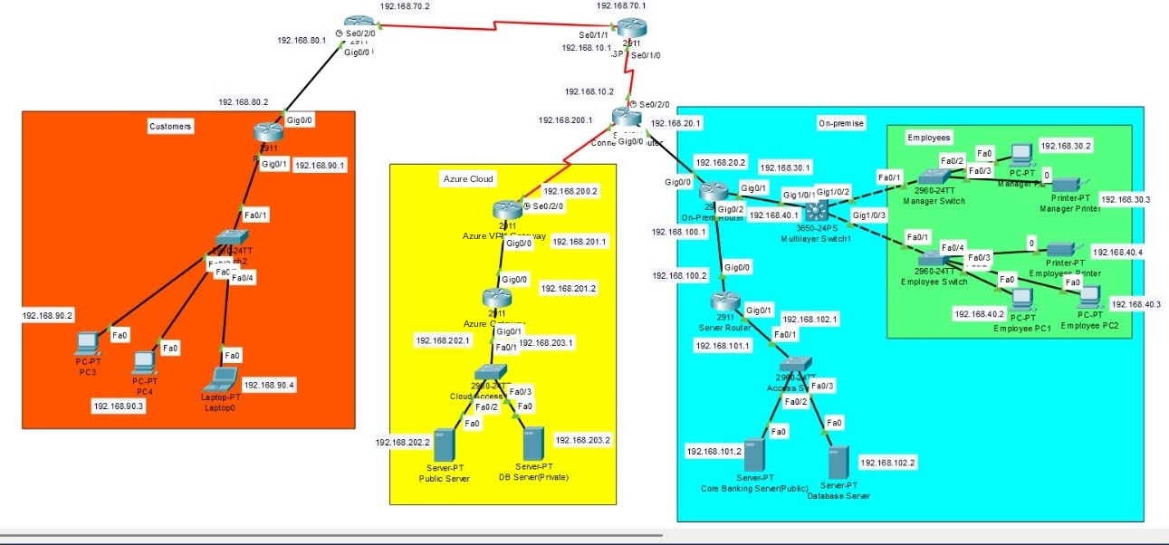
Network Topology Overview:
On-Premises Environment
Simulates internal enterprise network with essential systems and services.
Azure Virtual Network (VNet) Design
  Public Subnets: Host user-facing portals and APIs.
  Private Subnets: Run secure systems like fraud detection and databases.
Secure Connectivity
Encrypted IPsec tunnel via Azure VPN Gateway links on-premises to Azure.
Key Components
Load balancers, NSGs, and Azure Monitor ensure performance, security, and visibility.

Slide 12

Network Segmentation & Access Control
To ensure secure integration between on-premises and Azure, VLANs and ACLs were configured:
VLAN Segmentation
  Traffic segmented by roles (Employees, Managers) and network zones.
  Reduces broadcast traffic and enhances security.
Access Control Lists (ACLs)
  ACL 110 – Azure Database Access
    Permit: Manager VLAN (192.168.30.0/24) to Azure DB (192.168.203.2)
    Deny: All other traffic to Azure DB
  ACL 120 – On-Prem Database Access
    Permit: Employee & Manager VLANs to On-Prem DB (192.168.102.2)
    Deny: All other traffic
    Note: All Employees cannot access Azure resources
  ACL 130 – Employee to Manager VLAN Isolation
    Deny: Employee VLAN (VLAN 40) accessing Manager VLAN (VLAN 30)
  ACL 140 – Manager to Employee VLAN Isolation
    Deny: Manager VLAN accessing Employee VLAN (VLAN 40)
    Permit: Only necessary traffic

Slide 13
Cost and Resource Management
As part of the cloud migration initiative, cost analysis focuses on estimating ongoing Azure cloud expenses while accounting for minimal on-premises maintenance during the transition period.
Cost Management Practices:
Use VM Scale Sets to optimize compute capacity based on real-time demand.
Apply VM auto-shutdown and Blob lifecycle management to minimize idle resource usage.
Monitor usage and control budgets with Azure Budgets and Cost Management.
Consolidated Cost Overview:
Category | Description | One-Time Cost | Annual Cost
Azure Cloud Services | VMs, Azure SQL, Blob Storage, VMSS, Managed Disks | $0 | $96,000
Security Services | Entra ID, WAF, Key Vault, DDoS Protection | $8,500 | $12,000
Monitoring & DevOps Tools | Azure Monitor, Activity Log, Azure Pipelines | $2,500 | $3,200
Connectivity & Licenses | VPN Gateway, Azure DNS, ExpressRoute | $6,000 | $28,000
Residual On-Prem Support | Limited on-prem maintenance costs during cloud transition phase | $5,000 | $6,000
Total Estimated Cost |  | $22,000 | $145,200

Slide 14

Testing and Validation
Thorough testing and validation are critical to ensure the reliability, performance, and security of the hybrid cloud setup.
      Connectivity Testing: Verify secure VPN Gateway communication between on-prem and Azure.
      Security Validation: Run vulnerability scans (e.g., Nmap, Nikto) and simulate DDoS attacks to test Azure DDoS Protection & WAF.
      Performance Monitoring: Use Azure Monitor to track CPU, memory, and network metrics.
      Rollback & Recovery: Maintain snapshots and configs for fast recovery from failures.

Slide 15
Project Summary
Designed and deployed a secure, scalable hybrid cloud using Microsoft Azure to meet key business and technical goals:
Migrated critical on-prem services to Azure in phases.
Re-architected monoliths into microservices hosted on Azure VMs.
Implemented VM Scale Sets and Azure load balancing for efficiency.
Enforced security with Entra ID, Key Vault, DDoS Protection, and Activity Log.
Enabled monitoring, automation, and backups via Azure Monitor, Azure Pipelines, and Azure Backup.
Met compliance standards (PCI DSS, GDPR) with high availability and visibility.
Built a strong foundation for future cloud growth and modernization.

Slide 16
Future Demand & Scalability
Proposed Enhancements for Future Growth
To support business expansion and tech evolution, the following upgrades are recommended:
Scalability: Support higher transaction volumes and users.
Containerization (AKS): Use Kubernetes to manage scalable microservices.
Serverless (Azure Functions): Handle real-time tasks with event-driven functions.
Global Availability: Deploy across multiple regions for resilience and low latency.
Advanced Security: Enhance protection with Zero Trust and Microsoft Defender for Cloud.
These enhancements strengthen the architecture for scalability, security, and global readiness.

Slide 17

THANK YOU

