Slide 1


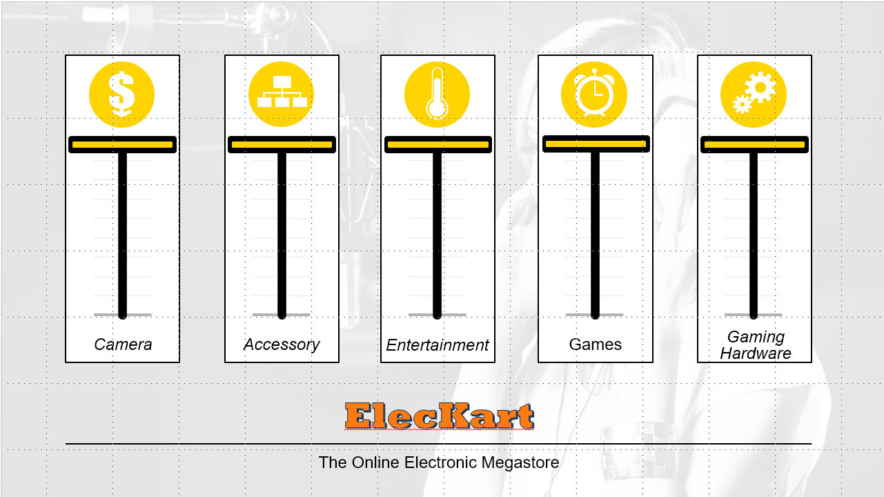
ElecKart
Capstone Project
Final submission
Anshika Misra
Prasanth Gopalakrishnan
Sanjukta Mitra
Sudheer Rao

Slide 2
About the company: ElecKart
ElecKart is an e-commerce firm specializing in electronic products .
Business Problem:
ElecKart about to create a marketing budget for the next year which includes spending on commercials, online campaigns, and pricing & promotion strategies. The CFO feels that the money spent over last 12 months on marketing was not sufficiently impactful, and, that they can either cut on the budget or reallocate it optimally across marketing levers to improve the revenue response.
The goal is to develop a market mix model to observe the actual impact of different marketing variables over the last year. The model built would hence recommend the optimal budget allocation for different marketing levers for the next year.
Scope: Market mix models for three product sub-categories - camera accessory, home audio and gaming accessory is needed. Also, the models have to be built at a weekly level.
Categories:
Camera
Camera Accessory
Entertainment_Small
Game/CD/DVD
Gaming Hardware
Home Audio
Marketing Channels:
TV
Digital
Sponsorship
Content Marketing
Online marketing
Affiliates
SEM
Radio
Other
Overview of the ElecKart performance
The data given is for 12 months (Jul 2015 through Jun 2016)
ElecKart primarily deals in 5 categories of electronic products. viz..Category (5), Sub-category (14) and Vertical (74)
The total marketing spent has been at 846 Crores INR (~USD 131 million); average NPS is at 49.6 %
Monthly NPS has strongly negative correlation (-0.81) against the marketing spend (counter-intuitive)
There was Sale for 49 days (~13%) during the given dates
The GVM of all products sold is ~ 4 Billion INR (62.7 Million USD)
The EBITDA (MRP – GMV) is ~2.723Billion INR (42.3 Million USD)
Previous: Introduction
Next: Understanding Data

Slide 3
Understanding Data
Load “ConsumerElectronics.csv” (consumderelec). This file contains the most granular (at Order Item Id level)
This table has 1648824 records and 20 variables
str(consumerelect)
FSN ID (SKU) as character (Primary key)
order_date as character (this field has both date and time stamp)
Year integer (2015 or 2016)
Month integer (between 1 though 12)
order_id numeric
order_item_id numeric
gmv numeric (range of 0 though 226947)
units integer, number of units sold, range is 1 through 50
Deliverybdays character (The dispatch delay from warehouse )
Deliverycdays character (The dispatch delay from customer)
s1_fact.order_payment_type character (COD or Prepaid)
sla integer (Number of days it typically takes to deliver the product, range of 0 though 1006)
cust_id numeric
pincode numeric
product_analytic_super_category character
product_analytic_category character
product_analytic_sub_category character
product_analytic_vertical character
product_mrp integer (range of 0 though 299999)
product_procurement_sla integer (range of 1 though 1000)
Look for missing values in consumderelec table gmv, customer_id , Pincode have 4904 missing values. There are duplicate records present as well.
Load tables that contain “Product List” (prod_list), “Media Investment” (media_info), “Special Sale Calendar” and “Monthly NPS Score(NPS)”
“prod_list” has frequency of sales 74 ‘vertical’ (or the detailed name of the product) and the total sales contribution. There is no missing data
“Media Investment” (media_info) file has the aggregated, channel specific spend for marketing in INR Crore for 12 months. Here, missing data would imply there was no spend or spend was zero. “Monthly NPS Score” (NPS) has the 12 month NPS scores for ElecKart. There is no missing data.
Previous: About ElecKart
Next: Data Preparation

Slide 4
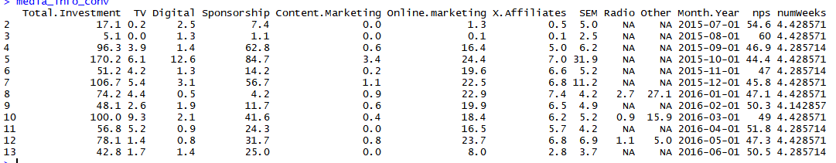
Data Preparation (1/4)
Load required Libraries (ggplot2,dplyr,cowplot,gdata,tidyr,MASS,car)
product_List table has no name for the vertical of product. A new name will be introduced
Missing values in media_info would mean there was no spend in that channel for the month. So, replace NA with zero
NPS table is horizontal. It will be transposed to vertical table. Name the columns appropriately.
This NPS information will be added (combined) with media_info table
We check for the duplicate records from product_List and media_info tables. There are no duplicate records.
Using Year and Month columns create a MMM.YY column
Convert the non-standard date/time fields into POSIXct format
Convert the variable types i.e., numbers o numeric/integer and categorical variables to character and dates to POSIXct format
Introduce a dummy variable numWeeks, which is the difzference in time between first date (Jul 1st, 2015) to order date in the unit of weeks.
Add (combine) this field with media_info table
To calculate the weekly estimate of ad spends for each month divide the monthly value with number of weeks
Currently, the media_info table has the following schema
Previous: Understanding Data
Next :Data Preparation (2/4)

Slide 5
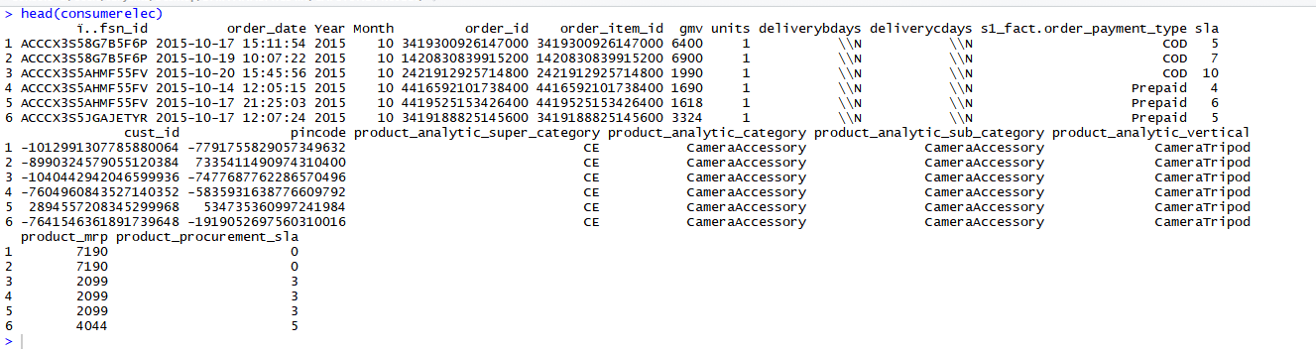
Data Preparation (2/4)
14. Create three tables, one each for Camera Accessories (media_infoCA), Home Audio (media_infoCA) and Gaming Accessories(media_infoGA)
Calculate the ad spend using the proportion of money spent across aforesaid categories. We use the ratio 14.54%, 7.55% and 12.54% respectively. This percentage is calculated using the percentage distribution of the count of each sub category of product sold.
The media_infoCA, media_infoHA and media_infoGA has monthly distribution of advertisement investment for the three sub categories
Now, we move on to process the consumerelec table
We check for duplicate records from consumerelec and there seem to be 104843 such records. We remove them.
Remove the redundant variables from the table (columns where the value is consistent for all records and columns where a proxy metric exists)
Check for Missing value – No column has missing value. But there are 14712 NA values. We drop those observations. (1643920 x 20 table)
Introduce a weekno as a variable for week number , using the order_date column such that we have 52 weeks starting from July 2015 till June 2016 numbered from 01 to 52.
Delete records where product MRP is zero (4912 records)
Format deliverybdays and deliverycdays as numeric to calculate the duration (as told by TA, \N will be treated as zero)
Now, we create three subsets (tables), each for Camera Accessories, Home Audio and Gaming Accessory. We will use these for building models
Now, the formatted table looks like this:
Previous: Data Preparation (`1/4)
Next :Data Preparation(3/4)

Slide 6
Data Preparation (3/4)
For each of the three tables Camera Accessory, Home Audio and Gaming Accessory bins were created from deliverybdays and deliverycdays to categories the delivery of goods under “Missed”, “No delay”, “Low delay”, “Medium delay” and “VH delay”
List price variable which is equal to gmv/units is created and two additional variables price markup and price markdown (discount) were created from gmv and mrp using the formula (list_price-product_mrp)/product_mrp) such that when this formula value is less than 0 it implies price markdown or discount offered on that good and when it is greater than 0 it implies price markup
A table Holiday were created which list all the dates when company offered special sales due to holidays or festivals .In the main table a column Holiday were created which is ‘Y’ if the order_date is one of the holiday dates or ‘N’ otherwise
Also we calculated monthly advertisement spent across various channels for each of the three categories Camera Accessory, Home Audio and Gaming Accessory . Hence we have divided the monthly advertisement spend into weeks and integrated it into the main dataframe Camera Accessory, Home Audio and Gaming Accessory .
NPS score also divided into weekly NPS score and were integrated it into the main dataframe Camera Accessory, Home Audio and Gaming Accessory
The final table look like this(snapshot of camera_accessory table) :Note : same follows for Home Audio and Game Accessory.
Previous: Data Preparation (2/4)
Next :Data Preparation(4/4)

Slide 7
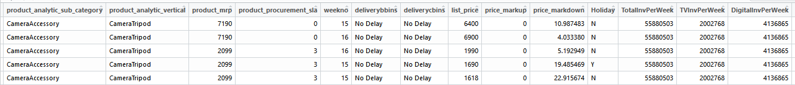
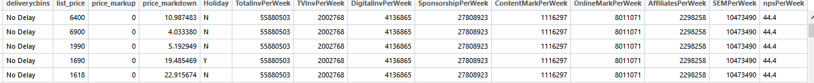
Data Preparation (4/4)
.
Previous: Data Preparation (3/4)
Next :EDA (1/4)

Slide 8
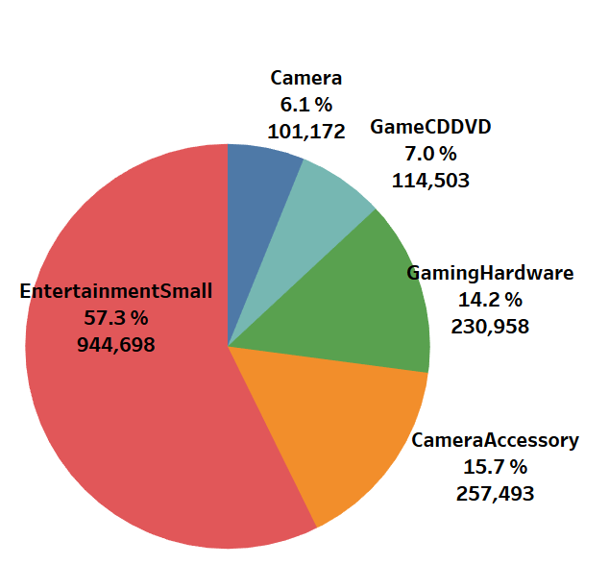
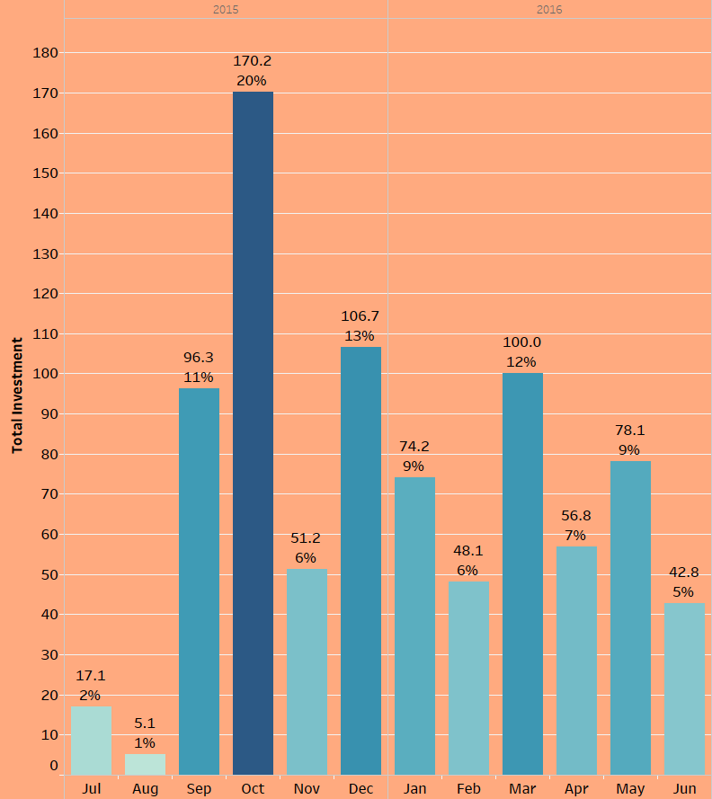
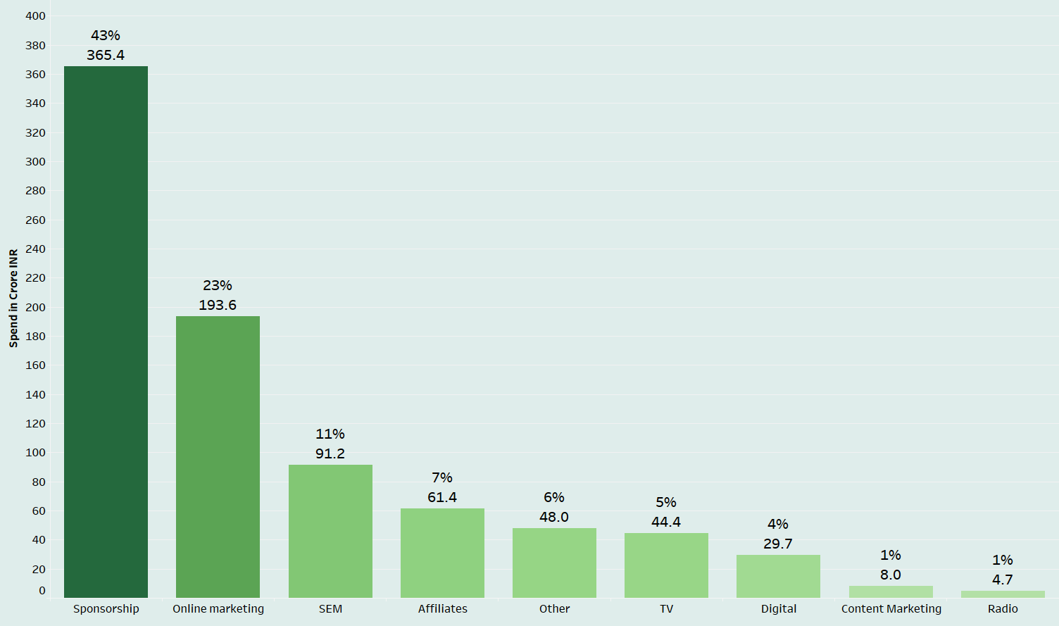
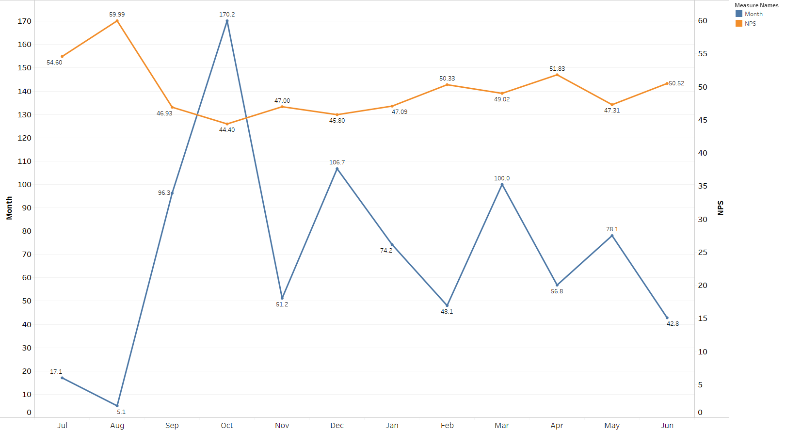
Exploratory Data Analysis – Marketing Spend (1/4)
Sales (volume)
57% of the sales (by vol) is from Small Entertainment category. About a million units are sold in this space.
Marketing Spend
20% of the budget is spent in Oct, during the Dussera Sale. March also has good marketing spend, this could be due to End of Season Sale
Marketing Channels
43% of expense for Marketing is seen from Sponsorship Channel, at a rate of a crore per day. Radio channel is extremely underutilized.
NPS vs Marketing Spend
There is strong, but negative correlation between NPS and Markeig spend at 0.8186189
Previous: Data Preparation (3/4)
Next: EDA (2/4)

Slide 9
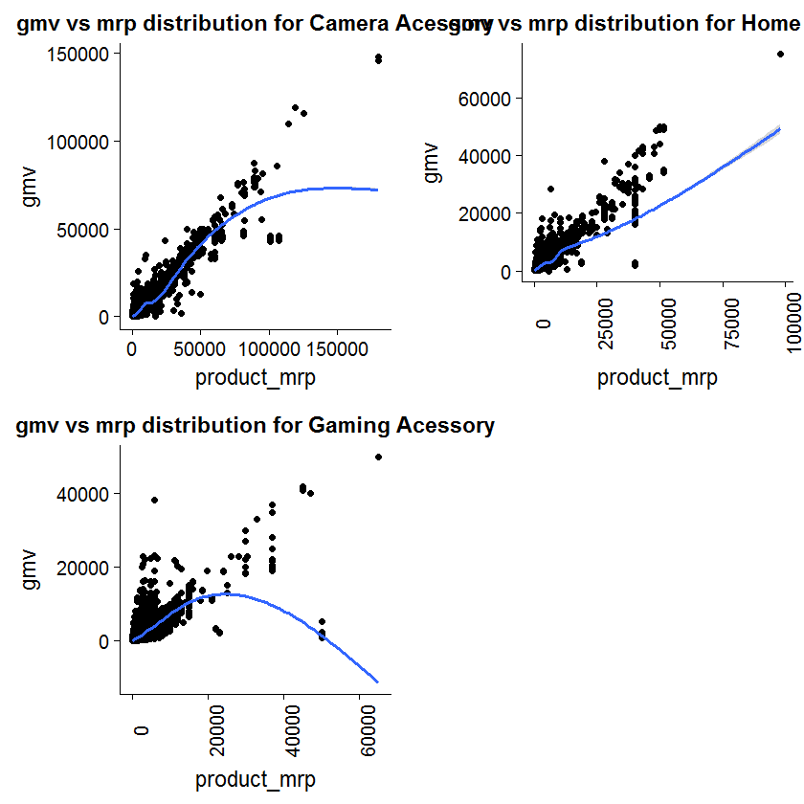
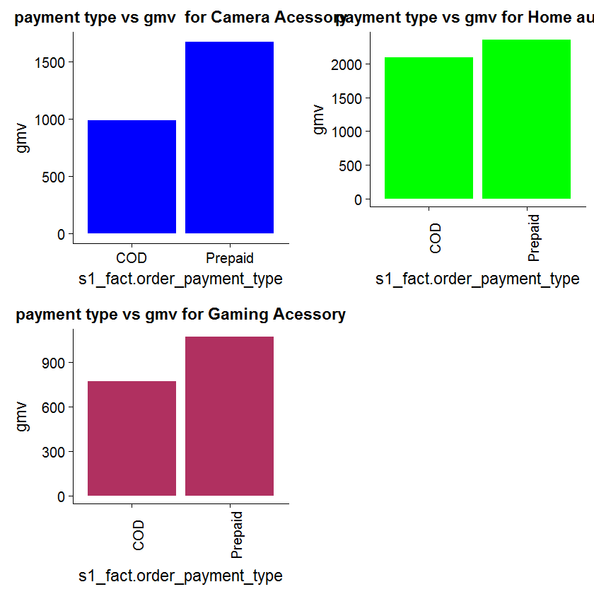
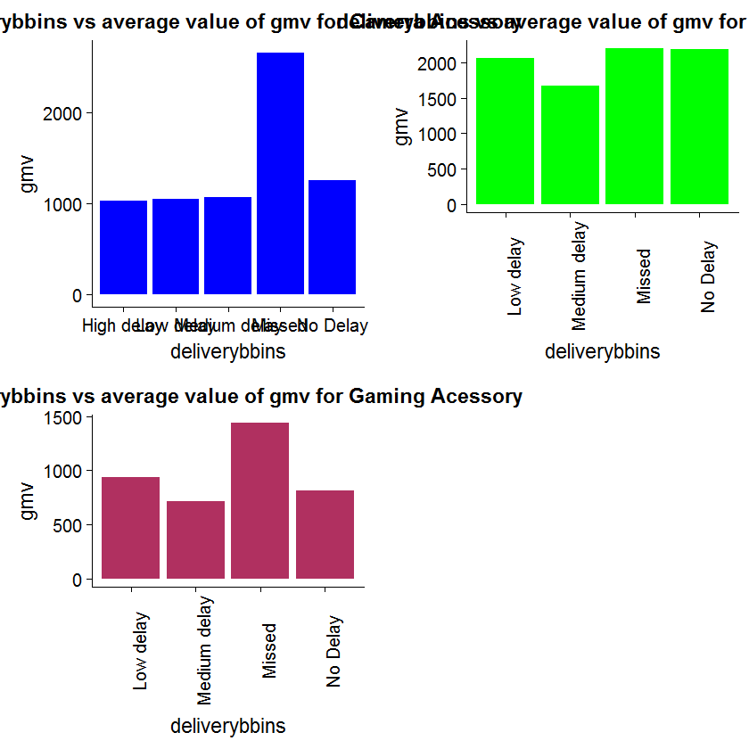
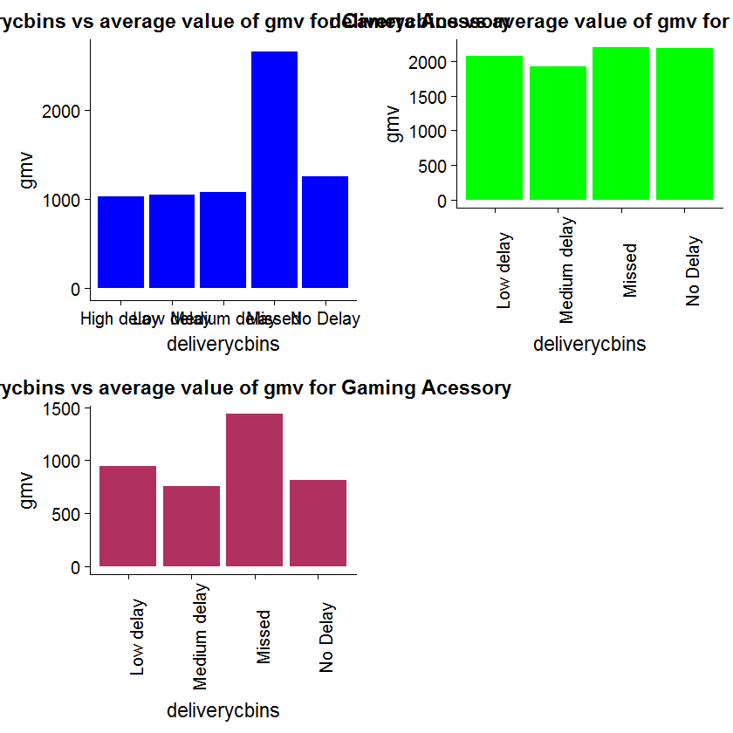
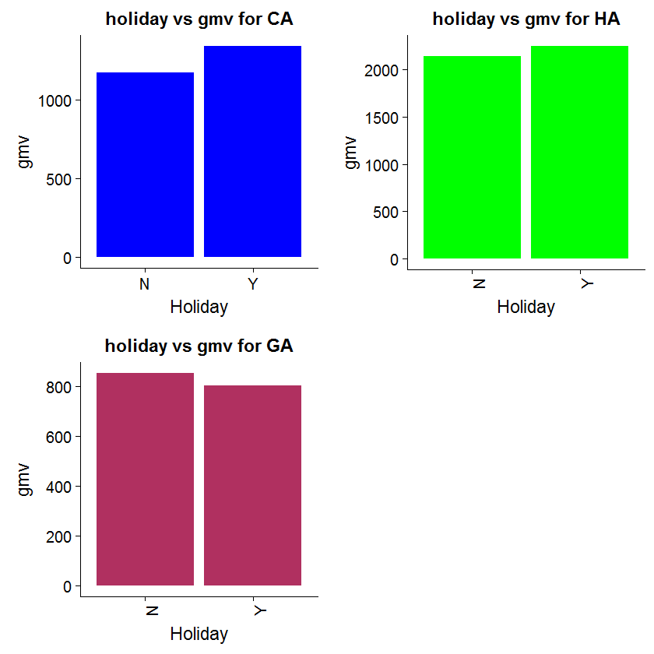
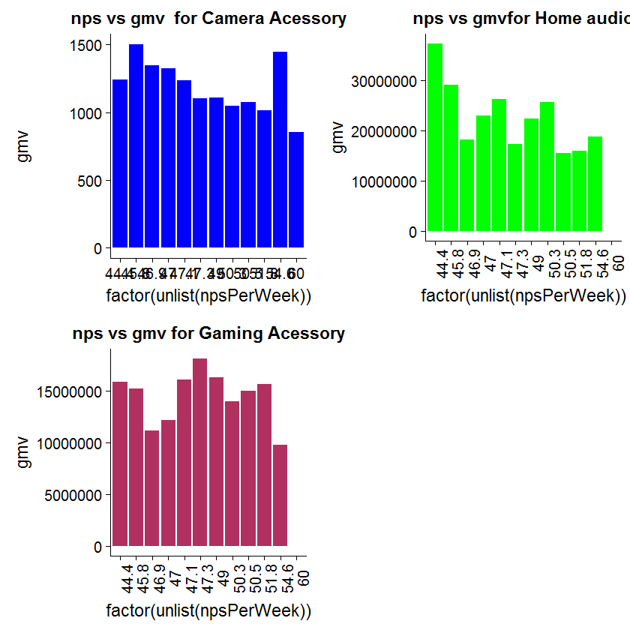
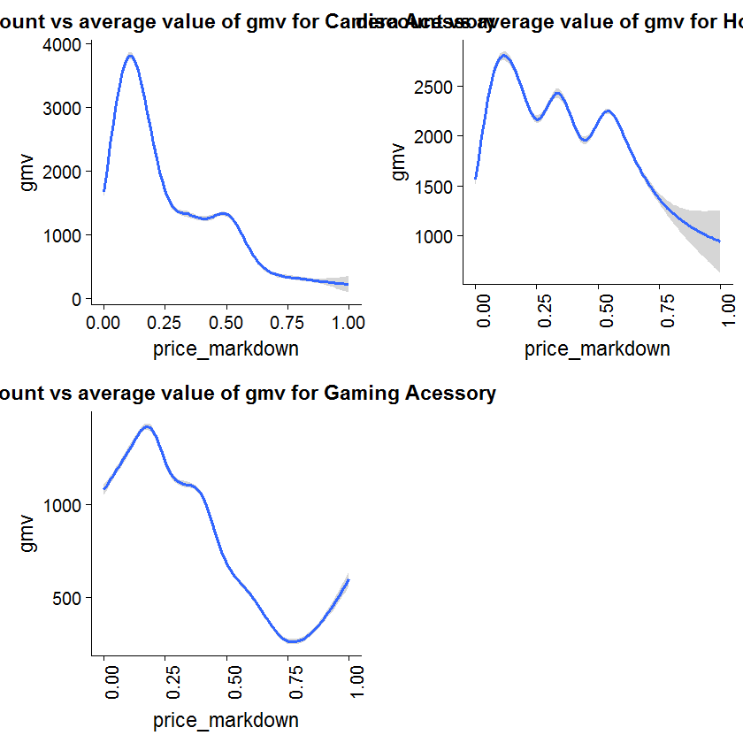
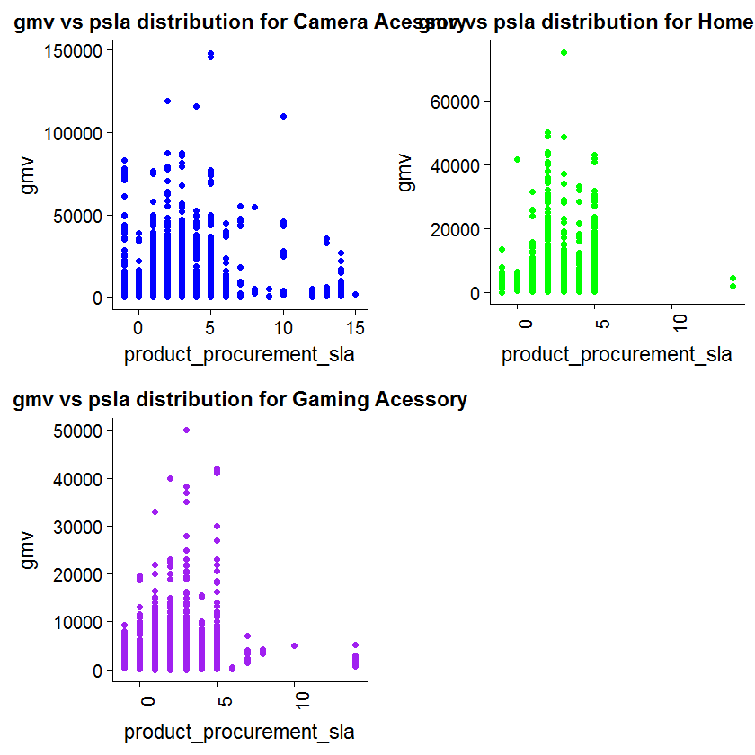
Exploratory Data Analysis – Marketing Spend (2/4)
GMV vs MRP
GMV vs Payment typec
Avg GMV vs Deliverybbins
Avg GMV vs Deliverycbins
Avg GMV vs Holiday
Avg GMV vs NPS
GMV vs PriceMark down
GMV vs Psla
Previous: EDA(1/4)
Next: EDA(3/4)

Slide 10
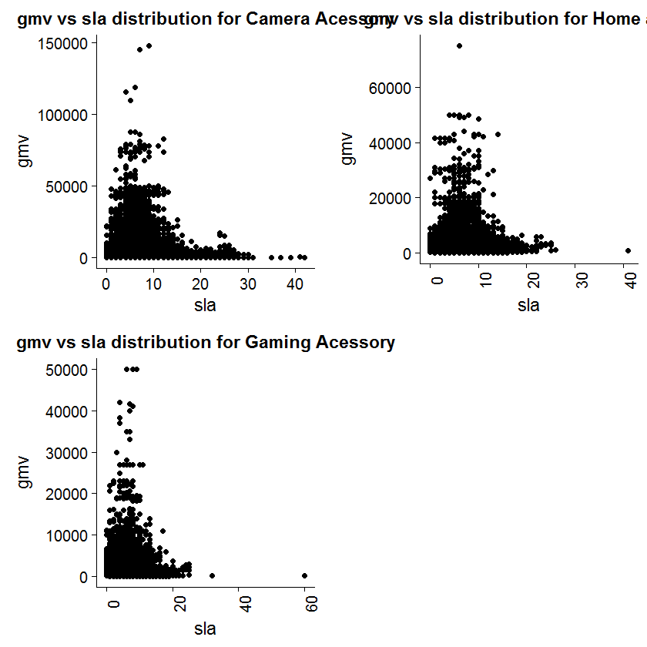
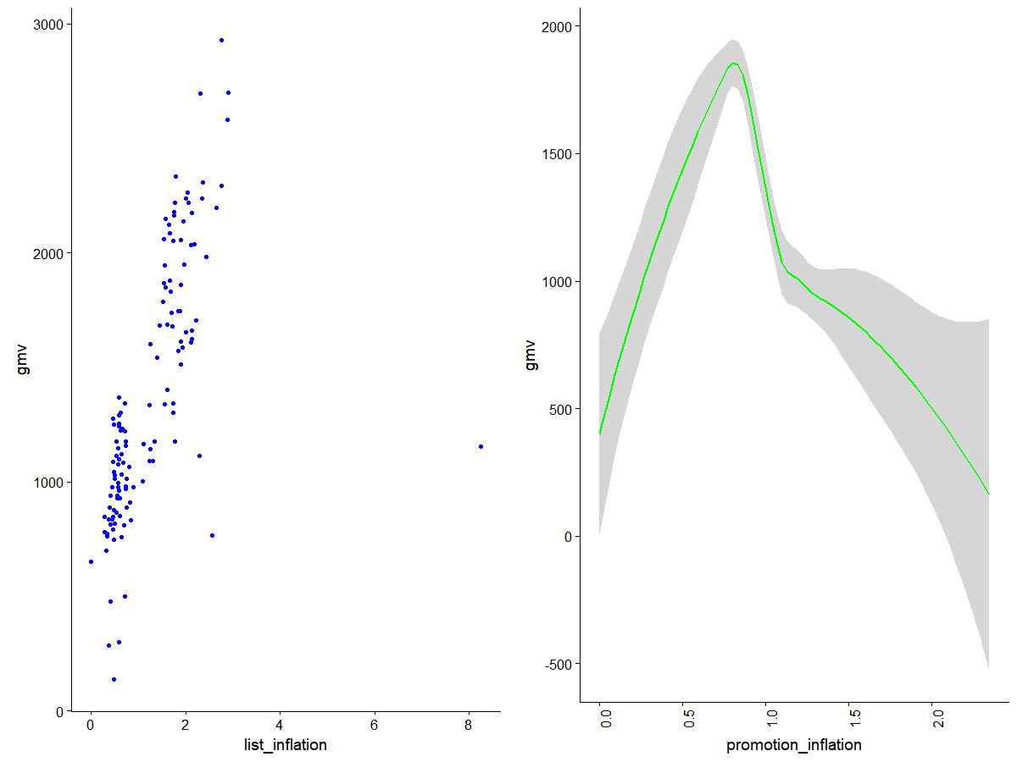
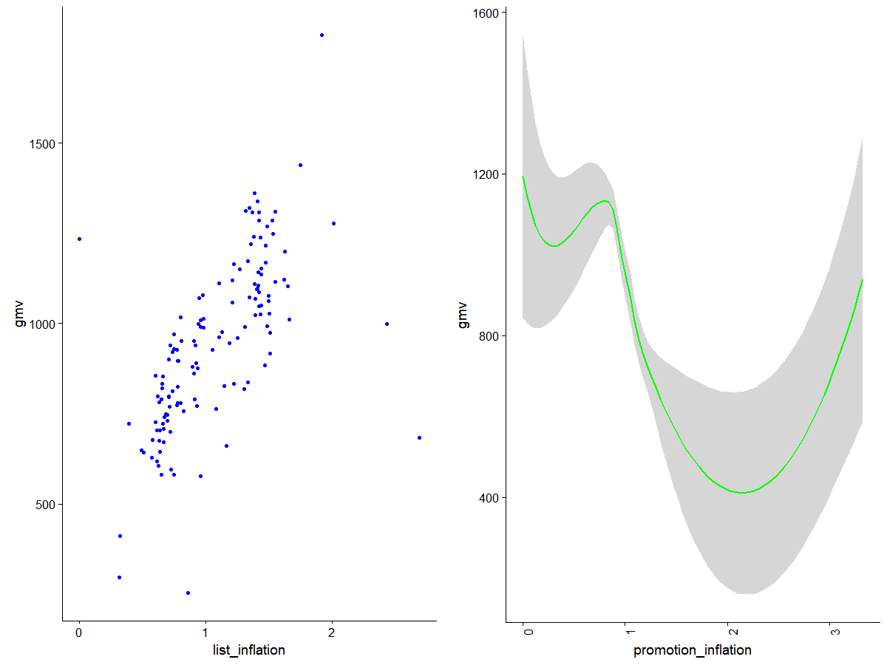
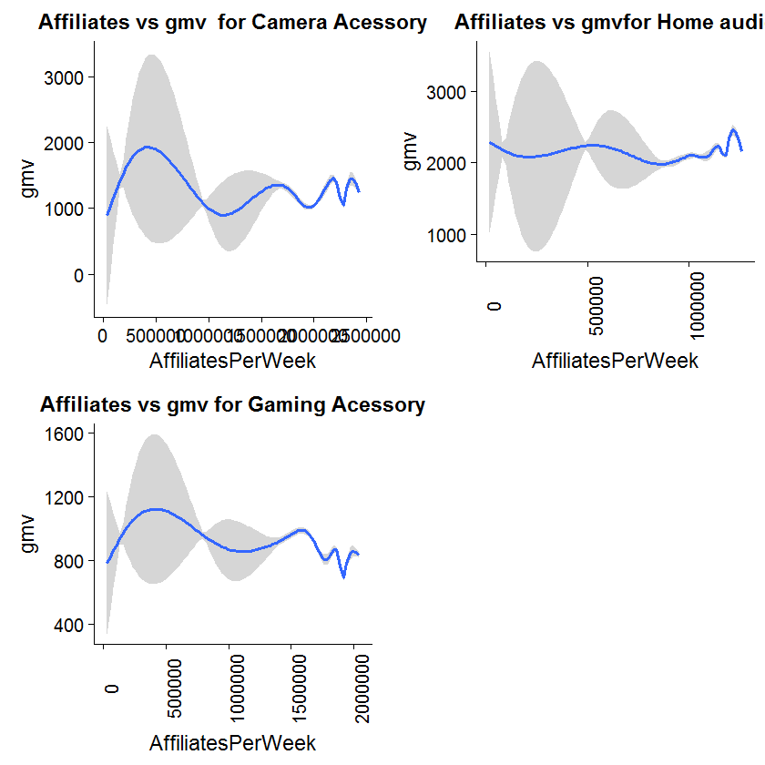
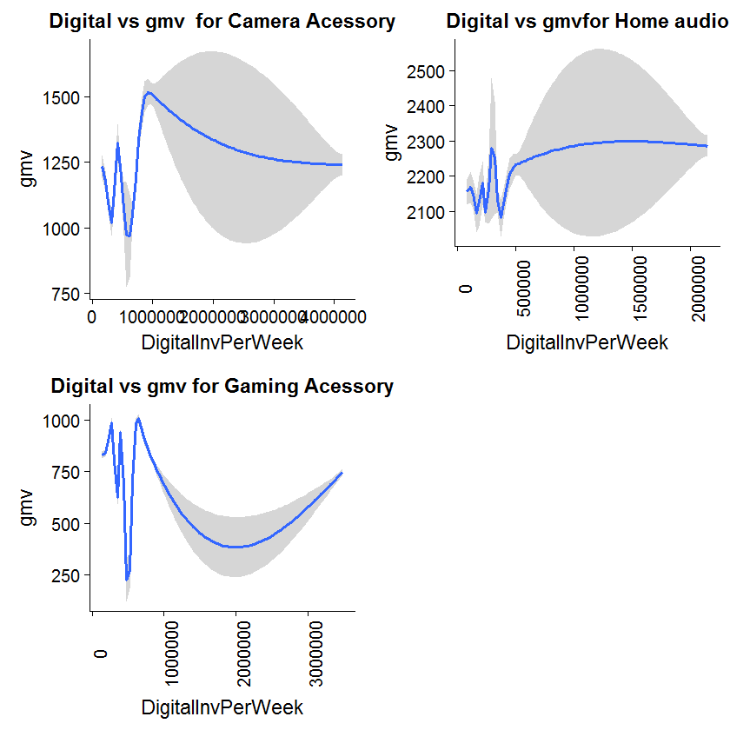
Exploratory Data Analysis – Marketing Spend (3/4)
GMV vs SLA
Camera Accessory : GMV vs List Inflation
& Promotion Inflation
Home Audio: GMV vs List Inflation
& Promotion Inflation
Game Accessory: GMV vs List Inflation
& Promotion Inflation
GMV vs Affiliates
GMV vs Digital
Previous: EDA(2/4)
Next: EDA(4/4)

Slide 11
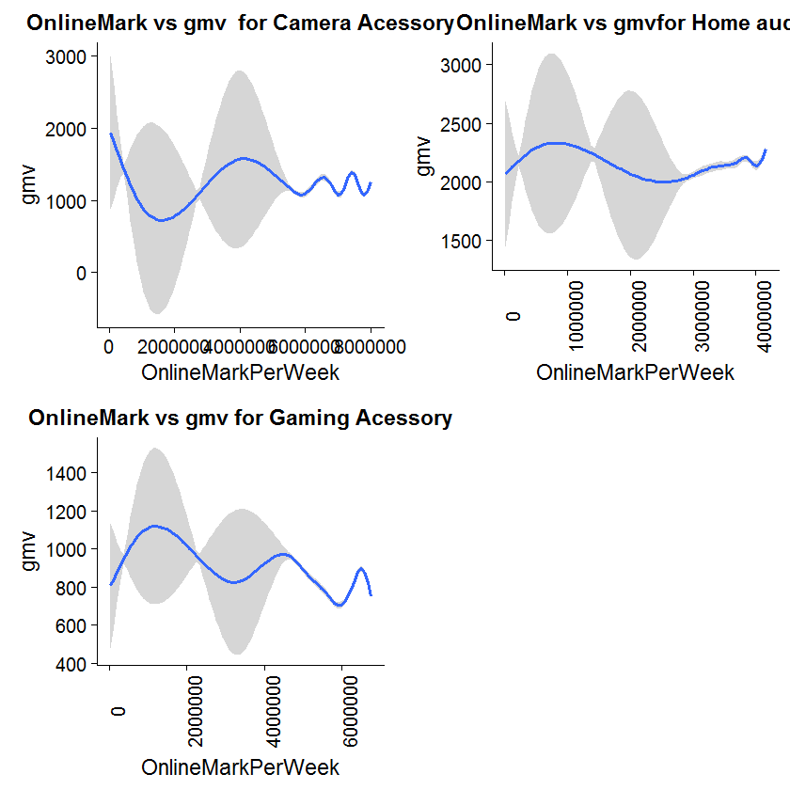
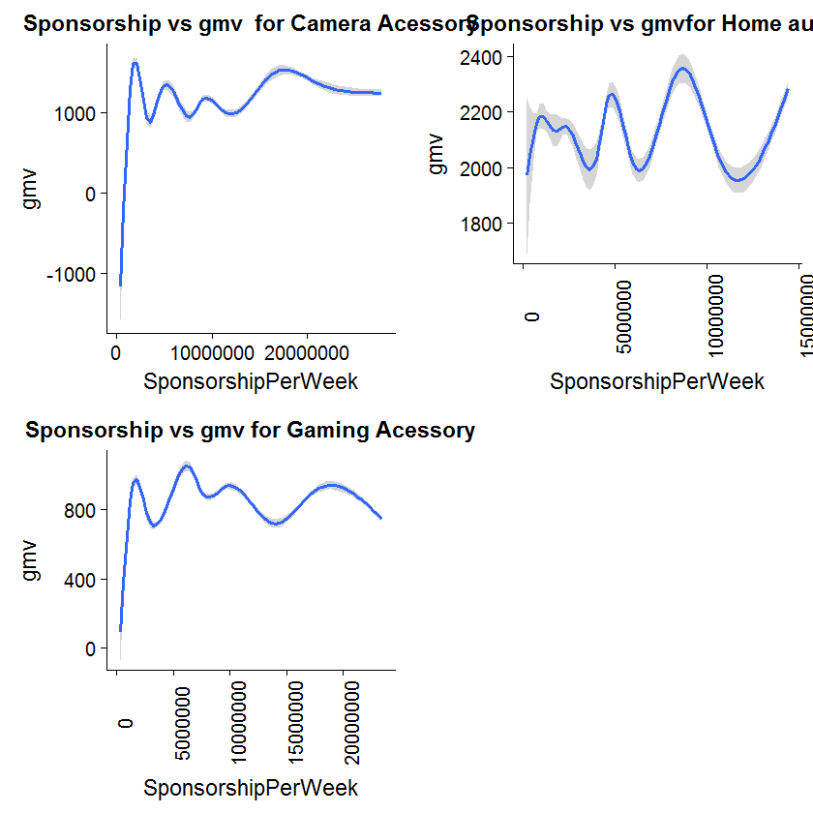
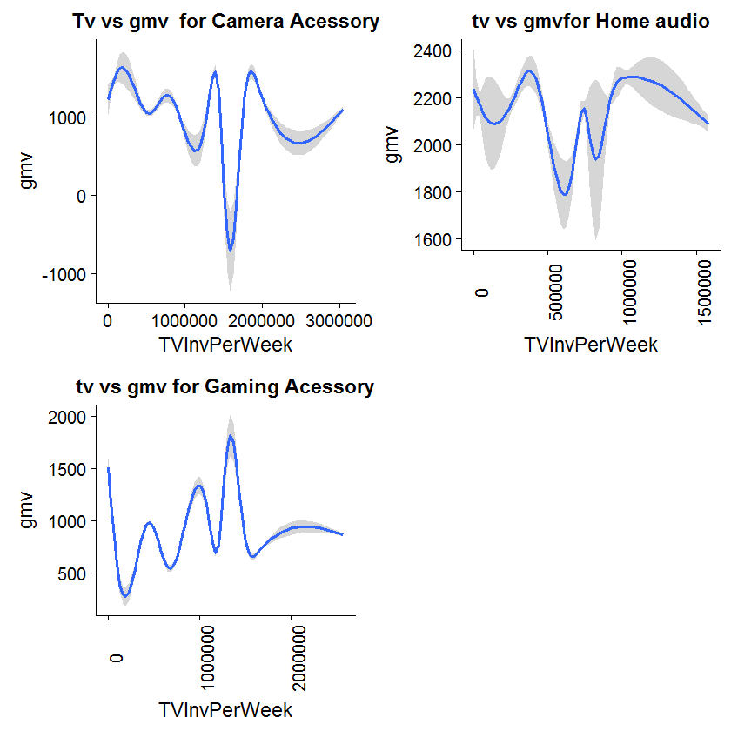
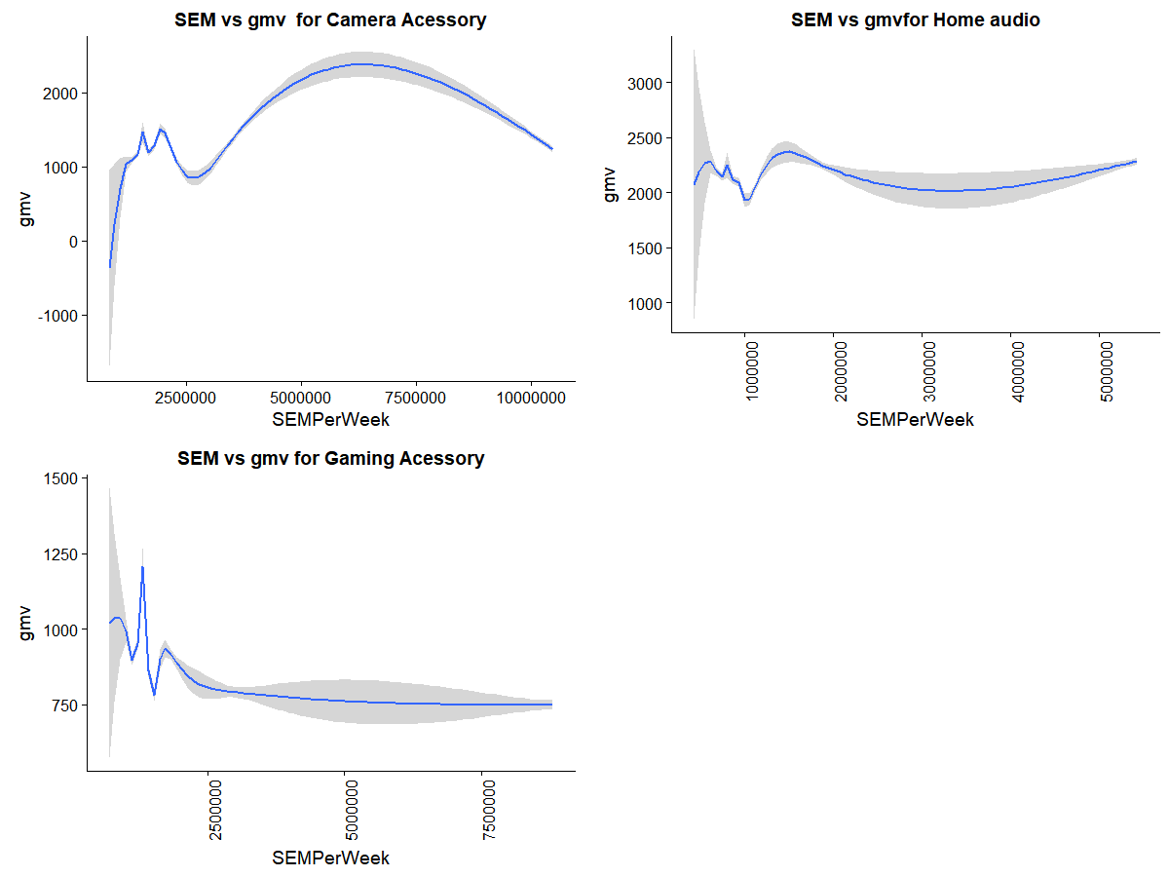
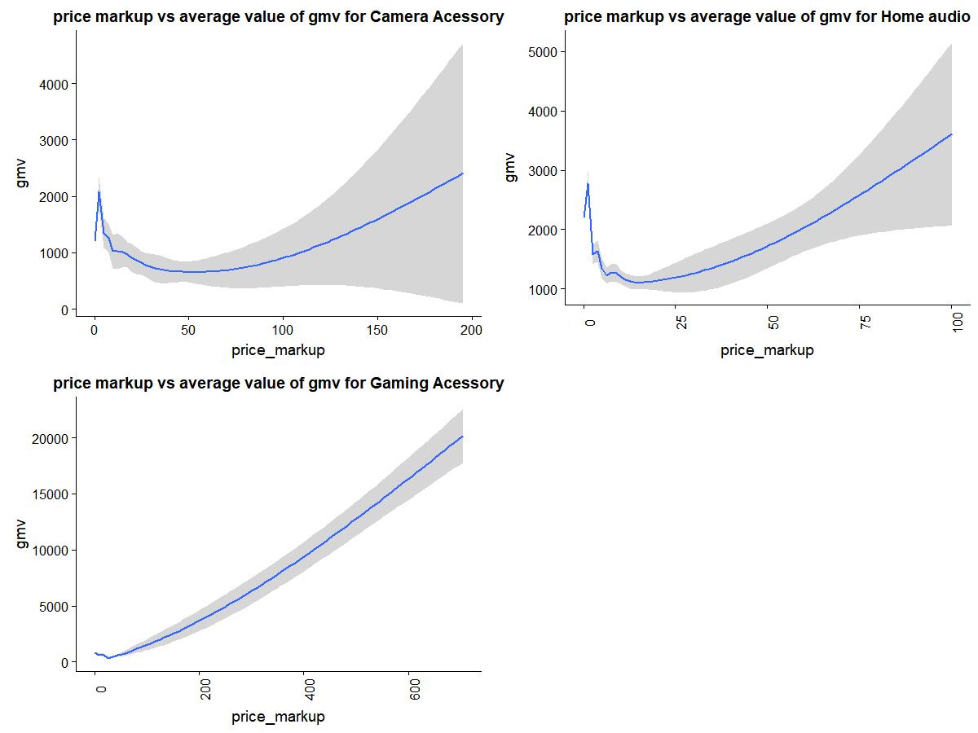
Exploratory Data Analysis – Marketing Spend (4/4)
GMV vs Online Marketing
GMV vs Sponsorship
GMV vs TV ads
GMV vs SEM
GMV vs SEM
Previous: EDA (3/4)
Next: Adstock (1/2)

Slide 12
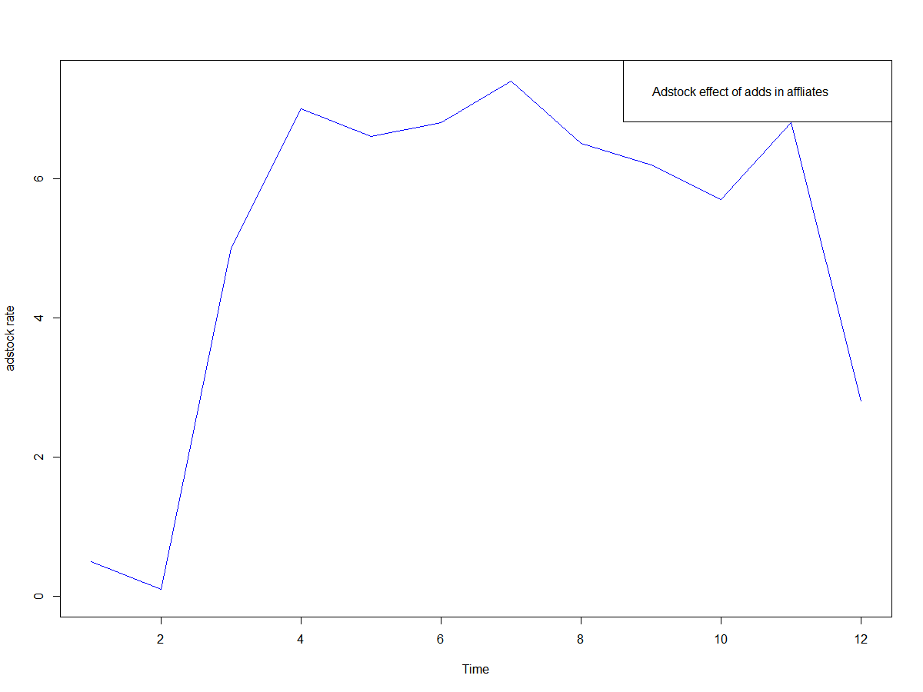
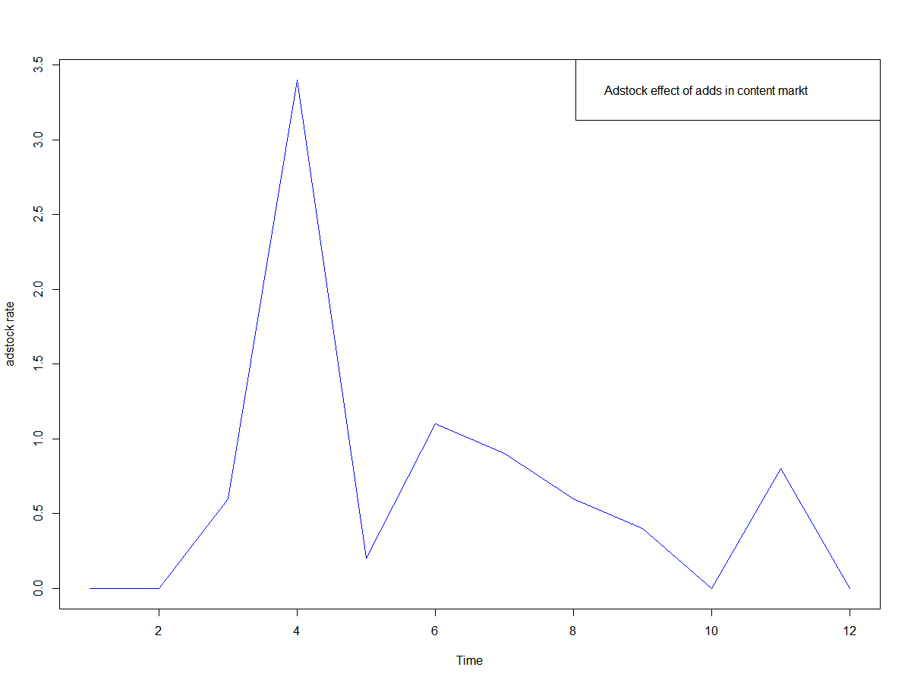
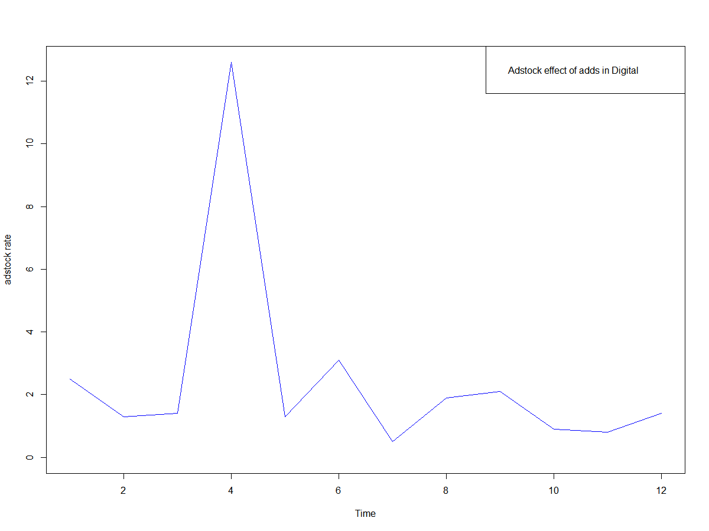
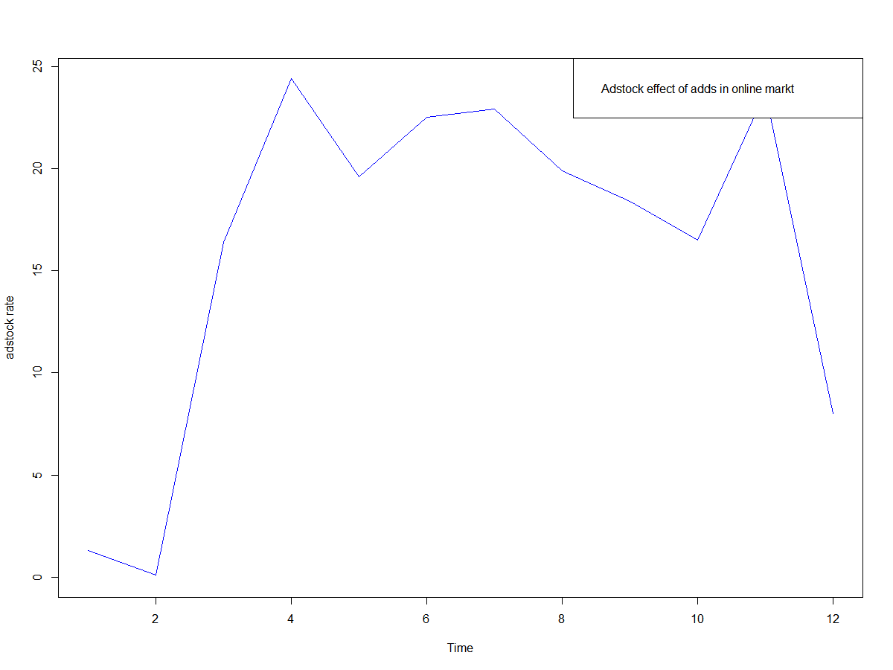
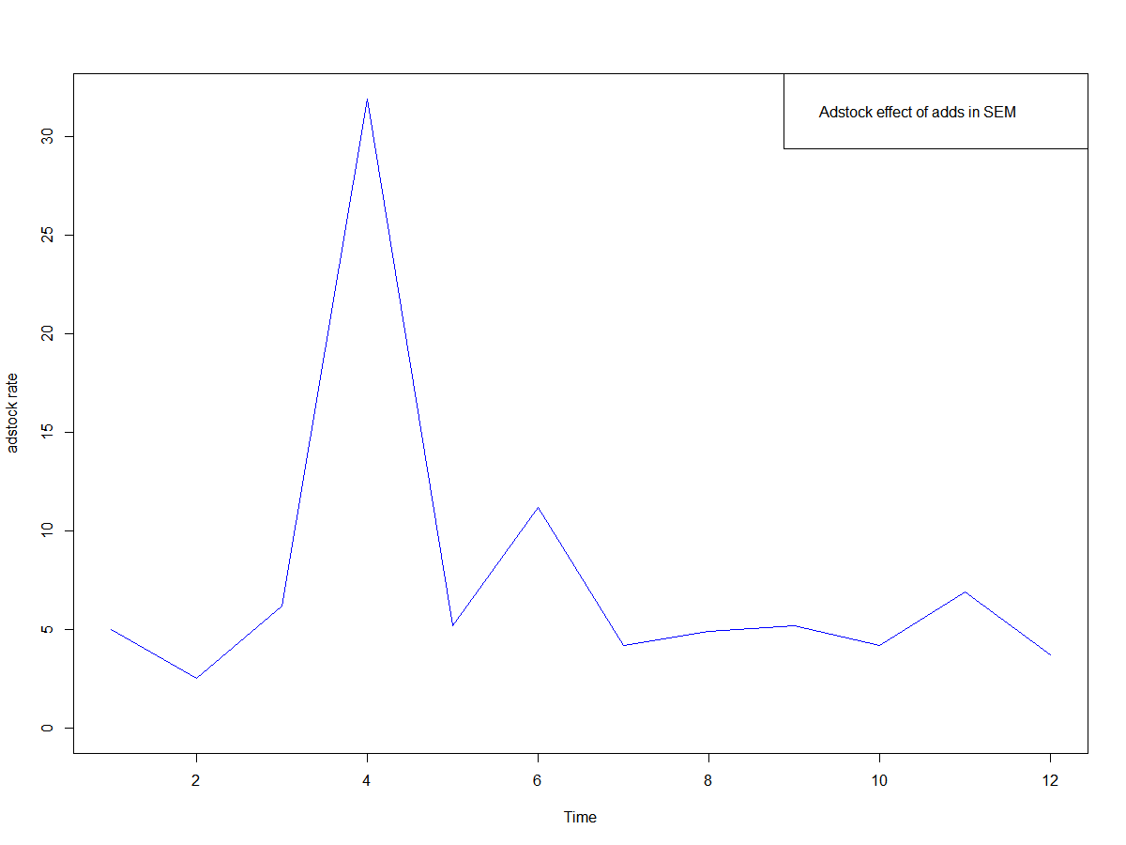
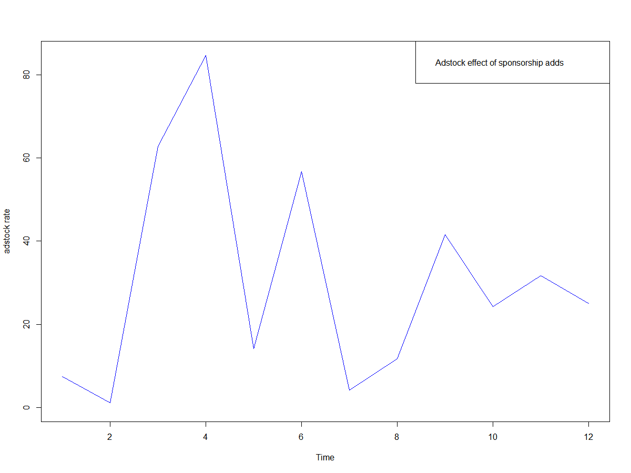
Adstock (1/2)
1. Adstock is directly proportional to the media investment made. Below is the adstock graph of various media channels like TV,Digital,Sponsorship,SEM,affliates,Content and Online marketing over time from week 1 to week 52
Previous: EDA (4/4)
Next: Adstock (2/2)

Slide 13
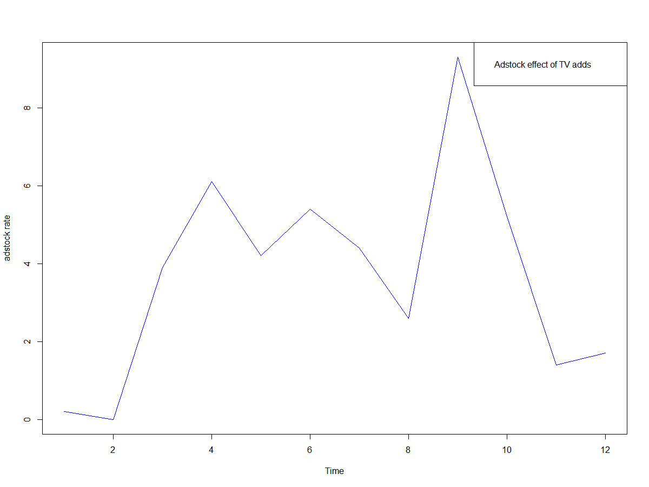
Adstock (2/2)
The adstock graph shows the following:
For TV adds adstock effect has an increasing trend but after April month the adstock effect comes down
For Digital effects adstock is highest during month 3 to 4 i.e. September to October which is during sales time
of Dussehra and Diwali . but other wise adstock effect is very low compare to that of TV
3. Sponsorship adstock follows cosine patterns i.e. regular ups and down , peaks are during Sep, Oct, Dec, Mar and May.
During festive season has good current effect as well as carry over effect
4. Content based adstock effects is less compare with TV adds and Sponsorship.
Adstock on online marketing has a high value of current effect from august to October and good carry over effect continues till May 2016.Adstock comes down towards the end of year. Hence Online marketing is a good channel for marketing and it seems to have a good effect on people memory
Like Online Marketing adstock on affiliates has a high value of current effect from august to October and good carry over effect continues till May 2016
Adstock comes down towards the end of year. Hence affiliates is a good channel for marketing and it seems to have a good effect on people memory
SEM adstock has lesser impact when compare with TV adds , Sponsorship or Online Marketing
Overall adstock plots shows that Sponsorship Marketing has highest adstock effect followed by Online Marketing, TV adds , and Affiliates .Hence it is better to invest for marketing in these channels first for the three products Camera Accessory, Home Audio and Gaming Accessory
Next: KPI selection(1/3)
Previous: Adstock(1/2)

Slide 14
From the EDA we can conclude and derive the following KPIs
Product_mrp : it has a linear increasing trend with gmv and is definitely an KPI
SLA : the gmv value lies within 10000 for SLA value 0 to 30. for the same value of SLA the gmv value ranges from 0 to 10000
Procurement SLA : the gmv value lies within 10000 for SLA value 0 to 15. for the same value of SLA the gmv value ranges from 0 to 10000.Hence both SLA and Procurement Sla is used as a KPI
Price Mark down : This is discount offered and from the graph we can conclude that initially gmv value increases with discount offered by the company and later it has a linear decreasing trend with price markdown. Hence price markdown is a KPI
Price Markup : Although price mark up has a increasing trend with the gmv value however it has collinearity with the price markdown variable . Also price markup is offered for very few products and hence has been removed from being used as KPI.
Holiday: for all the three sub categories the mean value of gmv with Holiday value Y and N is quite close. For Camera accessory and Home audio the mean value of gmv is slightly higher for Holiday 'Y' which implies sales of these products are higher during holidays . In case of Gaming Accessory the mean value of gmv is very close for both value of Holiday ‘Y’ and ‘N’. So we can conclude Sales during holidays are at par or even more when compare to non holidays and hence it cannot be ignored. Thus, Holiday is definitely an KPI.
Payment Type: Although number of COD orders will be more than prepaid delivery but the plotting of payment type with mean value of gmv shows that for prepaid delivery the gmv value is higher than compared with (COD).This is because people usually order lower price product using COD and higher price product are purchased using Prepaid. So, Payment Type is one of the KPI
NPS : It has a strong negative correlation with the marketing spend. NPS with gmv shows a bit wavy pattern and for Home Audio and Gaming Accessory and also for NPS value as high as 60 gmv values is very poor. So there is a strong scope of improvement here to get better score on NPS value from the customers for the products Home Audio and Gaming Accessory.NPS is another KPI.
Advertisement spend : Looking at the plots the advertisement spend on Marketing, Online, Digital, TV, sponsorship and affiliates were used as KPI to see it’s individual impact on gmv for each of the three products Camera accessory ,Home Audio and Gaming Accessory
Deliverycdays and Deliverybdays : the gmv value is more or less same for all the categories except of “Missed” under Camera Accessory. That may be because either data is not available or a lot of delivery went missed for Camera Accessory. Since there is no impact observed on gmv it has not been used as KPI for the model building.
A new variable list inflation is created on weekly level from the variable list price . The formula for list inflation is list price of the current week/list price of the previous week. The plot of list_inflation with gmv shows a linear increasing trend with gmv.
Previous: Adstock(2/2)
Next: KPI selection(2/2)

Slide 15
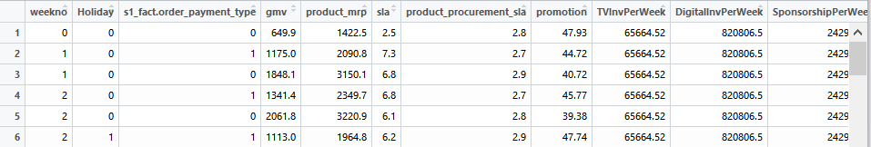
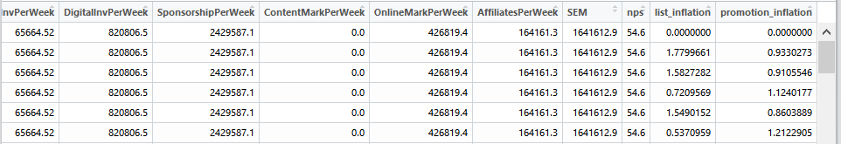
KPI Selection (2/2)
From the EDA we can conclude and derive the following KPIs
A new variable promotion inflation is created on weekly level from the variable promotion (which is price markdown or discount price). The formula for promotion inflation is promotion offered in current week/promotion offered in previous week. The plot of promotion inflation vs gmv shows a linear increasing trend initially which implies as company offers more discount or promotion gmv or sale value increases. However after a certain point despite increasing the promotion w.r.t previous week the gmv value decreases.
Price Mark down : This is discount offered and from the graph we can conclude that initially gmv value increases with discount offered by the company and later it has a linear decreasing trend with price markdown. Hence price markdown is a KPI
Hence both promotion and list inflation is used as an KPI for the final model
So the final KPIs used for model building of the three product categories Camera Accessory, Home Audio and Gaming Accessory are product_mrp, promotion, list inflation , promotion inflation, Holiday, Payment type, sla, procurements ,nps, advertisement spend on TV, Digital, Affiliates, Content, Sponsorship, Online, SEM etc.
Hence three new tables are created on weekly basis from Camera Accessory , Home Audio and Gaming Accessory group by weekno, holiday and payment type with the mean value of gmv, mrp, payment type, sla, procurement sla, advertisement spends ,list inflation, promotion and promotion inflation
This is how the three tables looks and this table created on weekly basis (for week 1 to 52 from July 2015 to June 2016) shall be used for Model Building
This is the snapshot of the Camera Accessory table. Same follows for Home Audio and Gaming Accessory
Previous: KPI Selection (1/2)
Next: Model Building

Slide 16
Presentation to the CXOs of ElecKart

Slide 17

Model Building Steps (Executive Overview)
Step 1. Understanding problem
If or when there is change in scope/data
Step 6. Model Deployment
Step 2. Define success definition (scope)
Step 5. Data modeling
Model building
Model evaluation
Model tuning
Step 3. Data acquisition
Step 4. Explore/understand data
Data preparation/processing
Anomaly / Error detection
Variable / KPI selection
EDA on Dependent variable (Y)
EDA on Dependent variable (X)
Relation between Xs , X and Y

Slide 18

Models Used in this Project
Model 1: Additive
Model Evaluation Metric (r-squared), Mean Squared Error (MSE)
This is a basic linear model that can capture the Current effect. This model is estimated using Multivariate linear regression method.
Target variable is gmv and independent variables we used are KPI’s related to ad spend, pricing, promotion.
Model 2: Multiplicative
Model Evaluation Metric (r-squared), Mean Squared Error (MSE)
This is a basic linear model similar to Additive, but KPI’s are multiplied to get the marketing mix.
This model includes the interaction effect in addition to current effect
KPI’s are same as Additive model
Model 3: Kyock
Model Evaluation Metric (r-squared), Mean Squared Error (MSE)
This is a basic linear model model similar to Additive, with time lagged values of gmv considered as independent variable
This model helps capture the carry-over effect, where past gmv values effect on current gmv values can be seen.
KPI’s are same as Additive model in addition to the lagged values (past 1 and 2 weeks)of gmv.
Model 5: Multiplicative distributed lag
Model Evaluation Metric (r-squared), Mean Squared Error (MSE)
This is an extension of Distribited lag model where in interaction effect is also captured.
All the KPI’s which include the time lagged versions of dependant and independent variables are multiplied to get the marketing mix.
Model 4: Distributed Lag
Model Evaluation Metric (r-squared), Mean Squared Error (MSE)
This is an extension of kyock model where in addition to the lagged values of dependent variable all the independent variables lags are also modelled.

Slide 19
Model results
Category | Model | Rsquared | MSE
Camera Accessory | Additive | 0.973 | 145.977
Camera Accessory | Multiplicative | 0.651 | 79342.92
Camera Accessory | Kyock | 0.97 | 302.7665
Camera Accessory | Distributed lag | 0.985 | 381.8965
Camera Accessory | Multiplicative distributed lag | 0.988 | 82178.02
Home Audio | Additive | 0.651 | 172.06
Home Audio | Multiplicative | 0.527 | 195158
Home Audio | Kyock | 0.934 | 693
Home Audio | Distributed lag | 0.791 | 730.569
Home Audio | Multiplicative distributed lag | 0.981 | 189731.5
Game Accessory | Additive | 0.67 | 505.28
Game Accessory | Multiplicative | 0.753 | 34991.07
Game Accessory | Kyock | 0.535 | 641.8156
Game Accessory | Distributed lag | 0.757 | 443.2908
Game Accessory | Multiplicative distributed lag | 0.994 | 35216.45
Among the five models evaluated, we are recommending Distributed lag model, because
Among the 5 models, Distributed lag is the one which consistently gives higher Rsquared value, thereby accuracy of future prediction and lower Mean squared error and thereby lower error in prediction compared to other models for all the three categories.
Although MSE value of additive model is also less but they contain only 18 variables in comparison with 52 variables for Distributed Lag Model. Hence with 52 variables MSE value of Distributed lag model is also less
In addition, with distributed lag model, we are able to capture the current effect, and carry over effect of all KPI’s .
Multiplicative models have high MSE, which could result in high prediction errors, additive model is having lower rsquared value for Home Audio and Game Accessory, and kyock only captures the carry over effect of target gmv variable. Hence distributed lag model is the optimal model for the problem.
4.

Slide 20

Distributed Lag model Statistics
Camera Accessories:
r-squared value: 0.985
MSE: 381.8965
Final KPI’s
product_mrp
Sla
Promotion
week 1 lag of product_procurement_sla
week 2 lag of DigitalInvestment
week 2 lag of ContentMarketing
Home Audio:
r-squared value: 0.791
MSE: 730.569
Final KPI’s
product_mrp
list_inflation
week 1 lag of product_mrp
week 2 lag of Affiliates
Gaming Accessories:
r-squared value: 0.757
MSE: 443.2908
Final KPI’s
list_inflation
week 1 lag of gmv
week 2 lag of order_payment_type

Slide 21
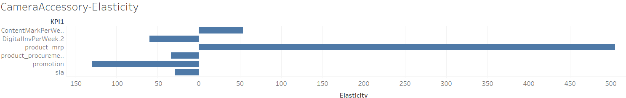
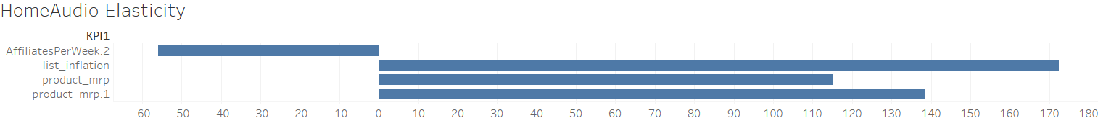
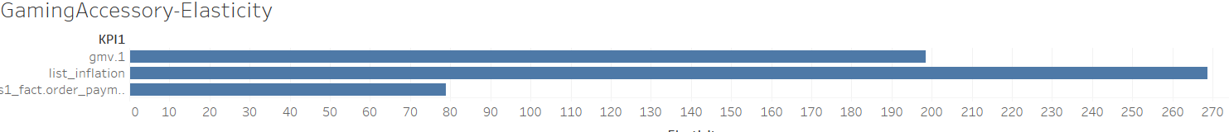
KPI elasticity for the final model for each category

Slide 22


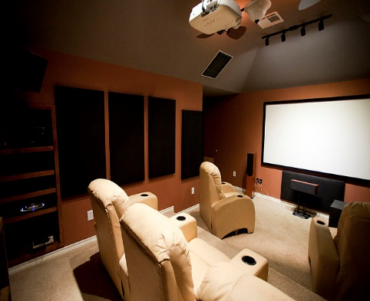
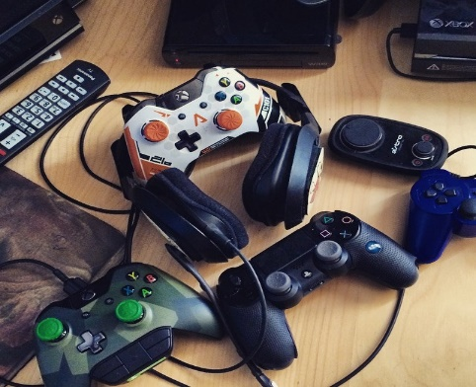
Recommendation and Financial Implications of the Solution
As per the KPI elasticity for Camera Accessory, Product MRP and carry over effect of Content Marketing are the KPI’s which have a positive effect on gross merchandise value.
As expected, both product procurement delay and sla delivery delay are impacting the GMV value negatively, but surprisingly lagged value of Digital investment is also impacting negatively.
However what is really eating up the GMV value is the promotion offered.
So the recommendation is to reduce the discount offered on MRP, and reduce product procurement delay. Also store can focus on selling high MRP products more and promote the products more with Content Marketing (as they have a carry over effect of two weeks)as this will increase GMV.
Camera
Accessory
Open Source Image: https://pixabay.com/en/accessories-cameras-canon-lens-1842573/
As per the KPI elasticity for Home Audio, Product MRP , list inflation and carry over effect of MRP are the KPIs having positive impact on GMV.
Surprisingly carry over effect of Investment in Affiliates is having a negative impact in the GMV.So company should use other marketing channels rather than affiliates to promote the Home audio products .
Increasing List Price on weekly basis is having a positive impact for GMV , provided Customers are not able to detect the changes in list price changes on a weekly basis.
Overall store should focus on selling high MRP products more, increase list price stealthily and avoid investment on Affiliates.
Home Audio
Open Source Image: https://commons.wikimedia.org/wiki/File:Dedicated_home_theater.jpg
As per the KPI elasticity of Gaming Accessory, carry over effect of previous week GMV and list inflation are having major positive impact on GMV.
In addition, carry over effect of payment type Cash on Delivery has positive impact on GMV for two weeks, this means people who purchased Game accessory goods with cash on delivery, has more chances of doing again and this contributes to increasing GMV.
Overall, store can do increase in list price stealthily and promote the usage of cash on delivery option to increase the GM. Also the carry over effect of sales of gmv is present for one week
Gaming
Accessory
Open Source Image: https://www.flickr.com/photos/bagogames/16273540025 /

Slide 23
Thank You !

