Slide 1
Medical insurance
CAPSTONE PROJECT
Presented By:
Sankara Narayanan M
Jayaraj Annapackiam CSI College of Engineering
B.E Mechanical Engineering

Slide 2
OUTLINE
Problem Statement
Proposed System/Solution
System Development Approach
Algorithm & Deployment
Result
Conclusion
Future Scope
References

Slide 3
Problem Statement
An insurance company wants to better understand and predict medical insurance costs for individuals based on their demographic information, lifestyle factors, and health attributes. The company aims to develop a predictive model that can accurately estimate insurance costs for new policyholders and help in pricing policies effectively.

Slide 4
Proposed Solution
Data Collection:
Gather the medical insurance dataset containing attributes such as age, sex, BMI, number of children, smoking status, region, and medical charges.
Ensure the dataset is representative and includes a diverse range of individuals.
Data Preprocessing:
Handle missing values in the dataset, either by imputation or removal, depending on the extent of missing data.
Encode categorical variables like sex, smoker, and region into numerical format using techniques like one-hot encoding.
Scale numerical features such as age, BMI, and number of children to a standard range, especially if using algorithms sensitive to feature scales (e.g., gradient-based algorithms).
Exploratory Data Analysis (EDA):
Analyze the distribution of medical charges to understand its range and variability.
Explore correlations between features and medical charges using visualizations like scatter plots, heatmaps, and histograms.
Identify any outliers or anomalies in the data that may need further investigation or preprocessing.
Feature Engineering:
Create new features if relevant, such as age groups (e.g., young adults, middle-aged, seniors) or BMI categories (e.g., underweight, normal weight, overweight, obese).
Transform data as needed, such as applying log transformations to skewed features.

Slide 5
System Approach
Building a medical insurance system involves several components, including data collection, processing, analysis, decision-making, and user interaction. Here's an approach to designing and implementing a medical insurance system:
Define System Objectives
Data Collection and Integration
Data Preprocessing
Data Analysis and Modeling
Decision Support and Rule Engine
User Interface and Interaction
Analytics and Reporting
Continuous Monitoring and Improvement
Integration with External Systems

Slide 6
Algorithm & Deployment
Deploying a medical insurance algorithm involves several steps to ensure that the model is integrated into a production environment and can make accurate predictions in real-time. Here's an approach to deploying a medical insurance algorithm:
Model Training and Validation
Model Serialization
Model Deployment Framework
API Development
Data Input and Output Handling
Security and Authentication
Scalability and Performance
Optimization Testing and Quality Assurance
Continuous Monitoring and Maintenance

Slide 7
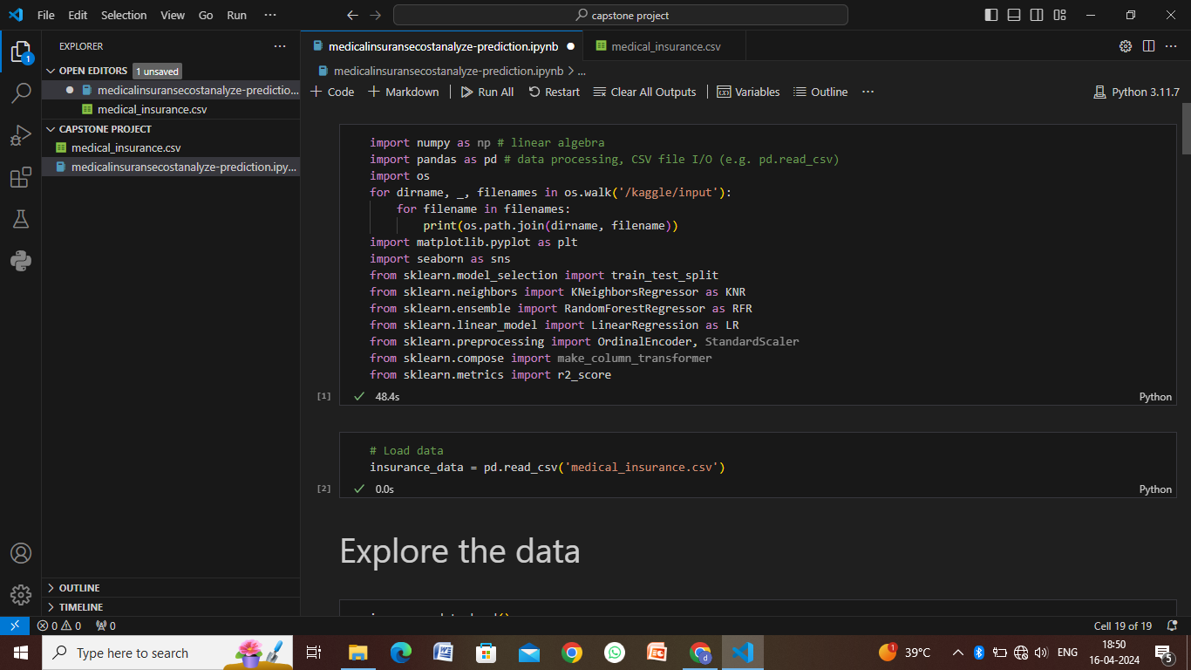
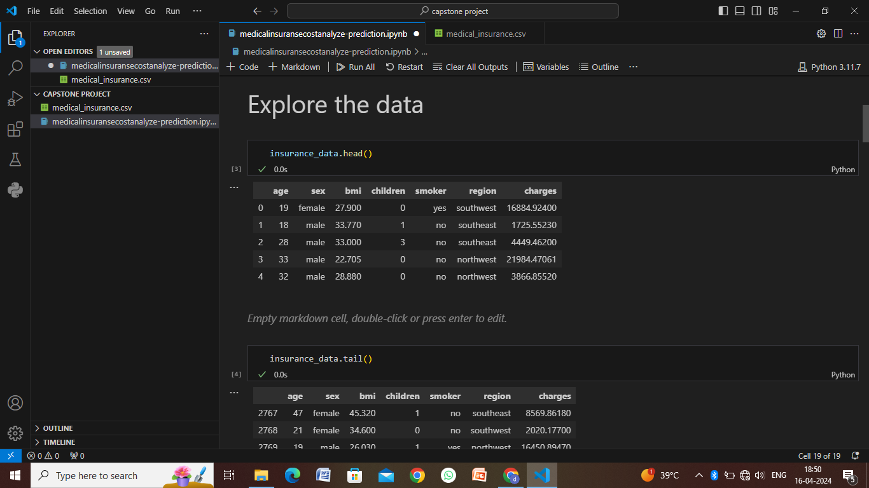
Result

Slide 8
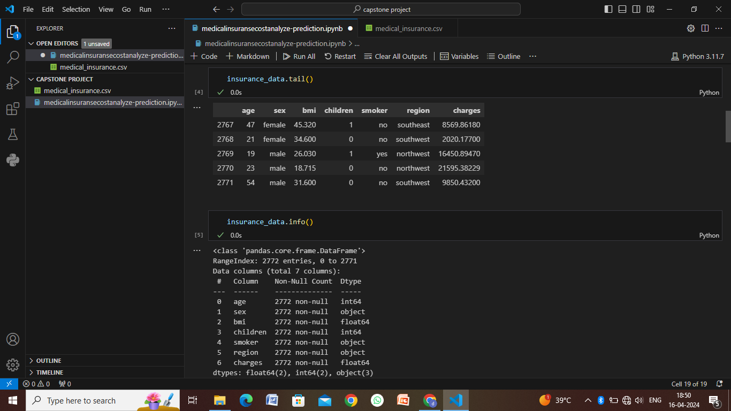
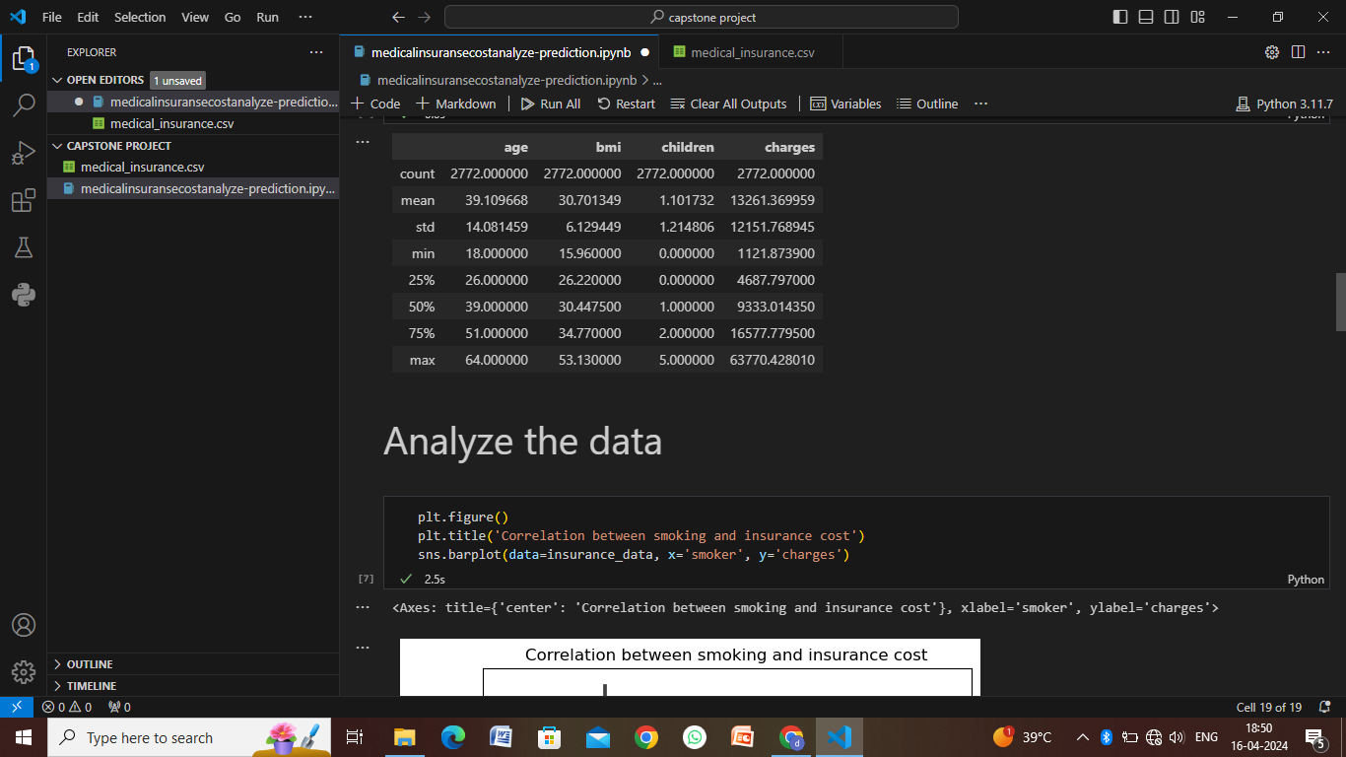
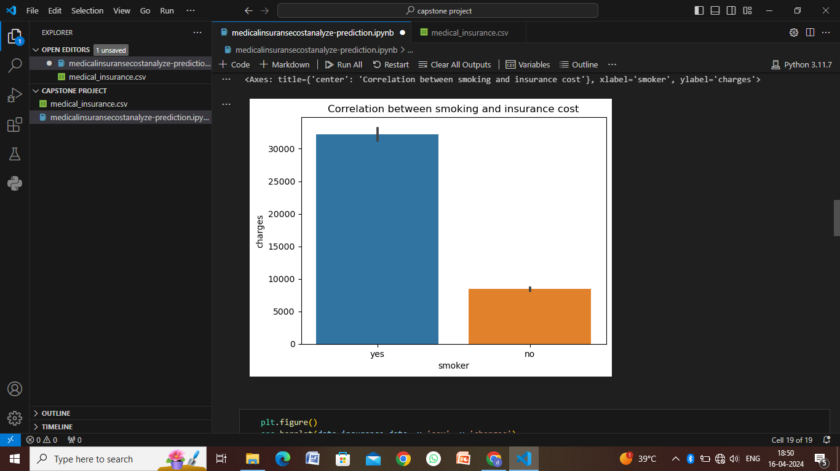
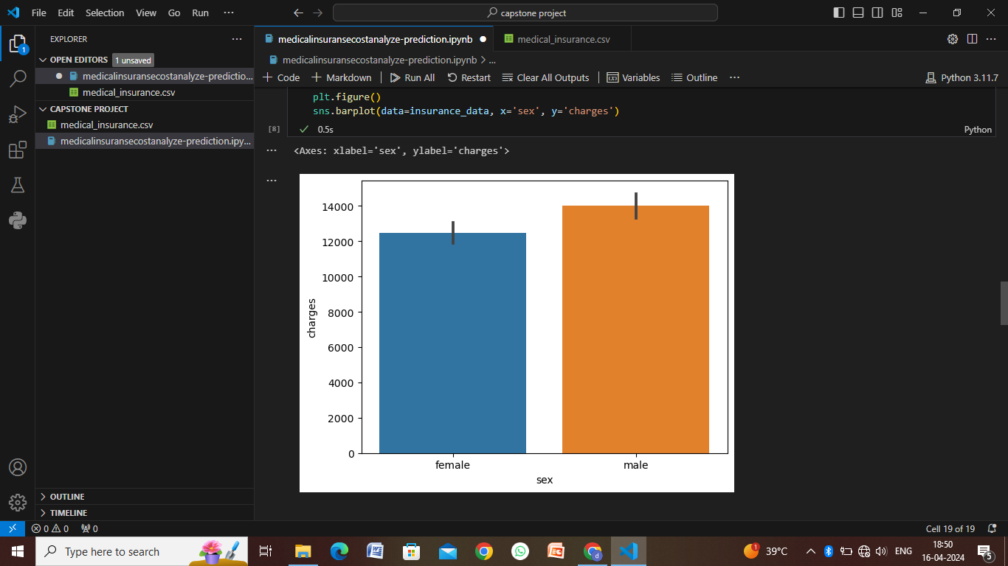

Slide 9
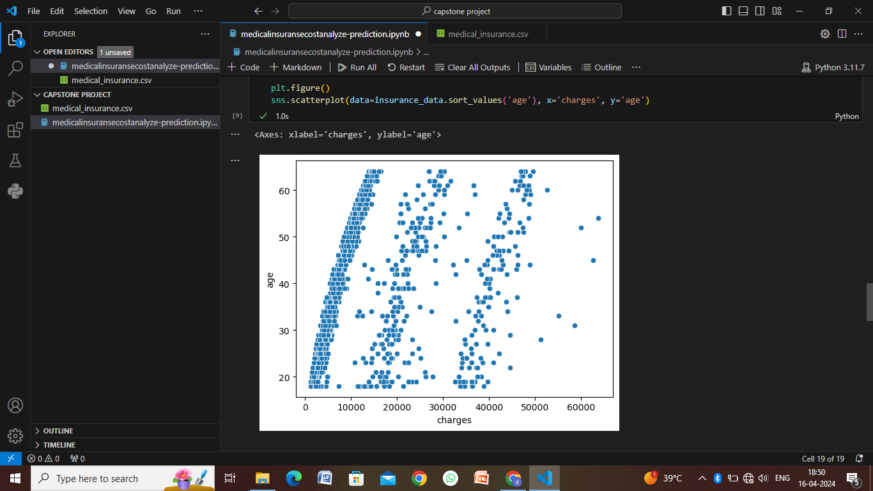
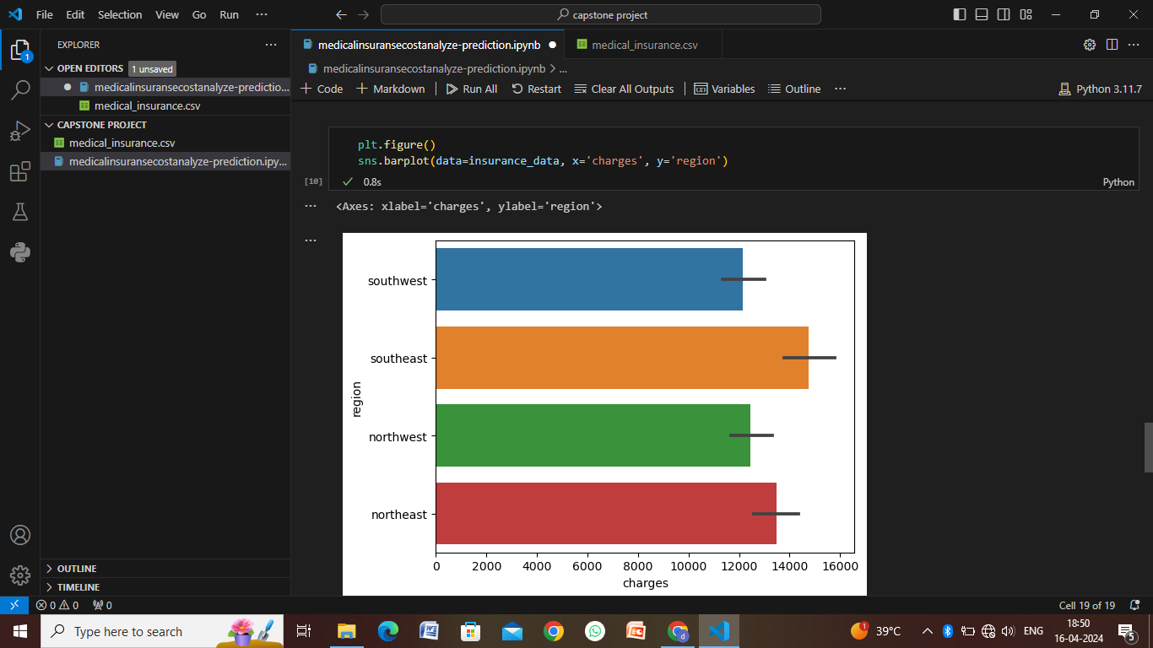
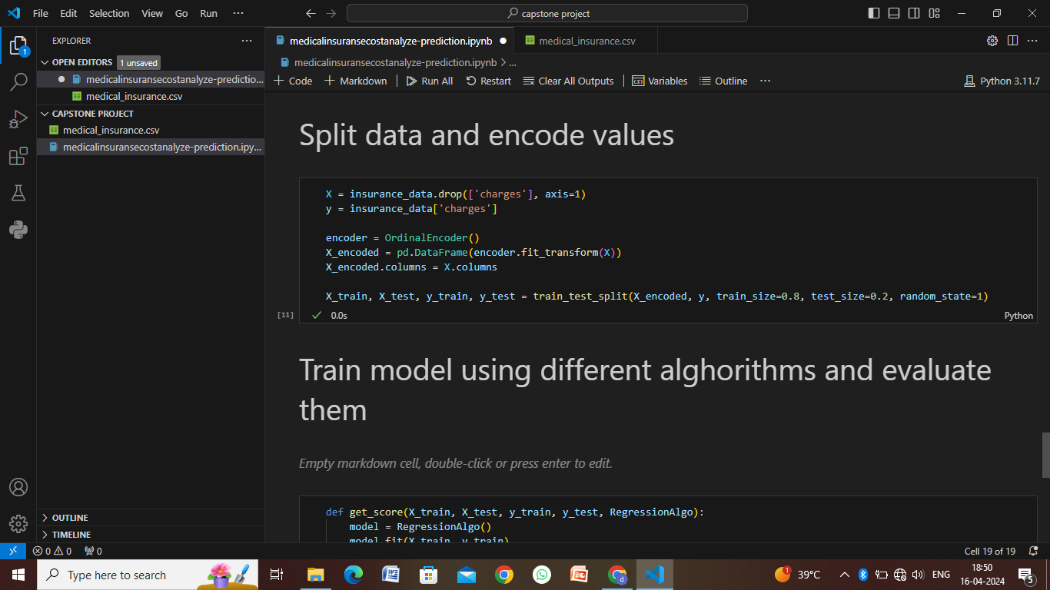
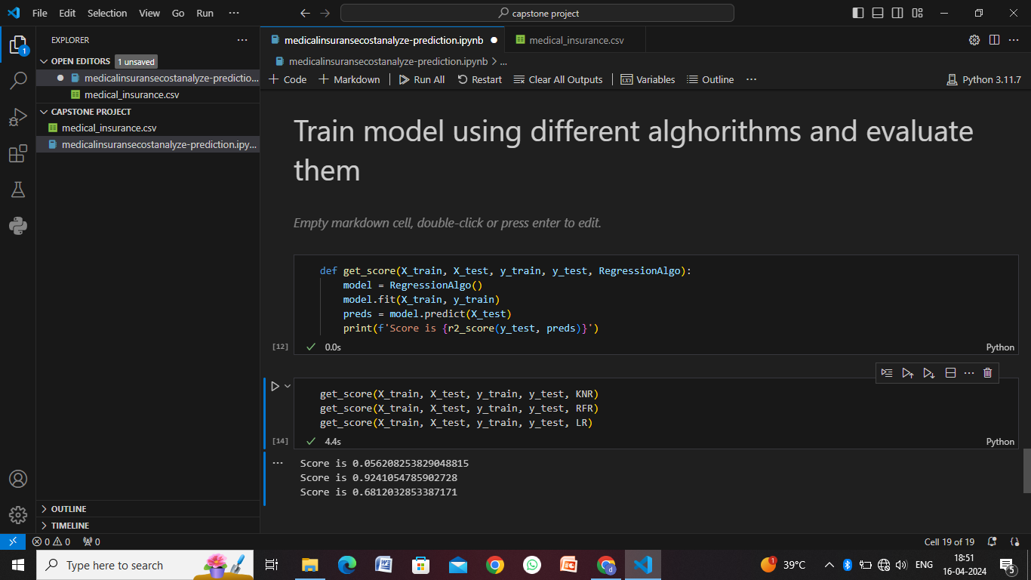

Slide 10
Conclusion
In conclusion, developing and deploying a medical insurance algorithm involves a systematic approach encompassing data preparation, model training, deployment, integration with frontend applications, security considerations, performance optimization, testing, and continuous monitoring. Here are the key takeaways:
Data Preparation
Model Training
Integration with Frontend
Security and Authentication
Scalability and Performance Optimization
Testing and Quality Assurance
Continuous Monitoring and Maintenance

Slide 11
Future scope
The future of medical insurance holds several exciting possibilities, driven by advancements in technology, data analytics, healthcare practices, and regulatory changes. Here are some potential future trends and areas of development in medical insurance:
Personalized Insurance Plans
Predictive Analytics and Risk Assessment
Value-Based Care Models
Telemedicine and Digital Health
Blockchain Technology
Behavioral Analytics and Wellness Programs
Regulatory Changes and Compliance
Customer Experience and Engagement
Data Sharing and Collaboration

Slide 12
References
Healthcare and Insurance Associations:
Check websites of healthcare and insurance associations such as the American Health Insurance Plans (AHIP), National Association of Insurance Commissioners (NAIC), and Health Information Management Systems Society (HIMSS) for resources, whitepapers, and industry insights.
Government Websites:
Visit government websites such as the U.S. Department of Health & Human Services (HHS), Centers for Disease Control and Prevention (CDC), and National Institutes of Health (NIH) for healthcare policy updates, regulatory information, and public health data relevant to medical insurance.
Insurance Companies and Providers:
Explore websites of major insurance companies, healthcare providers, and pharmaceutical companies for industry reports, case studies, and articles on medical insurance trends, innovations, and best practices.
Healthcare Technology and Innovation:
Look into resources from healthcare technology companies, digital health startups, and innovation hubs for insights into emerging technologies, AI applications, blockchain in healthcare, telemedicine trends, and patient engagement solutions related to medical insurance.
Financial and Business Publications:
Consult financial and business publications such as Forbes, Bloomberg, Harvard Business Review, and McKinsey & Company for articles, analyses, and thought leadership pieces on healthcare financing, insurance market trends, and industry disruptions.

Slide 13
THANK YOU

