Slide 1
Facial Recognition Using Deep Learning
Under the Guidance of Professor Dr.Satish K Singh
BY
Sannihith Kavala IHM2014004

Slide 2
Why Facial Recognition Project when we already have lots of Facial Recognition Software???

Slide 3
Accuracy
Security
Speed
Reliability on Real-time data
To obtain

Slide 4
Why Deep Learning?
What is facial Recognition? Facial recognition (or face recognition) is a biometric method of identifying an individual by comparing live capture or digital image data with the stored record for that person.
Deep Learning enables us to achieve outstanding accuracy in the field of facial recognition as compared to any other approaches.

Slide 5
Methodology
Dataset collection.
Preprocess the data(Detect, align and crop the dataset).
Generating facial embedding using Tensorflow.
Training the classifier using transverse learing.
Testing the data.

Slide 6
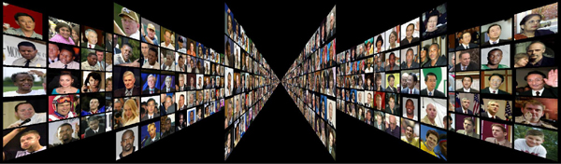
Dataset Selection
The LFW dataset is a standard benchmark in facial recognition research.
It has 13233 images of 5749 people.
We used 80% data for training and 20% for testing.
Also tested on the real time data to check reliability

Slide 7



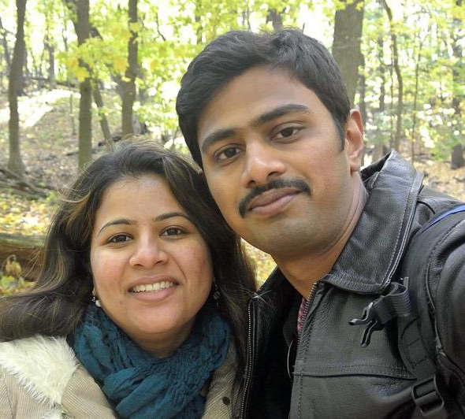
Pre-processing data
Image pre-processing in a facial recognition context typically solves a few problems. These problems range from lighting differences, occlusion, alignment.
We do not train the images which has very less brightness and very high contrast levels or even the images are blur.
We also neglect the images if a image have multiple faces.

Slide 8










Preprocessing Real-Time Dataset
So for every image we are able to generate
4 extra images of different weather condition.
By this process we can achieve more data
for the available data
This dataset contains 2054 Images of 40
Students of IIITA batch 2016 .

Slide 9
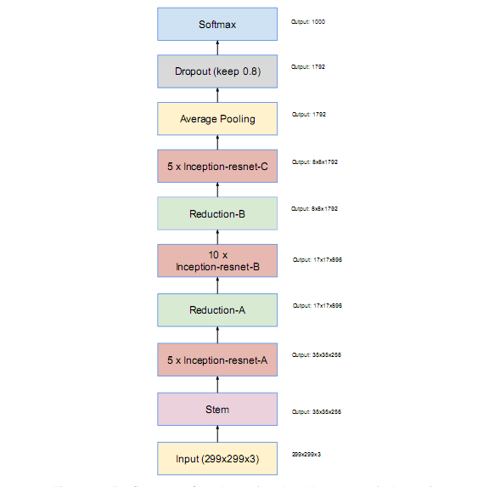
Inception resnet V1
We downloaded the weights to the model. By using pre-trained weights, we are able to apply transfer learning to a new dataset

Slide 10
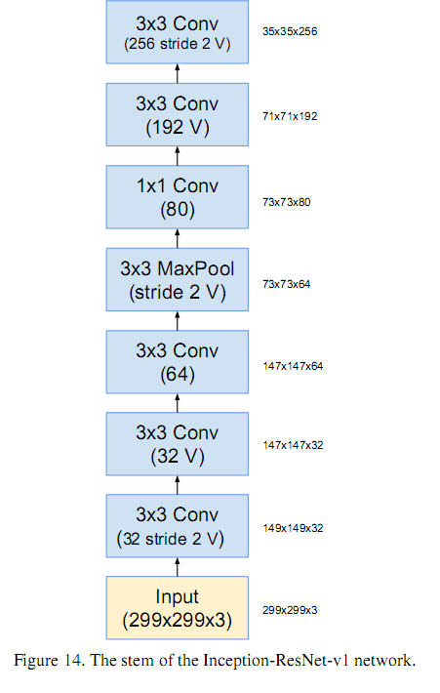
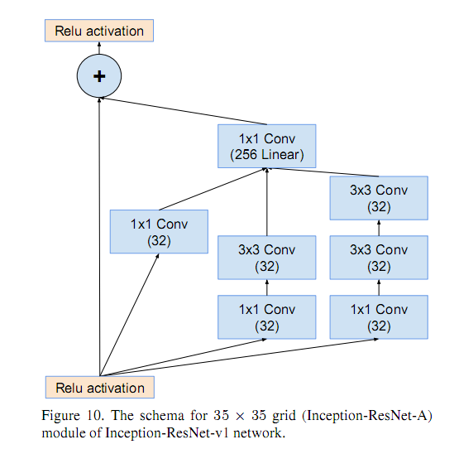
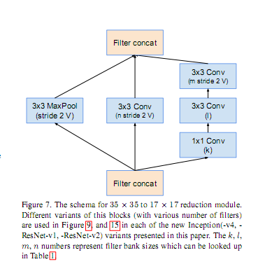
Stem
Inception Resnet A
Reduction A

Slide 11
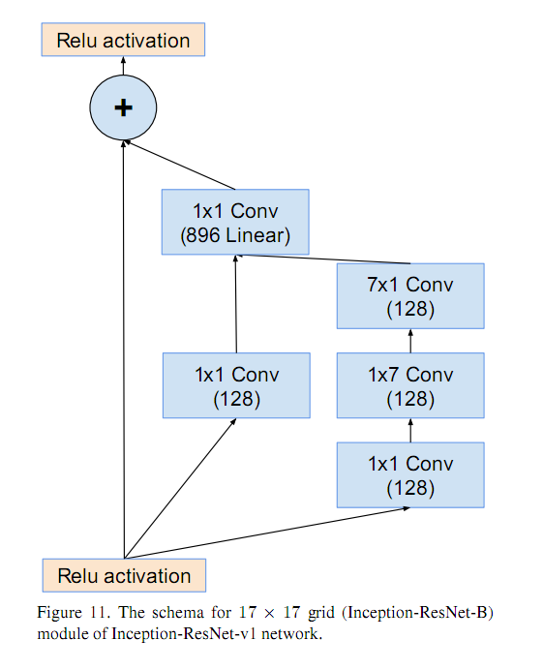
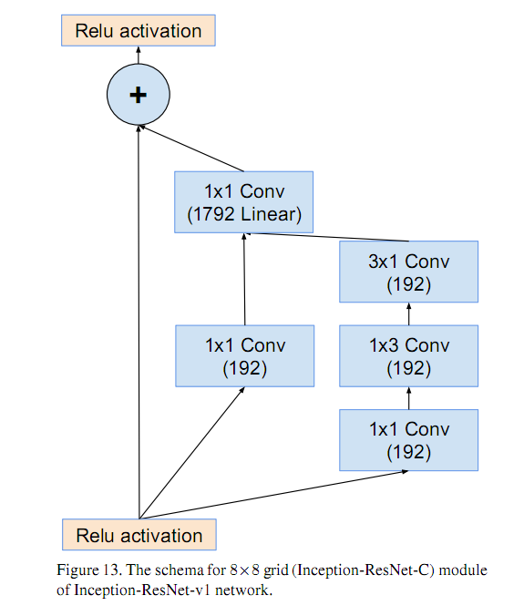
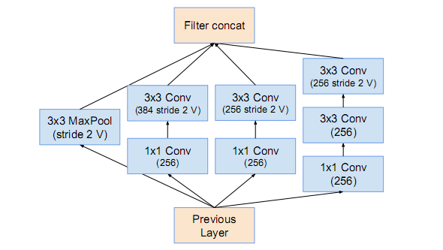
Reduction B
Inception Resnet C
Inception Resnet B

Slide 12
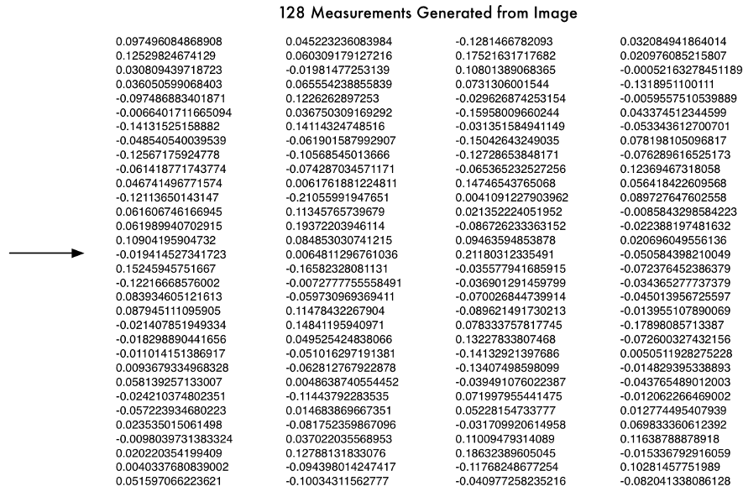

Slide 13
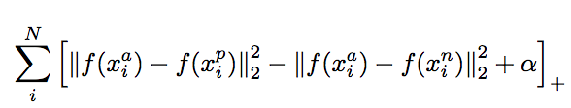
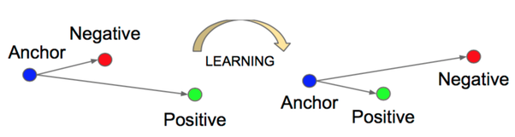
Triplet loss equation
Triplet loss learning

Slide 14


Training
Single “TRIPLET” training step
Picture of Siddarth
Test picture of Sakshi
Another picture of Sakshi
128 measurements generated
by neural-net
128 measurements generated
by neural-net
128 measurements generated
by neural-net
Compare results
Tweak neural net slightly such that the two measurements of
Sakshi are closer and Siddarth are farther away

Slide 15
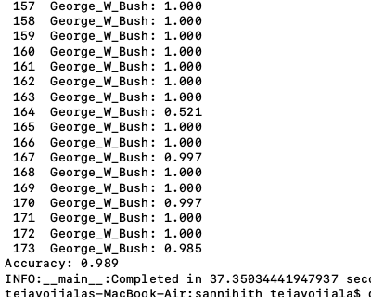
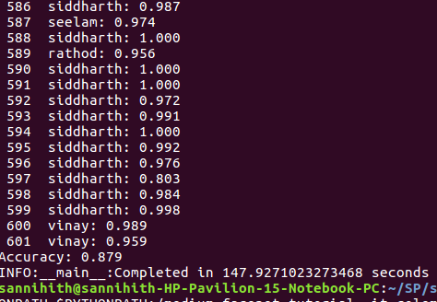
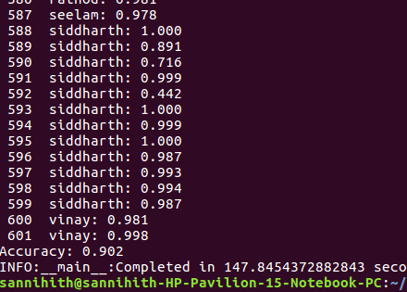
Results and Analysis
Results are comparable to the state of art.
The accuracy for LFW is 98.9%
The accuracy for real time data is 87.9%
Which is increased to 90.2% due to prepocessing
LFW DATASET
Real-Time DATASET
Real-Time DATASET -
After prepocessing

Slide 16
Comparison on LFW Dataset
S.NO | Model | Accuracy
1 | Simile classifiers | 0.8472
2 | Tom-vs-Pete | 0.9310
3 | DeepFace-ensemble | 0.9735
4 | DeepID | 0.9745
5 | FaceNet | 0.9963
6 | Our Methodology | 0.9890

Slide 17
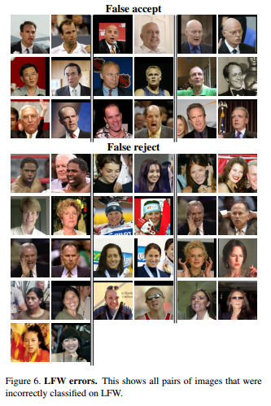
False accept
False reject
In LWF data set
In LWF data set

Slide 18
References
Y. Taigman, M. Yang, M. Ranzato, and L. Wolf. Deepface: Closing the gap to human-level performance in face verification. In IEEE Conf. on CVPR, 2014. 1, 2, 5, 8
M. D. Zeiler and R. Fergus. Visualizing and understanding convolutional networks. CoRR, abs/1311.2901, 2013. 2, 3, 4, 6 .
M. Lin, Q. Chen, and S. Yan. Network in network. CoRR, abs/1312.4400, 2013. 2, 4, 6.
D. Chen, X. Cao, L. Wang, F. Wen, and J. Sun. Bayesian face revisited: A joint formulation. In Proc. ECCV, 2012. 2
C. Lu and X. Tang. Surpassing human-level face veri- fication performance on LFW with gaussianface. CoRR, abs/1404.3840, 2014
Google facenet paper : arXiv:1503.03832v3
LFW Dataset http://vis-www.cs.umass.edu/lfw/.
Nitish Srivastava, Geoffrey Hinton, Alex Krizhevsky, Ilya Sutskever, and Ruslan Salakhutdinov, Dropout: A simple way to prevent neural networks from overfitting, J. Mach. Learn. Res. 15 (2014), no. 1, 1929–1958.
Images of Inception Resnet V1 are taken from m.blog.csdn.net/bea_tree/article/details/51784026http://m.blog.csdn.net/article/details?id=51880371 - 极客头条

Slide 19
THANK YOU

