Slide 1




NEXT GEN EMPLOYABILITY PROGRAM
Creating a future-ready workforce
Student Name : Santhosh Rajan
Student RegNo:110321104045
Student ID :au110321104045
Student email : santhoshrajan78900@gmail.com
College Name
GRT INSTITUTE OF ENGINEERING AND TECHNOLOGY

Slide 2

CAPSTONE PROJECT SHOWCASE
Project Title
MUSIC WEB APPLICATION USING DJANGO FRAMEWORK
Abstract | Problem Statement | Project Overview | Proposed Solution | Technology Used | Modelling & Results | Conclusion

Slide 3
Abstract
User Authentication: Start by creating user accounts and enabling login functionality. Users can sign up, log in, and access personalized features.
Song Management: Implement features to upload, store, and organize music files. Users can add, delete, and search for songs based on various criteria (genre, artist, album, etc.).
Playlist Creation: Allow users to create and manage playlists. They can curate their favorite tracks, reorder them, and play the playlists seamlessly.
Streaming and Playback: Develop a music player interface that streams songs, displays album art, and provides playback controls. Users can enjoy their music library online.

Slide 4
Problem Statement
User-Friendly Music Management: Design an application that allows users to create accounts, log in, and manage their music library. Users should be able to upload, organize, and delete songs effortlessly.
Dynamic Playlist Creation: Implement a feature that enables users to create personalized playlists. Users can add songs, reorder tracks, and play their custom playlists seamlessly.
Streaming and Playback: Develop a robust music player interface that streams songs, displays album art, and provides playback controls. Users should enjoy uninterrupted music playback.
Secure User Authentication: Ensure a secure login system, protecting user data and allowing seamless access to personalized features.

Slide 5
Project Overview
Song Management and Organization:
Implement features to upload, store, and categorize music files.
Users can search for songs based on genre, artist, or album.
Dynamic Playlists and Playback:
User Authentication and Registration:
Users can create accounts, log in, and manage their profiles.
Secure user authentication ensures data privacy.
Allow users to create personalized playlists.
Develop a music player interface for seamless song streaming.
Admin Panel for System Maintenance:
Manage user accounts, songs, and system settings through an admin dashboard.

Slide 6
Proposed Solution
1. User Authentication and Account Creation:
Create user accounts with features like registration, login, and password reset.
Use Django’s built-in authentication system or customize it to suit your needs.
Implement user sessions and secure user data storage.
2. Song Management and Playback:
Design a database model for songs, including fields like title, artist, category, audio file, and audio image.
Use Django’s ORM (Object-Relational Mapping) to manage song data.
Fetch songs from an external API or upload them directly to the application.
Develop views to display song details, play audio, and manage playlists.

Slide 7
Proposed Solution
3. Frontend Development:
Create responsive HTML templates using Django’s template engine.
Use CSS and JavaScript to enhance the user interface.
Implement search functionality to allow users to find songs based on preferences.
Display song images and relevant information on the home page.
4. Admin Panel and User Interaction:
Utilize Django’s admin panel for managing songs, users, and other application data.
Allow users to add new songs, update existing ones, and delete songs.
Implement user roles (e.g., regular user, admin) to control access and permissions.

Slide 8


Technology Used
Front-end
Back-end

Slide 9
Modelling & Results
Database Model for Songs:
Create a Django model named “Song” with fields such as id, title, category, artist, audio file, and audioimg.
Use the File Field to handle audio files and images associated with each song.
Implement a string representation method to display the song title.
User Authentication and Custom User Model:
Extend Django’s built-in Abstract User model to create a custom user model named “Custom User.”
Add fields for groups and user permissions to manage user associations with multiple groups and permissions.
Django Rest Framework Views:
Develop two views using Django Rest Framework:
SongListCreateView: Handles listing and creation of songs.
SongDetailView: Manages retrieval, update, and deletion of individual songs using the “Song” model and its corresponding serializer.
Frontend and Home Page:
Design responsive HTML templates using Django’s template engine.
Display song information, including titles and images, on the home page.
Implement search functionality for users to find songs based on preferences.

Slide 10
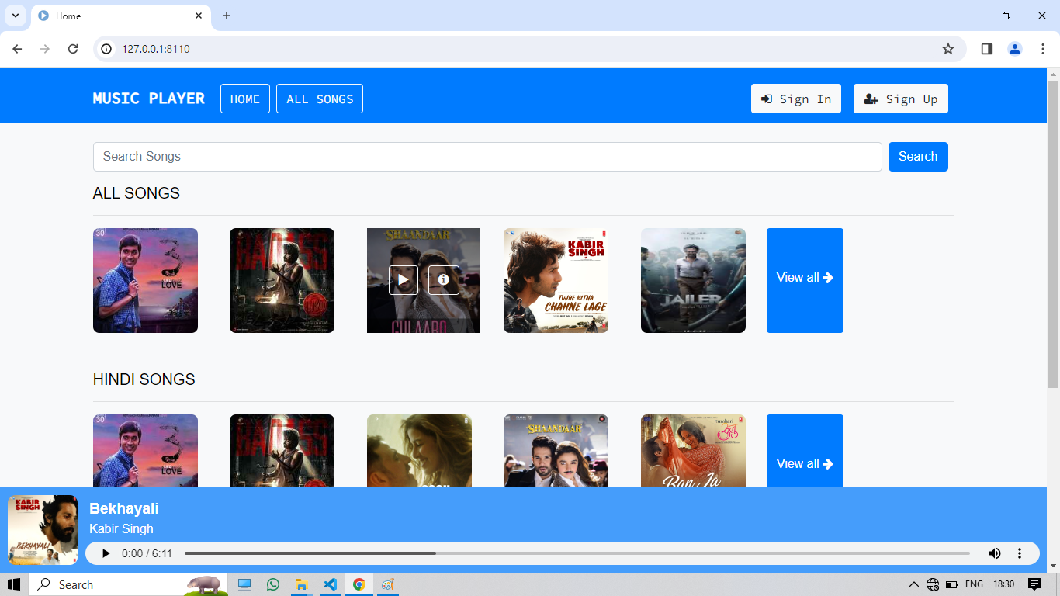
Home without sign in page

Slide 11
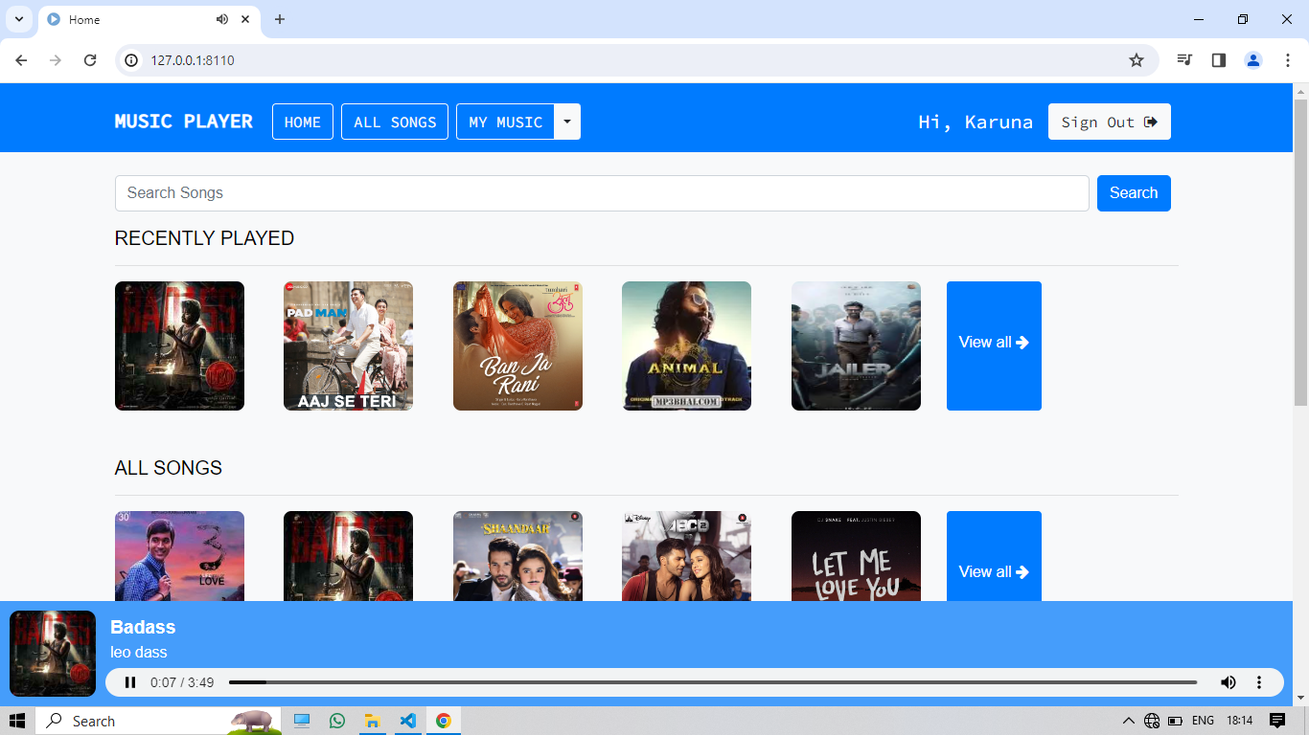
Homepage

Slide 12
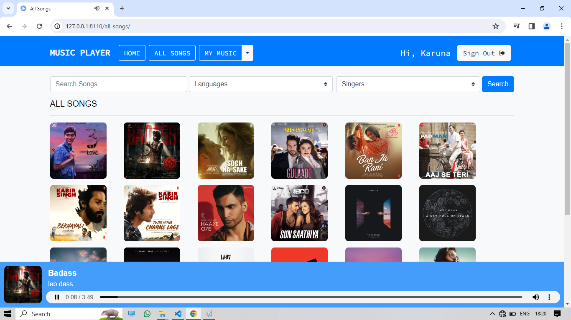
All Songs-Page

Slide 13
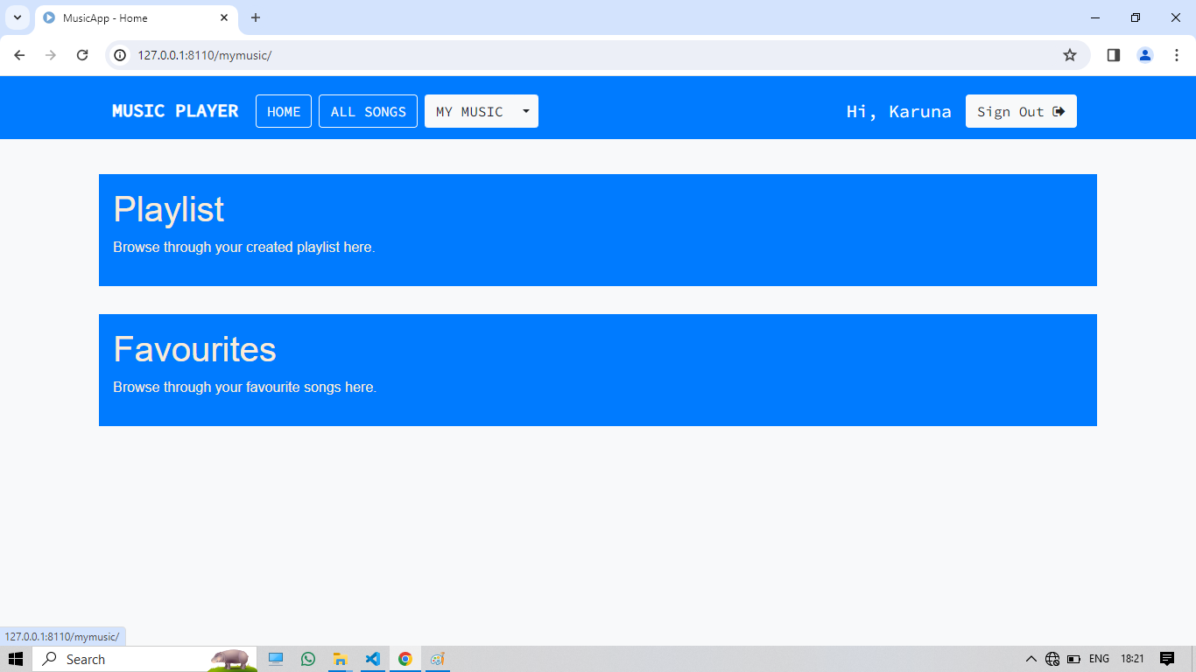
MYMUSIC-Page

Slide 14
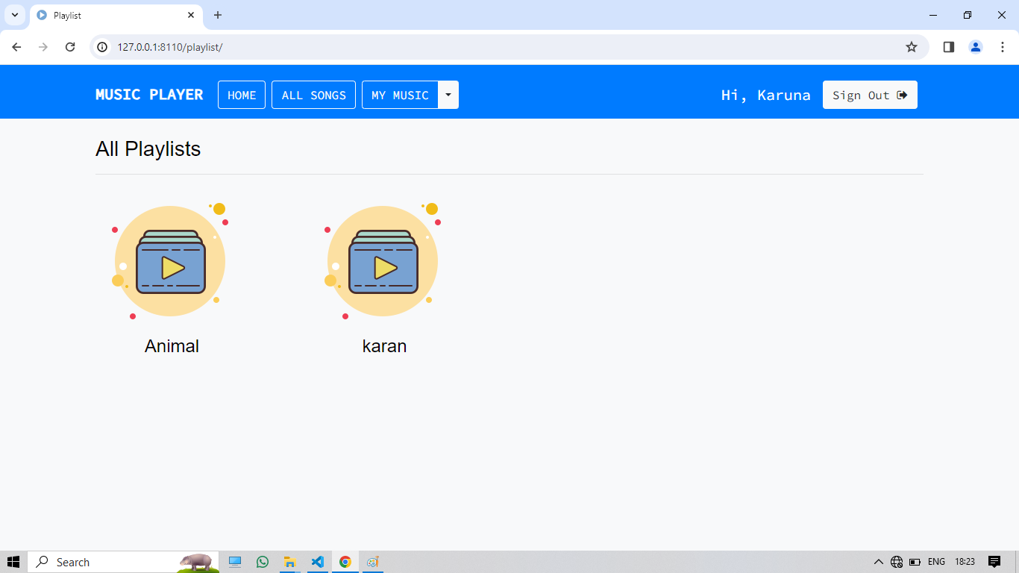
Playlist-Page

Slide 15
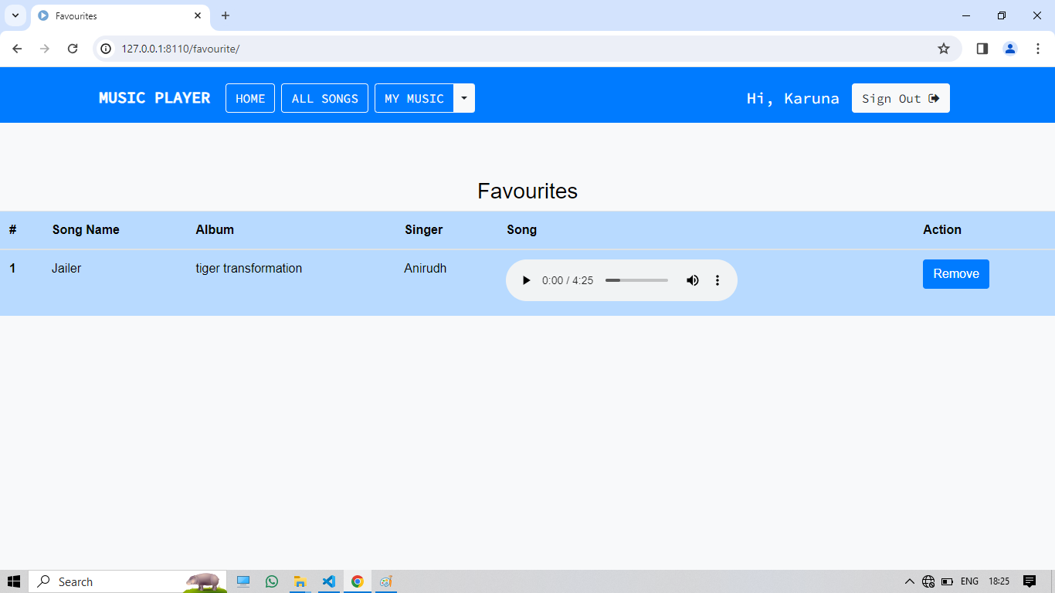
Favourites Page

Slide 16
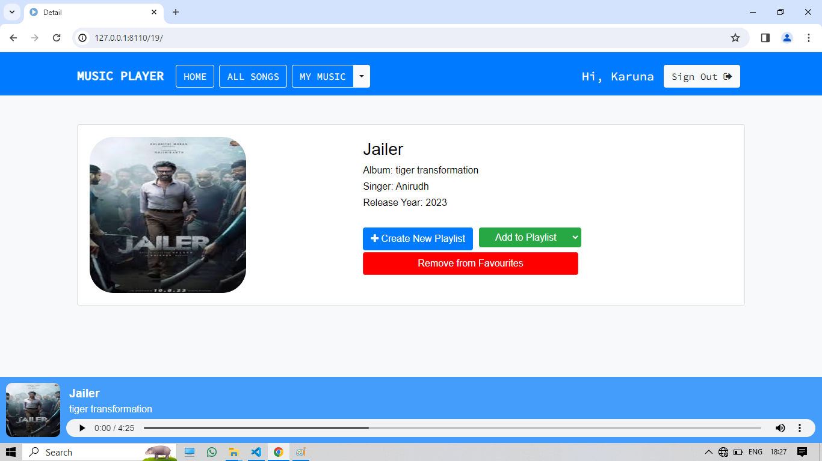
Details-Page

Slide 17
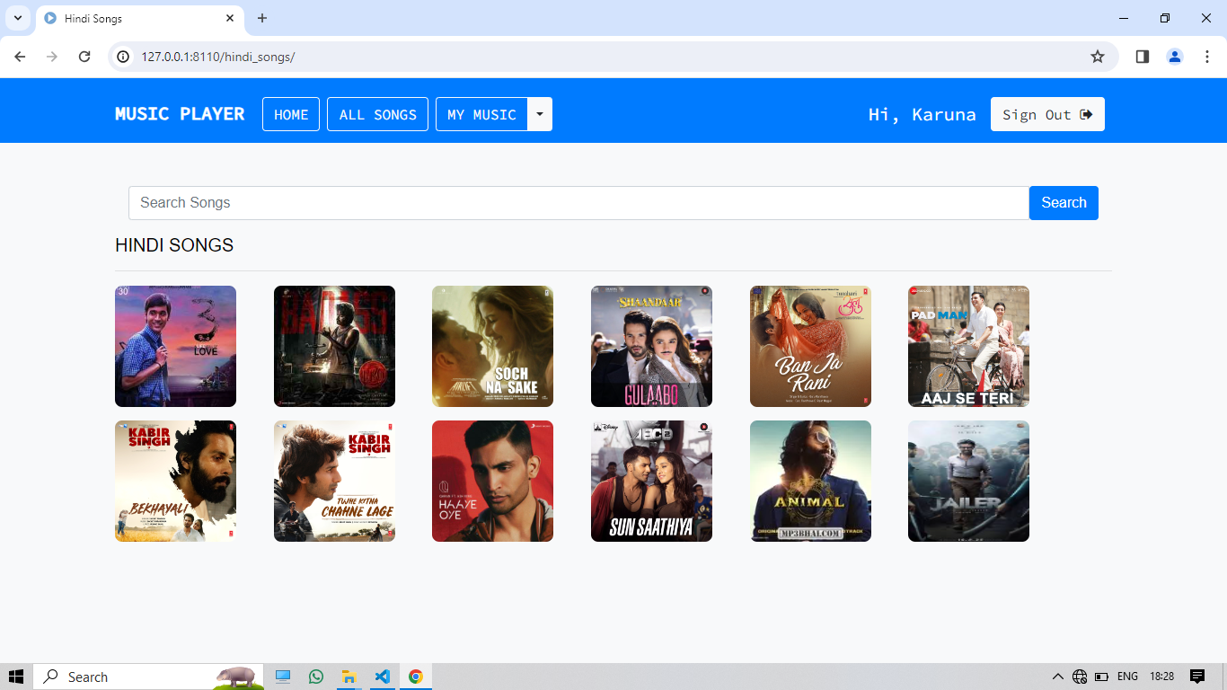
Hindi songs Page

Slide 18
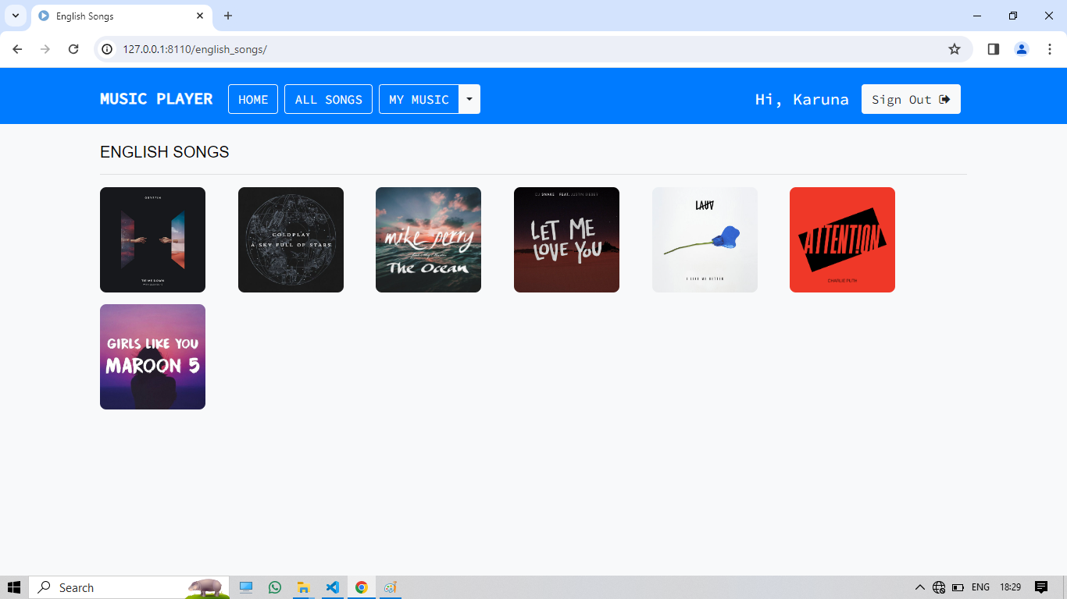
English songs Page

Slide 19
Future Enhancements:
User Profiles and Social Features:
Implement user profiles where users can customize their avatars, update personal information, and view their listening history.
Add social features like following other users, sharing playlists, and collaborating on playlists with friends.
Enable social authentication (e.g., login with Google or Facebook) to enhance user engagement.
Advanced Search and Recommendations:
Enhance the search functionality by allowing users to filter songs by genre, artist, release year, and popularity.
Implement recommendation algorithms (e.g., collaborative filtering or content-based recommendations) to suggest personalized playlists based on user preferences and listening history.
Playlist Management and Collaboration:
Allow users to create and manage playlists, including adding, removing, and reordering songs.
Enable collaborative playlists where multiple users can contribute and curate a shared playlist.
Implement playlist sharing via unique URLs or QR codes.

Slide 20
Conclusion
Achieved Milestones:
Successfully developed a functional music web application using Django.
Implemented user authentication, song management, and frontend views.
Future Prospects:
Explore enhancements like user profiles, advanced search, and social features.
Consider integrating audio visualization and lyrics display.
User Engagement and Feedback:
Encourage users to provide feedback on usability, performance, and features.
Continuously iterate and enhance the application based on user input.
Passion for Music and Technology:
Building this music web app was a rewarding experience, combining creativity, coding, and a love for music.
Source :

Slide 21
Thank You!
Notes:
Thank You !!

