Slide 1
Cliff Walking: Sarsa vs Q-learning
CS656 Reinforcement Learning | Programming Assignment, Part I, Problem 8
Sutton & Barto, Example 6.6
Submitted by
Santhoshkumar Anbalagan

Slide 2
Problem Statement: The Cliff Walking Gridworld
Element | Definition
States | Grid cells (row, column), 4 × 12 = 48
Actions | Up, Down, Left, Right
Reward | −1 for every step
Cliff | −100 and return to start S
Termination | Agent reaches goal G
Discount γ | 1 (episodic task)
Step size α | 0.5
Exploration ε | 0.1
S
The Cliff
G
R = −1 on every move; R = −100 on the cliff
The key tension
The shortest path runs right next to the cliff. With ε-greedy exploration, walking there risks a −100 fall. Do the two algorithms agree on which path is best?

Slide 3
ε-Greedy Action Selection
π(a | s) = 1 − ε + ε/|A| if a = argmax Q(s, a′) (greedy action)
π(a | s) = ε/|A| otherwise (each other action)
With probability 1 − ε the agent exploits (greedy); with probability ε it explores by picking one of the |A| actions uniformly at random.
0.925
0.025
0.025
0.025
Greedy action
Other action 1
Other action 2
Other action 3
With |A| = 4 and ε = 0.1: each other action = 0.1 × ¼ = 0.025.
The greedy action is reached two ways: exploit (0.9) or explore and pick it by chance (0.025), so 0.9 + 0.025 = 0.925.
Check: 0.925 + 3 × 0.025 = 1.000

Slide 4
The Two Update Rules
Sarsa (on-policy)
Q-learning (off-policy)
Q(S,A) ← Q(S,A) + α [ R + γ Q(S′,A′) − Q(S,A) ]
Q(S,A) ← Q(S,A) + α [ R + γ max Q(S′,a) − Q(S,A) ]
A′ is the action actually chosen in S′ by the ε-greedy policy. Sarsa learns the value of the policy it is following, exploration included.
The target uses the best next action (greedy), whatever action is actually taken. Q-learning learns the value of the optimal policy.
The only difference: Q(S′, A′) versus max Q(S′, a)

Slide 5
Worked Illustration of One Update
Setup: agent is in a cell just above the cliff and moves right (R = −1, α = 0.5, γ = 1). Q(S, right) = −10. At S′: Q(S′, right) = −8 (best), Q(S′, down) = −40 (cliff direction).
Q-learning: always uses the max (−8)
Sarsa: random “down” at S′ (P = 0.025)
Q = −10 + 0.5 [ −1 + (−8) − (−10) ]
= −10 + 0.5 [ −9 + 10 ]
= −10 + 0.5 (1)
= −9.5
Q = −10 + 0.5 [ −1 + (−40) − (−10) ]
= −10 + 0.5 [ −1 − 40 + 10 ]
= −10 + 0.5 (−31) = −10 − 15.5
= −25.5
Sarsa’s estimate for the edge cell is pulled down every time exploration takes the bad action, so it learns that the edge is dangerous. Q-learning ignores those bad outcomes in its target.

Slide 6
Path Lengths and the Risk of Falling
Path | Moves | Steps | Return (no falls)
Optimal (cliff edge) | 1 up + 11 right + 1 down | 13 | −13
Safer (top row) | 3 up + 11 right + 3 down | 17 | −17
Why the edge path is risky under ε-greedy (ε = 0.1)
At each of the 10 cells above the cliff, a random move is “down” with probability ε/|A| = 0.025.
P(no fall) = (1 − 0.025)^10 ≈ 0.776, so P(at least one fall) ≈ 0.224.
Expected failed attempts before success ≈ 1/0.776 − 1 ≈ 0.29, each costing about −106.
Expected return ≈ −13 + 0.29 × (−106) ≈ −44; random detours push this towards the simulated ≈ −50.
On the safer path the agent stays far from the cliff, so falls are very rare (simulated ≈ −27).

Slide 7
Implementation
Algorithm (per episode)
Setting | Value
Episodes per run | 500
Independent runs | 100 (500 for the reward-curve plot)
Averaging | Mean reward per episode over runs
Smoothing | Moving average, window 10
Tie-breaking | Random among equal Q-values
Tools | Python, NumPy, Matplotlib (Colab)
Initialise Q(s, a) = 0 for all states and actions.
Start at S; choose A with ε-greedy.
Take A; observe R and S′.
Choose A′ from S′ with ε-greedy.
Update Q(S, A) with the Sarsa or Q-learning target.
S ← S′, A ← A′; repeat until G is reached.
Record the sum of rewards for the episode.
Code and figures are in the GitHub repository (CS656-RL-Assignment).

Slide 8
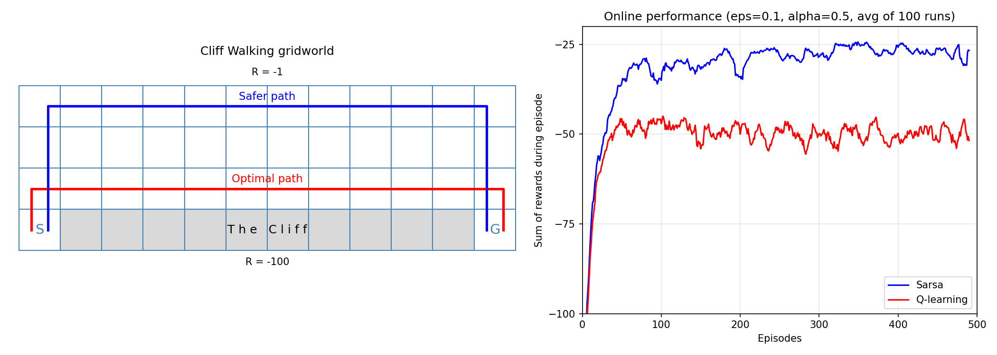
Results: Gridworld and Online Performance
Left: gridworld with the optimal path (red) and safer path (blue). Right: online performance, averaged over 100 runs of 500 episodes (ε = 0.1, α = 0.5).
Reproduces the book’s result: Sarsa earns higher reward during learning than Q-learning.

Slide 9
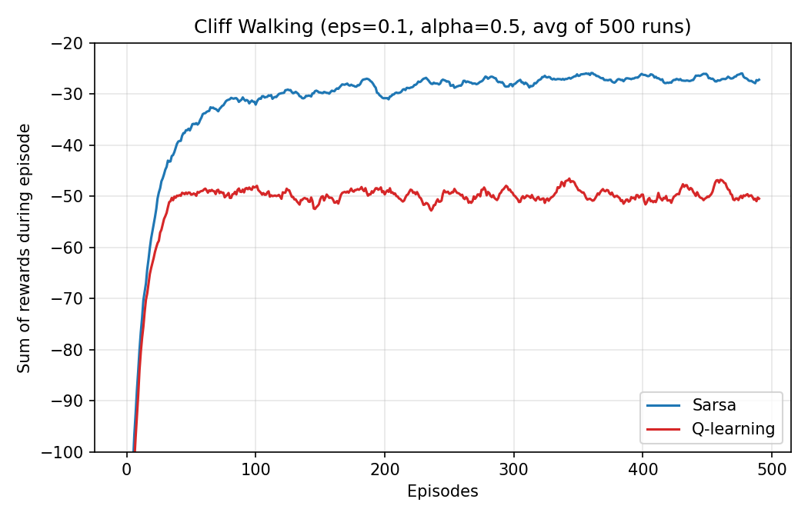
Reward Curves: Sarsa vs Q-learning
≈ −27
Sarsa
≈ −50
Q-learning
Mean reward over the last 100 episodes, averaged over 500 runs. Both curves rise quickly in about 50 episodes, then stay flat; Q-learning stays lower because exploration keeps pushing it off the cliff.

Slide 10
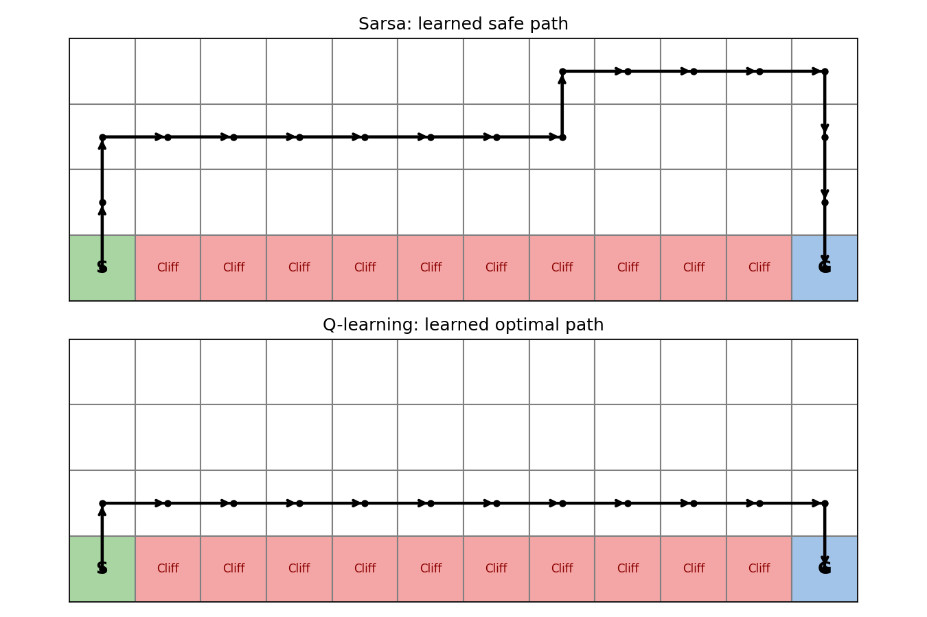
Learned Greedy Paths
Sarsa: safe route
Moves up and away from the cliff, crosses along the upper rows, then descends to G (about 17 steps).
Q-learning: optimal route
Steps up once, runs along the row directly above the cliff, then drops into G (13 steps).
Paths come from one run (seed 1).

Slide 11
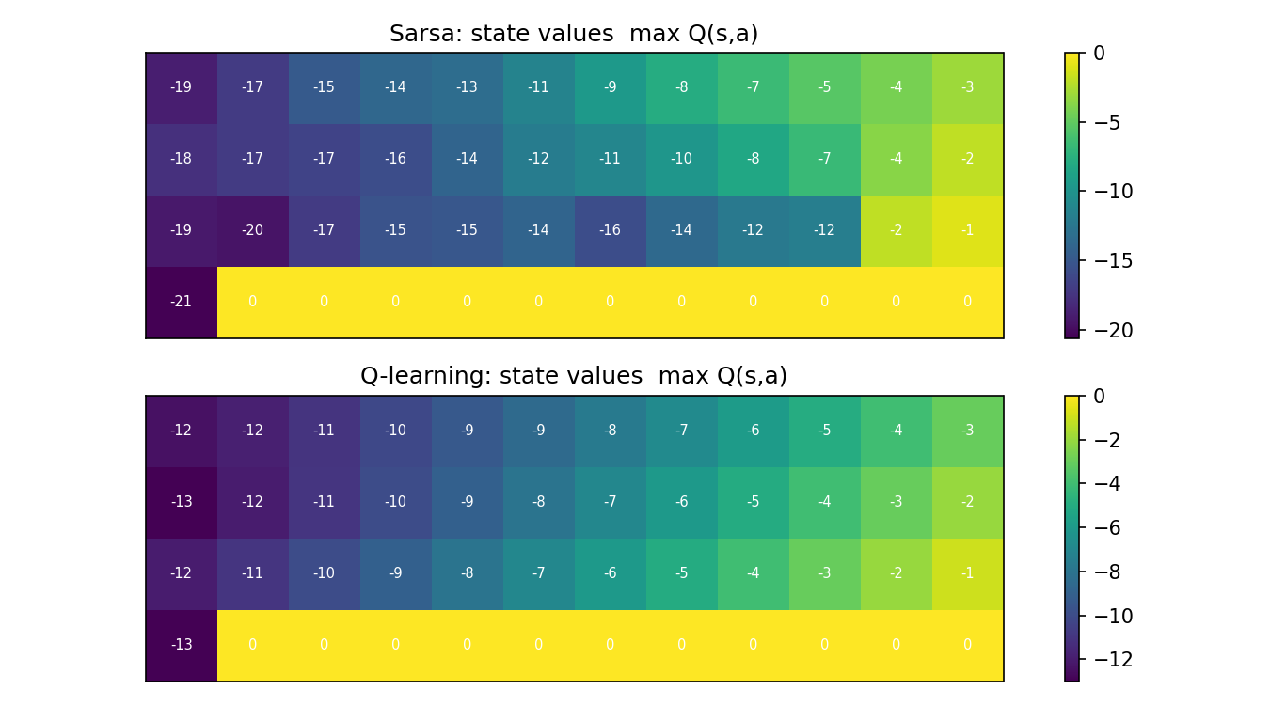
Learned State Values: max Q(s, a)
How to read it
Q-learning values fall steadily from −13 at the start to −1 beside the goal, matching the 13-step optimal path.
Sarsa values are lower along the edge (for example −20 versus −11 in the first cell above the cliff) because it accounts for the risk of falling.
Cliff cells show 0 because they are never learned as states.

Slide 12
Discussion and Conclusion
Q-learning
Sarsa
When to prefer which
Learns the optimal path, but behaves ε-greedily while learning, so it falls off the cliff often. Worse online performance.
Learns the value of the ε-greedy policy it follows, so it avoids the edge. Longer path but better online performance.
Sarsa: mistakes during learning are costly (safety, online learning).
Q-learning: learning in simulation, or the final greedy policy is what matters.
If ε were gradually reduced towards 0, both methods would converge to the optimal policy. The choice of algorithm matters most when exploration is kept constant.

