Slide 1

SmartCourier Delivery Management System
Microservices-Based Courier Booking & Tracking Platform
FINAL YEAR TRAINING PROJECT
JAVA FULL STACK DEVELOPMENT

Slide 2

Agenda
01
02
Training Background
Problem & Objectives
Context & motivation
What we set out to solve
03
04
System Architecture
Technology Stack
Microservices design & flow
Backend, frontend & tools
05
06
Core Features
RabbitMQ Event Flow
Functionality & design patterns
Asynchronous communication
07
08
Results & Outcomes
Challenges & Future Scope
Deliverables & metrics
Lessons learned & roadmap

Slide 3
Training Background & Problem Statement
CONTEXT
THE PROBLEM
Training Setting
Why SmartCourier?
Developed during a structured Java Full Stack training, applying enterprise-grade patterns to a real-world logistics challenge.
Traditional courier systems rely on monolithic architectures — slow to scale, hard to maintain, and unable to handle real-time tracking demands.
Full project lifecycle: design → build → test → deploy
Agile sprints with iterative feedback cycles
Industry-aligned coding standards and reviews
No centralized shipment visibility
Rigid pricing with no dynamic rules
Poor fault isolation in monolithic designs
Synchronous bottlenecks under high load

Slide 4
Project Objectives
Secure Access
Courier Booking
Real-Time Tracking
JWT-based authentication with role-based access for customers and administrators.
End-to-end booking with dynamic pricing using the Strategy Design Pattern.
Live shipment status updates delivered via event-driven RabbitMQ messaging.
Admin Dashboard
Scalable Architecture
Hub management, delivery monitoring, and operational reporting in one view.
Independent microservices, each with its own database, enabling isolated scaling.

Slide 5
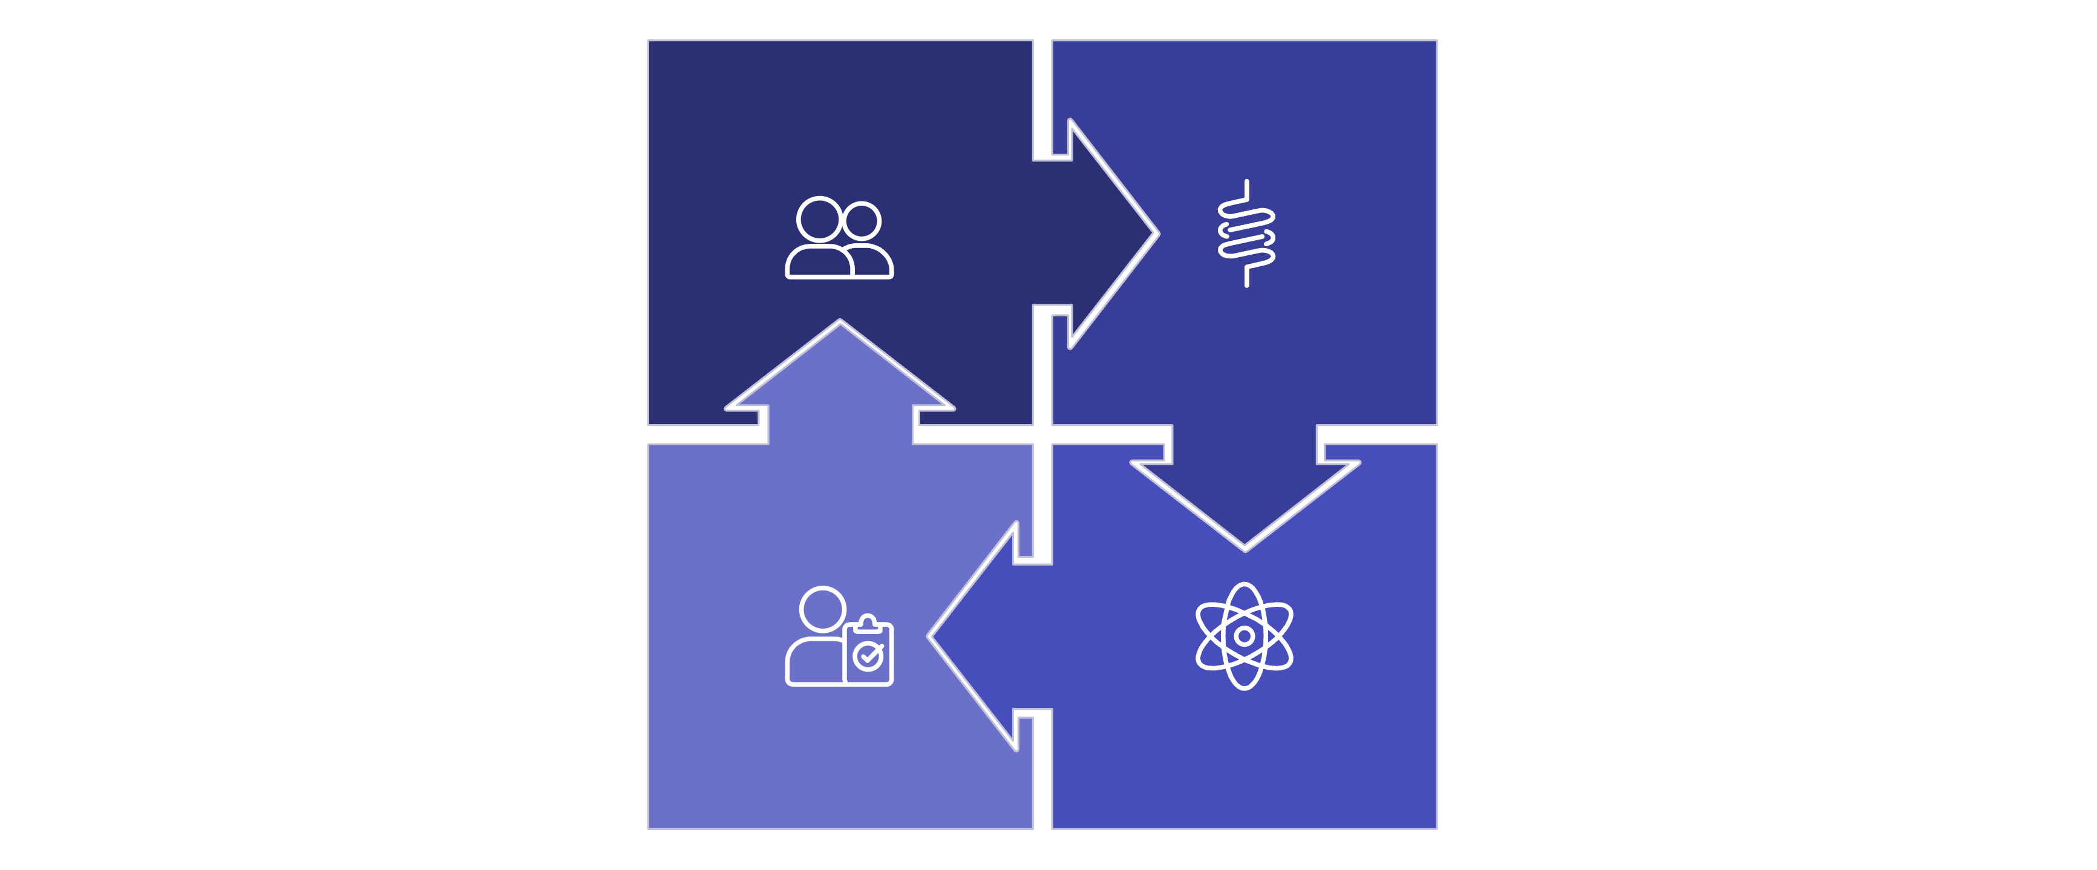
Development Methodology
Requirements
Backend
Testing
Frontend
The project followed an Agile iterative model — each sprint delivered a working increment, enabling continuous integration, early bug detection, and stakeholder-aligned feature prioritization throughout the training.

Slide 6
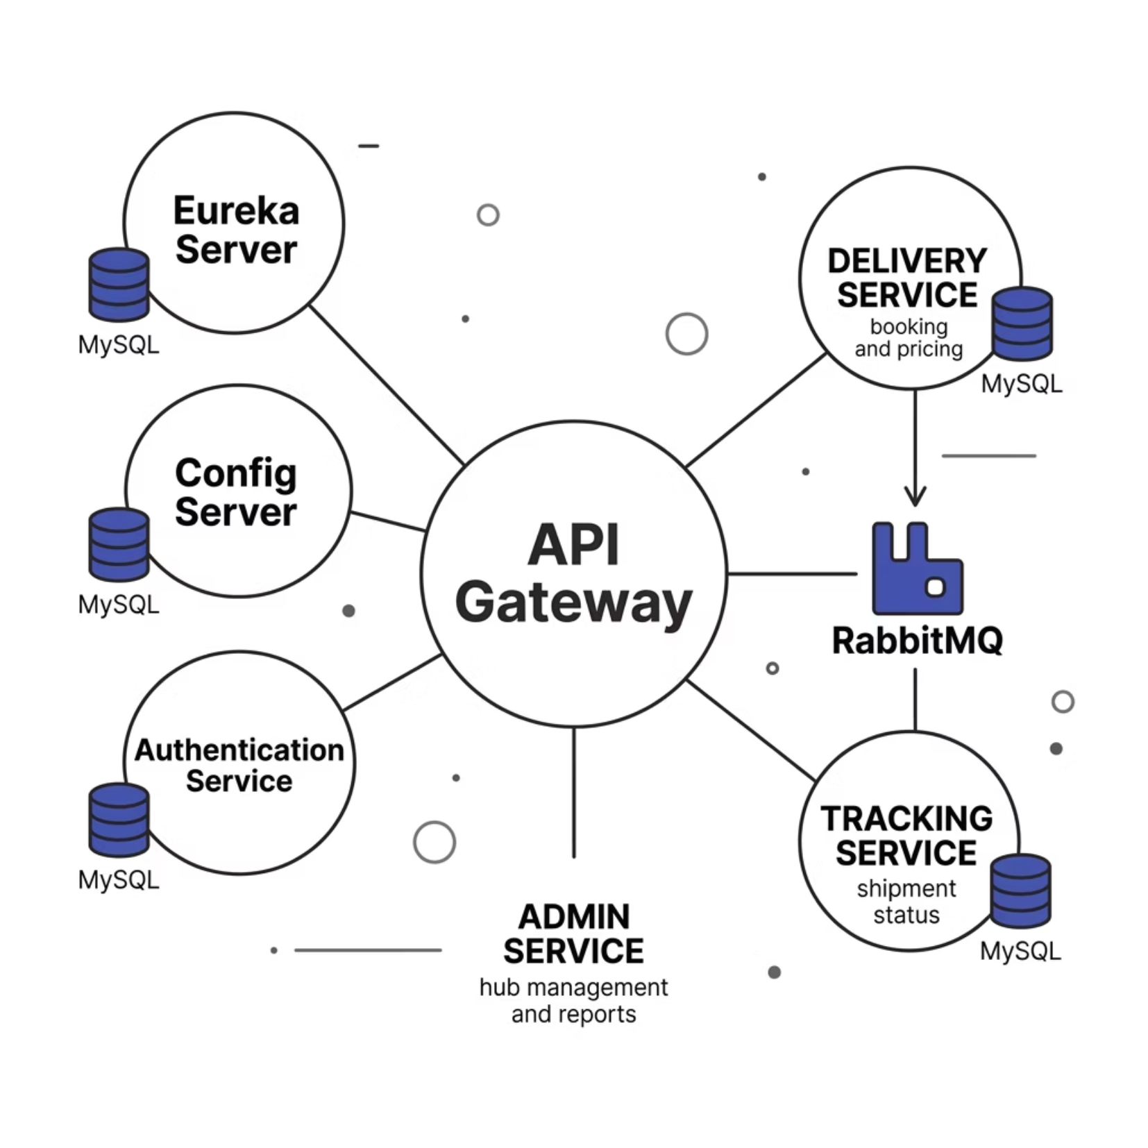
System Architecture
Architectural Principles
API Gateway — Single entry point; routes requests to downstream services
Eureka — Dynamic service discovery and health registration
Config Server — Centralized, version-controlled configuration
OpenFeign — Declarative REST clients for inter-service calls
RabbitMQ — Async messaging decouples Delivery and Tracking
Per-service DB — Full data isolation and independent scaling

Slide 7
Technology Stack
BACKEND
FRONTEND
Java 17 · Spring Ecosystem
React.js · Security · UX
Spring Boot — Service scaffolding & auto-configuration
Spring Cloud Gateway — API routing & filtering
Eureka — Service discovery & registration
Config Server — Externalized configuration management
OpenFeign — Declarative inter-service HTTP clients
RabbitMQ — Asynchronous message broker
MySQL — Relational database per service
JUnit — Unit & integration testing
Zipkin — Distributed tracing & latency monitoring
React.js — Component-based responsive UI
React Router — Client-side navigation & routing
Axios — HTTP client for REST API calls
JWT — Stateless token-based authentication

Slide 8
Implementation: Backend & Frontend
BACKEND
FRONTEND
Spring Boot Microservices
React.js Single-Page Application
RESTful APIs with layered service architecture
Spring Data JPA for MySQL persistence
Strategy Pattern for dynamic courier pricing
RabbitMQ publishers & consumers for async events
OpenFeign clients for synchronous service calls
JUnit test suites with mocked dependencies
Context API for global state & auth token management
Protected routes enforced via JWT expiry checks
Axios interceptors for automatic token injection
Responsive design with modular component structure
Real-time UI updates on RabbitMQ-driven status changes

Slide 9
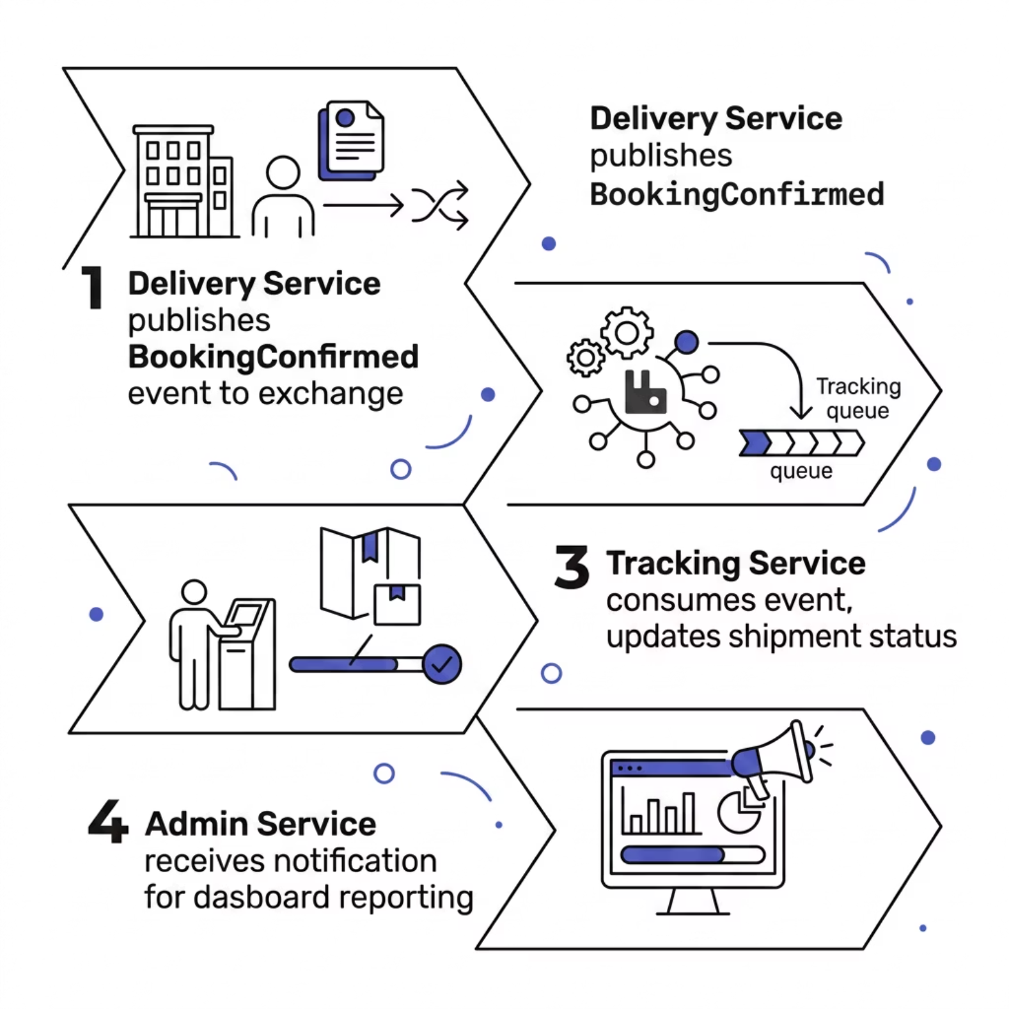
Core Features & RabbitMQ Event Flow
Feature Highlights
User Registration & Login — Secure JWT token issuance on auth
Courier Booking — Dynamic pricing via Strategy Pattern
Shipment Tracking — Real-time status from Tracking Service
Admin Dashboard — Hub management & delivery reports

Slide 10

Results, Challenges & Future Scope
Key Outcomes
Challenges & Solutions
Future Scope
8 independently deployable microservices
Full CRUD operations across all domains
Event-driven status updates via RabbitMQ
Zero-downtime service discovery with Eureka
Service discovery latency → Eureka heartbeat tuning
Distributed tracing gaps → Zipkin integration
JWT expiry handling → Axios refresh interceptors
Real-time GPS tracking with WebSocket streams
ML-based delivery time prediction
Mobile app (React Native) for customers
Kubernetes orchestration for cloud deployment
SmartCourier demonstrates mastery of microservices architecture, event-driven design, and full-stack Java development — a production-grade foundation for modern distributed systems.

