Slide 1
Global Noise Reduction
versus Phonetic Preservation
in Wiener Speech Enhancement
Weitao Shi 550603890
ELEC5305
Does noise reduction preserve all speech sounds equally?
1
Notes:
Hello, I'm Weitao Shi. My project tests a Wiener speech filter. It asks whether reducing noise preserves all speech sounds equally. I compare the overall output with the changes in individual speech sounds.
Sources
https://github.com/SAOTAO117/elec5305-project-550603890/blob/main/readme.md

Slide 2
Experimental setup and processing
Speech | Noise | Test conditions
10 speakers One utterance each 16 kHz mono | Kitchen Cafeteria Traffic | SNR: −5, 0, 5, 10 dB Two noise excerpts 240 mixtures
Mixture
STFT
Wiener gain
Inverse STFT
Enhanced
speech
Phone timing labels
Locate each speech sound for local measurements
Speech: LibriSpeech Segment Noise: DEMAND
2
Notes:
I use ten speakers, three noises, and four SNR levels. Two noise clips per combination give 240 mixtures. The program splits each mixture into short frames. It calculates the spectrum, applies a Wiener gain, and reconstructs the sound. Timing labels locate the speech sounds for measurement.
Sources
https://github.com/SAOTAO117/elec5305-project-550603890/blob/main/main.m
https://github.com/SAOTAO117/elec5305-project-550603890/blob/main/experimentSettings.m

Slide 3
Creating the noisy speech
main.m
scale = sqrt(mean(cleanSpeech(activeSpeech).^2) / ...
(mean(evaluationNoise(activeSpeech).^2)*10^(snrDb/10)));
clean = [zeros(prefixLength,1); cleanSpeech];
addedNoise = scale*noiseSegment;
noisy = clean + addedNoise;
Noise estimate from the 0.5 s noise-only prefix
noisePSD = mean(powerY(:,calibration),2);
Input SNR uses active speech samples
3
Notes:
This code sets the input SNR. It measures power during speech, scales the noise, and adds the signals. This gives a controlled comparison across noise levels.
The first half-second contains noise only. The filter averages its spectral power to estimate noise power. That estimate stays fixed during the recording.
Sources
https://github.com/SAOTAO117/elec5305-project-550603890/blob/main/main.m
https://github.com/SAOTAO117/elec5305-project-550603890/blob/main/wienerFilter.m

Slide 4
Calculating and applying the Wiener gain
wienerFilter.m
1 Estimate speech power
smoothed = c.NoiseSmoothing*smoothed ...
+ (1-c.NoiseSmoothing)*powerY(:,frame);
speechPSD = max(smoothed-noisePSD,0);
2 Calculate the gain
gain(:,frame) = max(c.GainFloor, ...
speechPSD./max(speechPSD+noisePSD,powerFloor));
3 Reconstruct the waveform
result.Enhanced = synthesis(gain.*Y,meta,c);
32 ms window 50% overlap Smoothing 0.8 Minimum gain 0.05
4
Notes:
The code smooths the noisy power across frames. It subtracts the noise estimate and sets negative values to zero. This gives the estimated speech power.
The gain compares speech power with total estimated power. A value near one keeps that frequency. A small value reduces it. I set a minimum gain of 0.05. The code multiplies the spectrum by this gain, then reconstructs the waveform. The window is 32 milliseconds, with 50 percent overlap.
Sources
https://github.com/SAOTAO117/elec5305-project-550603890/blob/main/wienerFilter.m
https://github.com/SAOTAO117/elec5305-project-550603890/blob/main/experimentSettings.m

Slide 5
Measuring speech preservation
Separate speech loss from residual noise
result.Enhanced = synthesis(gain.*Y,meta,c);
result.SpeechComponent = synthesis(gain.*S,meta,c);
result.NoiseComponent = synthesis(gain.*N,meta,c);
Filtered speech
+
Filtered noise
=
Enhanced mixture
Speech retention = 10 log₁₀(filtered speech energy / original speech energy)
Same labelled interval. 0 dB: unchanged energy. Lower: more attenuation.
5
Notes:
A quieter output may also contain weaker speech. I apply the same gain to the known speech and noise separately. Their filtered components add up to the enhanced output. This lets me measure speech loss apart from noise reduction.
For each labelled sound, I compare speech energy before and after filtering. Zero decibels means unchanged energy. More negative values mean greater loss.
Sources
https://github.com/SAOTAO117/elec5305-project-550603890/blob/main/wienerFilter.m
https://github.com/SAOTAO117/elec5305-project-550603890/blob/main/phoneMetrics.m

Slide 6
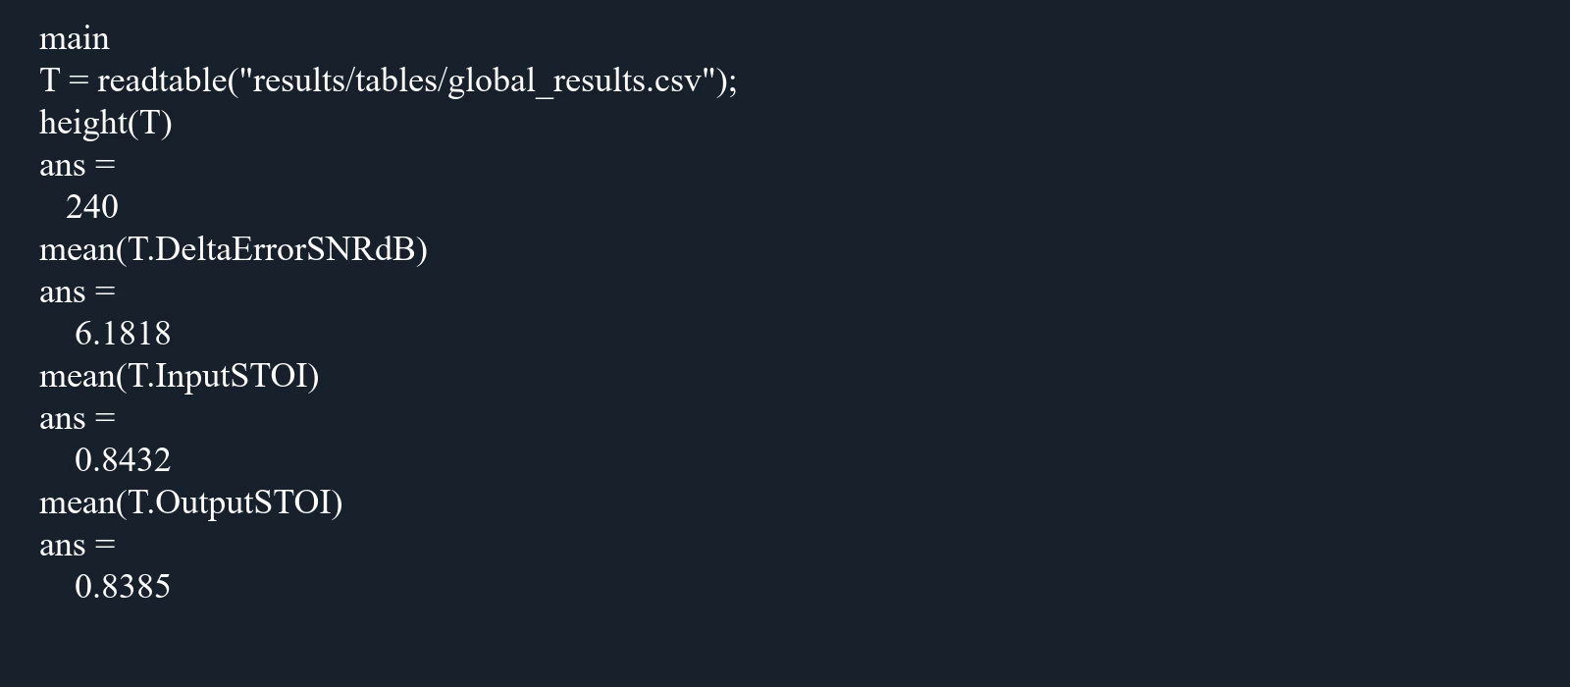
Running the experiment
MATLAB output replay at 4× speed
Play run
Saved to results/tables, results/figures and results/audio
6
Notes:
Running main processes all 240 mixtures. It saves the measurements, figures, and audio examples. This clip shows the MATLAB output.
The table contains 240 rows. The next slides use its results and saved audio.
Sources
https://github.com/SAOTAO117/elec5305-project-550603890/blob/main/main.m
https://github.com/SAOTAO117/elec5305-project-550603890/blob/main/results/tables/global_results.csv

Slide 7
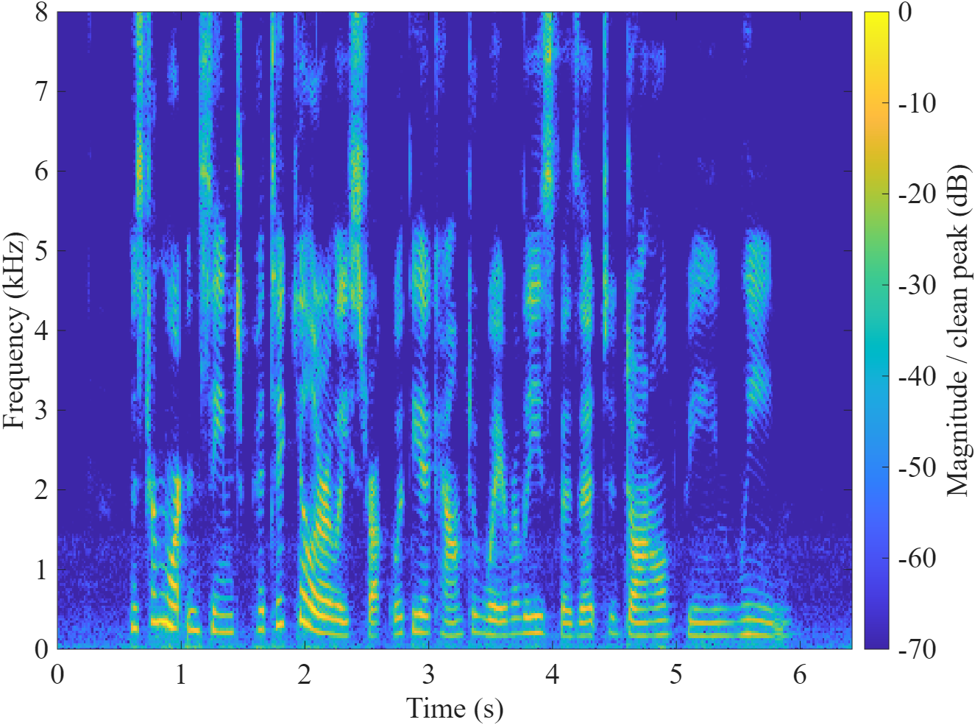

Clean speech
Play clean speech
6.42 seconds
Original recording
Same utterance
Same playback scale
7
Notes:
Here is the original recording. Listen to the voice before noise is added.
Sources
https://github.com/SAOTAO117/elec5305-project-550603890/blob/main/results/audio/example_clean.wav

Slide 8
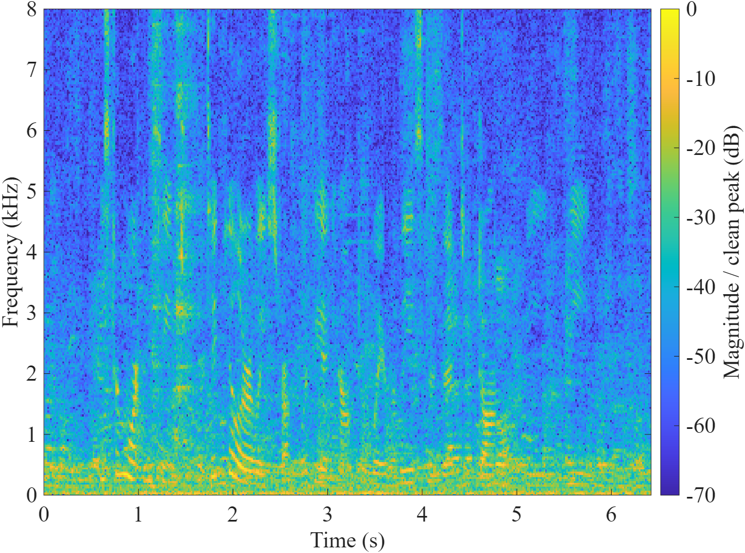
Noisy speech
Play noisy speech
6.42 seconds
Cafeteria noise
0 dB input SNR
Same utterance
Same playback scale
8
Notes:
This is the same recording with cafeteria noise at zero decibels SNR. The noise fills the gaps between speech sounds.
Sources
https://github.com/SAOTAO117/elec5305-project-550603890/blob/main/results/audio/example_noisy.wav

Slide 9
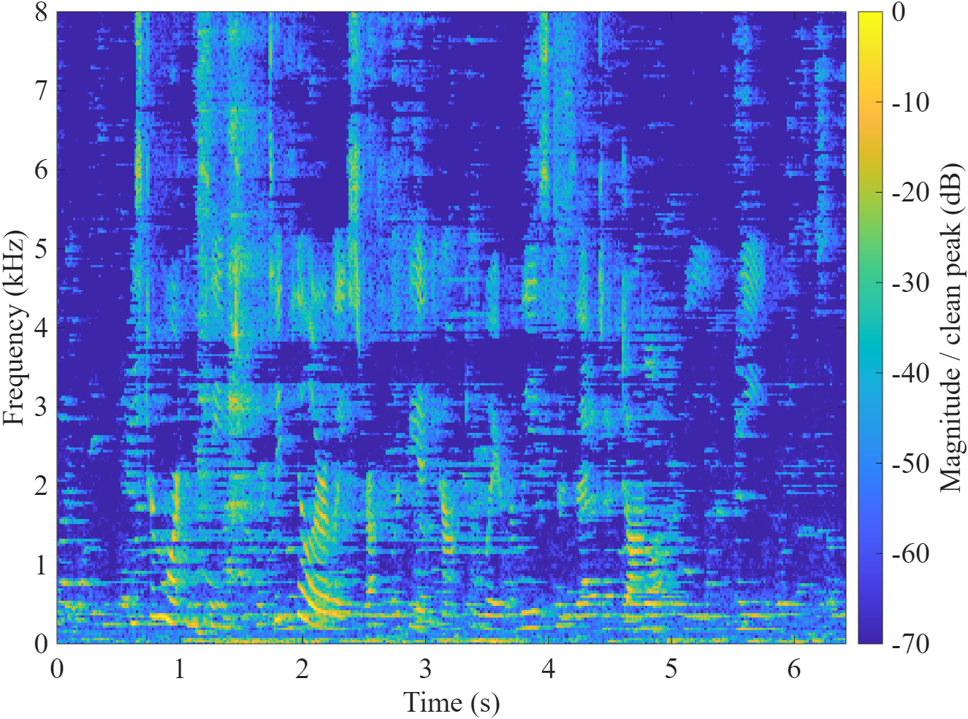
Enhanced speech
Play enhanced speech
6.42 seconds
Cafeteria noise
0 dB input SNR
Same utterance
Same playback scale
9
Notes:
Now listen to the filtered output.
There is less energy between speech sounds. Some noise remains. To see what happens to the voice itself, I examine two labelled sounds next.
Sources
https://github.com/SAOTAO117/elec5305-project-550603890/blob/main/results/audio/example_enhanced.wav
https://github.com/SAOTAO117/elec5305-project-550603890/blob/main/plotExample.m

Slide 10
Two sounds in the same recording
Cafeteria noise, 0 dB input SNR
Vowel IY 5.09–5.33 s
Fricative S 1.16–1.25 s
Speech retention: -5.27 dB
Speech retention: -0.33 dB
Energy-weighted gain: 0.50
Energy-weighted gain: 0.91
Each spectrum uses the original speech peak in that interval as its reference.
10
Notes:
These plots compare the speech component before and after filtering. The vowel loses 5.27 decibels of energy. The S sound loses only 0.33. Here, the vowel is weakened more.
The gain is smaller where this vowel carries its energy. The S sound keeps much of its strong high-frequency energy. Individual sounds can differ from the class average.
Sources
https://github.com/SAOTAO117/elec5305-project-550603890/blob/main/wienerFilter.m
https://github.com/SAOTAO117/elec5305-project-550603890/blob/main/phoneMetrics.m
https://github.com/SAOTAO117/elec5305-project-550603890/blob/main/results/tables/phone_results.csv

Slide 11
Noise type and input SNR
Global error-SNR improvement
STOI at 0 dB input SNR
Noise | Input | Output
Kitchen | 0.943 | 0.945
Cafeteria | 0.701 | 0.682
Traffic | 0.804 | 0.804
Higher STOI indicates greater
predicted intelligibility.
All conditions: mean error-SNR improvement +6.18 dB
Means across 10 speakers after averaging the two noise excerpts.
11
Notes:
Across all tests, error SNR improves by 6.18 decibels on average. The result varies with noise. For cafeteria noise, the improvement falls from 5.29 to 3.51 as input SNR rises. The fixed noise estimate cannot track later changes in noise power.
STOI predicts how easy speech is to understand. At zero decibels, the cafeteria score falls after filtering. Lower signal error does not guarantee a higher STOI score.
Sources
https://github.com/SAOTAO117/elec5305-project-550603890/blob/main/results/tables/global_summary.csv
https://github.com/SAOTAO117/elec5305-project-550603890/blob/main/phoneMetrics.m

Slide 12
Speech preservation across classes
All noises and SNR levels
Cafeteria noise
Mean ± SD across 10 speakers
Class colours match the bar chart
Noise attenuation averages 8.7–9.0 dB across the four classes.
12
Notes:
The class averages show a different pattern from that single example. Vowels lose 1.24 decibels. Fricatives and stops or affricates lose about 2.5. Noise drops by roughly nine decibels in every class.
The cafeteria results also show more speech loss at lower input SNR. The filter reduces noise, but preserves different speech groups by different amounts.
Sources
https://github.com/SAOTAO117/elec5305-project-550603890/blob/main/results/tables/pooled_class_summary.csv
https://github.com/SAOTAO117/elec5305-project-550603890/blob/main/results/tables/class_summary.csv

Slide 13
Window length comparison
Same 240 mixtures, shorter analysis window
Metric | 32 ms | 16 ms
Error-SNR improvement (dB) | 6.18 | 6.24
STOI | 0.8385 | 0.8292
Whole-utterance speech retention (dB) | -0.66 | -0.92
The shorter window increased speech energy loss.
Same overlap ratio and smoothing time constant. FFT length: 512.
13
Notes:
I tested a shorter window to reduce mixing across sound boundaries. I used the same mixtures. Average error SNR improves slightly, from 6.18 to 6.24 decibels. But STOI falls further, and speech energy loss increases. This change did not improve speech preservation.
Sources
https://github.com/SAOTAO117/elec5305-project-550603890/blob/main/compareWindows.m
https://github.com/SAOTAO117/elec5305-project-550603890/blob/main/results/window_comparison/window_comparison.csv

Slide 14
Conclusion
Noise reduction does not preserve all speech sounds equally.
Fricatives and stops / affricates lose more energy on average.
Noise condition and local spectrum affect the result.
Ten short recordings. No listening test.
Project site
Code, data and results
14
Notes:
The Wiener filter reduced noise in these tests. Speech preservation depended on the sound and noise condition. Fricatives and stops or affricates lost more energy on average. Measuring both components exposed losses hidden by the overall SNR score.
These results cover ten short recordings. A listening test would show how well people understand the output. The code and results are on the project site. Thank you.
Sources
https://github.com/SAOTAO117/elec5305-project-550603890/blob/main/results/tables/pooled_class_summary.csv
https://github.com/SAOTAO117/elec5305-project-550603890/blob/main/results/tables/global_summary.csv

