Slide 1
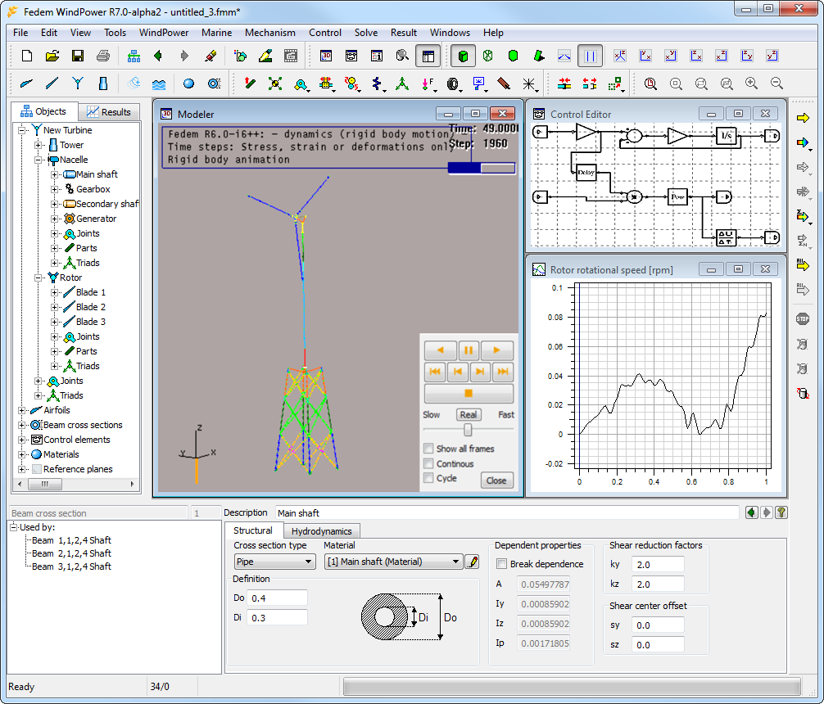
Control
System
Editor
Graphics
Modeler
Model
Manager
Graph
Views
ID and
Topology
Property
Editor

