Slide 1
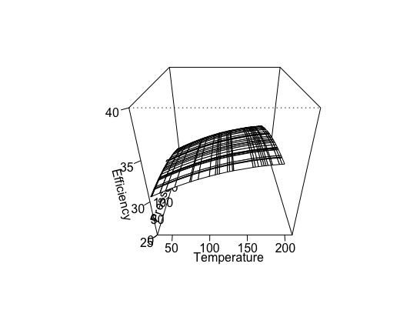
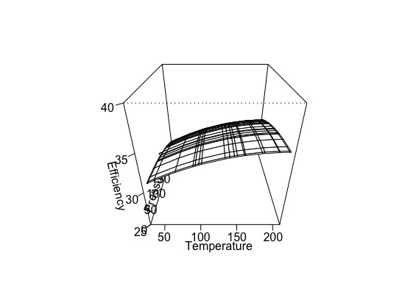
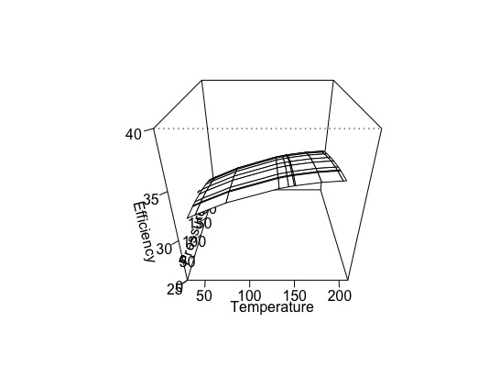
Boiler Efficiency R Model Built at Cloud
Derived from Temperature and Pressure sensor data from Boiler
As more data are fed, the model gets trained
Once model is ready, deploy the model to Edge Services running at the gateway from Policy Service
Output from the model are fed to rule engine at the edge
A rule can create workorder if the efficiency is below the prescribed threshold

