Slide 1
Where are you located?
What’s you local time?
How many sessions did you attend at this TechEd so far?
Did you work with SAP HANA Spatial or Graph or both before?

Slide 2


DAT260 Multi-model Data Processing with SAP HANA Cloud
Mathias Kemeter, SAP SE Markus Fath, SAP SE

Slide 3
Agenda 8:50 AM - 10:50 AM CET
Prerequisites and Introduction (20 min)
Workshop demo scenario
SAP HANA Cloud Trial
DAT260 course content on github.com
Data import
DBeaver
Exercises 1-3 (spatial focus, 20 min)
Exercises 4-5 (spatial focus, 20 min)
Exercises 6-7 (graph focus, 20 min)
Exercises 8-9 (graph focus, 20 min)
Summary and wrap up

Slide 4
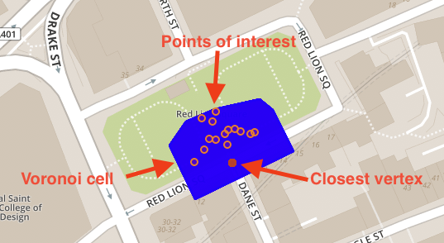
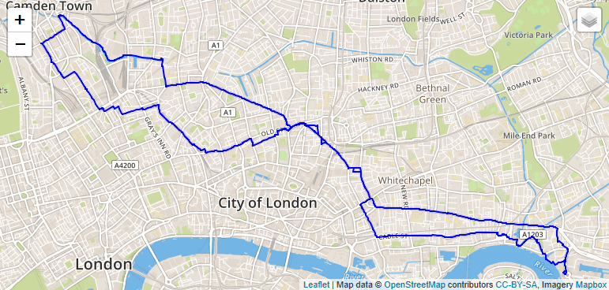
Prerequisites and Introduction Demo Scenario and data
Demo data
London points-of-interest (POI)
London street network
Road segments and junctions
London tube
Tube lines and stations
Sample tasks
Basic spatial functions
Spatial analysis of street network
Finding paths on the street network

Slide 5
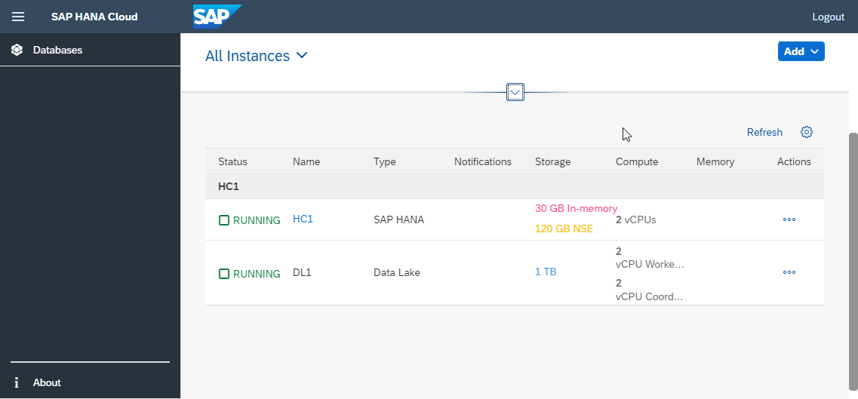
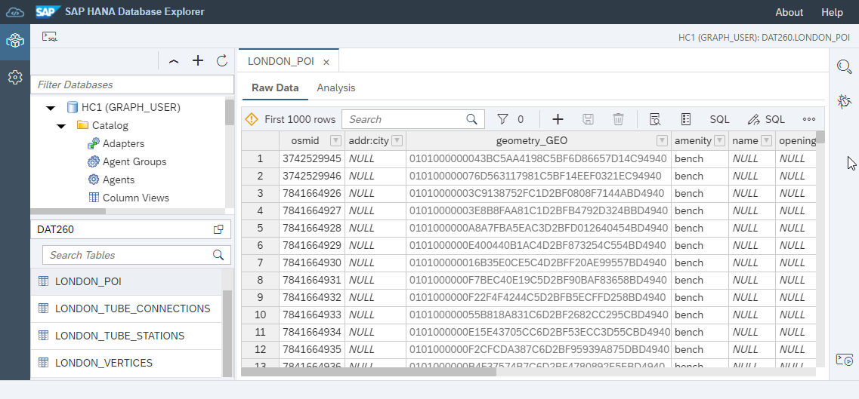
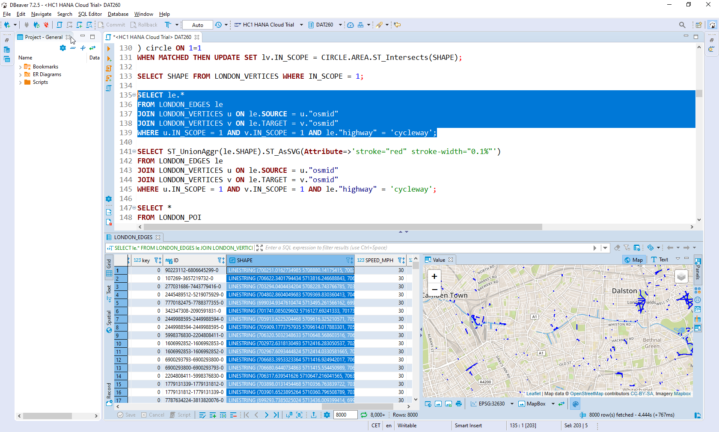
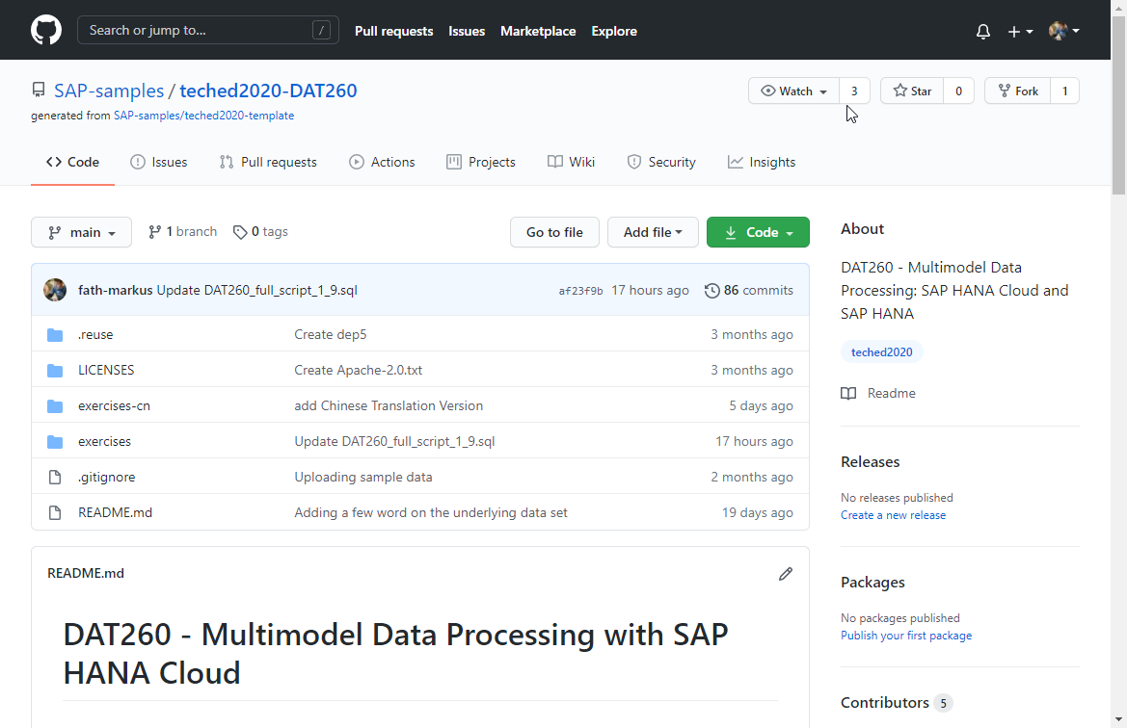
Prerequisites and Introduction
Your SAP HANA Cloud Trial system is up and running
Access github.com
https://github.com/SAP-samples/teched2020-DAT260
Download workshop data set from exercises/data/
Launch SAP HANA Database Explorer
Import the data
Alternative: DBeaver (open source database manager)
Installation
Spatial visualizations

Slide 6
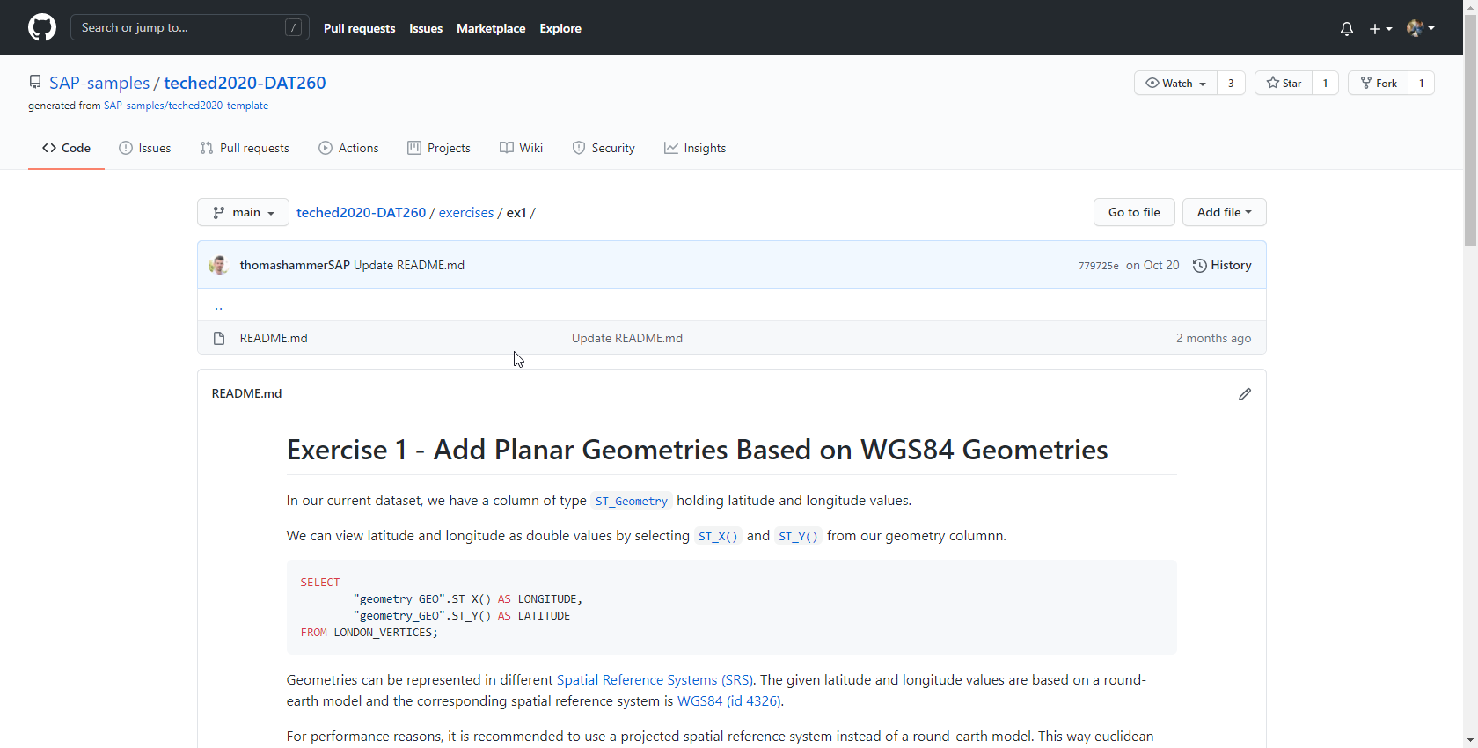
Workshop
Work on the exercises sequentially
Read
Copy a execute SQL statements
In SAP HANA Database Explorer (F8 and F9)
In DBeaver (Ctrl + Enter and Alt + X)
Review results returned by SQL statements
Questions
Via chat
Discussions will run in breakout rooms

Slide 7

Our Session Schedule for Spatial Enthusiasts. Don‘t miss it!
PT102 Elevating the Power of Spatial Data
Enterprise Spatial Intelligence
by Tom Turchioe & Bill Gough
DAT108 Translytical Data Processing with SAP HANA Cloud
by Witalij Rudnicki
DAT201 Embedded Location Analytics and the Power of Geospatial Data with Partners
by Thomas Hammer & Mathias Kemeter
DAT202 Performing Data Science with SAP HANA Cloud
December 8th-10th, 2020
by Christoph Morgen
Sign Up Now
DAT260 Multi-model Data Processing with SAP HANA Cloud
by Markus Fath & Mathias Kemeter
#SAPTechEd
Notes:
Andreas

Slide 8


Contact information:
Mathias Kemeter
Head of SAP HANA Spatial, SAP SE
mathias.kemeter@sap.com
Markus Fath
Head of SAP HANA Graph, SAP SE
markus.fath@sap.com

