Slide 1
Workshop: Classify Business Documents and Extract Information
INT166
Dr. Manuel Berning, SAP
Piyush Dane, SAP
Alexander Bolshakov, SAP
Notes:
Hello everyone, I am happy to greet you here at the online SAP TechED 2020 business documents processing workshop. I would like to thank you for your interest in this topic and the time that you took to participate in this workshop. Before we get going I would like to present ourselves.
Present ourselves

Slide 2
Disclaimer
The information in this presentation is confidential and proprietary to SAP and may not be disclosed without the permission of SAP. Except for your obligation to protect confidential information, this presentation is not subject to your license agreement or any other service or subscription agreement with SAP. SAP has no obligation to pursue any course of business outlined in this presentation or any related document, or to develop or release any functionality mentioned therein.
This presentation, or any related document and SAP's strategy and possible future developments, products and or platforms directions and functionality are all subject to change and may be changed by SAP at any time for any reason without notice. The information in this presentation is not a commitment, promise or legal obligation to deliver any material, code or functionality. This presentation is provided without a warranty of any kind, either express or implied, including but not limited to, the implied warranties of merchantability, fitness for a particular purpose, or non-infringement. This presentation is for informational purposes and may not be incorporated into a contract. SAP assumes no responsibility for errors or omissions in this presentation, except if such damages were caused by SAP’s intentional or gross negligence.
All forward-looking statements are subject to various risks and uncertainties that could cause actual results to differ materially from expectations. Readers are cautioned not to place undue reliance on these forward-looking statements, which speak only as of their dates, and they should not be relied upon in making purchasing decisions.

Slide 3
Workshop flow
Introduction to SAP Business Documents Processing
Get a SAP Cloud Platform Trial account
Use Document Classification service on sample data and analyze the results
Use Document Information Extraction and its UI to extract information for documents, validate the extraction correctness and configure the enrichment of the extracted information
Questions
Notes:
First of all I am going to give you a short introduction to SAP Business Document Processing services and briefly explain what can be done with SAP DC and SAP DOX services
Than we will together create a SAP CP Trial account and set-up DC service instance to be able to use this service
After we have the DC service at hand Manuel will show you how DC service can be used to classify business documents and how the classification results can be analyzed
After we have successfully classified the documents with DC service, we will proceed and Piyush show you how to use DOX service via its UI and REST API to extract information and validate the extraction results
Piyush will also demonstrate how SAP DOX supplier data matching feature can help you automate processing of your business documents even further
Please ask questions and provide your feedback during the whole session in the chat, please also unmute yourselves and ask questions in case you are blocked
We would like to ask toy to provide your feedback after the session

Slide 4







SAP AI Business Services Business Document Processing
Business documents
Business Document Processing
Instant value
550B
Automation
Increase efficiency and enable teams to focus on strategic tasks
Estimated invoice document volume in 2019
100B
Classify
Extract
Enrich
Estimated delivery note volume in 2018
Accuracy
Achieve more accurate results than classical systems
Document classification
Information extraction
Master data matching
11B
Paper receipts printed in the UK alone per year
Classify incoming documents
Extract semantical information from documents
Enrich extracted information by matching it to your business data
124B
Speed
Process incoming documents faster and improve customer service
Business e-mails received and sent per day
Transform unstructured documents to structured information with machine learning-based document processing and embed the information into your business processes for instant value.
60%
Sales orders come in through unstructured documents
Cost
Reduce business document processing costs and leverage advantages in follow-up processes
Notes:
BDP provides you with means to automate the documents processing and reduce costs, in this workshop we will deep dive into the classification, information extraction and information enrichment use-cases and demonstrate how exactly this can be done and guide you through this process.

Slide 5






SAP Business Document Processing portfolio
Business document processing provides strategic machine-learning capabilities that automate and optimize processing of business documents. They are provided as reusable services on SAP Cloud Platform.
Business Entity Recognition – Not presented in this workshop
Document Information Extraction
Document Classification
Classifies documents into customer-specific categories
Locates and classifies business entities in unstructured text documents – meaning documents that do not have any set structure such as e-mails, letters, or chats
Extracts structured information from business documents such as invoices or purchase orders, and enriches the extracted information by matching it to uploaded master data
Notes:
BDP consists from multiple services, we will focus on Document Classification and Document Information Extraction in this workshop

Slide 6








Document Classification: manual processing
Date | Document Title | Type
01.02.2001 | Inv. 42146
21.05.2001 | Reminder: payment from …
01.02.2004 | Dunning no. 2
11.07.2008 | Problem
23.02.2008 | This product does not…
01.02.2009 | Please pay your invoice …
01.04.2009 | Wrong article
31.05.2009 | Invoice 42318
20.03.2010 | Missing MD
12.04.2010 | How does this work?
05.02.2011 | Order confirmation
03.01.2014 | Product request
06.08.2014 | Invoice 08272
09.03.2015 | Dunning number 1
19.03.2016 | Help please
16.09.2016 | Reminder: invoice not payed
07.08.2018 | Object broke
Invoice
Dunning letter
Dunning letter
Complaint
Open every file & read to classify
Complaint
Bob, spends much time on classifying documents
Bob, Customer Service
Notes:
Let me briefly explain how Document Classification and Document Information Extraction services can be useful. Bob that works at customer service needs to process a lot of incoming documents, every document type requires different processing steps. First action that Bob needs to do with each and every incoming document in order to start processing it is to open it, look at its contents and determine its type. This consumes a lot of time, considering the amount of documents that he needs to process.

Slide 7



Document Classification: automatic processing
Date | Document Title | Type
01.02.2001 | Inv. 42146
21.05.2001 | Reminder: payment from …
01.02.2004 | Dunning no. 2
11.07.2008 | Problem
23.02.2008 | This product does not…
01.02.2009 | Please pay your invoice …
01.04.2009 | Wrong article
31.05.2009 | Invoice 42318
20.03.2010 | Missing MD
12.04.2010 | How does this work?
05.02.2011 | Order confirmation
03.01.2014 | Product-Request
06.08.2014 | Invoice 08272
09.03.2015 | Dunning number 1
19.03.2016 | Help please
16.09.2016 | Reminder: invoice not payed
07.08.2018 | Object broke
Invoice
Dunning letter
Dunning letter
Complaint
Complaint
Dunning letter
Complaint
Invoice
Request
Request
From chaos to order in short time & higher accuracy
Confirmation
Bob, Can now do more value creating tasks
Request
Invoice
Dunning letter
Request
Bob, Customer Service
Dunning Letter
Complaint
Notes:
After integration of Document Classification service, Bob knows the document type in advance and can start processing every document directly. Now Bob only needs to process the documents that are relevant for him and other documents are automatically forwarded to other employees. This saves Bob a lot of time and increases his productivity.

Slide 8
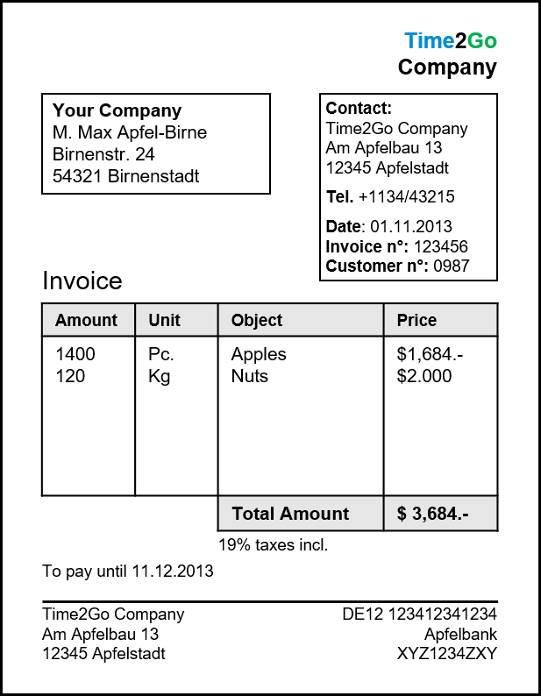
Document Information Extraction
Company | Time2Go Company
Supplier ID | 009753
Invoice N° | 123456
Amount | 3684.00
Currency | USD
Date | 2013-11-01
Position 1 | Amount: 1400 Unit: PC Amount: 1684.00 Description: Apples
Position 2 | Amount: 120 Unit: KG Amount: 2000.00 Description: Nuts
Enrichment happens automatically
John, Can now do more value creative tasks
John, AP-Clerk
Notes:
Normally when Bob receives an invoice he would forward it to John for further manual processing, but company can go even further by applying Document Information Extraction service to extract information out of classified documents and route it directly to the appropriate system or for manual processing. Automatically extracted information can be associated (enriched) with corresponding info from ERP, SRM or CRM systems, for example the supplier or employee IDs, to ease the further processing. With such automation much faster data processing is possible and John can spend more time on value-adding tasks and the error-rate is reduced.
Now let’s proceed to the hands on part of our workshop. We will start with SAP CP trial account creation.

Slide 9
Workshop flow
Introduction to SAP Bussines Documents Processing
Get a SAP Cloud Platform trial account
Document Classification
Get access to the Document Classification service
Installation and invocation of the client library
Inference with a pretrained model
Performance metrics of a classification model
Use confidence values to sort out documents from "Other" category
Document Information Extraction
Setup Document Information Extraction service and UI
Upload a document for extraction using UI application
Visualize, correct extraction results and confirm document using UI application
Get an authentication token to use Document Information Extraction REST API
Get extraction results of document using Rest API
Upload supplier data for matching
Upload document through Rest API to enrich the extraction results with supplier data
Questions
Notes:
We will provide you with a short introduction to SAP Business Document Processing services and briefly explain what can be done with SAP DC and SAP DOX services
Thank we will guide you through the process of creating a SAP CP Trial account and set-up DC service instance to be able to use these services
We will show you how DC service can be used to classify business documents and how the classification results can be analyzed
We will show you how DOX service and its UI and REST API can be used for information extraction and validation of the results
We will demonstrate how SAP DOX supplier data matching feature can help you automate processing of your business documents even further
Please use EU trial landscape:
Please use the following link to get to SAP CP Trial account creation page:
https://www.sap.com/cmp/td/sap-cloud-platform-trial.html
https://cockpit.eu10.hana.ondemand.com/trial/#/home/trial
https://developers.sap.com/tutorials/hcp-create-trial-account.html
https://github.com/SAP-samples/teched2020-INT166

