Slide 1
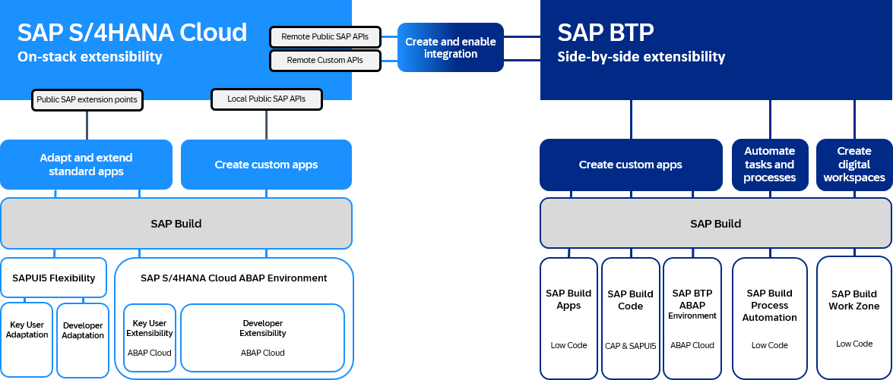
SAP S/4HANA Extensibility Overview (ORIGINAL)
Reference: Extension Architecture Guide

Slide 2
SAP S/4HANA Extensibility Overview (FLIPPED)
SAP BTP
Side-by-side extensibility
SAP S/4HANA
On-stack extensibility
Create and enable Integration
Remote Public SAP APIs
Remote Custom APIs
Public SAP extension points
Local Public SAP APIs
Create custom apps
Automate tasks and processes
Create digital workspaces
Adapt and extend standard apps
Create custom apps
SAP Build
SAP Build
SAP Build Apps
SAP Build Code
SAP BTP ABAP Environment
SAP Build
Process Automation
SAP Build
Work Zone
SAPUI5 Flexibility
SAP S/4HANA Cloud ABAP Environment
Key User Adaptation
Developer Adaptation
Key User Extensibility
ABAP Cloud
Developer
Extensibility ABAP Cloud
Low Code
CAP & SAPUI5
ABAP Cloud
Low Code
Low Code

