Slide 1
EasyFranchise diagrams
Identity Management Mission

Slide 2







SAP
S/4HANA
Cloud
SAP BTP – Partner Global Account
Customer Landscapes
Partner Subaccount (Provider)
SAP HANA Cloud
Namespace: frontend
Easy Franchise DB
User Interface Service
5
Partner Schema
Customer Schemas
Namespace: integration
AppRouter
4
Database
Service
1
2
Mentor Coordinator
(City Scooter)
JWT
3
9
10
Business Partner
Service
6
Authorization and Trust Management
(XSUAA)
8
Customer Subaccounts (Subscribers)
Broker
Email
Service
S/4HANA Cloud
Destination Configuration
Tenant Id
Namespace: backend
7
End User Assignment
Easy Franchise Service
Scheduler

Slide 3
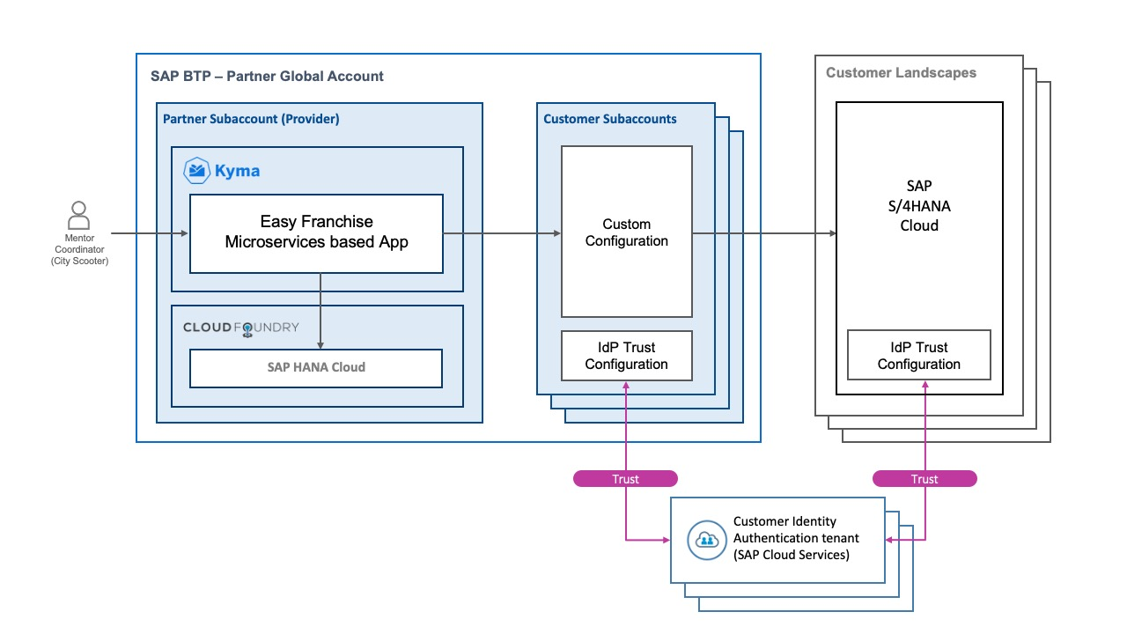
SAP HANA Cloud
Easy Franchise DB

Slide 4
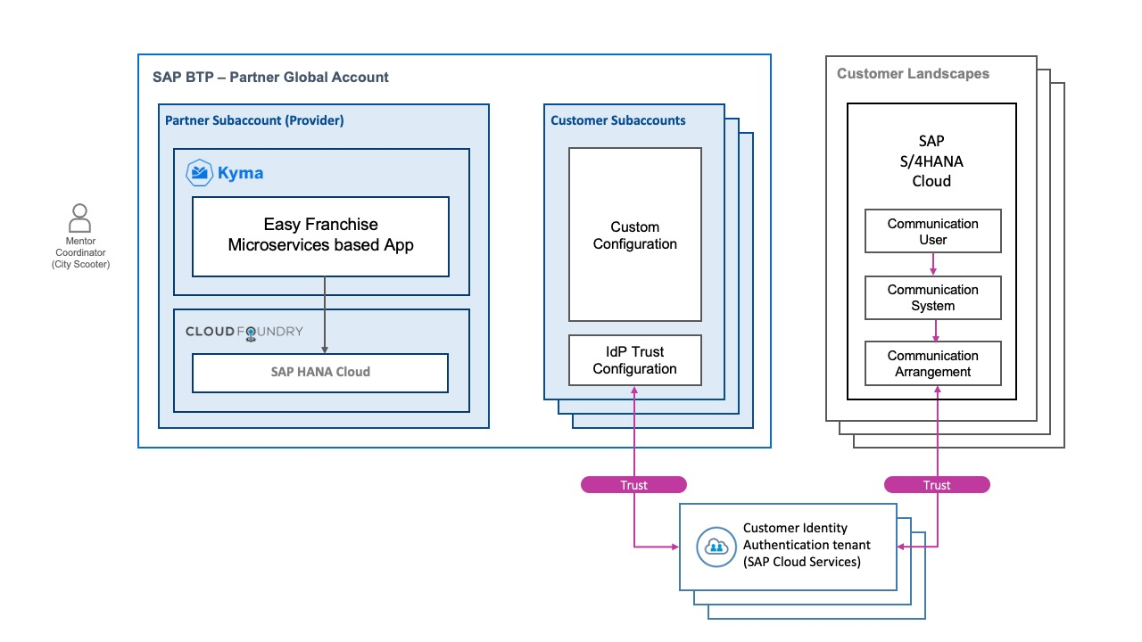
SAP HANA Cloud
Easy Franchise DB

Slide 5
SAP HANA Cloud
Easy Franchise DB
Trust
Trust
Corporate identity Provider
(Microsoft Azure Active Directory)
Corporate identity Provider
(Microsoft Azure Active Directory)
Corporate identity Provider
(Microsoft Azure Active Directory)
Trust

Slide 6
SAP HANA Cloud
Easy Franchise DB
Trust
Trust
Corporate identity Provider
(Microsoft Azure Active Directory)
Corporate identity Provider
(Microsoft Azure Active Directory)
Corporate identity Provider
(Microsoft Azure Active Directory)
Trust

