Slide 1
EasyFranchise diagrams
Identity Management Mission

Slide 2








SAP
S/4HANA
Cloud
SAP BTP – Partner Global Account
Customer Landscapes
Partner Subaccount (Provider)
Namespace: frontend
SAP HANA Cloud
User Interface Service
5
Partner Schema
Customer Schemas
Namespace: integration
AppRouter
4
Database
Service
1
2
Mentor Coordinator
(City Scooter)
JWT
3
9
10
Business Partner
Service
6
Authorization and Trust Management
(XSUAA)
8
Customer Subaccounts (Subscribers)
Broker
Email
Service
S/4HANA Cloud
Destination Configuration
Tenant Id
Namespace: backend
7
End User Assignment
Easy Franchise Service
Scheduler

Slide 3
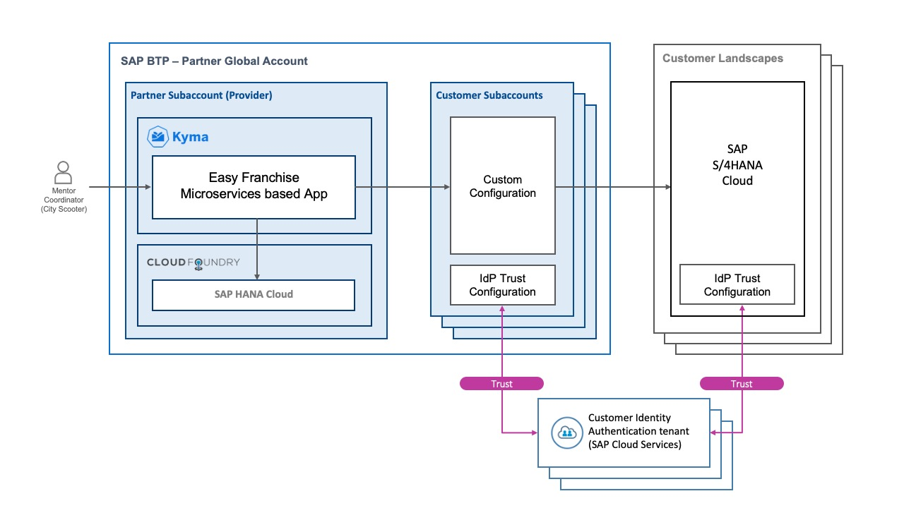

Slide 4
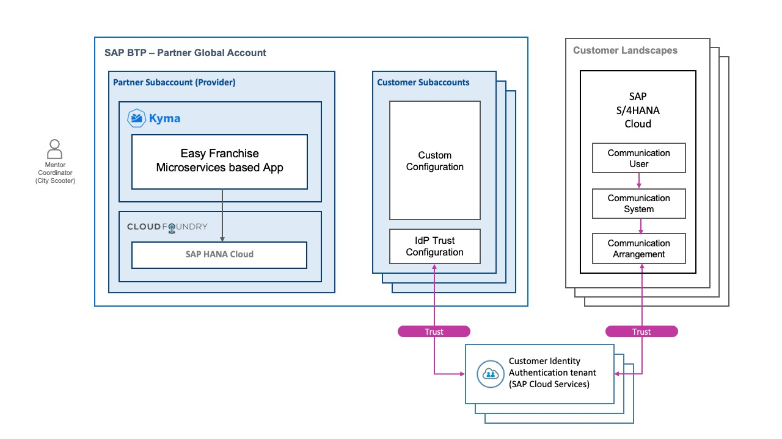

Slide 5
Trust
Trust
Corporate identity Provider
(Microsoft Azure Active Directory)
Corporate identity Provider
(Microsoft Azure Active Directory)
Corporate identity Provider
(Microsoft Azure Active Directory)
Trust

Slide 6
Trust
Trust
Corporate identity Provider
(Microsoft Azure Active Directory)
Corporate identity Provider
(Microsoft Azure Active Directory)
Corporate identity Provider
(Microsoft Azure Active Directory)
Trust

