Slide 1

SAP Commerce Cloud Extensibility powered by SAP Kyma runtime
Assem Hussein, Principal Software Architect
Deni Daja, Software Engineer

Slide 2
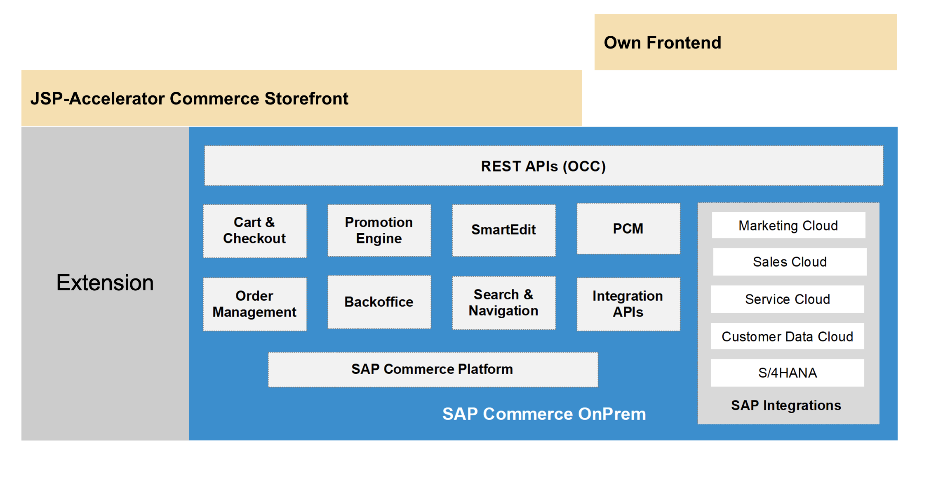
SAP Commerce Cloud - Yesterday

Slide 3
SAP Commerce Cloud - Today
25 years of continious innovation
Broad customer adoption
Rich community and ecosystems
Feature-rich platform to support B2C and B2B businesses
In-App extensibility fashion, or in other words, vertical extensbility

Slide 4
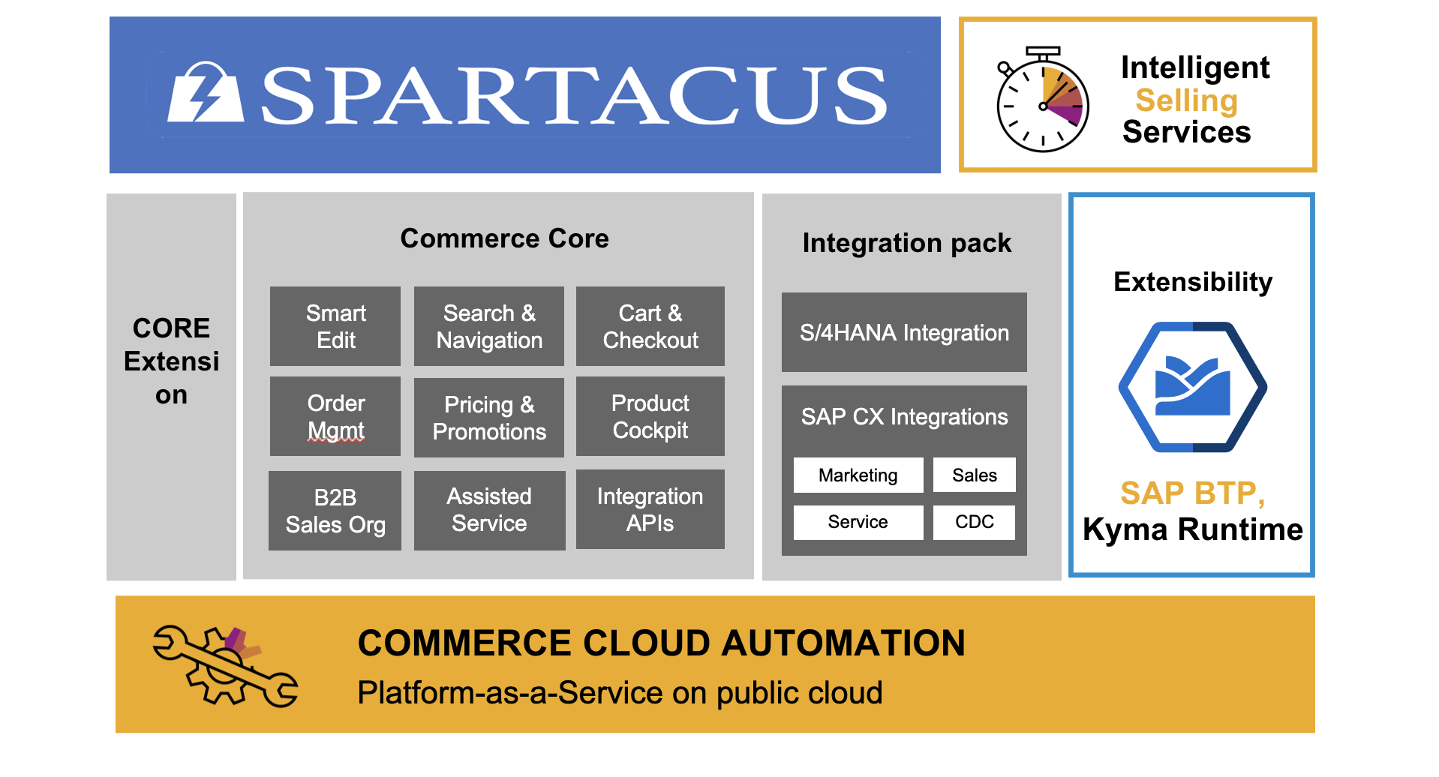
SAP Commerce Cloud – Today

Slide 5
SAP Commerce Cloud - Today
More of side-by-side extensibility than vertical extensibility
Headless, API first and event driven
Support for custom events to handle sophisticated use cases
Secure and robust integration with Kyma runtime
More than 150 events are automatically sent to chosen targets for processing and augmented business logic

Slide 6
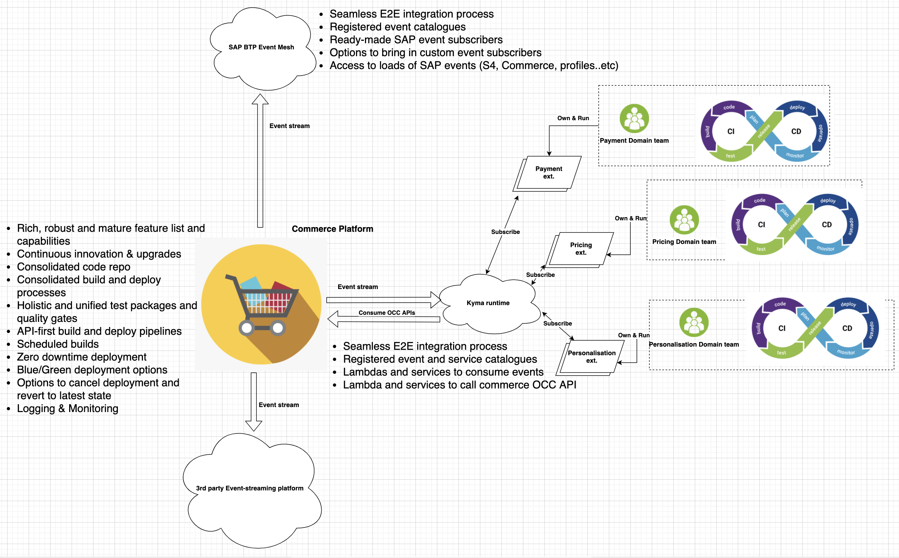
SAP Commerce Cloud – Supports Domain Driven Business Model

Slide 7
SAP Commerce Cloud
Thank you!

