Slide 1
CA262 - Analyze and optimize front-end application performance
Joaquin Recio Huertas
SAP SE

Slide 2



Meet the speakers
Joaquin Recio Huertas
Front-End Performance Expert
SAP SE
Martin Hellmich
Performance Engineer
SAP SE
Claudia Semmler
Performance & Scalability Expert
SAP SE

Slide 3

Front-end application
Responsive across browsers and devices
Translation and internationalization support
Extensibility concepts at code and application level
Standards like MVC, OData, JSON, XML and others
Predefine theme, custom theme or High Contrast theme to aid visually impaired users
And much more…

Slide 4
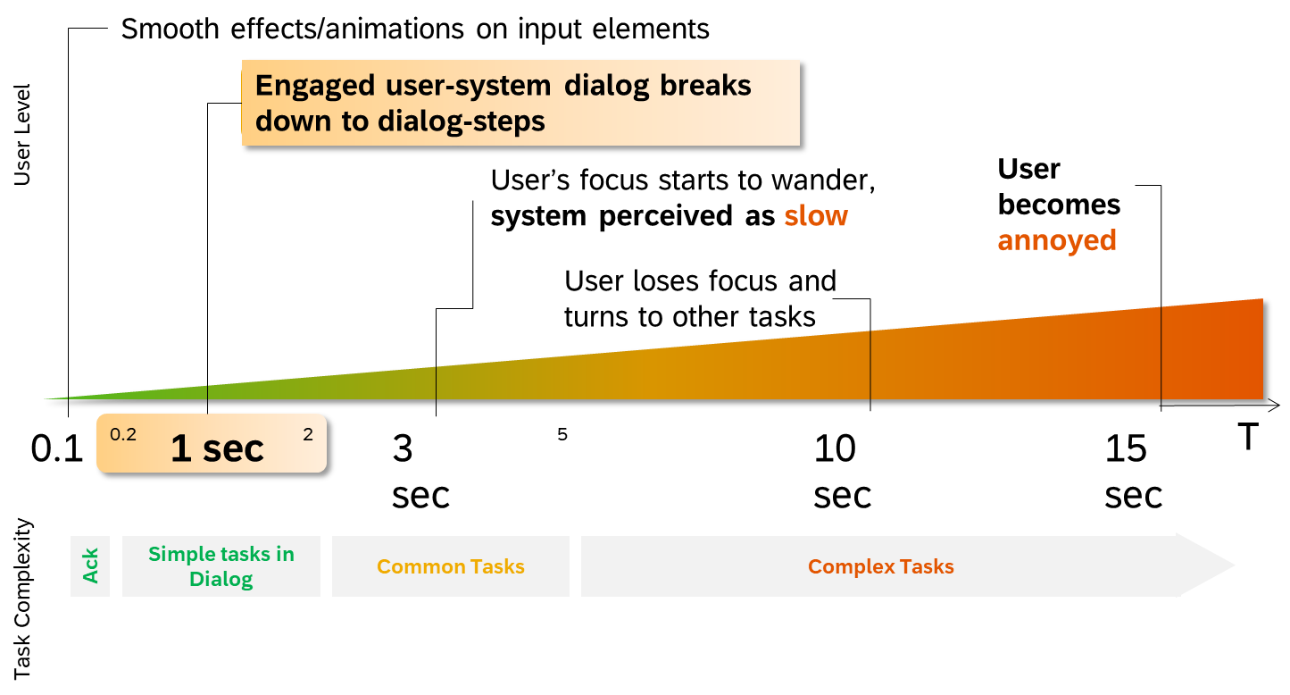
Front-end application performance

Slide 5
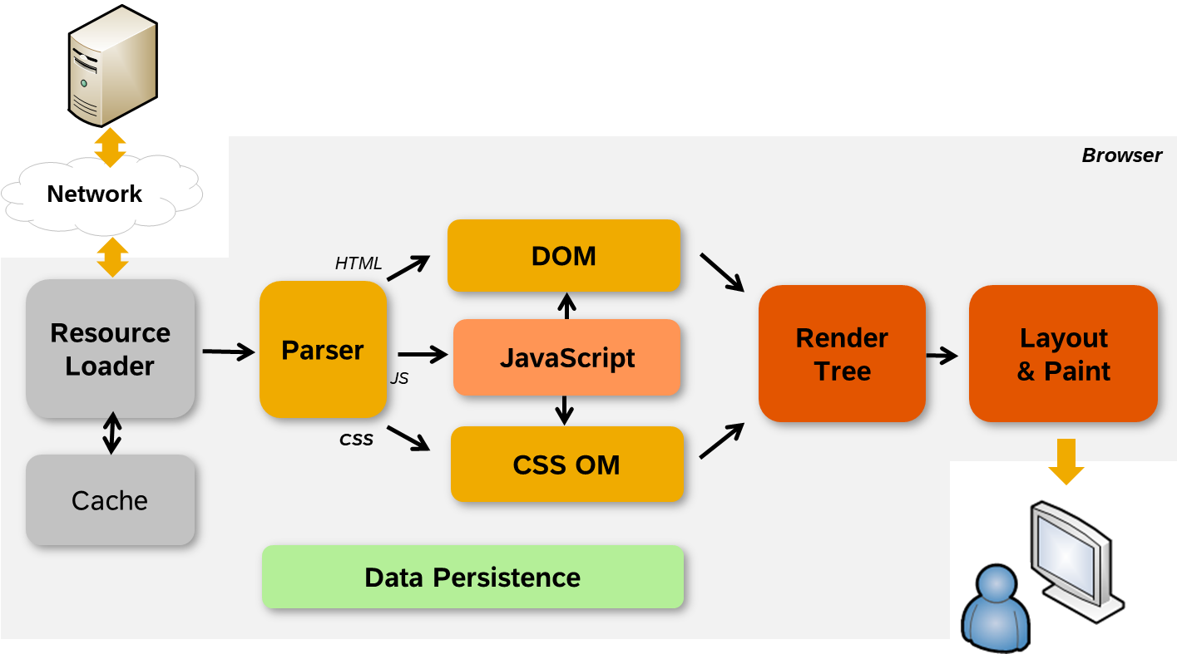
How browsers work

Slide 6
First-level break-down to frontend, network and backend performance issues
Big gaps?
No
Most probably high browser rendering time
Also high JavaScript processing time
Yes
Browser caching?
Network quality?
Check local machine
Check customer expectation
OK
OK
Not OK
Not OK
Long running oData calls?
No
Check browser settings for better performance
Check local IT policy
Latency < 200ms
Bandwith > 2 Mbps
Yes
Check backend
Check database

Slide 7
Fully optimized application – Round-Trips
Check if round-trips could be avoided or optimized
Can it be removed completely (i.e. not used libraries, out-dated library, 3rd-party library duplicating browser functionality)?
Can it be merged/aggregated to other requests ($batch, $expand, sprites, aggregated libraries …)?
Can it be cached in the browser cache?
Can it be cached for longer time?
Can it be served through Content Delivery Network (CDN)?
Can it be loaded in later point of time (on demand)?
The fastest round-trip is the one that doesn’t happen!

Slide 8
Fully optimized application – Round-Trips (cont)
Reduce resource fragmentation (JavaScript, CSS) by merging:
/resources/js/myCodeList.js
/resources/js/myCodeDetail.js
/resources/js/myCodeUtils1.js
/resources/js/myCodeUtils2.js
Avoid loading of resource duplicates
/resources/js/myCode.js
/some/other.css
/resources/js/myCode.js
/resources/js/myCode.js
Use aggregation of small images/icons
Icon fonts
CSS sprites
Image sprites (including SVG sprites)
/resources/js/myLib.js
Bad Modularization?
Use UI5 Builder:
Library bundling
Component-preload generation
Minify sources

Slide 9
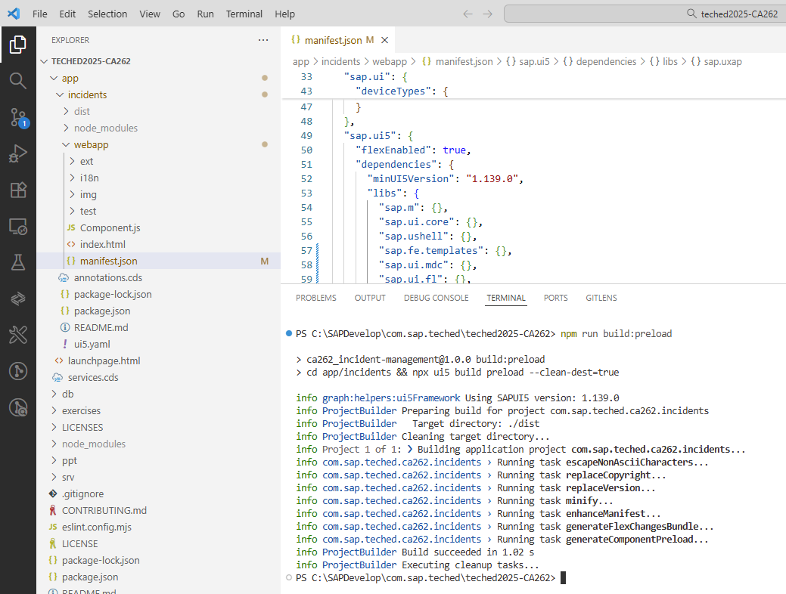
Exercises overview
Getting started
Clone our repository and start the server locally
Exercise 1
Introduction to the tools and network traffic
Exercise 2
Introduction to UI5 Builder
Exercise 3
Deep dive into network traffic
Exercise 4
Deep dive into OData requests
(Bonus) Exercise 5
Deep dive into additional settings

Slide 10

Let‘s get started
Clone the repository:
https://github.com/SAP-samples/teched2025-CA262

