Slide 1



Neetha Pucknat
Senior Product Specialist
SAP Business Data Cloud
Rithivika Acharya
Senior Product Specialist
SAP Business Data Cloud

Slide 2
Use Case 01: Cashflow Forecast
Scenario: Cashflow Forecast
The data scientist wants to forecast the cashflow for the upcoming 6 months and make the result available for reporting. For that he needs to access the cashflow data product from S/4HANA, apply ML/AI model training and forecasting, and share / install the enriched data product in BDC Cockpit and Datasphere.
Persona
Data Scientist / AI Engineer
Goal
Enrich Data Product with ML / AI insights
Consume enriched custom Data Product in Datasphere and Analytics Cloud
Scenario Flow
SAP Databricks
SAP Analytics Cloud
Story
Activate SAP Data Product Cashflow into SAP Foundation Service and make it available in SAP BDC Cockpit
Share Data Product Cashflow to SAP Databricks
Apply ML/AI to forecast the cashflow for upcoming 6 months and persist ML model + result set in SAP Databricks
Share result set as enriched custom data product to BDC Cockpit
Install data product to SAP Datasphere and consume in SAP Analytics Cloud
Unity Catalog
3
Notebook
consume
Learnings
Sharing Data Product to SAP Databricks
Enrich Data Product with ML/AI Insights:
Data understanding and preparation
Train time series forecast model
Apply cashflow forecast
MLFlow for monitoring query performance
Re-sharing custom Data Product to BDC Data Catalog with `sap-bdc-connect-sdk`
ML Model
SAP Datasphere
SAP Data product
Result Set
Analytic models
Views
Remote Table
2
Share
Share
4
5
SAP BDC Cockpit
Install
Data Catalog
Data product
SAP Data product
1
Expose
SAP Foundation Service
SAP Data product
Delta Table
Notes:
paint the picture how do they do --> business data cloud replication flow change to Delta share No need to prepare the data

Slide 3
Use Case 02: Payment Delay Prediction and Key Drivers
Scenario: Prediction of Payment Delays and their Key Drivers
The data scientist needs to predict payment delays and run a root cause analysis. He has to provide the key drivers for the delays and an explanation in a human readable manner. For that he combines SAP Databricks and AI Foundation LLM capabilities to derive the insights. These insights will help the Financial Controller to better understand the payment delays problem and to derive the corresponding actions to mitigate.
Persona
Data Scientist / AI Engineer
Goal
Integrate AI Foundation LLM services in SAP Databricks
Explain and interpret key drivers for attrition in human readable manner
Scenario Flow
AI Foundation
SAP Databricks
SAP Analytics Cloud
Activate SAP Data Product Workforce Core Data into SAP Foundation Service and make it available in SAP BDC Cockpit
Share Data Product Entry View Journal Entry to SAP Databricks
Integrate AI Foundation LLM services
Predict payment delays + key drivers and use LLM service to explain the results in human readable text format
Share enriched data product to BDC Cockpit
Install data product to SAP Datasphere and consume in SAP Analytics Cloud
API/Services
4
Notebook
Story
LLM Access
consume
3
3
ML Model
Learning
Advanced ML/AI capabilities
Determine key drivers for payment delay via SHAP values
Visualizing SHAP values
Hyperparameter optimization with XGBoost
Integrating SAP AI Core Service for LLM
Configure SAP AI Core orchestration service
Implementing MLflow model class for model tracking and logging
Unity Catalog
Result Set
SAP Datasphere
Analytic models
SAP Data product
Views
Remote Table
Share
5
2
Share
6
SAP BDC Cockpit
Install
Data Catalog
SAP Data product
SAP Data product
1
Expose
SAP Foundation Service
SAP Data product
See blog post: Unlocking SAP AI Foundation capabilities in SAP Databricks

Slide 4
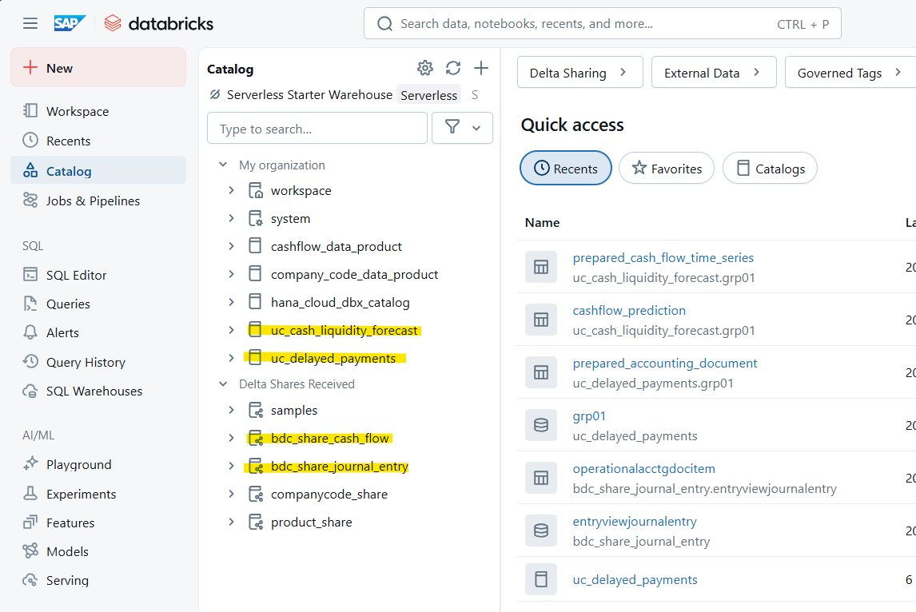
02 What are the requirements and where to find the materials?
Requirements
Access to the GitHub Repository for the script & files: https://github.com/SAP-samples/teched2025-DA266
Access to SAP Databricks and SAP Business Data Cloud Cockpit
System users will be provided to the participants
Databricks Pre-Setup:
Unity Catalog
uc_cash_liquidity_forecast
uc_delayed_payment
Received Delta Shares and Data Products
Cash Flow
Entry View Journal
SECRET scopes
sap-bdc-connect-sdk for Data Product sharing
AI Core Service for GenAI Hub LLM service
Notes:
KP

Slide 5
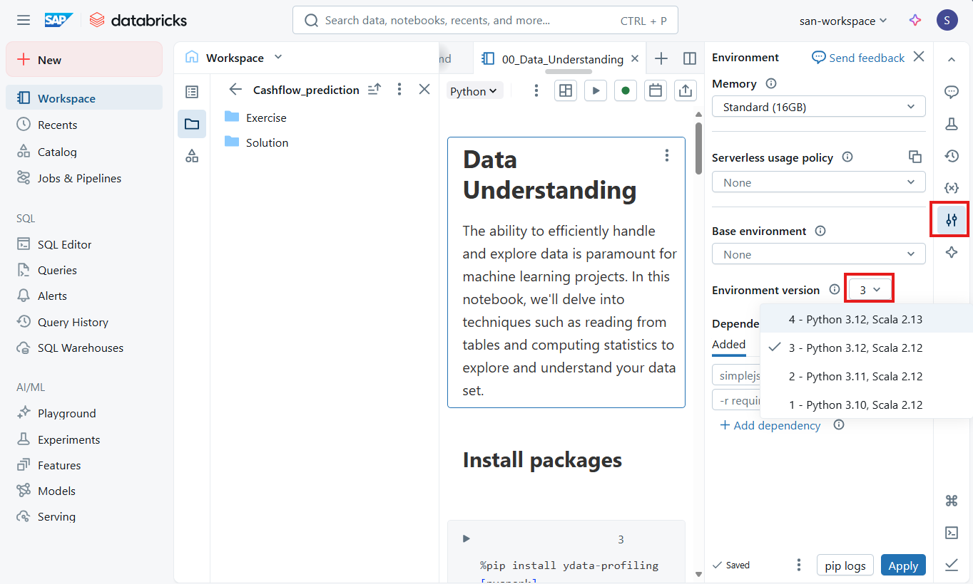
Setting the python environment for the exercises
Environment = Python 3.12, Scala 2.12

Slide 6
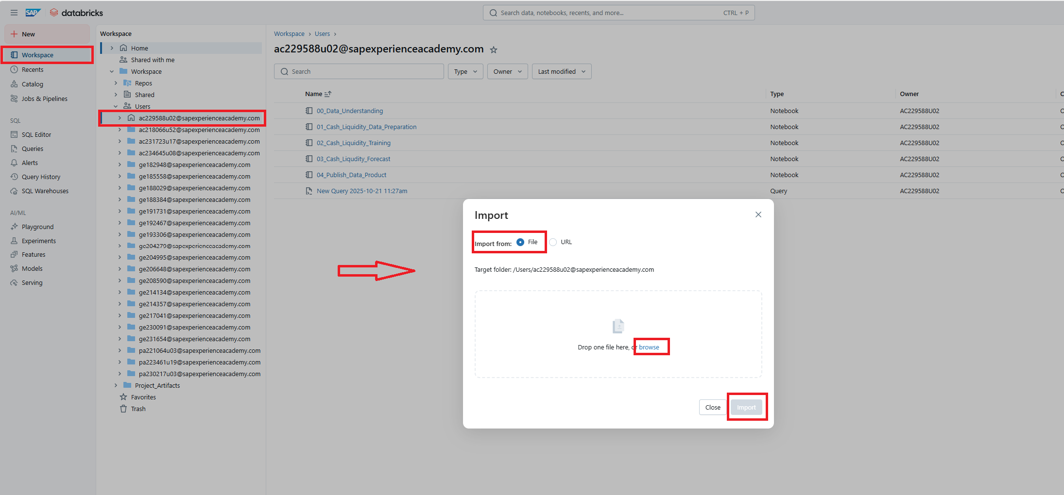
How to upload the notebook

Slide 7


Your feedback matters.
Share your thoughts on this session.

Slide 8
Contact information
Rithivika Acharya
Neetha Pucknat
San Tran
Product Management SAP Business Data Cloud

Slide 9
DA266 Operationalizing AI with SAP Databricks in SAP Business Data Cloud
Rithivika Acharya
Neetha Pucknat
San Tran
Product Management, SAP Business Data Cloud November 2025

Slide 10
What are the requirements and where to find the materials?

