Slide 1
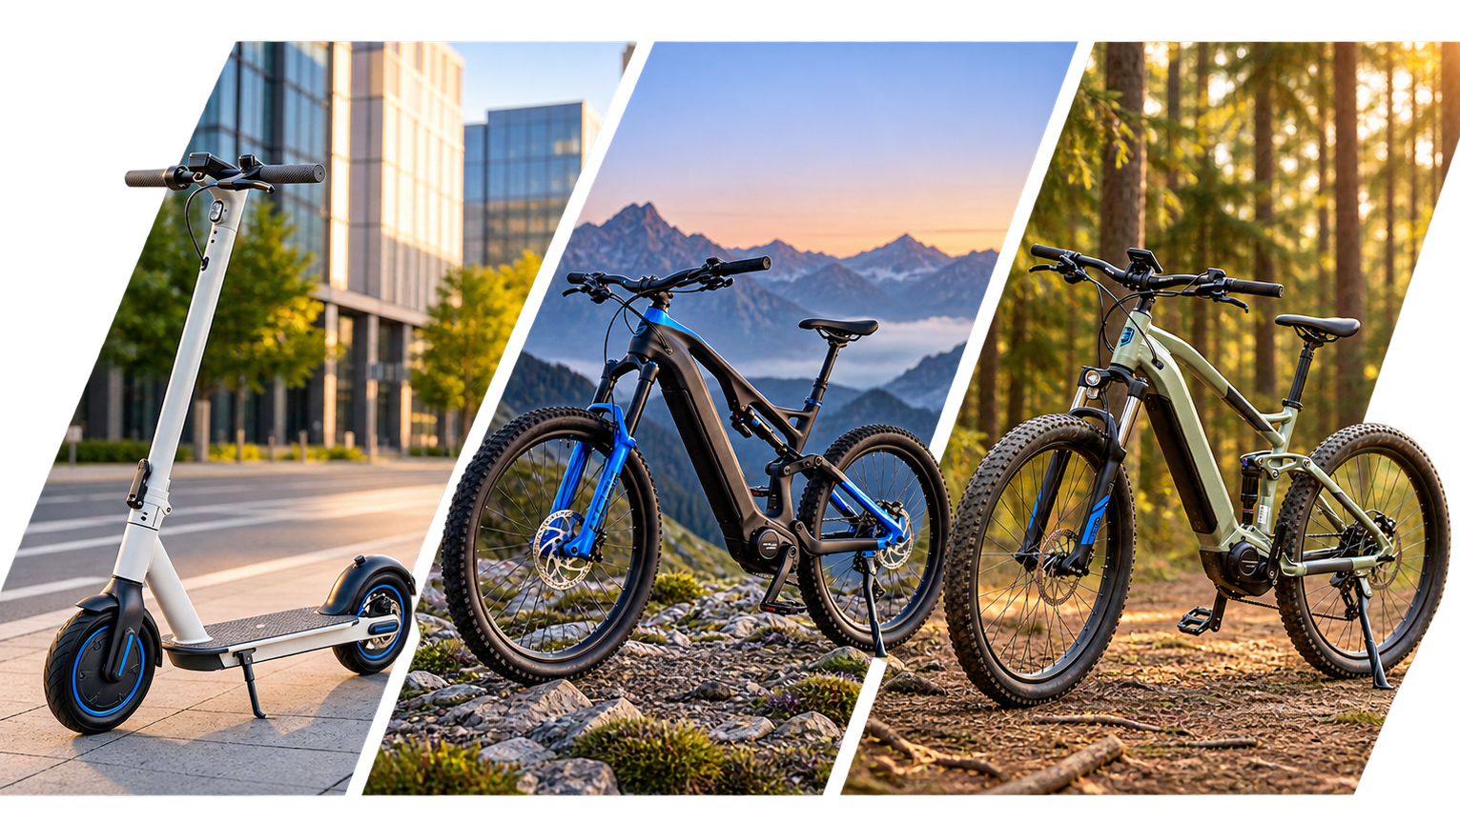

BestRun EV
Apex Series
The next generation of electric mobility. Now available to pre-order.
DEALER LAUNCH BROCHURE
BestRun EV | Authorized Dealer Program
01

Slide 2
THE OPPORTUNITY
Why the Apex Series Matters
▸ BestRun EV's most significant product line in five years
▸ Three new models spanning urban, adventure, and performance segments
▸ Launching in 90 days — pre-orders open now for authorized dealers
▸ Headline innovation: the Apex Pro's new LFP battery system
Biggest sales
opportunity of
the year
for your dealership.
BestRun EV | Authorized Dealer Program
02

Slide 3
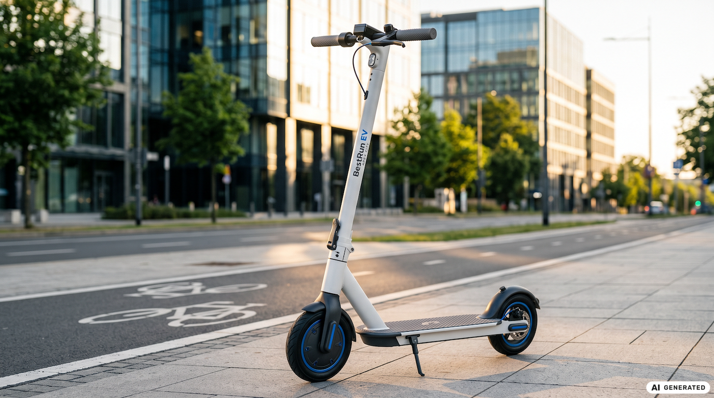
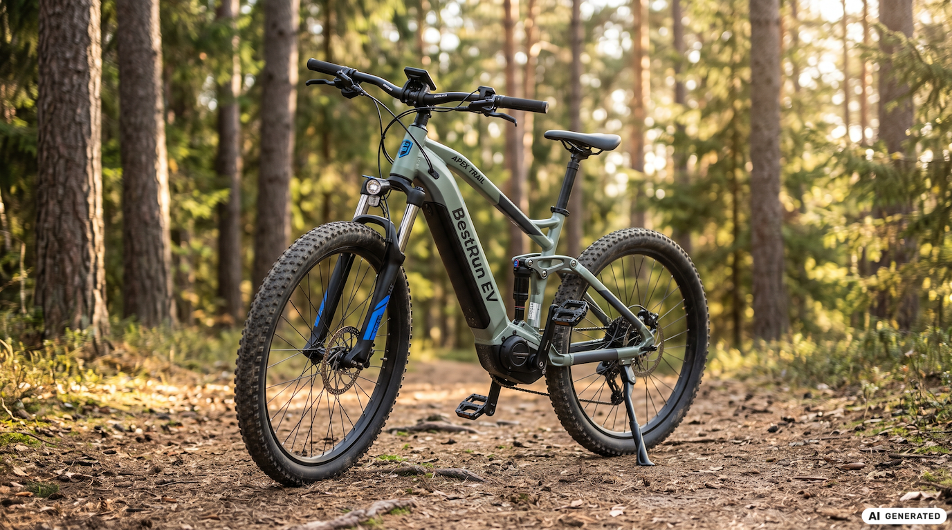
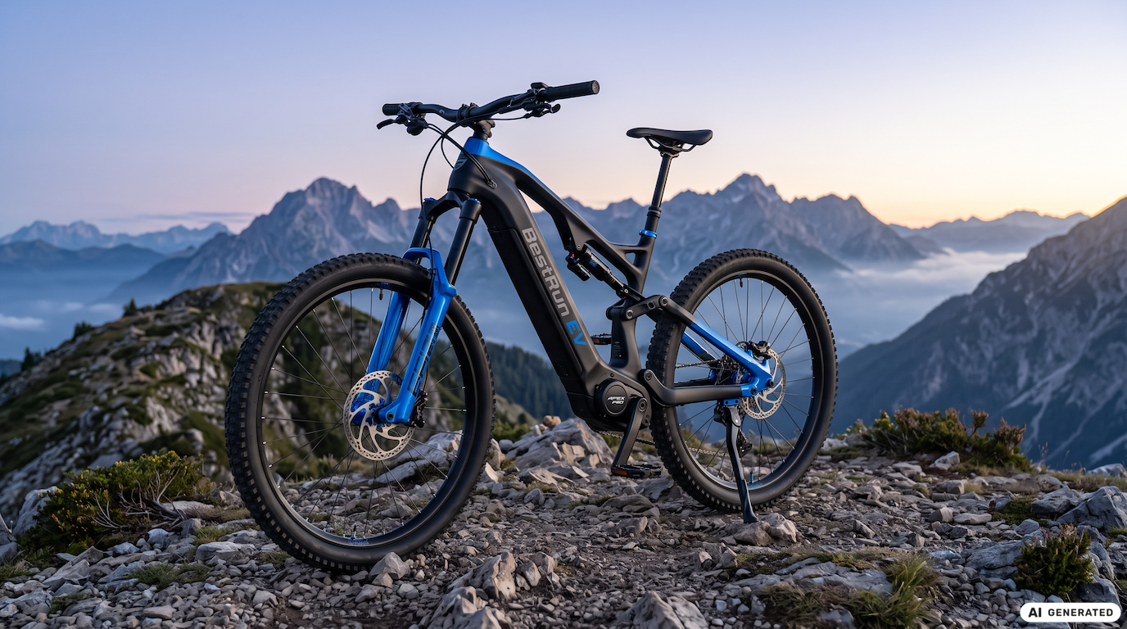
THE LINEUP
The Range at a Glance
Apex City
Apex Trail
Apex Pro
Urban commuter scooter
Adventure ebike
Performance ebike
Lightweight, city-optimized
140 km range, all-terrain
200 km range, new LFP battery
BestRun EV | Authorized Dealer Program
03

Slide 4
URBAN COMMUTER SCOOTER
Apex City
▸ City-optimized, lightweight design — easy handling and storage
▸ Low maintenance, built for high-use urban riders
▸ Ideal for urban commuters and last-mile delivery fleets
▸ The accessible entry point into the Apex Series
BestRun EV | Authorized Dealer Program
04

Slide 5
ADVENTURE EBIKE
Apex Trail
▸ 140 km range for long weekend rides and touring
▸ All-terrain capability with a durable aluminium frame
▸ Built for outdoor enthusiasts and weekend riders
▸ The versatile mid-range choice in the lineup
BestRun EV | Authorized Dealer Program
05

Slide 6
FLAGSHIP PERFORMANCE EBIKE
Apex Pro
▸ 200 km range — the longest in the BestRun EV lineup
▸ New LFP (Lithium Iron Phosphate) battery system
▸ Off-road performance with premium components throughout
▸ BestRun EV's most advanced model to date
BestRun EV | Authorized Dealer Program
06

Slide 7
HEADLINE INNOVATION
Apex Pro Battery &
Drive Technology
▸ Next-generation LFP battery — improved thermal stability and longer cycle life
▸ Range: 200 km in eco mode, 140 km in standard mode
▸ Fast charging: 0–80% in approximately 2.5 hours
▸ Integrated Battery Management System optimizes charge cycles
▸ Service interval: 5,000 km or annually, whichever comes first
BestRun EV | Authorized Dealer Program
07

Slide 8
FOR DEALERS
Pre-Order Opportunity
Open now
Secure stock
Pre-orders open ahead of the public launch
Lock in early allocation for your dealership
Dealer terms
Guaranteed launch
Pricing & discount tiers in the Commercial Handbook
Early commitment helps secure launch-day availability
BestRun EV | Authorized Dealer Program
08

Slide 9
NEXT STEPS
How to Get Started
1
Explore the Apex Series launch page in your BestRun EV Dealer Portal
2
Review the technical spec sheet and battery guide
3
Ask Joule any product or commercial question — answered instantly
4
Register your pre-order interest with your regional sales contact
Explore the full Apex Series in your dealer portal today.
BestRun EV | Authorized Dealer Program
09

Slide 10
Apex Series
Ride further. Sell smarter.
BestRun EV | Authorized Dealer Program

