Slide 1

AS260 - Discover the Financial Closing Assistant
Introduction and First Steps
Donatella Cechet, Cloud ERP Finance Product Management
Torsten Gerlach, Cloud ERP Core Finance Product Engineering

Slide 2
Disclaimer
  The information in this presentation is confidential and proprietary to SAP and may not be disclosed without the permission of SAP. Except for your obligation to protect confidential information, this presentation is not subject to your license agreement or any other service or subscription agreement with SAP. SAP has no obligation to pursue any course of business outlined in this presentation or any related document, or to develop or release any functionality mentioned therein.
  This presentation, or any related document and SAP's strategy and possible future developments, products and or platforms directions and functionality are all subject to change and may be changed by SAP at any time for any reason without notice. The information in this presentation is not a commitment, promise or legal obligation to deliver any material, code or functionality. This presentation is provided without a warranty of any kind, either express or implied, including but not limited to, the implied warranties of merchantability, fitness for a particular purpose, or non-infringement. This presentation is for informational purposes and may not be incorporated into a contract. SAP assumes no responsibility for errors or omissions in this presentation, except if such damages were caused by SAP’s intentional or gross negligence.
  All forward-looking statements are subject to various risks and uncertainties that could cause actual results to differ materially from expectations. Readers are cautioned not to place undue reliance on these forward-looking statements, which speak only as of their dates, and they should not be relied upon in making purchasing decisions.
Notes:
Please remember that in many cases the content in this presentation represents ‘Labs Preview’ functionality and is subject to change.

Slide 3
Agenda
01
Introducing the Financial Closing Assistant
What is the Financial Closing Assistant?
02
Financial Closing Assistant Agents
Explaining each Agent in the Financial Closing Assistant
03
Getting Started with Financial Closing Assistant Hands On Session
Test scripts and first steps in with Joule
Notes:
Today’s session cover four sections. First, we will introduce the Financial Closing Assistant as a natural part of Autonomous Finance. Second we will cover how it works and what are its key capabilities. Third, we will explain each agent that is utilized by the Financial Closing Assistant. And Fourth we will wrap – up with what is next.

Slide 4
Introducing the Financial Closing Assistant
© SAP SE
Notes:
Now let’s cover the background for the Financial Closing Assistant.

Slide 5
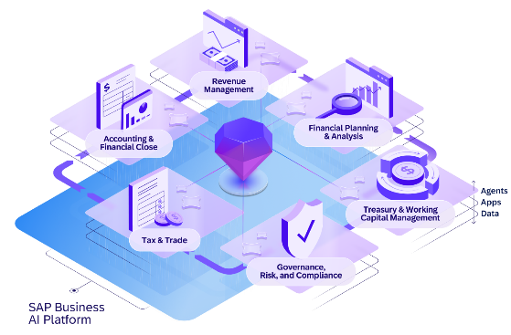
SAP Autonomous Finance
AI-driven processes to help companies measurably deliver on their key finance objectives
CFOs will have…
Reduced manual work freeing and motivating their valuable talent
Better decisions due to unified and trustworthy data
Automatic compliance thanks to audit-ready data
Connection between predictions, plans, and actual KPI results
SAP Autonomous Finance
Business Data Context
Suite-wide Process Orchestration
Enterprise-Grade Governance
Notes:
SAP Autonomous Finance is available from SAP. It provides AI-driven processes to help companies measurably deliver on their key finance objectives
With SAP Autonomous Finance, CFOs can achieve Reduced Manual Work, Better decisions, be audit ready automatically, and have line of sight across all activities
Building on SAP Autonomous Enterprise, SAP Autonomous Finance provides the right business data context across suite-wide process orchestration for finance teams while enabling enterprise grade governance

Slide 6




People direct. Assistants coordinate. Agents execute.
AI-assisted Finance teams will drive value creation and better business decisions.
Joule
Autonomous Finance transforms the
office of the CFO from retrospective reporting to continuous financial intelligence.
This autonomous domain fundamentally repositions the CFO from financial steward
to enterprise value architect – enabling their companies to sense, predict, and execute with speed, delivering high efficiency gains and overall greater return on investments.
The result: a business that runs leaner, moves faster, and bends without breaking.
Autonomous Finance
Industry AI
Autonomous
CX
Autonomous Spend
Autonomous HCM
AGENTS
Autonomous SCM
APPS
DATA
Agents
Inside each domain, it all runs as a continuous cycle. People set the direction. Applications generate signals. Data provides context.
Agents take action.
Value compounds.
Data
Apps
Notes:
Remember that with SAP: people direct, assistants coordinate, and agents execute. With SAP, the human is always in the loop with practical AI capabilities vetted and validated by SAP.

Slide 7
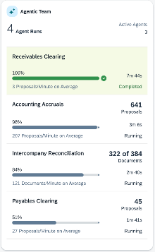
Introducing the Financial Closing Assistant
Leverage an agentic workforce for faster financial closes
Blog
Agents
Status cards
Analytical
business insights
Financial
Closing
Assistant
Financial Consistency
Analysis
Receivables &
Payables Clearing
Faster close cycles
Improved accuracy and consistency
Greater finance team productivity
Accounting accruals
Journal entry
Intercompany matching and reconciliation
Asset Accounting
Anomaly detection
20-30%
10-20%
Enhanced
Public Cloud Scope
productivity increase
in GL & closing
time reduction in closing cycle
reporting accuracy

Slide 8
Current Financial Closing process pre-Financial Closing Assistant
PREPARE
PERFORM
VALUATE
REPORT
Perform
Physical Inventory
Perform Foreign
Currency Remeasurement Run
Post Accruals
and Valuations
Create Audit
Balance Trail
Send Balance
Confirmations to
Suppliers & Customers
Perform
Depreciation
and other Valuation runs
Post Reserves
and Transfers
Create Asset
History Report
Run Other
Period Closing Preparations
Perform Accounts Payables/Accounts Receivables runs
Intercompany
Matching
and Reconciliation
Create
Financial Statements
Manual Activity
ERP
Automation
Existing Capability
Notes:
Here we have a standard closing process pre-Financial Closing Assistant described covering the Prepare, Perform, Valuate, and Report closing steps. Your actual close process is probably different, but has these common core steps. Note that it is comprised of a both manual activities and ERP automation.

Slide 9
Autonomous Financial Closing process with the Financial Closing Assistant
The Agentic Team Close
Labs Preview
PREPARE
PERFORM
VALUATE
REPORT
Perform
Physical Inventory
Perform Foreign
Currency Remeasurement Run
Accruals Agent
Create Audit
Balance Trail
Journal Entry Agent
Send Balance
Confirmations to
Suppliers & Customers
Anomaly detection
for asset accountant
Perform
Depreciation
and other Valuation runs
Post Accruals
and Valuations
Post Reserves
and Transfers
Create Asset
History Report
Run Other
Period Closing Preparations
Financial
Consistency Agent
Human in the Loop (HITL)
Intercompany
Matching
and Reconciliation
Analytical
business insights
Autonomous Process
Manual Activity
Financial
Consistency Agent
Receivables &
Payables Clearing Agent
ERP
Automation
Intercompany
matching
and reconciliation agent
Create
Financial Statements
Agent Capability
Existing Capability
Notes:
Now we have the Financial Closing Assistant activated and show the difference compared to the standard closing process. Note that the agentic team is now dispersed throughout the Prepare, Perform, Valuate, and Report closing steps. And besides manual activities and ERP automation, both Autonomous Processes and Human-in-the-Loop activities have been added.
Unique to SAP, the agentic team leverages core SAP ERP capabilities that only SAP can offer.

Slide 10
Financial Closing Assistant Agents
© SAP SE

Slide 11

Journal Entry Agent
Notes:
Now let’s cover the Journal Entry Agent

Slide 12
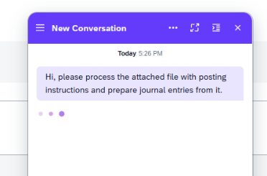
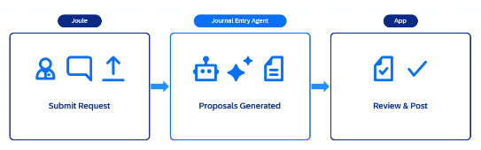
Labs Preview
Autonomous Finance
Public & Private Cloud
Journal Entry Agent
Agent summary
The Journal Entry Agent transforms unstructured posting input files into accurate, compliant journal entry proposals
Eliminates manual and complex data conversion
Ensures data quality with extensive automated checks against posting guidelines, historical postings
Avoids late-stage system errors with intelligent validation rules and understandable user feedback
SAP S/4HANA Cloud Public Edition
SAP S/4HANA Cloud Private Edition (Min Version Required: For EAC: 2025 FPS01; For GA: 2023 FPS1)
70%
50%
Improved
Pre-Requisites
Reduction in effort to curate manual journal entries.
Reduction in effort to upload and validate manual journal entries
Quality of manual postings
SAP Advanced Financial Closing
Additionally recommended solutions
General Availability
Early Adopter Care
Roadmap
Planned September 30, 2026
Registration Full
Public Cloud link Private Cloud link
Notes:
(High level agent summary of the slide). The Journal Entry Agent Journal Entry Agent transforms unstructured posting input files into accurate, compliant journal entry proposals. Benefits include a 70% reduction in effort to curate manual journal entries, a 50% reduction in effort to upload and validate manual journal entries, and improved quality of manual postings. Prerequisites include SAP S/4HANA Cloud Public Edition and Private Edition.

Slide 13

Journal Entry Agent
Labs Preview
Public & Private Cloud
Process flow and involved roles
GL
Accountant
GL
Accountant
GL
Accountant
Decide
Check
accounting entries
Upload posting input Excel file
Notify
User
SAP ERP-grounded Knowledge Graph
Review and Accept/Reject
journal entry proposals
Validate correctness of posting input data
Validate against company posting rules (if existing)
Prepare
journal entry proposals
Execute
Post journal entries
Parse & Map
posting input file
Validate with historical postings
Execute
ERP Core
foundation
Only Available with SAP
-Real-time interoperability with SAP ERP Core
-Real-time integration with SAP Knowledge Graph
Human in the Loop (HITL)
Autonomous Process
Manual Activity
ERP Automation
Notes:
Let’s walk through a simple process flow for the Journal Entry Agent.
We have the GL Accountant who welcomes assistance from the Journal Entry Agent by uploading and Excel file with posting inputs. The Journal Entry Agent then parses and maps the input file relying on the SAP ERP-grounded Knowledge Graph. It then applies the company posting rules following the ERP Core Foundation and prepares the journal entry proposal. Note the mixture of Agent and Human in the loop activities, for instance when the GL Accountant reviews the journal entry proposals for approval or rejection.
Only SAP allows the Journal Entry agent to interact with the SAP ERP-grounded Knowledge Graph and the ERP Core Foundation as shown with the blue diamonds.

Slide 14
Accounting Accruals Agent
Notes:
Now let’s cover the Accounting Accruals Agent

Slide 15
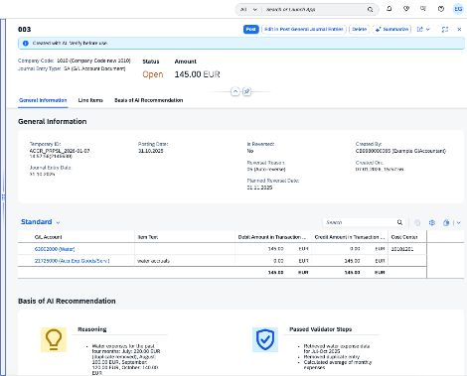
Accounting Accruals Agent
Flyover Video
Labs Preview
Public Cloud
Autonomous Finance
Accounting Accruals Agent
Agent summary
The Accounting Accruals Agent uses accounting policy documents and historical data to propose accrual and deferral journal entries
100% of agent-generated accrual proposals aligned with accounting policy
Data analyzed from across ERP and Business Suite (Ariba, Concur)
Clear description of reasoning and validation steps help accountants approve proposals with confidence
SAP S/4HANA Cloud Public Edition
SAP S/4HANA Cloud Private Edition (Min Version Required: For EAC: 2025 FPS01; For GA: 2023 FPS1
80%
50%
Reduced
Pre-Requisites
Reduction in manual work of calculating the accruals/deferrals amounts.​
Reduction in time spent reviewing the calculated amounts and posting
Manual effort and errors during period-end close.
SAP Advanced Financial Closing
Additionally recommended solutions
General Availability
Early Adopter Care
Roadmap
Planned September 30, 2026
Registration Full
Public Cloud link Private Cloud link. Discovery Center Link
Notes:
(High level agent summary of the slide). The Accounting Accruals Agent uses agentic capabilities, accounting policy documents, and historical data to propose accrual and deferral journal entries and offers a 80% reduction in manual work of calculating the accruals/deferrals amounts., a 50% reduction in time spent reviewing the calculated amounts and posting, and reduced manual effort and errors during period-end close. Prerequisites include SAP S/4HANA Cloud Public Edition. It is highly recommended to also use SAP Advanced Financial Closing.

Slide 16
Accounting Accruals Agent
Labs Preview
Public Cloud
Process flow and involved roles
GL
Accountant
GL
Accountant
GL
Accountant
Notify
User
Check the
accounting entries
Decide
Upload accounting policy and trigger Agent
Execute
Identify relevant accounting accrual types (s)
Review and Accept/Reject
proposals
Retrieve historical data as a base for the calculations
Execute
Execute
Prepare
accounting accrual proposals
Post journal entries
Read company
accounting policy
Apply the calculation rules from the
accounting policy
Execute
Execute
Only Available with SAP
-Agent places proposals within the Manage Accruals Proposals App
Human in the Loop (HITL)
Autonomous Process
Manual Activity
ERP
Automation
Notes:
Let’s walk through a simple process flow for the Accounting Accruals Agent.
We have the GL Accountant who uploads the accounting policy and triggers the Accounting Accruals agent to begin work. The Agent applies the accounting policy, refers to historical data, calculates and prepares the accruals. Note the mixture of Agent and Human in the loop activities, for instance when the GL Accountant reviews the accruals proposals for approval or rejection. Also, unique to SAP, the Accounting Accruals agent places proposals within the Manage Accruals Proposals App.

Slide 17
Receivables & Payables Clearing Agent
Notes:
Now let’s cover the Receivables & Payables Clearing Agent Receivables & Payables Clearing Agent

Slide 18
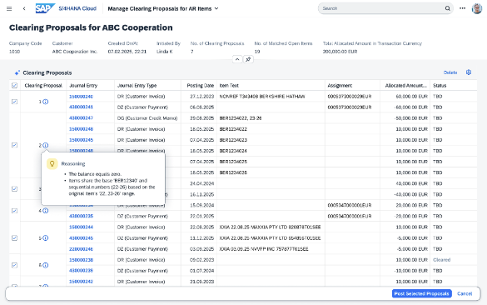
Labs Preview
Autonomous Finance
Public & Private Cloud
Receivables & Payables Clearing Agent
Agent summary
The Receivables and Payables Clearing Agent enhances operational efficiency by reducing manual workload and minimizing risk of human errors.
Analyzes open items, applying rule-based exact matching and AI-powered fuzzy matching across reference fields, assignments, and OB74 user-defined fields to automatically identify clearing candidates.
Generates balanced matching proposals & pre-validates proposals in advance of AP/AR accountant review
Posts approved proposals as clearing documents
SAP S/4HANA Cloud 2602
SAP S/4HANA Cloud Private Edition (Min Version Required: For EAC: 2025 FPS0, For GA 2025 FPS0)
86%
8.38%
Pre-Requisites
reduction in % of SAP FI-AR & FI-AP tasks that need manual intervention
Reduction in Costs (% rev): G/L and financial closing
SAP Advanced Financial Closing
Additionally recommended solutions
General Availability
Early Adopter Care
Roadmap
Planned September 30, 2026
Registration Full
Notes:
(High level walk through the slide’s key points). The Receivables and Payables Clearing Agent enhances operational efficiency by reducing manual workload and minimizing risk of human errors. Using the Receivables & Payables Clearing Agent can achieve a 86% reduction of SAP FI-AR & FI-AP tasks that need manual intervention resulting in an estimated 8.38% reduction in costs. SAP S/4HANA Cloud and SAP S/4HANA Cloud Provate required for GA September 30th 2026.

Slide 19
Receivables & Payables Clearing Agent
Labs Preview
Public & Private Cloud
Process flow and involved roles
AR or
AP Clerk
AR or
AP Clerk
AR or
AP Clerk
Decide
Check the
accounting entries
Trigger agent for specific company and/or customer/supplier
Notify
User
Review and Accept/Reject
proposals
Apply clearing rules
Sample rules
Zero Balance
Reference
Assignment
Item Text
Execute
Post journal entries
Execute
Prepare
clearing proposals
Execute
Only Available with SAP
-Integration with dedicated SAP Fiori apps.
Human in the Loop (HITL)
Autonomous Process
Manual Activity
ERP
Automation
Notes:
We have the AR or AP Clerk who wants to clear accounts payables and accounts receivables. The analyst triggers agent for a specific company or supplier. The Receivables & Payables Clearing Agent applies the clearing rules to prepare the clearing proposals. Note the mixture of Agent and Human in the loop activities, for instance when the AR or AP Clerk reviews the clearing proposals for approval.

Slide 20
Analytical Business Insights Agent
Notes:
Now let’s shift gears and talk specifically about the agents. First, we will cover the Analytical Business Insights Agent.

Slide 21
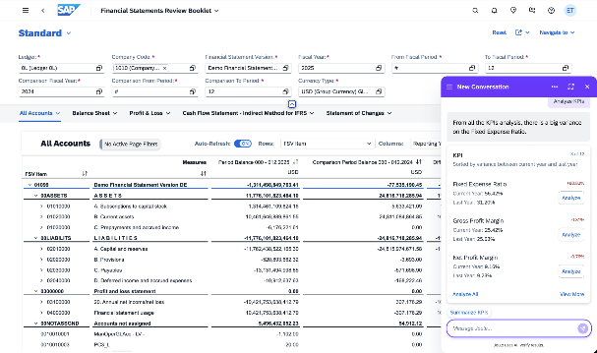
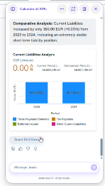
Labs Preview
Autonomous Finance
Public & Private Cloud
Analytical Business Insights Agent
Agent summary
The Analytical Business Insights Agent helps analysts spend less time on manual data investigation and focus more on driving data-supported financial decisions and enhancing business performance
Calculates KPIs across different account hierarchies
Guides users in variance analysis to find the root cause
Supports data correctness analysis, accelerating the period-end close
SAP S/4HANA Cloud Public Edition
SAP S/4HANA Cloud Private Edition (Min Version Required: For EAC: 2025 FPS02; For GA: 2025 FPS02) Oct 7th 2026
Financial Statement Review Booklet
50%
60%
Pre-Requisites
Reduction in effort to analyze financial statement KPIs
Reduction in effort to prepare financial statement KPI variance summary
General Availability
Early Adopter Care
Roadmap
SAP Advanced Financial Closing
Additionally recommended solutions
Planned September 30, 2026
Registration Full
Private Cloud link. Public Cloud link
Notes:
(High level agent summary of the slide). The Analytical Business Insights Agent accelerates data investigation and analysis and offers a 50% reduction in effort to analyze financial statement KPIs, 60% reduction in effort to prepare financial statement KPI variance summary. Prerequisites include SAP S/4HANA Cloud Public Edition and Private Edition.

Slide 22
Analytical Business Insight Agent
Labs Preview
Public & Private Cloud
Process flow and involved roles
Financial
Analyst
Financial
Analyst
Execute
Trigger the KPI Calculation
Show Used Component’s Value
Share for Further Analysis
Review Variance by the main factors
Smart Drill down
on Component
Execute
Click Component for further analysis
Execute
Decide
Select the KPI for deep dive
View Component Variance Analysis
Generate Variance Analysis Result
Show KPIs Value & Variance
Decide
Execute
Decide
Execute
Only Available with SAP
-Real-time interoperability with the Financial Statement Review Booklet
Human in the Loop (HITL)
Autonomous Process
Manual Activity
ERP
Automation
Notes:
Let’s walk through a simple process flow for the Analytical Business Insights Agent.
We have the financial analyst who wants to perform data investigation and analysis on financial statements. The analyst triggers the KPI Calculation. The Analytical Business Insights Agent shows the KPI’s Value & Variance and the human decides. Note the mixture of Agent and Human in the loop activities, for instance when the analyst reviews the Variance analysis to confirm the main factors creating those variances. Only SAP allows the analysis to be shown dynamically in real-time in both Joule and the Financial Statement Review Booklet as shown with the blue diamond.

Slide 23
Getting Started with Hands On Session
© SAP SE

Slide 24
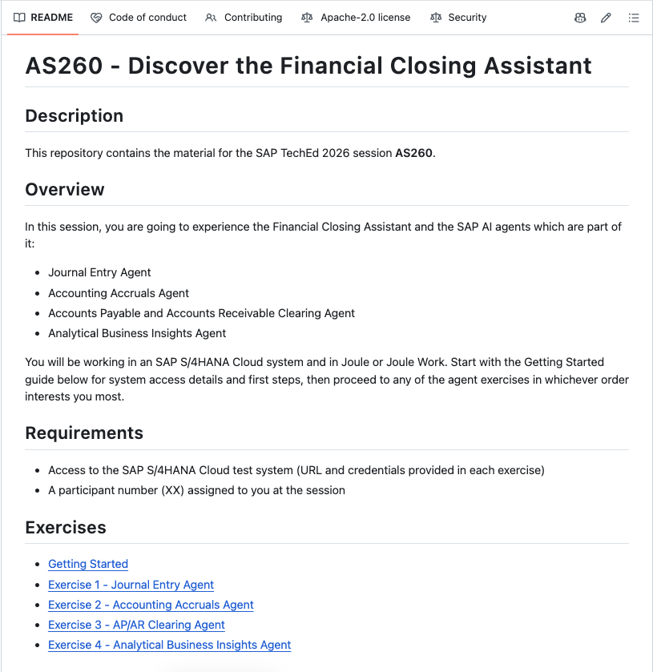
Hands On Session Test Scripts & Additional Material
Test scripts and additional material are stored in a dedicated GitHub: teched2026-AS260
  Start with the Getting Started section
  Proceed with any test script based on your interest
    Just select one exercise and follow the instructions
    All required additional documents are linked in the test scripts
    The test scripts contain also instructions on how to login to the SAP S/4HANA system and how to start Joule and Joule Work

Slide 25
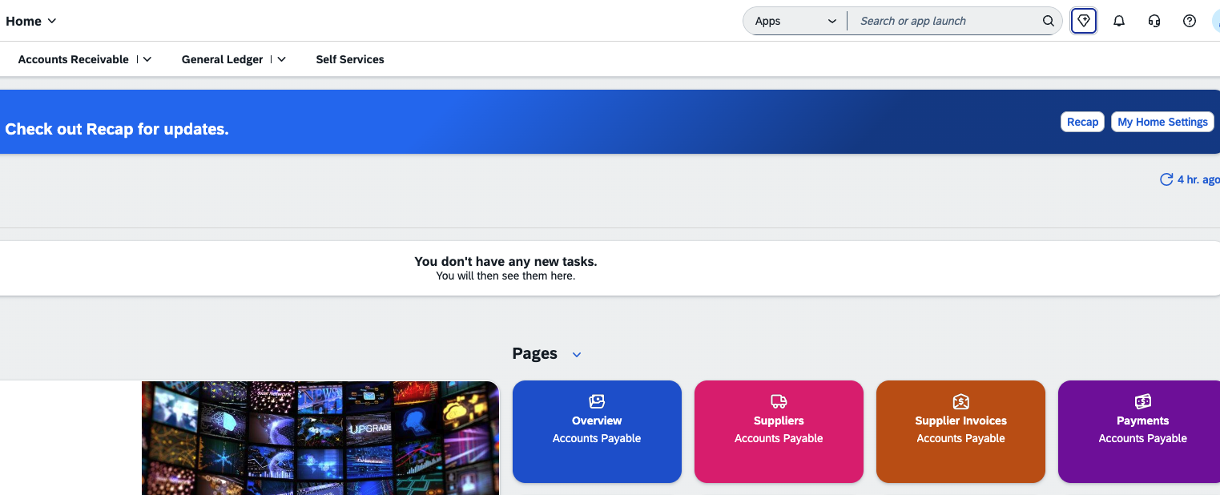

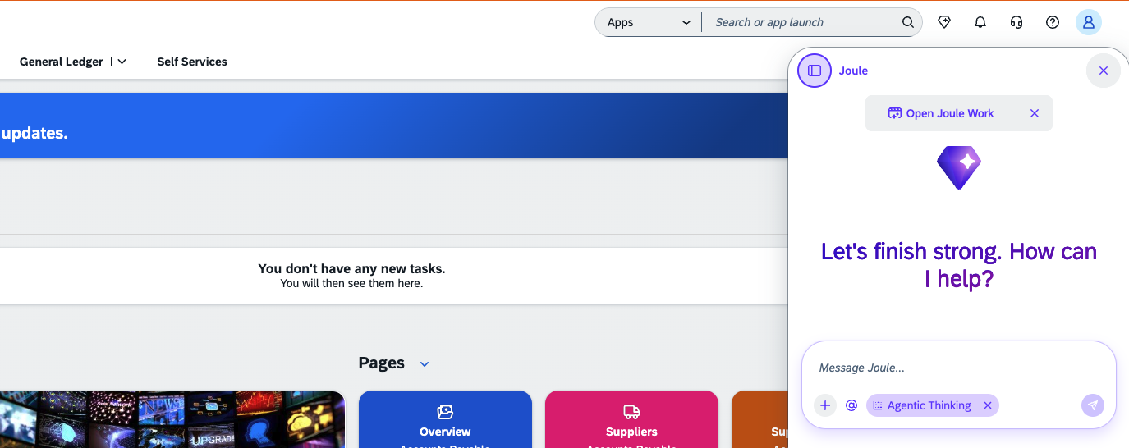
How to work with the Financial Closing Assistant in Joule – First Steps
Login into SAP S/4HANA with the provided user and password.
Click the diamond symbol to open Joule.
The Joule window opens.

Slide 26
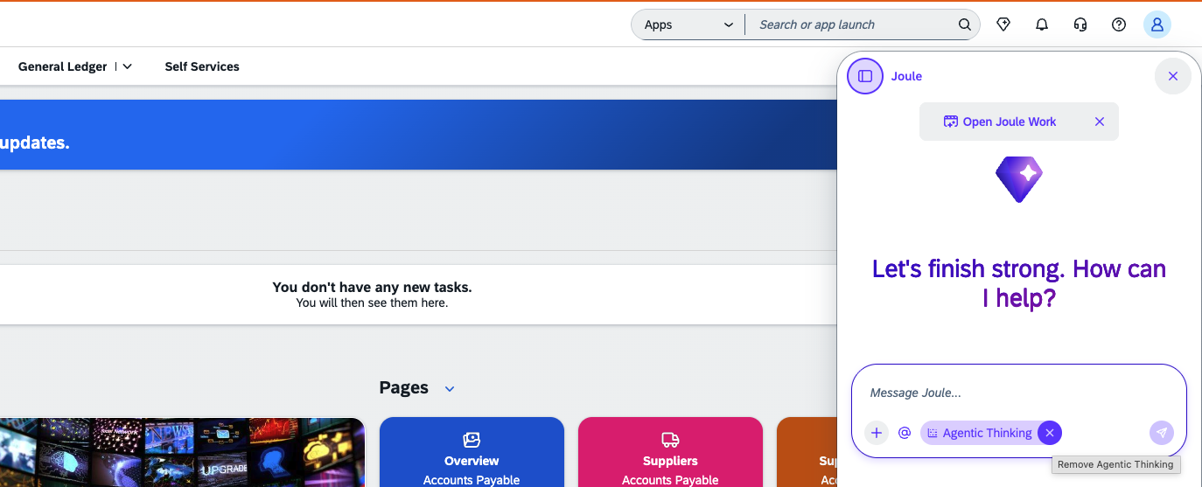
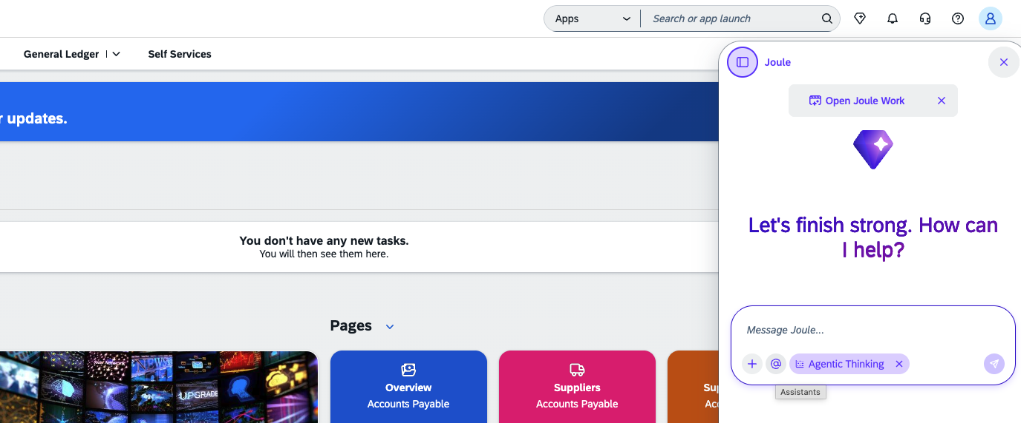
How to work with the Financial Closing Assistant in Joule – First Steps
Remove Agentic Thinking by clicking X.
Cklick @ to display the list of available assistants.

Slide 27

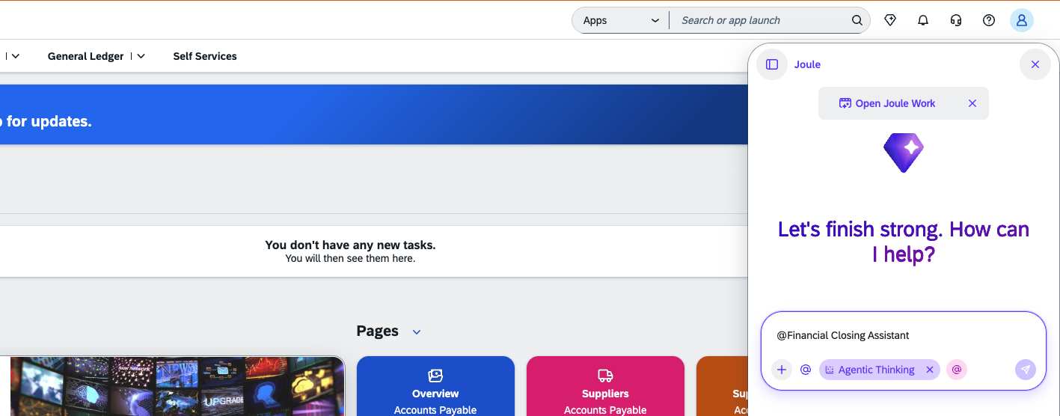
How to work with the Financial Closing Assistant in Joule – First Steps
Scroll until you find the @Financial Closing Assistant.
Start typing your prompt after @Financial Closing Assistant.

Slide 28
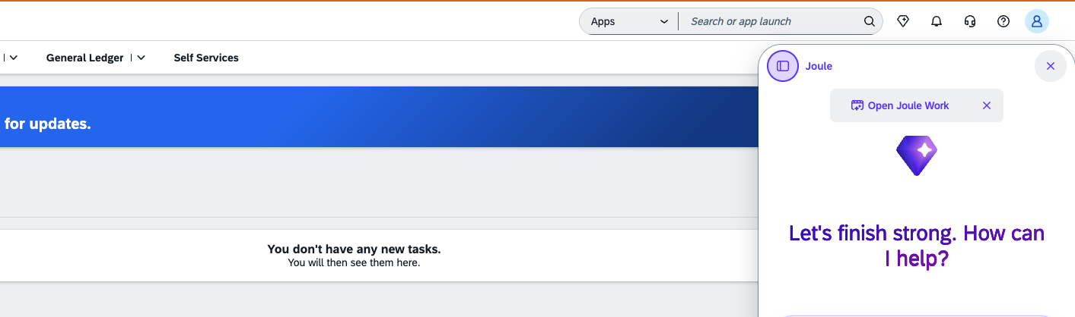
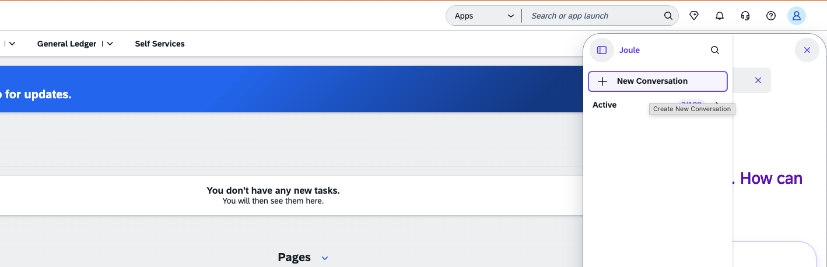
How to work with the Financial Closing Assistant in Joule – First Steps
To open a new conversation, click the symbol at the top left corner in the Joule window.
Choose New Conversation.

Slide 29
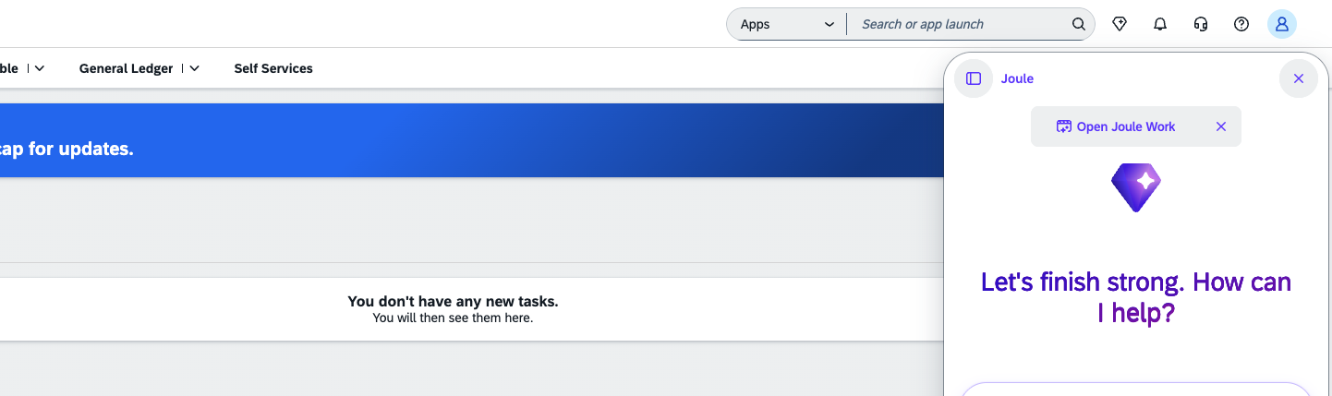

How to work with the Financial Closing Assistant in Joule – First Steps
You can stay in the Joule window or open Joule Work. To open Joule Work just click on the Open Joule Work text.
Joule Work opens in a separate window next to the SAP S/4 HANA system.

Slide 30

Thank You
© SAP SE

