Slide 1
IN261 — Model context protocol (MCP) unlocked: Enable governed access to AI agents
Markus Winter
VP & Head of Product Management, SAP
Sunny Kapoor
Lead Product Manager, SAP
Emily Mui
VP of Product Marketing, SAP
Bruno Renzo
Lead Product Manager, SAP

Slide 2










Model context protocol (MCP) unlocked: Enable governed access to AI agents
Scenario Overview
NEWHIRE Event
API key
SAP SuccessFactors
Employee Onboarding
AI Agent – SAP AI Core
Developer Hub
SAP Integration Suite, advanced
event mesh
Product and AI Agent Subscription
SAP AI Launchpad
Document Grounding
Add New Employee
LLM calls
Integration Flow
MCP tool calls
Employee Lookup MCP
SAP API Composition
HR Policy Lookup MCP
SAP AI Core
Claude Sonnet
SAP Integration Suite
MCP Gateway
Get Employee and
Job Information Lookup
HR Policy for Equipment's, System
Access and Training Enrollment
Integration Flow
Create PR
Create Support Case
Create S/4 Hana PR MCP
Manager Approval
Create Support Case MCP
SAP S/4HANA Equipment Ordering
Service Cloud V2
System Access and Training Enrollment
Notes:
Say:
- Imagine: a new employee just joined BestRun and completed their profile in SAP SuccessFactors
- That single action kicks off a chain across multiple SAP systems — automatically, governed, and traceable
- The AI agent: fetches the employee profile → retrieves HR policies → builds an onboarding plan → asks the manager to approve → only then creates the Purchase Requisition in S/4HANA and the Support Case in Service Cloud
- No backend is touched without human approval
- This is not a demo — you will build and setup every piece of this today
"By the end, you will type 'Approved' in a terminal and watch SAP S/4HANA create a Purchase Requisition — triggered by an AI agent you built, governed by policies you configured."
The four MCP Servers you will build:
1. Employee Lookup — API Composition (Business Data Graph) unifies 10+ SuccessFactors APIs into 2 clean entities
2. HR Policy Lookup — RAG via SAP AI Launchpad Orchestration with Document Grounding
3. Purchase Requisition — Integration Flow → SAP S/4HANA
4. Support Case — Direct to SAP Service Cloud V2
The MCP Gateway in SAP Integration Suite sits in front of ALL of them:
- Authentication enforced on every call (IAS OIDC)
- Principal Propagation — your identity flows all the way to SuccessFactors — it logs you, not a service account
- Traceability and analytics on every tool call
- The AI agent cannot bypass any of this — it goes through the gateway, period
The event backbone:
- SuccessFactors publishes a NEWHIRE event to SAP Advanced Event Mesh
- Your personal queue receives it — your agent wakes up automatically
The agent:
- Pre-built Node.js agent powered by Claude via SAP AI Core
- You configure it with your MCP Server URLs — then run it

Slide 3
Model context protocol (MCP) unlocked: Enable governed access to AI agents
Session Exercises Flow
NEWHIRE Event
API key
SAP SuccessFactors
Employee Onboarding
AI Agent – SAP AI Core
Developer Hub
SAP Integration Suite, advanced
event mesh
Ex6 – Create Product and AI Agent Subscription
Ex 7 – Download and setup
SAP AI Launchpad
Document Grounding
Ex 8 – Add New Employee
Ex 1 – Create Queue and Topic Subscription
LLM calls
Integration Flow
MCP tool calls
Employee Lookup MCP
SAP API Composition
HR Policy Lookup MCP
SAP AI Core
Ex 2 – Create and Deploy
Claude Sonnet
SAP Integration Suite
MCP Gateway
Ex 3 – Copy, Configure and Deploy
Get Employee and
Job Information
HR Policy for Equipment's, System
Access and Training Enrollment
Integration Flow
Create PR
Create Support Case
SAP S/4HANA Equipment Ordering
Create S/4 Hana PR MCP
Manager Approval
Ex 9
Create Support Case MCP
Service Cloud V2
System Access and Training Enrollment
Ex 4 – Create and Deploy
Ex 5 – Copy, Configure and Deploy

Slide 4
Model context protocol (MCP) unlocked: Enable governed access to AI agents
Best Practices
Use your participant number on everything — every artifact name, every MCP path, every queue name
Use underscore (_) in all artifact names: IN261_0** — hyphen only in your login username (IN261-0**)
To complete the session on time, please stick to the time estimate given above each exercise.Check artifact status is STARTED before moving to the next exercise
Keep your terminal open once the agent is running
Don't touch anyone else's artifacts — if it doesn't have your number, leave it alone
Don't click Deploy twice — wait and refresh
Fast Track tip: If you fall behind on Ex 2–5 (building MCP Servers), the solution MCP URLs are already in mcp-servers.json under workshop_01a_solution or workshop_01b_solution — copy them to active and keep going
Troubleshooting guide is linked from the main README — your companion for quick resolution

Slide 5
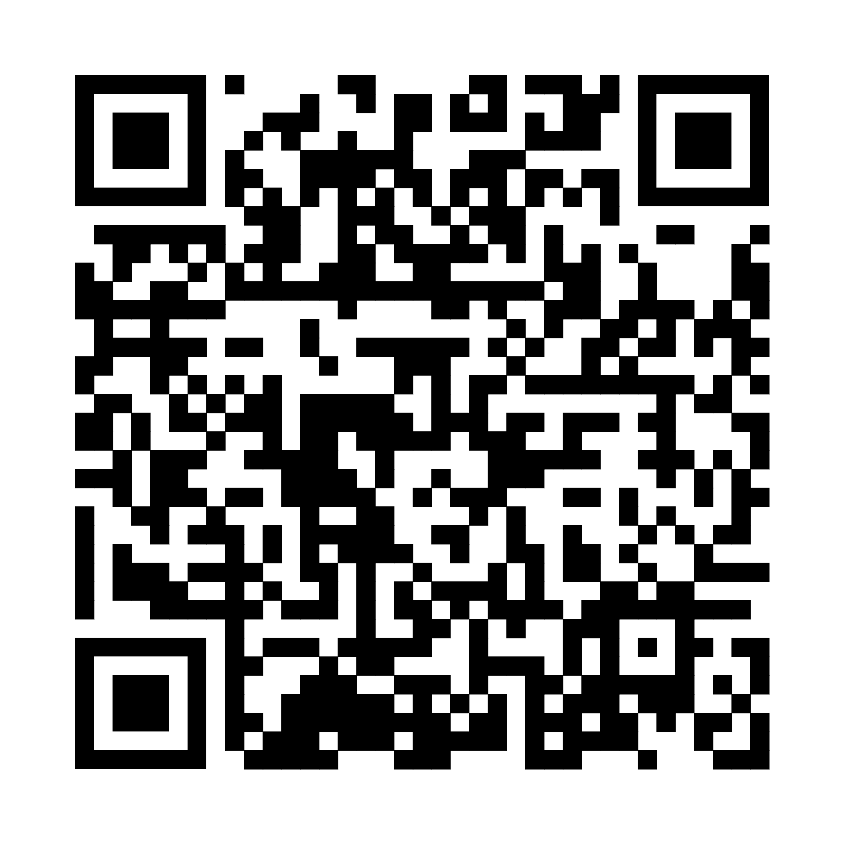
SCAN TO SHARE FEEDBACK
YOUR FEEDBACK MATTERS
How was this
session?
Scan the QR code to complete the session survey.
Before you scan: Open the SAP Events app and add this session to My Schedule.
SAP TechEd Berlin 2026

