Slide 1
JW263 – AI-assisted optimization of SAP front-end application performance
Joaquin Recio Huertas, SAP
October 2026

Slide 2
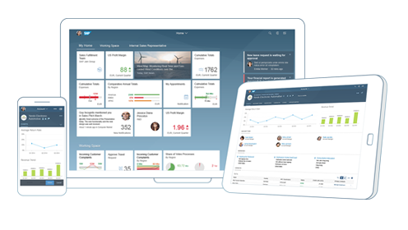
Front-end application
  Responsive across browsers and devices
  Translation and internationalization support
  Extensibility concepts at code and application level
  Standards like MVC, OData, JSON, XML and others
  Predefine theme, custom theme or High Contrast theme to aid visually impaired users
  And much more…

Slide 3
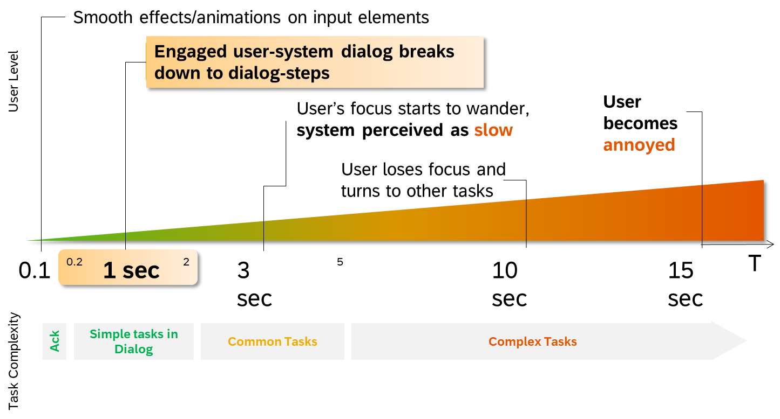
Front-end application performance

Slide 4
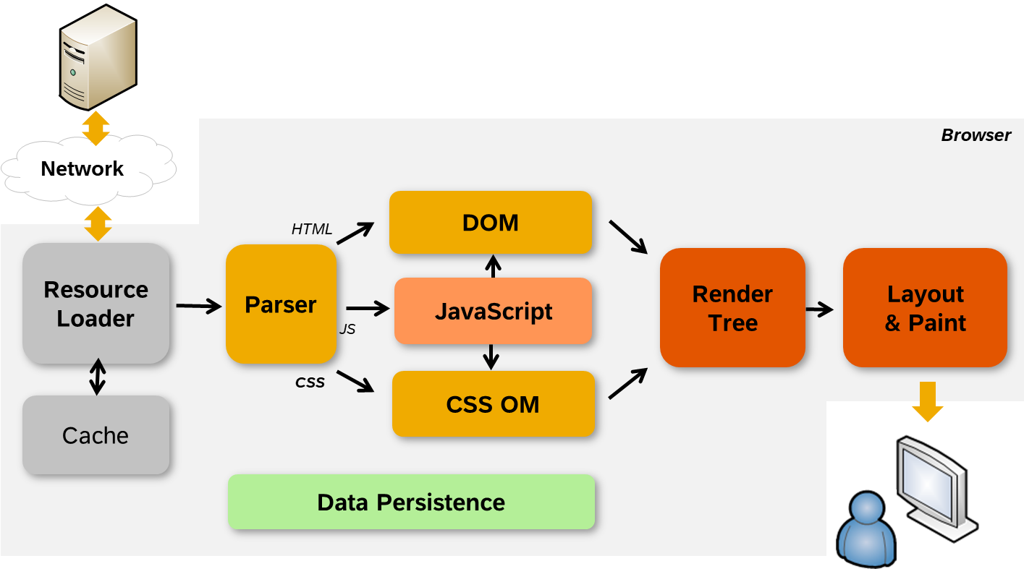
How browsers work

Slide 5
First-level break-down to frontend, network and backend performance issues
First-level break-down to frontend, network and backend performance issues
Big gaps?
No
Most probably high browser rendering time
Also high JavaScript processing time
Yes
Browser caching?
Network quality?
Check local machine
Check customer expectation
OK
OK
Not OK
Not OK
Long running oData calls?
No
Check browser settings for better performance
Check local IT policy
Latency < 200ms
Bandwith > 2 Mbps
Yes
Check backend
Check database

Slide 6
Fully optimized application – Round-Trips
Check if round-trips could be avoided or optimized
  Can it be removed completely (i.e. not used libraries, out-dated library, 3rd-party library duplicating browser functionality)?
  Can it be merged/aggregated to other requests ($batch, $expand, sprites, aggregated libraries …)?
  Can it be cached in the browser cache?
  Can it be cached for longer time?
  Can it be served through Content Delivery Network (CDN)?
  Can it be loaded in later point of time (on demand)?
  The fastest round-trip is the one that doesn’t happen!

Slide 7
Fully optimized application – Round-Trips (cont)
  Reduce resource fragmentation (JavaScript, CSS) by merging:
    /resources/js/myCodeList.js
    /resources/js/myCodeDetail.js
    /resources/js/myCodeUtils1.js
    /resources/js/myCodeUtils2.js
  Avoid loading of resource duplicates
    /resources/js/myCode.js
    /some/other.css
    /resources/js/myCode.js
    /resources/js/myCode.js
  Use aggregation of small images/icons
    Icon fonts
    CSS sprites
    Image sprites (including SVG sprites)
/resources/js/myLib.js
Bad Modularization?
  Use UI5 Builder:
    Library bundling
    Component-preload generation
    Minify sources

Slide 8
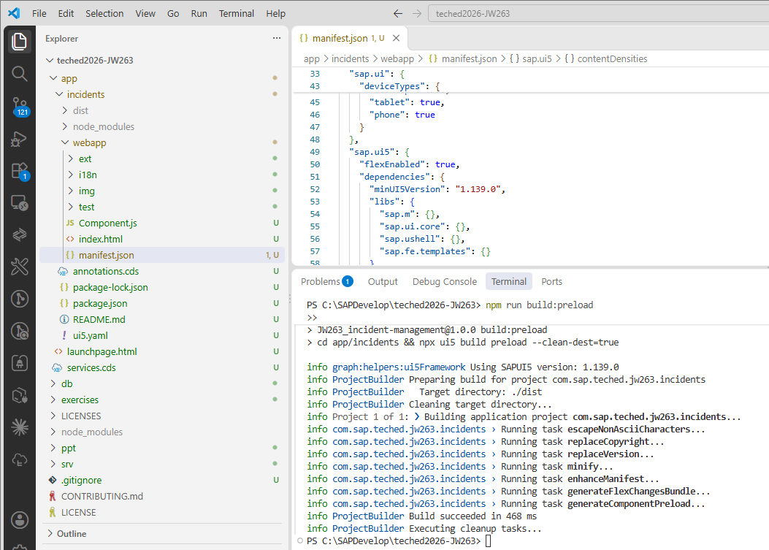
Exercises overview
  Getting started
    Clone our repository and start the server locally
  Exercise 1
    Introduction to the tools and network traffic
  Exercise 2
    Introduction to UI5 Builder
  Exercise 3
    Deep dive into network traffic
  Exercise 4
    Deep dive into OData requests
  (Bonus) Exercise 5
    Deep dive into additional settings

Slide 9

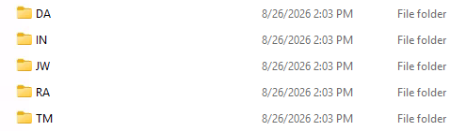
Let‘s get started
Access the exercises on your TechEd machine (shortcut)
JW263
Public available in:
https://github.com/SAP-samples/teched2026-JW263

