Slide 1
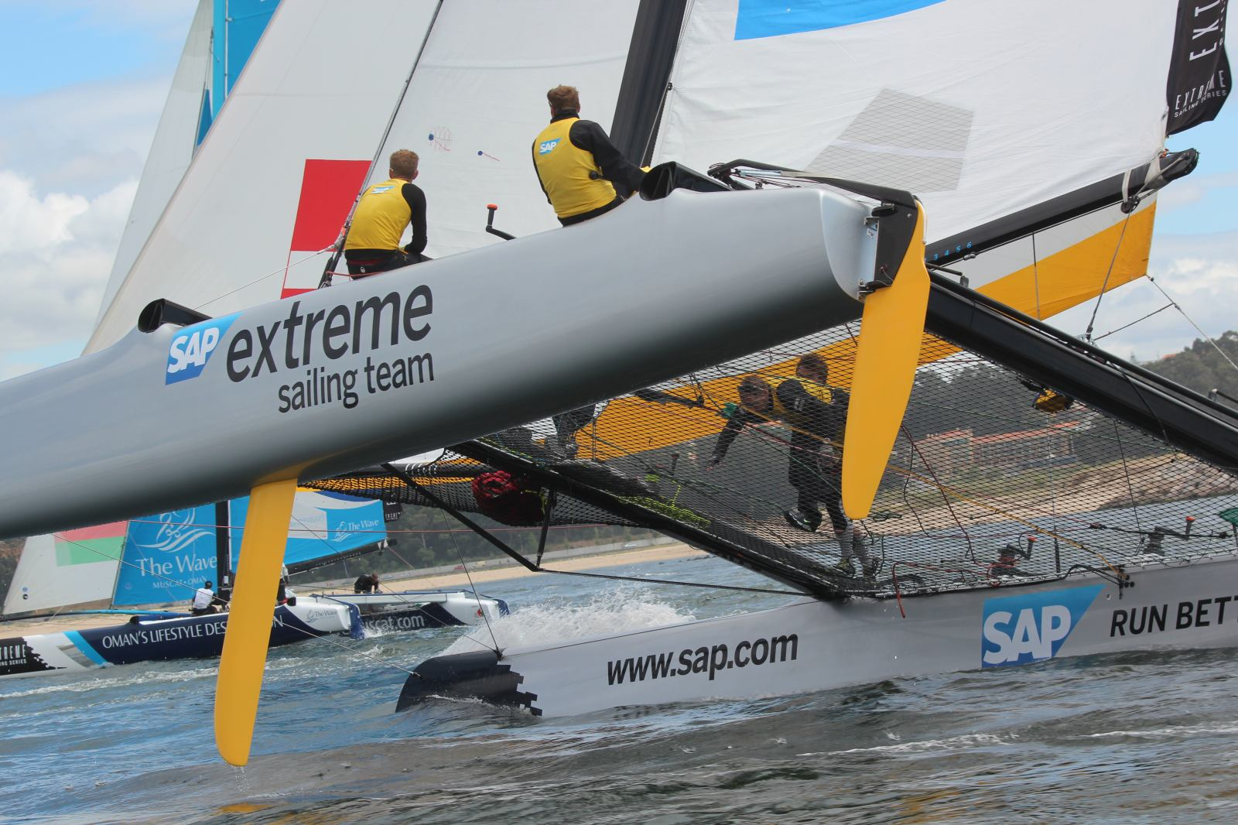

SAP Sailing Analytics
Software Architecture in a Showcase Set-Up
Axel Uhl, Global Sponsorships
March 21, 2013

Slide 2
Agenda
What is SAP Global Sponsorships About?
History of Sailing in SAP Global Sponsorships
From Kieler Woche 2011 to the 5O5 Worlds 2013 in Barbados
Laying the Cornerstones
Java and OSGi, Git, Maven, MongoDB
Recording and Analyzing Real-World Data in Memory with Java
Replacing a UI Layer
From a Python-based Web UI to GWT
Using OSGi Web Bundles
Caching and Locking in a Highly Concurrent Environment
Scaling an In-Memory Architecture with Replication

Slide 3

What is SAP Global Sponsorships About?

Slide 4
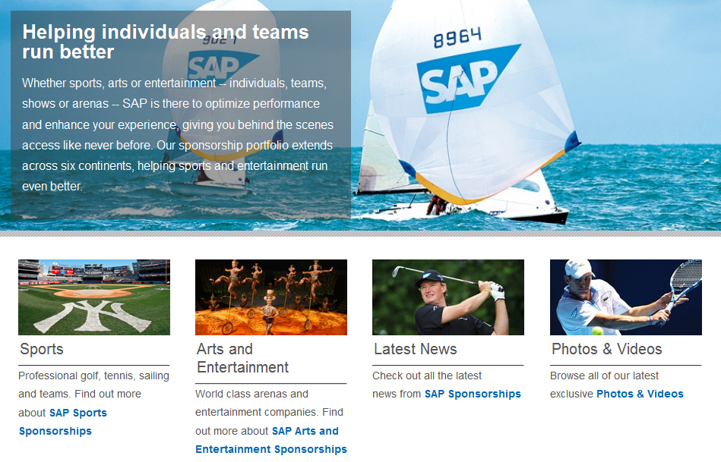

Slide 5
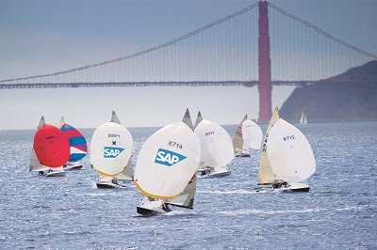

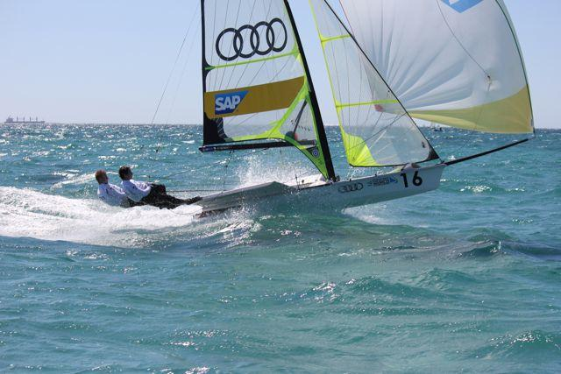
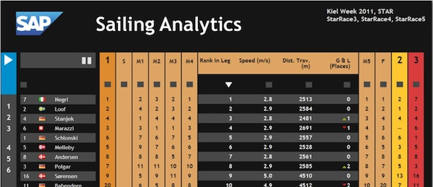

History of Sailing in Global Sponsorships
SAP Sponsors the 5o5 Worlds Since 2009
Hospitality Program
Since 2010 Tracking-Based Analytics
Kieler Woche 2011-2012
First Live Leader Board with Basic Live Analytics (e.g., Speeds, Distances, Wind)
Various Smaller Events with Live Analytics
IDM Travemünde, MdM Hamburg, Young Europeans Sailing Kiel, BMW Sailing Cup Wannsee, Berlin Match Race, Dragon IDM Wannsee, 49er Euros Lake Garda
Extreme Sailing Series
Live Analytics for the last three acts of 2012
Official Score Keeper and Analytics Provider for the 2013 Series
See http://sapsailing.com

Slide 6

Gathering Live Data from Sailing Boats

Slide 7
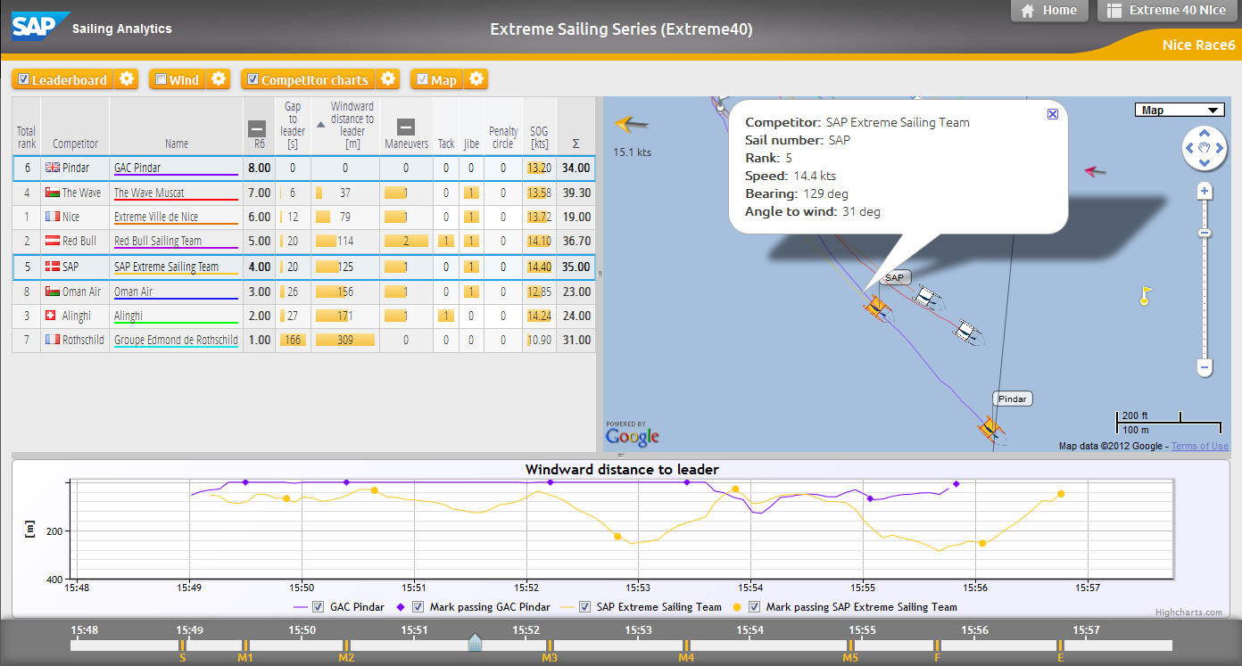
Analyzing a Single Race While It’s Live

Slide 8
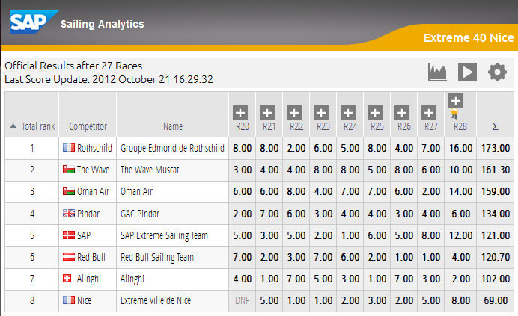
Live Regatta Leaderboard Based on Live Tracking

Slide 9

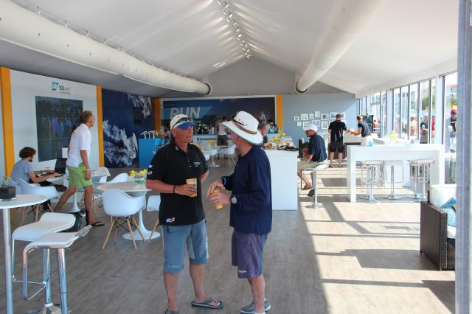
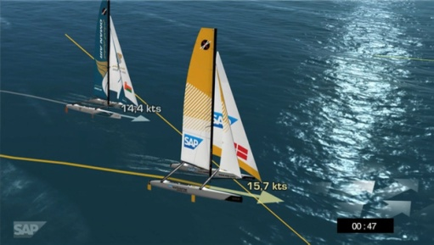
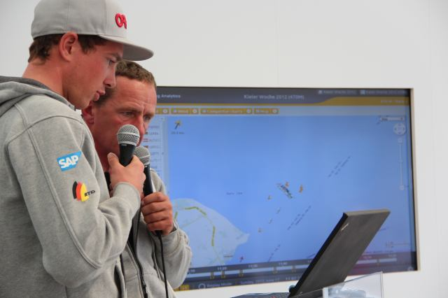
History of Sailing in Global Sponsorships
Typical Event Set-Up
Hospitality Program with Spectator Boats
Live Race Analytics shown to spectators on tablets
Lounge
iPads and big screens
On-Shore Viewers
Online live program with scheduled racing times and course areas
Live 2D / 3D Course and Race Visualization on shore
Live Internet streaming with commentary
Sailors Debrief using the SAP Sailing Analytics

Slide 10

Laying the Cornerstones

Slide 11



Started with Kieler Woche 2011 Requirements
Handle Live GPS and Wind Data
Calculate Live In-Race Ranking Based on Wind and Boat Positions
Provide Live Statistics about Distances, Speeds, Rank Changes, ETA
Choices for a Quick Prototype
Java with OSGi/Equinox to record and analyze live data
Insert-only; queries aggregate on the fly
Parallel aggregations for different key figures per query
Coarse-grained used of synchronized as q&d “locking”
Rendered JSON for multi-race leader-board in <10ms
Embedded Jetty as Servlet/RESTlet container
Explicit registration of RESTlets in bundle activator
Python to render HTML front-end
REST/JSON interfaces between Python and Java
Git, Junit, Maven, Hudson, MongoDB

Slide 12



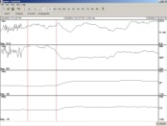




Kieler Woche 2011 System Landscape, Data Flow
sapsailing.com
HTTP
Expedition
Toughbook
TCP
UDP
TCP
UDP
Mobile hotspot
GSM / GPS Boat Tracker

Slide 13
Inside sapsailing.com
sapsailing.com
Apache
Java Equinox
Python
MongoDB
Wind and config data

Slide 14
Early Bundles Living Inside the Java Server

Slide 15
Produced this Output after Four Weeks

Slide 16
Evaluation of First Prototype
UI layer
Python server instance somehow redundant → move to GWT, eliminate Python instance
In-Memory On-the-Fly Aggregation
Works nicely, particularly for out-of-order delivery of GPS and wind data
Parallel execution results in nice speed-up for large leader-boards
Use of synchronized as poor-man’s locking replacement doesn’t scale particularly because of read-read lock-out → move to ReentrantReadWriteLock
First few key figures were well-chosen → add more, exciting figures for sailors
Front-end used only by one or two users so far → scaling to many users so far not required
Use of DB mostly for Recovery Only
Works well for the data volumes we face so far. All tracking of Kieler Woche takes less than 1GB of Java heap space.

Slide 17
Replacing a UI Layer
From a Python-based Web UI to GWT

Slide 18
Google Web Toolkit (GWT)
Allows Java developers to build rich, dynamic HTML5 applications
Cross-compiles Java to efficient JavaScript
Uses the Eclipse Java debugging infrastructure
Can be made play reasonably well with OSGi
Code can be shared between server and browser if a few constraints are obeyed
Powerful Eclipse JDT features available also for browser code
New versions of the leader-board and administration console
Replaces Python server instance
Runs more efficiently because more can be done in the browser more easily

Slide 19
Leaderboard as Re-Built with GWT

Slide 20
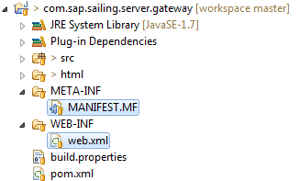

Switched from Explicit Registration to OSGi Web Bundles
Turned all Servlet/RESTlet providers into OSGi Web Bundles
No longer requires explicit registration in activator
Bundle start/stop and registration / deregistration handled automatically
Easily supports exposing web content
Easy compatible upgrades of UI and gateway bundles in running server
Helpful if server state is a bit expensive to re-construct after start-up
In MANIFEST.MF

Slide 21
GWT Bundles in OSGi

Slide 22
Caching and Locking in a Highly Concurrent Environment

Slide 23
Growing Complexity, Growing Data, More Users
5o5 Worlds 2012, La Rochelle, France
~190 boats in one fleet, racing concurrently
Races last about two hours each
In addition to commentary, several users in VIP lounge and on tablet devices
Where “insert-only” and “aggregate on the fly” bit us
Simple example: distance traveled for one competitor
Find first fix at or after start line passing
Sum up great-circle distance to the next fix that’s not an outlier
For a leader-board that’s O(c*f) with c=number of competitors and f=number of fixes
Java and OSGi, Git, Maven, MongoDB
Recording and Analyzing Real-World Data in Memory with Java
Second level
Third level

Slide 24
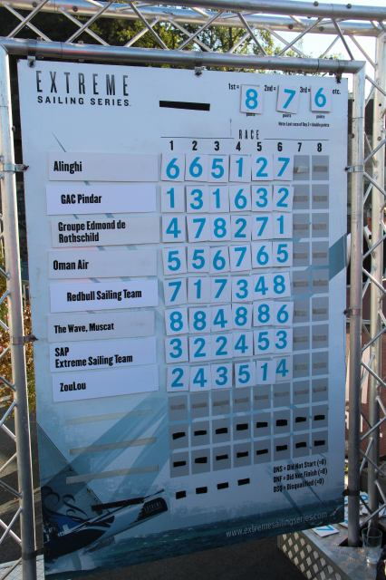
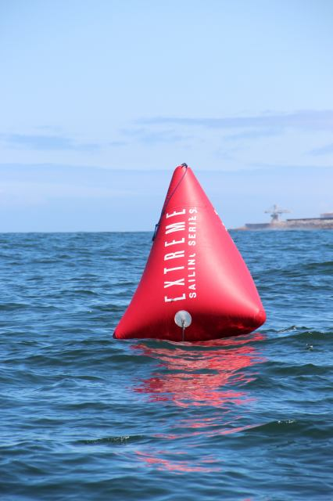
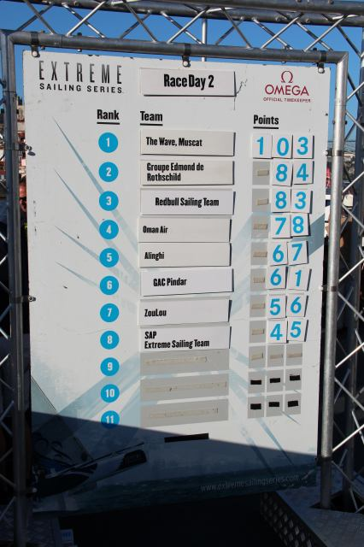
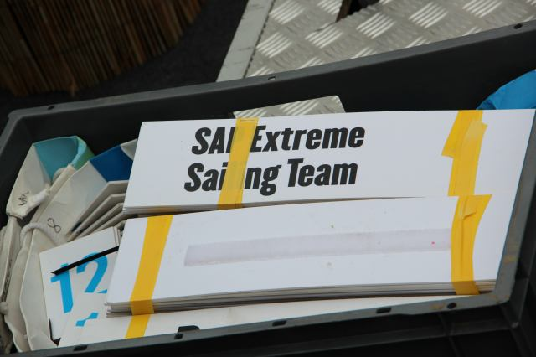
Insert page title
First level
Java and OSGi, Git, Maven, MongoDB
Recording and Analyzing Real-World Data in Memory with Java
Second level
Third level

Slide 25
Insert page title
First level
Java and OSGi, Git, Maven, MongoDB
Recording and Analyzing Real-World Data in Memory with Java
Second level
Third level

Slide 26
Scaling an In-Memory Architecture with Replication

Slide 27
Insert page title Subtitle
First level
Second level
Third level

Slide 28
Open Issues, Outlook

Slide 29
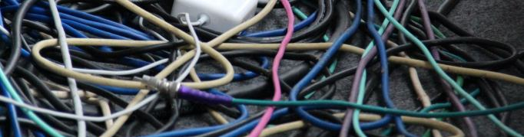
Questions?

Slide 30
Insert page title
First level
Second level
Third level

Slide 31
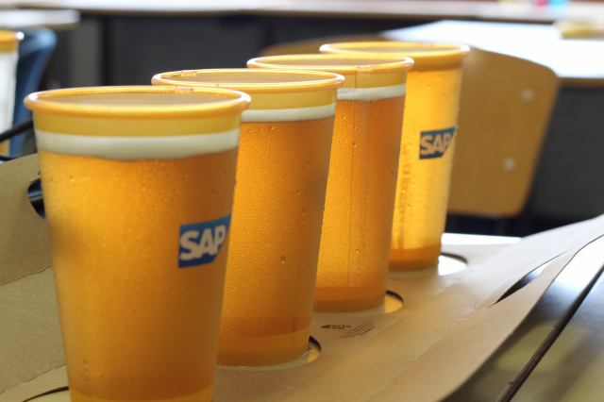

Thank you
Contact information:
axel.uhl@sap.com

