Slide 1
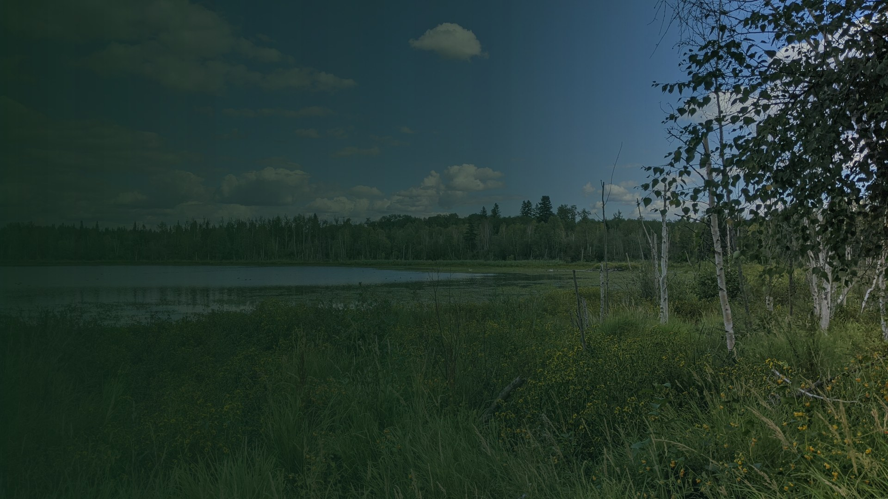
SIR-SAPAA · WEEKLY UPDATE
The map works.
Sprint 3 is close to done. Release Tuesday.
Friday, October 23, 2026 · University of Alberta CMPUT 401
Aaron · Abhinav · Alissa · Chris · Jayden · Saumya · Zanab

Slide 2
TODAY
Three things.
1
What is new since last Friday
2
Sprint 3: what ships Tuesday
3
What we need from you
Then questions from the team, and a summary.
2

Slide 3
1
What is new
since last Friday
Oct 16 to Oct 23
3

Slide 4
SINCE LAST FRIDAY
Where your four projects stand.
Fixes
Password reset is merged. The past-report edit is not complete.
P1
Testing
New tests for site links, GPX upload and offline areas.
2a
People
Profile report links and hidden answers are merged.
2b
Maps
Sites link to boundaries. The map shows details and saves areas offline.
2c
Code freeze is Sunday, Oct 25. Release is Tuesday, Oct 27.
4

Slide 5
SINCE LAST FRIDAY
New in Sprint 3.
Sites link to government boundaries
Map popup shows site details
2c
2c
View SIRs opens the site page
GPX upload, many files at once
2c
2c
Save a map area offline
Offline view marks missing tiles
2c
2c
Photo upload limits: 10 MB
A test for each new feature
P1
2a
All eight items above are merged and tested. Release is Tuesday.
5

Slide 6
ON OCTOBER 16
What you asked us on Oct 16.
Map colours
Sprint 4. Story 2.0.14. Two points.
Skills and focus areas
Sprint 4. Story 1.0.6. Two points.
Stewards without an account
Sprint 4. Story 3.0.4. Three points.
Proof of concept
Proposed for Sprint 4. We need your two requirements.
Your three requests are in Sprint 4. The proof of concept is new work.
6

Slide 7
2
Sprint 3:
what ships Tuesday
Oct 23 to Oct 27
7

Slide 8
NEXT WEEK
What we will do, project by project.
Fixes
Finish the past-report edit. Show the edits everywhere.
P1
Testing
Run all tests. Update the traceability matrix.
2a
People
Finish the activity totals on the profile.
2b
Maps
Draw GPX tracks on the map. List the unmatched sites.
2c
8

Slide 9
SPRINT 3 · DUE TUESDAY, OCTOBER 27
What the plan has by Tuesday.
Oct 22-23
Merged: profile links, password reset, map detail
Oct 24
GPX tracks on the map · Small, separate changes
Oct 25
Code freeze · All Sprint 3 work is merged
Oct 26
Release notes · The Sprint 3 release
Oct 27
20:00 deadline · Release is out
Planned dates. Four items are open. The release has one day of spare time.
9

Slide 10
SPRINT 3 · DUE TUESDAY, OCTOBER 27
Sprint 3: what is built.
Map
Sites link to boundaries. Popups show site details.
Built
2c
Tracks
GPX upload works. Tracks on the map are next.
Part built
2c
Offline
Save an area. Zoom 5 to 14. Up to 4,000 tiles.
Built
+
People
Profile report links and hidden answers.
Built
2b
Reports
Password reset is merged. Past-report edit is partial.
In progress
P1
Built means the code is finished. It is not released yet.
10

Slide 11
PROJECT 2C · MAPS
The map, in your four layers.
1
Base map
Alberta on load. Online and offline.
Working
2
Boundaries
A site links to its boundary when the names match.
Working
3
History
GPX files upload. Map lines are next.
Part built
4
Data views
Visit counts and the scoreboard.
Later
The link uses the exact site name. Unmatched sites need an admin.
11

Slide 12
THE CALENDAR WE WORK TO
Where we are on the calendar.
Sprint 1
Sprint 2
Sprint 3
Sprint 4
Sprint 5
Sep 29
Oct 13
Oct 27
Nov 17
Dec 1
Documentation
and discovery
Version 1.1,
released
The map and
history
Your requests
and the PoC
Field test and
handover
Sprint 4 starts Oct 28. The lab demo is that day.
12

Slide 13
3
What we
need from you
Decisions for Sprint 4
13

Slide 14
FOR SPRINT 4
Five decisions we need from you.
1
Proof of concept: our two suggestions. Do you agree?
2
Who is our contact at the Riverlot 56 Society?
3
December field test: which weekend? You, stewards or both?
4
If the PoC is large, we cut: activity points, priority or export?
5
Should each new request be a one-page change request?
Our two suggestions: media and GIS assets, and person roles.
14

Slide 15
SPRINT 4 · NOVEMBER 17
What Sprint 4 holds.
Your Oct 16 requests
Map colours, skill dropdowns, stewards without accounts. Seven points.
Access requests
Five stories. Twenty-nine points.
Planned items
Activity points, visit priority, all-files export, all-SIR summary.
Proof of concept
Proposed. No estimate. It needs your two requirements.
Sprint 4 is 65 points against 57 of capacity. We will review the load.
15

Slide 16
SUMMARY
Today in one slide.
This week
Next week
Coming up
Sites link to boundaries
Map popups show details
GPX files upload
Offline areas save
Merge the last features
Freeze Sunday
Release Tuesday
Nov 17: Sprint 4 and the PoC (proposed)
Dec 1: final release
December: field test
16

Slide 17
Round table.
Frank picks the order. Bring your test results.
17

Slide 18
BACKUP · SPRINT 3
Sprint 3: story status.
STORY | PROJECT | STATUS
Sites link to boundaries | 2c | Built
Site details from the map | 2c | Built
GPX upload | 2c | Built
Offline and online layers | 2c | Built
Sites on one map | 2c | Part built
Profile report links | 2b | Built
Password reset | P1 | Built
Edit past reports | P1 | Part built
Activity totals | 2b | Part built
Safety and iNaturalist | P1, 3a | Removed by client
18
18

Slide 19
BACKUP · OPEN ITEMS
What is not done.
GPX tracks on the map
Upload works. The map lines are not built.
Unmatched sites
The link uses exact names only. There is no admin list.
Profile links and password reset
Both are merged. The reset needs one email setting changed.
Activity totals
Part built.
We will report these on Tuesday.
19

