Slide 1



Avoiding Version Chaos in a Multi-Version World
June Blender
Technical Evangelist
SAPIEN Technologies, Inc.
Windows PowerShell MVP
juneb@sapien.com - @juneb_get_help
Notes:
Embarassment of riches

Slide 2
About this presentation
The information in this presentation applies to:
Windows PowerShell 5.0.10586.122, 5.0.11082.1000, 5.0.14279.1000
Microsoft.PowerShell.Core\Get-Command, Get-Module, Import-Module 3.0.0.0
PowerShellGet 1.0.0.1
PackageManagement 1.0.0.1

Slide 3
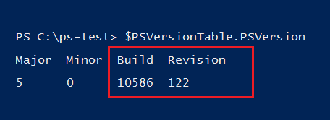
PowerShell 5.0 is not final
It can (and probably will) change with Windows Update
Build and revision numbers in versions
PowerShell is backward-compatible. But, changes aren't backported.

Slide 4
Modules are coming from more sources
Versioned, but might not be backward-compatible
Microsoft: In Windows
PowerShell Gallery
PowerShellGet: Other galleries
PackageManagement (OneGet)
GitHub
Friends, colleagues

Slide 5
Side-by-Side Module Versions
Beginning in Windows PowerShell 5.0, you can install different versions of the same module on the same computer.

Slide 6
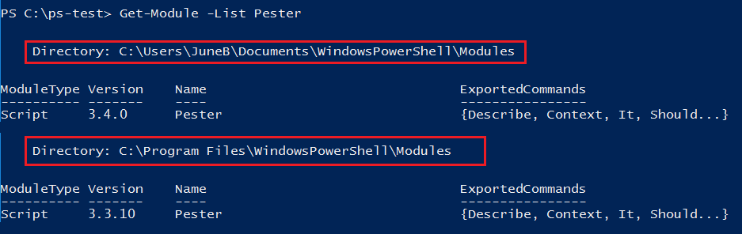
Different versions of the same module … in different paths

Slide 7
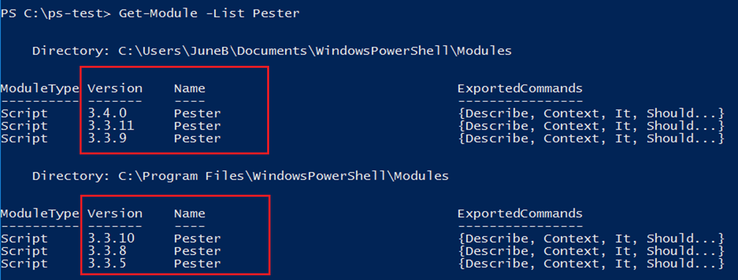
Different versions of the same module … in the same path

Slide 8
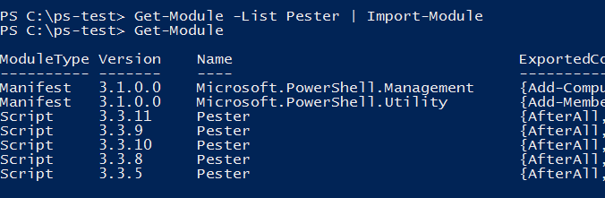
And, you can import them. All of them. Into the same session.

Slide 9
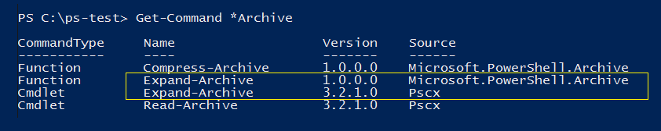
Commands with the same name in different modules
Module-qualified name: PSCX\Expand-Archive
Microsoft.PowerShell.Archive\Expand-Archive

Slide 10
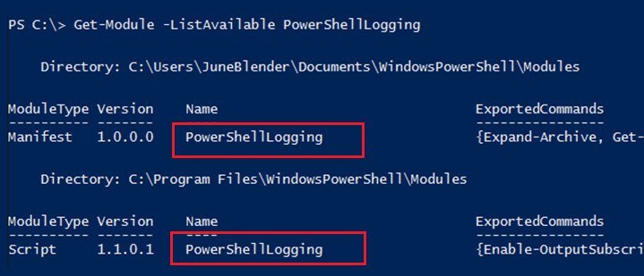
Different modules with same name

Slide 11
What could possibly go wrong?
Which version of a module is imported?
Which version of a command runs?
How do different versions differ?
How do I assure my script runs the command I want?

Slide 12
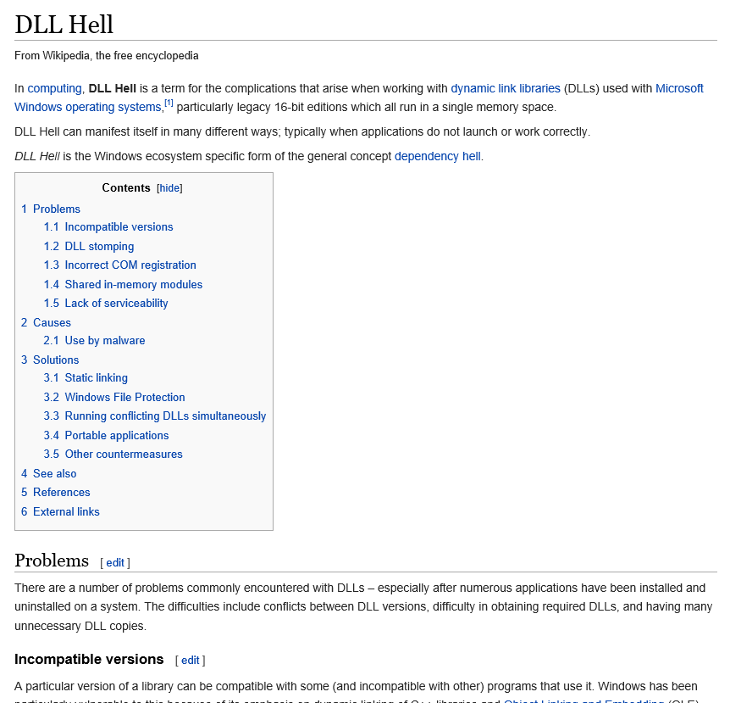
Notes:
This is not a protest.

Slide 13
About_MyModule
TOPIC
About_MyModule
SHORT DESCRIPTION
…
This module requires Windows PowerShell 5.0.11086, PSCX 3.3.12, PSLogging 2.5.3, and lots of luck.
Each of these modules requires other versions of other modules…

Slide 14
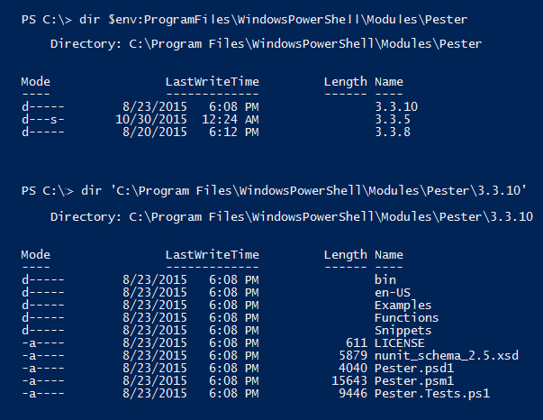
Side-by-side: How do they do it? "Version-Wrapped Modules"
Modules in a version subdirectory
DEMO

Slide 15
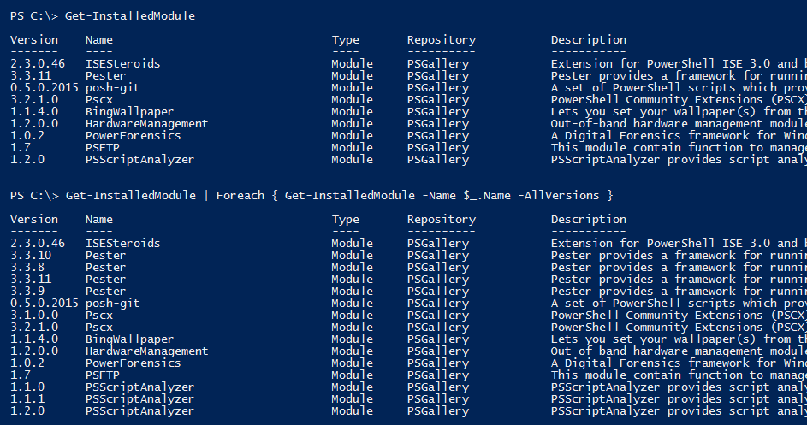
PowerShellGet on PowerShell 5.0+ Installs versioned modules
Notes:
Get-InstalledModule : The RequiredVersion, MinimumVersion, MaximumVersion or AllVersions parameters are allowed only when you specify a single name as the value of the
Name parameter, without any wildcard characters.

Slide 16
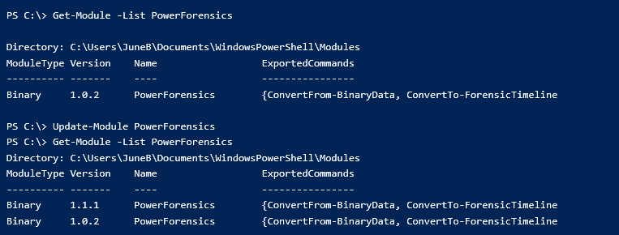
Update-Module in PowerShellGet
Adds the newest version of the module to the same directory

Slide 17
Taming the Beast: Avoid Version Chaos
Require a version of Windows PowerShell
Require and import the versions of the modules you need
Specify the command that runs:
Module-qualified names
Fully-qualified names (with versions)
Prefixes
Documentation (blogs, videos) need version info

Slide 18
Require a version of PowerShell
Easy! #Requires -Version
DEMO
Notes:
Demo now!

Slide 19
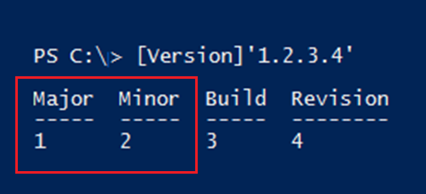
#Requires -Version
Specifies the version of Windows PowerShell
Specifies the minimum version (not a required version)
Inspects only the Major and Minor properties of the version number, not the Build or Revision.
Notes:
Test-PSVersionRequirement.ps1

Slide 20
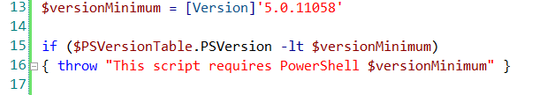
Require a version of PowerShell
To test major and minor build numbers, use #Requires -Version
To test build or revision, use:
-lt, -le, eq
$PSVersionTable.PSVersion.CompareTo( <version> )

Slide 21
Require a module
#Requires -Module <Name>
#Requires -Module <ModuleSpecification>
Imports the first version of the module that it discovers
(newest version in the user module directory)
Same as Import-Module
Notes:
Imports the newest module in the user module directory

Slide 22
ModuleSpecification [Microsoft.PowerShell.Commands.ModuleSpecification]
#Requires -Module
Parameters: -FullyQualifiedName, -FullyQualifiedModule
@{ModuleName=<string>; ModuleVersion=<Version> [;GUID=<GUID>]}
@{ModuleName=<string>; MaximumVersion=<Version> [;GUID=<GUID>]}
@{ModuleName=<string>; RequiredVersion=<Version>[;GUID=<GUID>]}
To test your module spec, cast it!
[Microsoft.PowerShell.Commands.ModuleSpecification]@{...}

Slide 23
Require a module : Module Specification
#Requires -Module Pester
#Requires -Module @{ ModuleName = 'Pester'; ModuleVersion = '3.3.9'}
#Requires -Module @{ ModuleName = 'Pester'; MaximumVersion = '3.3.9'}
#Requires -Module @{ ModuleName = 'Pester'; RequiredVersion = '3.3.9'}
** ModuleVersion == MinimumVersion
** -Min/Max version don't import the earliest/latest version. They import the first version discovered that meets the specification.
DEMO

Slide 24
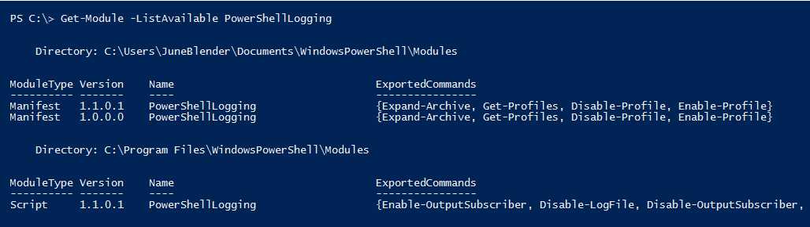
GUID doesn't trigger autoload
#Requires -Module @{ ModuleName = 'PowerShellLogging'; RequiredVersion = '1.1.0.1'; GUID = '345320b5-bdc3-4ab6-a13e-fcb019362fe6'}

Slide 25
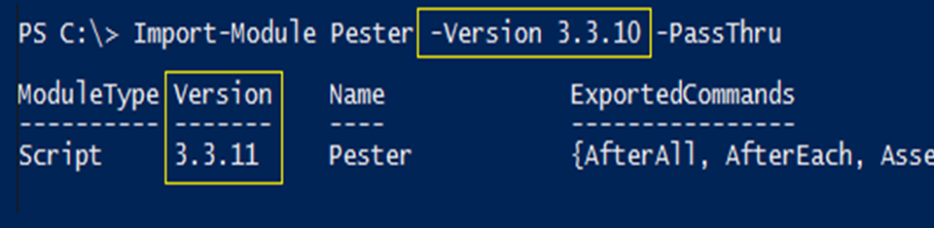
Version Parameters
-Version (3.0); Alias = MinimumVersion
-RequiredVersion (3.0)
-MaximumVersion (5.0)
-AllVersions (PowerShellGet, PackageManagement)
Prefix parameter, too!
Notes:
Doesn't always import the latest: PSReadline

Slide 26
Cmdlets with Version Parameters
Find-DscResource
Find-Module
Find-Package
Find-PackageProvider
Find-Script
Get-InstalledModule
Get-InstalledScript
Get-Package
Install-Module
Install-Script
Install-Package
Install-PackageProvider
Import-Module
Import-PackageProvider
Publish-Module
Save-Module
Save-Package
Save-Script
Uninstall-Module
Uninstall-Package
Uninstall-Script
Update-Module
Update-Script
Update-ScriptFileInfo
Notes:
Doesn't always import the latest: PSReadline

Slide 27
Import-Module
Default: PSModulePath discovery order ($home\...\Modules)
# Imports the first conforming module it discovers
Version (minimum) imports first module >= version.
MaximumVersion imports the first module <= version.
RequiredVersion imports the specified version.
FullyQualifiedName takes ModuleSpecification object.
DEMO

Slide 28
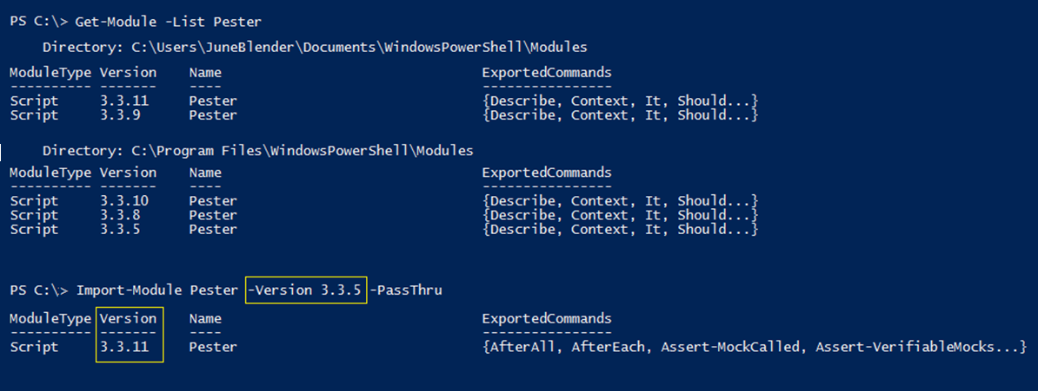
Import-Module -Min/Max version don't import the earliest/latest version. It imports the first version discovered that meets the specification.

Slide 29
Get-Module Remove-Module
-FullyQualifiedName <ModuleSpecification>
Get-Module -ListAvailable `
-FullyQualifiedName @{ModuleName='Pester'; ModuleVersion = '3.4.0';
GUID='a699dea5-2c73-4616-a270-1f7abb777e71'}
Remove-Module -FullyQualifiedName @{ModuleName='Pester'; RequiredVersion = '3.4.0'; GUID='a699dea5-2c73-4616-a270-1f7abb777e71'}
-Min/Max version don't import the earliest/latest version. -It imports the first version discovered that meets the specification.
-Doesn't trigger module autoload. Needs Import-Module.

Slide 30
Cmdlets with -FullyQualifiedName/Module
@{ModuleName=<string>; ModuleVersion=<Version> [;GUID=<GUID>]}
Get-Command
Get-Module
Import-Module
Remove-Module
Export-PSSession
Import-PSSession
Save-Help
Update-Help

Slide 31
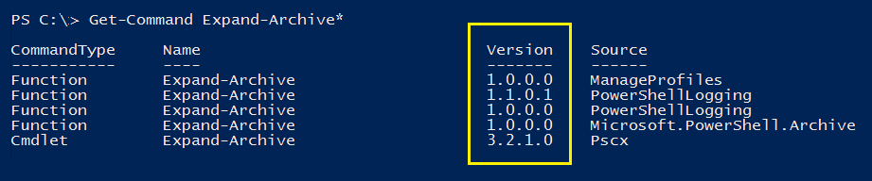
Get the Right Command

Slide 32
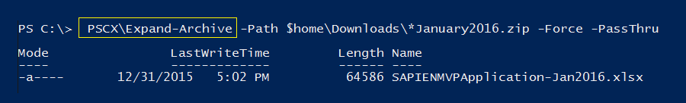
Run the right command

Slide 33
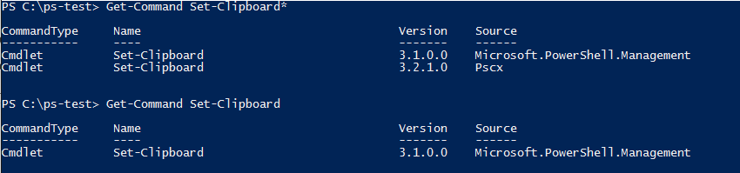
Command Precedence
Commands with the same name: Use type to decide. Alias -> Function -> Cmdlet -> Native Windows command
Command with same name and type:
Command added to session last
Which command will run? Get-Command (no wildcards)
about_Command_Precedence
Notes:
No demo. Keep going.

Slide 34
Get the Right Command
# Wildcards: Gets all commands with the name pattern
Get-Command -Name <Name>*
# No wildcards : Gets the command that would run
Get-Command -Name <Name>
# Qualified by module name, version, GUID
Get-Command -FullyQualifiedModule
# Get only commands in the session Get-Command -ListImported

Slide 35
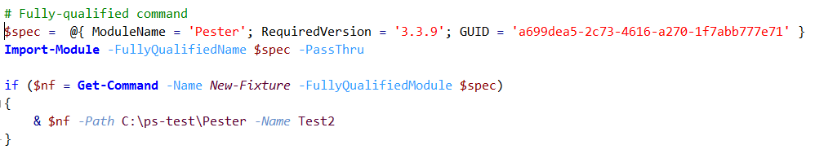
Run the right command
Module-qualified command: <Module>\<Command>
Fully-qualified command: & Get-Command <ModuleSpecification>
Prefixes

Slide 36
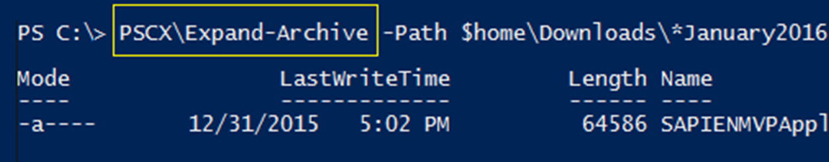
When module name is ambiguous, use module-qualified command...
SYNTAX: <ModuleName>\<CmdletName>
EXAMPLE: PSCX\Expand-Archive # No version qualifier
* Works only for exported commands

Slide 37
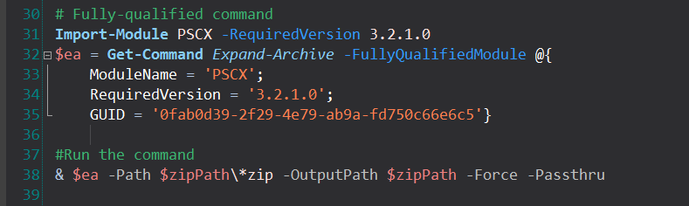
When the version or guid is ambiguous, use fully-qualified command
1. Get-Command -FullyQualifiedModule <ModuleSpecification> 2. Invoke operator: & (Get-Command...)
* Does not trigger module autoload. Need Import-Module
DEMO*2

Slide 38
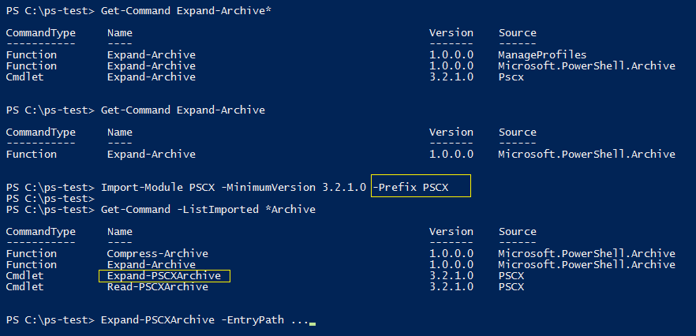
Command prefixes ???
Use Prefix parameter of Import-Module

Slide 39
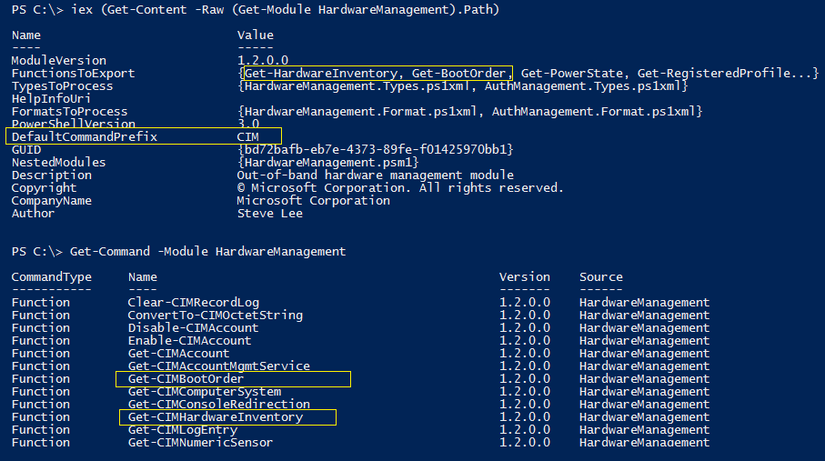
Use command prefixes
Use DefaultCommandPrefix key in module manifest

Slide 40
Taming the Beast: Avoid Version Chaos
Require a version of Windows PowerShell
Require and import the versions of the modules you need
Specify the command that runs:
Module-qualified names
Fully-qualified names (with versions)
Prefixes ?
Documentation (blogs, videos) need version info

Slide 41
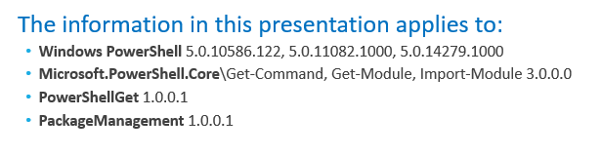
Call to Action: Blogs, Talks, and Videos
Date of publication, latest update
PowerShell version
Module versions

Slide 42
Avoiding Version Chaos in a Multi-Version World
June Blender
Technical Evangelist
SAPIEN Technologies, Inc.
Windows PowerShell MVP
juneb@sapien.com - @juneb_get_help

