Slide 1

A Class of Wine
June Blender
Technology Evangelist
SAPIEN Technologies, Inc.
juneb@sapien.com
@juneb_get_help
Create a scripted Class in windows PowerShell 5.0

Slide 2


SAPIEN USB Drive
Contains complete and latest versions of all SAPIEN products
Lasts for 10 calendar days after activation (use it or lose it)
Must be activated before the last day of this month.
Questions about license keys or buying software? Contact sales@sapien.com
Questions about products? Contact me (juneb@sapien.com) or SAPIEN Trial Forum.

Slide 3
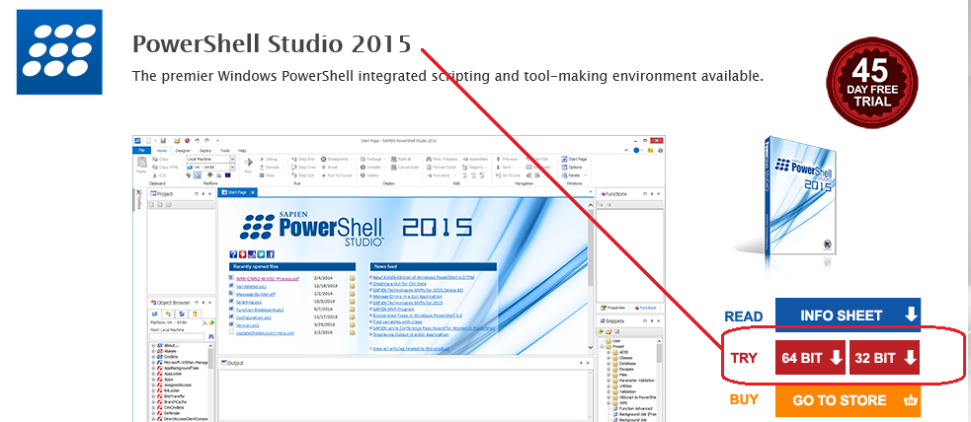
PowerShell Studio 2015
Go to: www.sapien.com/software/powershell_studio

Slide 4
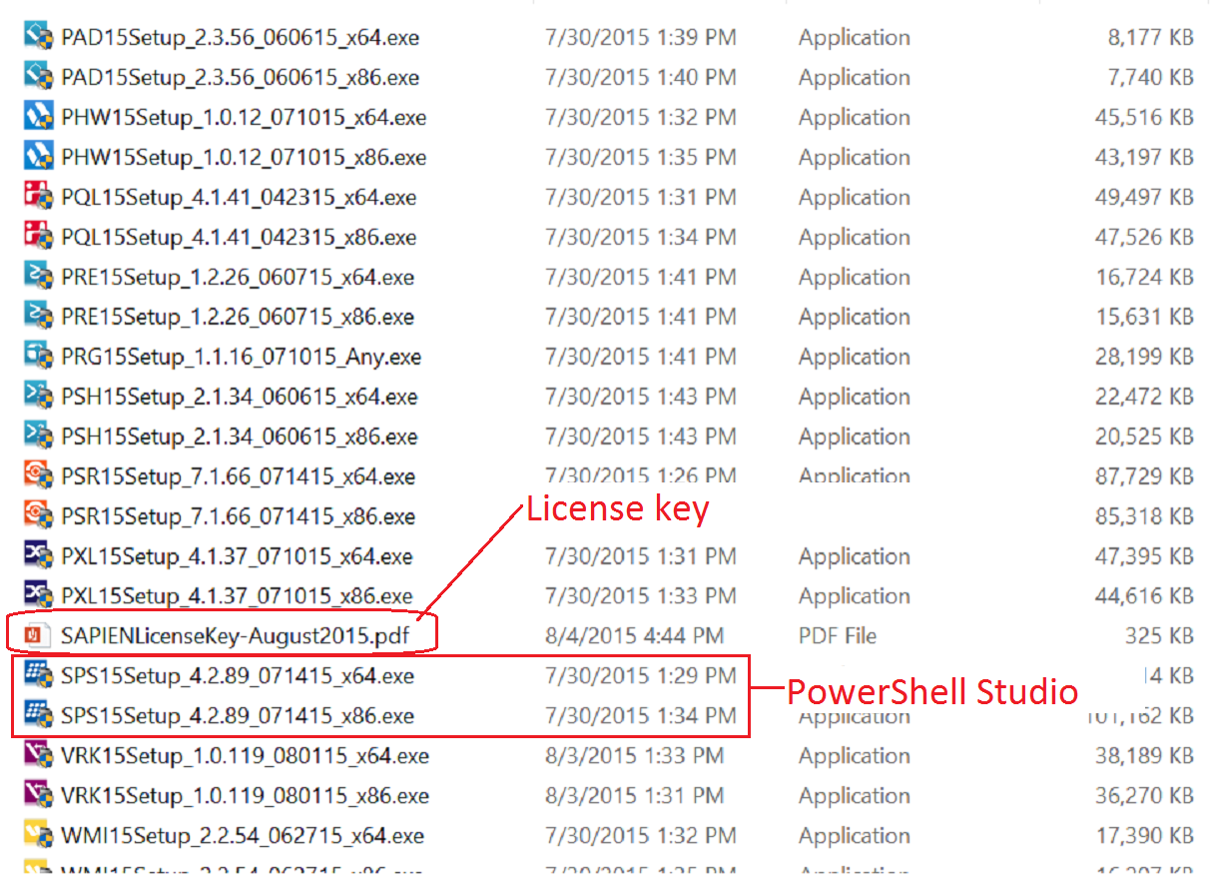
SAPIEN USB Key

Slide 5

What is a class?
In Windows PowerShell, a class defines a type of object.
The class is not an object.
It's like a specification of an object.
You can create objects based on the specification.

Slide 6

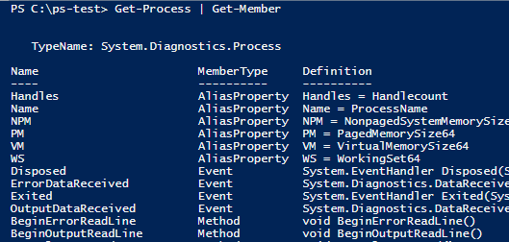

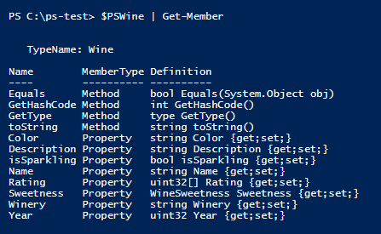
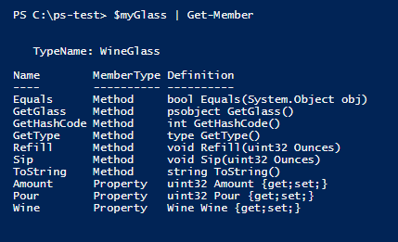

To discover classes, use Get-Member
Wine
WineGlass

Slide 7

What is an instance?
It's an object that's based on a class.
Like a house that's built from a model (but more reliable!)
It has the properties and methods that the class defines, like Roof and Door.
But it's property values might differ from other instances, like: Roof = Composite Door = 1

Slide 8
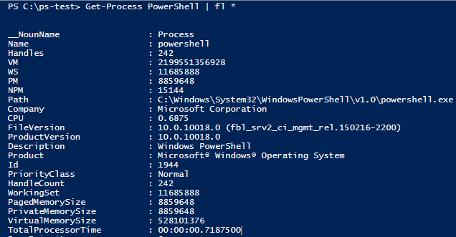
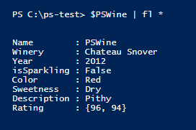
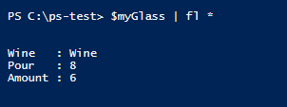
To discover instances, use Format-List -Property * (fl *)
Wine
WineGlass

Slide 9
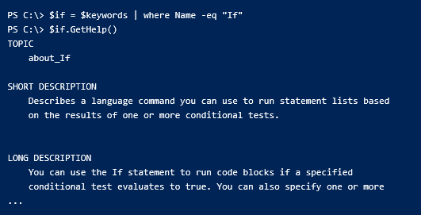
Why?
You create custom objects … from hash tables, CSV files, Select-Object
What if you could create classes -- reusable object models -- with methods?

Slide 10

Classes: The Final Frontier
Write a script
Create a module
Write a function
DevOps Continuum
Run scripts
Create a class
Run cmdlets
Script with your own classes

Slide 11
Demo: Wine Class
Define the Wine class
Create instances of the Wine class
Use their properties and methods
Version 5.0.10240
[Wine]::new()
New-Object –TypeName Wine

Slide 12
Create a class : Class keyword
Syntax:
class <className> { }
Example:
class Wine { }

Slide 13
Create an object -- "instance of the class"
-- Use the New static method
Syntax:
[ <className> ]::New(<Optional_Constructor>)
Example:
$myWine = [Wine]::New()

Slide 14
Create an object -- "instance of the class"
-- Use the New-Object cmdlet
Syntax:
New-Object -TypeName <className> -ArgumentList <Constructor>
Example:
$myWine = New-Object -TypeName Wine

Slide 15
Create an object -- "instance of the class"
-- From a hashtable (Get-Help about_Object_Creation)
Syntax:
New-Object -TypeName <className> -ArgumentList <Constructor>
Example:
$myWine = [Wine]@{}
Requires: A constructor with no parameters () : "null constructor"

Slide 16
Add properties
Syntax:
class <className> {
[<Attribute>] [<Type>] <PropertyName> [= <defaultValue>] }
Example:
class Wine
{
[String] $Name
}

Slide 17
Wine class properties
class Wine
{
[String] $Name
[String] $Winery
[Int32] $Year
[ValidateSet("Red", "White", "Rose")][String] $Color
[Double] $Price = 0.0
}

Slide 18
Get/Set Property Values (in other languages)
class Wine {
[String] $Name
...
}
$myWine = [Wine]::new()
$myWine.Name = "Great Duck"
Error: Name is a read-only property. #Not PowerShell
$myTree.Name
Error: Name is a private value. #Not PowerShell

Slide 19
Get/Set Property Values (in Windows PowerShell)
class Wine {
[String] $Name # <-- Property
...
}
$myWine = [Wine]::new()
$myWine | Get-Member -Force ...
Name Property string Name{get;set;}
get_Name Method string get_Name()
set_Name Method void set_Name(string )

Slide 20
Add Constructors
# Constructors
Wine () {} # Null constructor; Automatic in Windows PowerShell
Wine ([string]$Name) {$this.Name = $Name}
Wine ([string]$Name,
[string][ValidateSet('Red','White','Rose')]$Color), ...
{
$this.Name = $Name
$this.Color = $Color
...
}

Slide 21
Add Constructors ("ctor")
Special methods for creating an instance of the object.
Constructor name is always the class name.
Multiple constructors for a class.
Each constructor must take a different number or type of parameter values.
Windows PowerShell adds a null constructor (no parameters) to every class.
- But when you add an explicit constructor, it disappears (overridden).

Slide 22
Find the constructors
Syntax:
[<ClassName>]::New #<-- No parentheses
Examples:
[Wine]::New
[System.Version]::New
[System.DateTime]::New

Slide 23
Calling a constructor: create new instance
[<className>]::New(<constructor>)
Constructor:
Wine () {}
Call:
$myWine = [Wine]::New()
Constructor:
Wine ([string]$Name, [int]$Year)
{
$this.Name = $Name
$this.Year = $Year
}
Call:
$myWine = [Wine]::new('PSWine', 2006) #No parameter names!
$myWine = [Wine]@{Name='PSWine'; Year=2015} #Requires null/"parameter-less" constructor
$myWine = New-Object -Type Wine -ArgumentList 'PSWine', 2015

Slide 24
$this
Refers to the current instance of the class (like $_ for classes)
Distinguishes properties of the class from parameters and variables.
class Wine
{
#Properties
[String] $Name
[Int32] $Year
wine ($WineName, $Year) {
$this.Name = $WineName
$this.Year = $Year
}
}

Slide 25
Add methods : syntax
[returnType] <methodName> ([<parameters>]) {
<process parameter values>
[return] <returnType expression> }

Slide 26
Add methods : syntax
[returnType] <methodName> ([<parameters>]) {
<process parameter values>
[return] <returnType expression> }
[Double] Discount ([Int32]$Percentage)
{
$this.Price = $this.Price * ((100 - $Percentage) / 100)
return $this.Price
}

Slide 27
Wine class methods
class Wine
{
...
# toString() # Override: Returns a human-readable string.
# Methods
[String] toString()
{
return "$($this.Color) Wine: "
+ "$($this.Name) $($this.Year) by $($this.Winery)."
+ " Priced at: $("{0:C}" -f $this.Price)."
}
}

Slide 28
Rules for methods
[returnType] <methodName> ([<parameters>]) {
<process parameter values>
[return] <returnType expression> }
Parentheses around parameters are required ()
Default return type is void (nothing)
...

Slide 29
Rules for methods
[returnType] <methodName> ([<parameters>]) {
<process parameter values>
[return] <returnType expression> }
All parameters are mandatory and positional
No parameter sets. Instead, multiple methods with same name and different parameter types ("overload").

Slide 30
Return keyword
-- Standard PowerShell
Exits current scope
[Optional] Returns object (return $path)
Does not prevent the function from returning other objects.
-- In PowerShell scripted classes
Exits current scope
[Optional] Returns object (return $path)
Prevents the function from returning other objects.
function Test-Return
{
'Hello'
return 12
}
class ReturnTester
[int32] TestReturn ()
{
'Hello'
return 12
}

Slide 31
Return Types: Contract
Optional. The default is "[void]" : Cannot return anything.
Every logical path must return the same type.
Return keyword is required when return type is not void.
[String] GetHelp()
{
[String]$firstRef = $this.Reference.Split(",").Trim() | Select-Object -First 1
try
{
return Get-Help $firstRef
}
catch
{
return ""
}
}

Slide 32
Overload: Same name, different signature
In same class or parent class
Drink ([int]Amount) { ... }
Drink () { ... }

Slide 33
Override: Same name, same signature
In superclass class and subclass : Local takes precedence
class Glass {
Drink ([int]Amount) { ... }
}
class WineGlass : Glass {
Drink ([int]Amount) { ... }
}

Slide 34
Subexpression $(…)
Evaluates the statements in parentheses
Includes the output in the result.
Required for multiple statements and properties of an object.
Avoids intermediate variable
Try It!
"Hello from (Get-Service WinRM).DisplayName"
"Today's date is Get-Date."

Slide 35
Calling class methods
No parameter names; All parameters are mandatory and positional; Parentheses are required
[String] Sip ([Int]$Ounces, [String]$Response) {
if ($this.Amount ge- $Ounces)
{
$this.Amount -= $Ounces
return "Oh! $Response"
} }
$myWine.Sip(2, "What a delightful finish!")
$myWine.Sip("what a delightful finish", 2)
$myWine.Sip(2)
$myWine.Sip(-Amount 2 -Response "what a delightful finish")

Slide 36
Create a wine (hash table)
(Feb. v5.0.10018.0)
$myWine = [Wine]::New() # Must be explicit
$myWine = [Wine]@{Name="Great Duck";
Winery="Escalante Winery";
Year="2003";
Color = "White";
Price = 32}

Slide 37
Enumerated types ("enums")
enum WineSweetness
{
VeryDry
Dry
Moderate
Sweet
VerySweet
}
enum WineSweetness {VeryDry; Dry; Moderate; Sweet; VerySweet}
class Wine
{
#Properties
...
[WineSweetness] $Sweetness ...
}

Slide 38
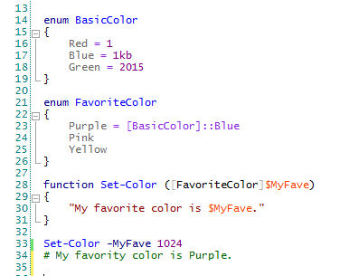
Enum value rules
Default values are zero-based integers.
You can change to a different int, but you can't change the base type.
Values can be expressions that return an int.
Can't be the result of an invoked command. ("Must be a parse-time constant.")
You can't define it or refer to it at the command-line. ("You can't use a type literal outside the script/module file in which the class is defined.")

Slide 39
Using enums
enum WineSweetness {VeryDry; Dry; Moderate; Sweet; VerySweet}
#Properties
[WineSweetness] $Sweetness
$myWine.Sweetness = 4
$hisWine.Sweetness = VerySweet

Slide 40
Enums: set alternate int values
enum WineSweetness
{
VeryDry = 10
Dry = 20
Moderate = 50
Sweet = 90
VerySweet = 100
}
class Wine
{
#Properties
...
[WineSweetness] $Sweetness ...
}

Slide 41
Interacting Classes
Create a WineGlass class
class WineGlass
{
[Wine]$Wine
[Int] $Size
[Int] Amount
...
}

Slide 42


Inheritance
Hierarchy of classes
Child classes inherit properties and methods (and events and other members) from parent classes
If they don't like them, they can override them.
Terminology:
Parent class: Superclass, base class
Child class: Subclass

Slide 43
Inherit from System.Object
All .NET classes are derived from System.Object ("superclass")
Superclass System.Object System.Object
| | |
Subclass Wine Glass
|
WineGlass, BeerGlass

Slide 44
Inherit from other classes
Base a scripted class on a .NET class (heritable, not sealed)
Base a scripted class on another scripted class
System.Object System.Object System.Object
| | |
Wine, Tree Glass KeyedCollection (.NET class)
| |
WineGlass FileCollection

Slide 45
Create a subclass : syntax
class <subClassName> : <SuperClass>
class WineGlass : Glass {}

Slide 46
Hidden: sort of…
Hidden keyword
Hidden hides them from Get-Member and other cmdlets (Format-List *), but you can see them in Get-Member -Force.
class WineGlass : Glass
{
hidden [int] Consumed
hidden [int] TotalPoured
}

Slide 47

Interfaces
An interface is a like a contract.
It guarantees that classes have the members (properties/methods/events) that it specifies.
But, the interface does not specify how the members work.
Classes that "sign the contract" implement the interface.
They have the members that the interface specifies ("signature").
Each class can implement multiple interfaces.
Classes can inherit multiple interfaces and override them.

Slide 48
Interfaces in .NET
IEnumerable: enumerating, foreach
IComparable: sorting
IClonable: duplicate instances of the class
IFormattable: change toString() behavior
IDisposable: garbage collection, releasing unused resources
To find the interfaces a class implements:
[<className>].ImplementedInterfaces # PowerShell 4.0
[<className>].GetInterfaces() # PowerShell 5.0

Slide 49
Interfaces : syntax
Scripted classes can implement interfaces
You cannot (yet?) create/define interface
class <className> : <interfaceName>
class <className> : <superclass>, <interfaceName> [,<interfaceName>, ...]

Slide 50
Get-Help
Script help, About topics
Best practices:
-- Examples: -- Show how to create an instance (constructors). -- Show how to use the properties and methods.
-- Explain the purpose of the class and its instances.
-- Describe the properties and their values.
-- Explain the methods, their parameters/values, and return values.
-- Note inheritance, interfaces, overrides.

Slide 51
Classes in 5.0.10240
You can create scripted classes in Windows PowerShell 5.0 preview.
class <className> [: <Superclass>, <Interface]
Classes have constructors to make instances of the class
Classes have properties and methods.
Windows PowerShell adds getter/setter methods for properties.
Classes can inherit from other classes (and System.Object)
You can override inherited methods.
Classes can implement .NET interfaces.
You can include classes in scripts and modules.
You can write help for classes.

Slide 52
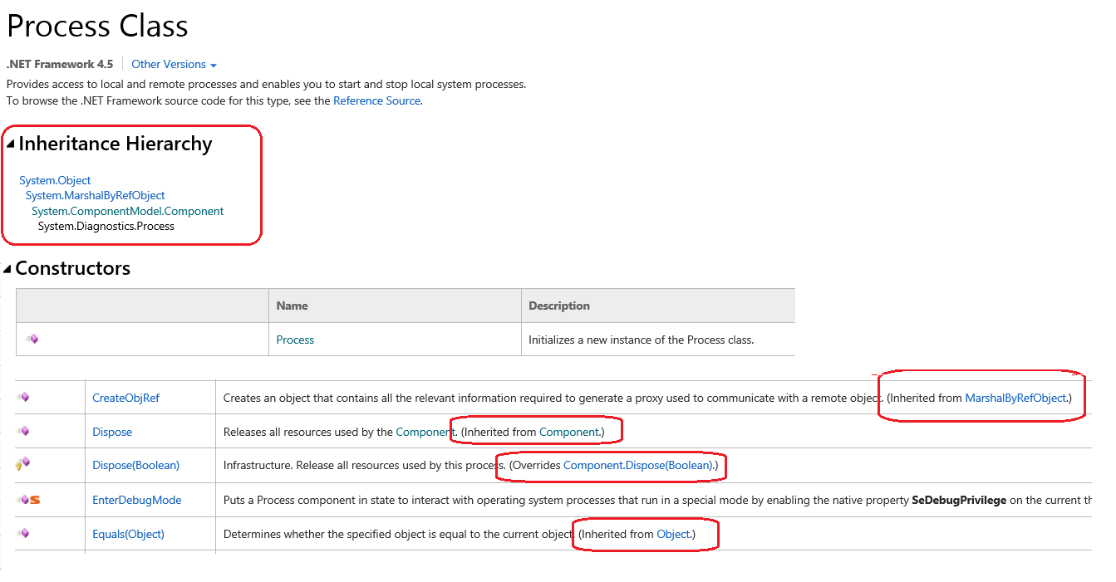
Understanding MSDN

Slide 53
Resources
about_Classes
Hey, Scripting Guy (videos and blog posts)
Implementing a .NET Class in PowerShell v5 by Trevor Sullivan
Playing with Classes in PowerShell v5 Preview by Lee Holmes
Writing Classes With PowerShell V5-Part 1 & 2 by Thomas Lee
Beyond custom objects: Create a .NET class by June Blender
Enumerated Types in Windows PowerShell 5.0 by June Blender
Hidden.. Sort of by June Blender
… and so much more

Slide 54
Classes: The Final Frontier
Write a script
Create a module
Write a function
DevOps Continuum
Run scripts
Create a class
Run cmdlets
Script with your own classes

Slide 55
A Class of Wine
June Blender
Technology Evangelist
SAPIEN Technologies, Inc.
juneb@sapien.com
@juneb_get_help
Creating Classes in the windows PowerShell 5.0 Preview

