Slide 1
DSC on Linuxx
SAPSUG – JUNE 2017
Alex Campos

Slide 2
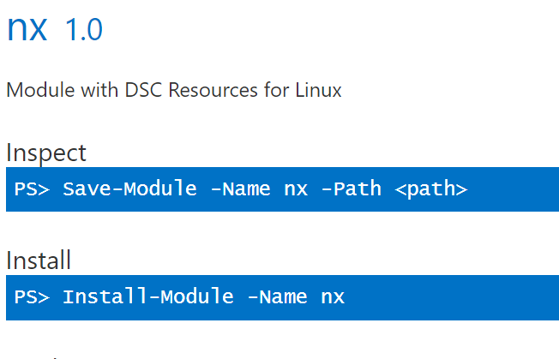
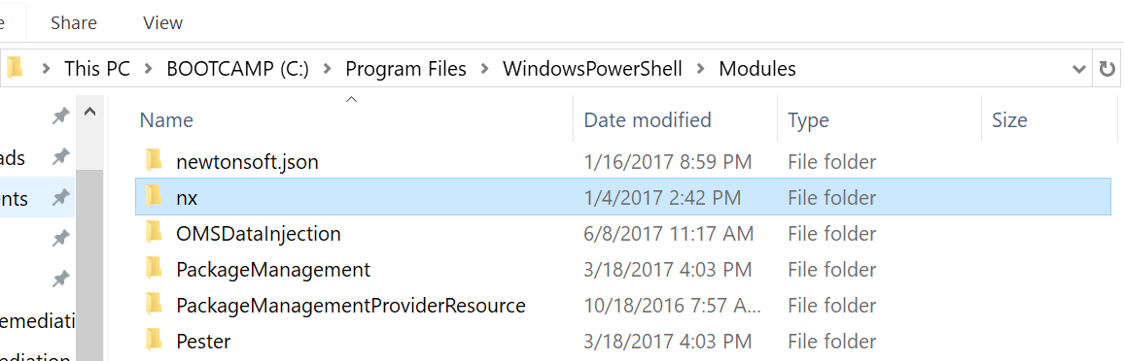
Summary
You can write your DSC “scripts” to target Linux OS as well.
Uses custom nx DSC module

Slide 3
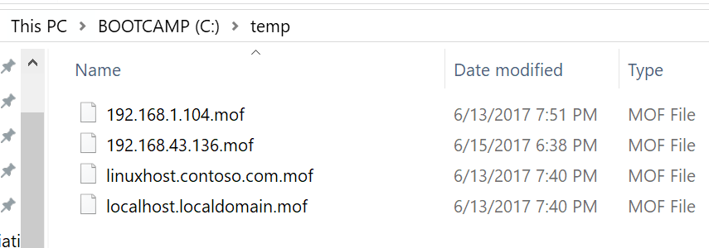
Deploys and enforces a pre-compiled .mof file (CIM Session)
Uses Start-DscConfiguration

Slide 4
Supported Distributions
The following Linux operating system versions are supported for DSC for Linux.
CentOS 5, 6, and 7 (x86/x64)
Debian GNU/Linux 6 and 7 (x86/x64)
Oracle Linux 5, 6 and 7 (x86/x64)
Red Hat Enterprise Linux Server 5, 6 and 7 (x86/x64)
SUSE Linux Enterprise Server 10, 11 and 12 (x86/x64)
Ubuntu Server 12.04 LTS and 14.04 LTS (x86/x64)

Slide 5
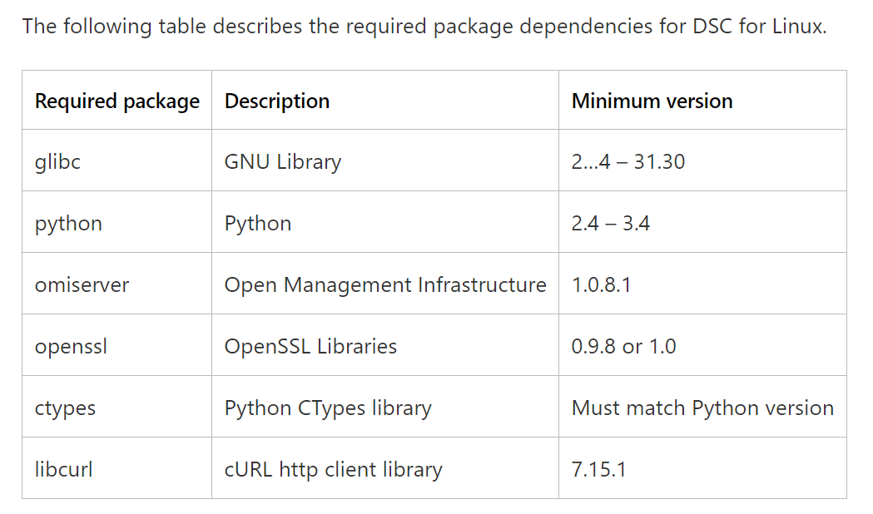
High Level Configuration Steps

Slide 6
High Level Configuration Steps (cont)
Install missing dependencies
Install Open Management Infrastructure (OMI) CIM Server
Install DSC
Get your nx module
Write your DSC
Compile into a MOF
Create a new CIM session and Start-DscConfiguration

Slide 7
Installation Commands
Make sure you have all the pre-reqs as per: https://msdn.microsoft.com/en-us/powershell/dsc/lnxgettingstarted
sudo rpm -Uvh http://packages.microsoft.com/config/rhel/7/packages-microsoft-prod.rpm
yum install omi.x86_64
cd /usr/local/src
wget https://github.com/Microsoft/PowerShell-DSC-for-Linux/releases/download/v1.1.1-294/dsc-1.1.1-294.ssl_100.x64.rpm

Slide 8
Create your DSC Configuration
Configuration ExampleConfiguration{
Import-DscResource -Module nx
Node "192.168.43.136"{
nxFile ExampleFile {
DestinationPath = "/tmp/example"
Contents = "hello world `n"
Ensure = "Present"
Type = "File"
}
ExampleConfiguration -OutputPath:"C:\temp"

Slide 9
Working with DSC locally
DSC for Linux includes scripts to work with configuration from the Local Linux Computer. The scripts are located in /opt/Microsoft/dsc/Scripts and include:
GetDscConfiguration.py
GetDscLocalConfigurationManager.py
StartDscLocalConfigurationManager.py –configurationmof /tmp/localhost.mof

