Slide 1



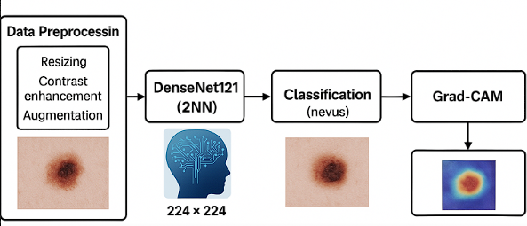



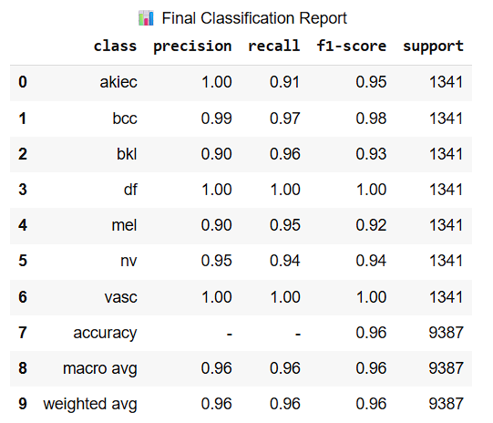
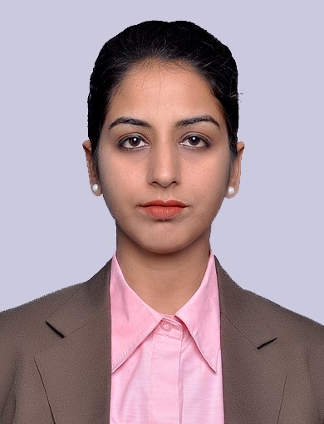
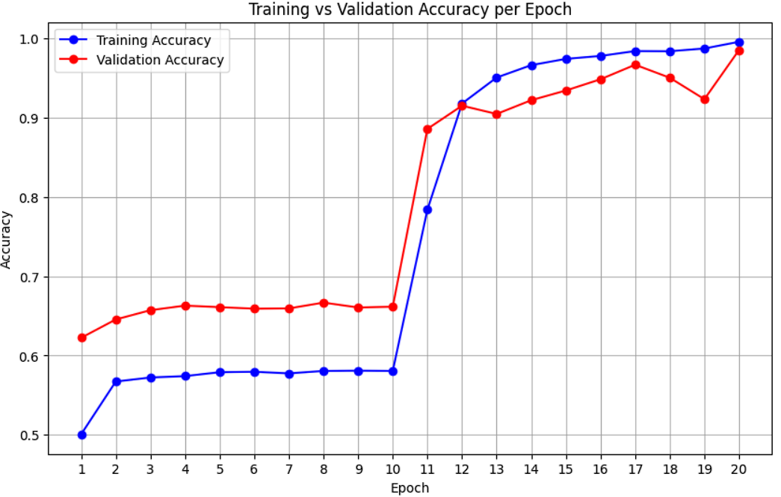
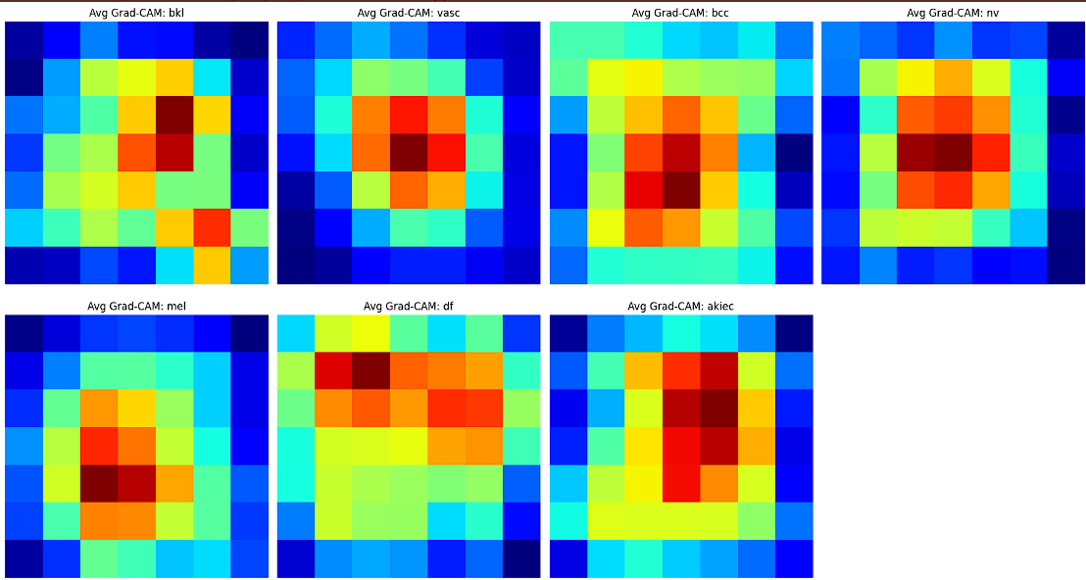
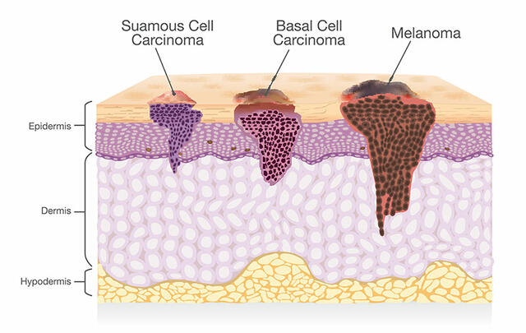

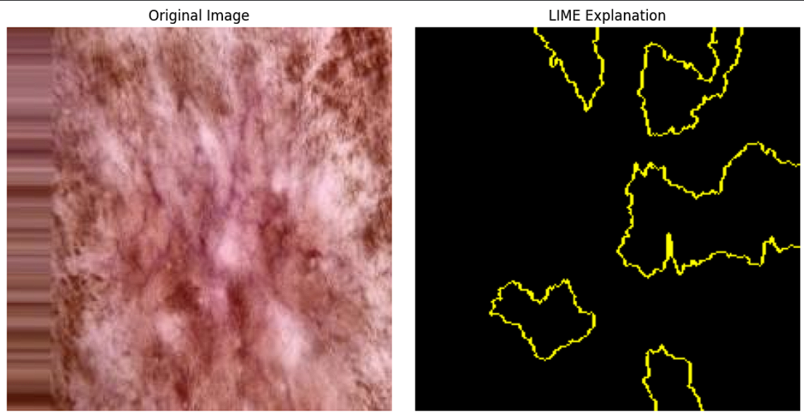
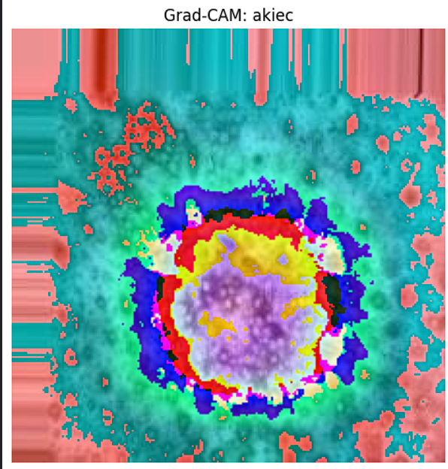
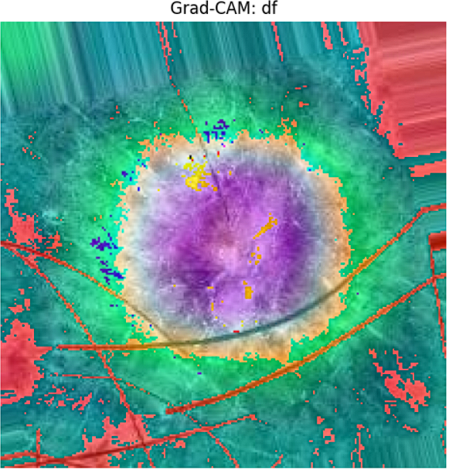
Explainable AI for Skin Cancer Detection
ABSTRACT
This project presents an explainable AI model for skin cancer classification, based on DenseNet121. The model is trained on contrast-enhanced images to improve detection accuracy. Grad-CAM and LIME are used to provide visual explanations of the model's predictions.
Submitted by:
Sarabjeet Singh
Supervisors:
Ms. Simranjit Kaur
Mr. Sachin Kansal
PROPOSED METHODOLOGY
TECHNOLOGY USED:
PROBLEM DESCRIPTION
Skin cancer is among the most common cancers, and early detection is crucial. However, diagnosis using dermoscopic images can be subjective and inconsistent.
This project trains a DenseNet121 model on contrast-enhanced images from the HAM10000 dataset to classify seven types of skin lesions.
Due to high visual similarity between classes, accurate classification is challenging.
To improve interpretability, we apply explainable AI techniques—Grad-CAM and LIME—to highlight image regions that influence model predictions, enhancing trust and understanding of results.
EVALUATION METRICES
OUTPUT RESULTS
The DenseNet121 model came up with the accuracy of 96% and average Recall of 0.9614 for all classes. Below are resultant graphs and images obtained:
DATASET USED: HAM10000 (Human Against Machine with 10,000 training images) dataset, which contains dermoscopic images of seven skin lesion types.
CONCLUSION
An accurate Deep Learning model for skin cancer detection, enriched with Grad-CAM and LIME to make its predictions more predictable, trustworthy and aligned with visual reasoning.
FUTURE SCOPE
Expand the work by integrating SHAP for deeper explainability and exploring real-time deployment
Grad-CAM
LIME

