Slide 1

NAMED ENTITY RECOGNITION FOR TOURISM
SARAH C JOJY
S4 MCA 2020

Slide 2
Relevance of topic
Tourism information is scattered around nowadays. To search for the information, it is usually time consuming to browse through the results from search engine, select and view the details.
The tourism industry has particularly evolved in the era of the social media and due to the large amount of data available on the web tourism forums have become spaces for exchanging information about many topics concerning a country’s tourism.
Named Entity Recognition (NER) is a method to search for a particular Named Entity from a file or an image, recognize it and classify it into specified Entity Classes like Name, Location, Organization, Numbers and Others Categories.

Slide 3
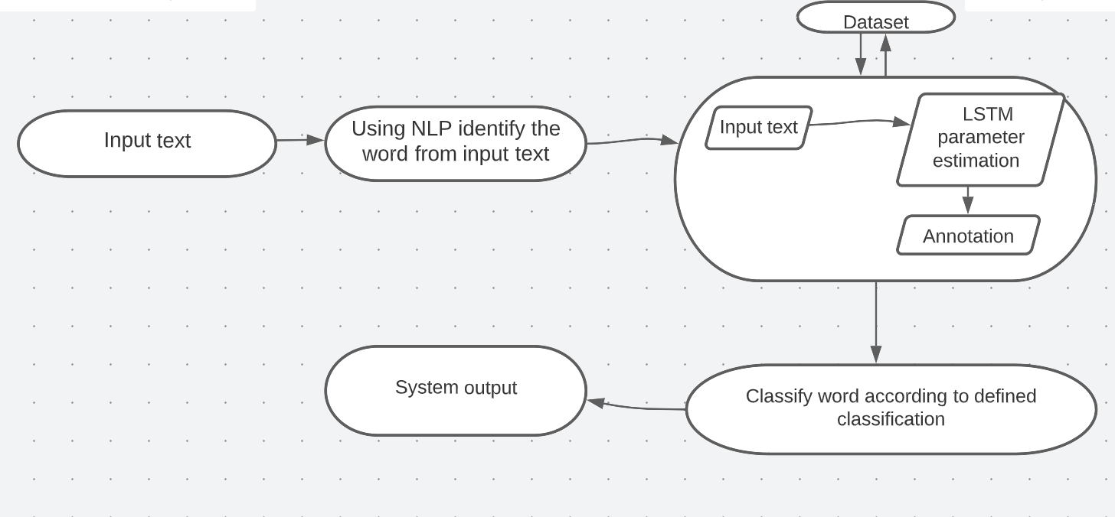
Description

Slide 4
Objectives
To develop a Named Entity Recognition (NER) model that facilitates fast query processing, information retrieval and data preprocessing of Travel and Tourism Domain.
To develop a model that obtain effective information and providing high quality services about tourist places, location, timings, .etc .

Slide 5
Existing System
Some models were introduced based on the Named Entity Recognition applied on the tourism domain.
In the NER applied on Moroccan tourism corpus, natural language processing
transformers classified entities (i.e., Named Entity Recognition) in text that was collected from the Moroccan forum in TripAdvisor.
Different models were created on different countries.
But there is no models applied NER on tourism in Kerala.

Slide 6
Proposed System
In this project, it is supposed to create a model on Named Entity Recognition for tourism domain in Kerala.
The text in the dataset which labelled with tags are trained.
If an input text is given, by using NLP it identifies the word.
By using algorithm, the input text is annotated and classifies the word according to defined classification.
The output is generated.

Slide 7
Modules
Data collection
Data pre-processing
Model training
Model evaluation

Slide 8
Algorithms
LSTM(Long Short Term Memory)
A special kind of recurrent neural networks that are capable of selectively remembering patterns for long duration of time.
Working
Take input the current input, the previous hidden state, and the previous internal cell state.
Calculate the values of the three different gates by following the below steps:-
For each gate, calculate the parameterized vectors for the current input and the previous hidden state by element-wise multiplication with the concerned vector with the respective weights for each gate.
Apply the respective activation function for each gate element-wise on the parameterized vectors.
Calculate the current internal cell state by first calculating the element-wise multiplication vector of the input gate and the input modulation gate, then calculate the element-wise multiplication vector of the forget gate and the previous internal cell state and then adding the two vectors.
Calculate the current hidden state by first taking the element-wise hyperbolic tangent of the current internal cell state vector and then performing element-wise multiplication with the output gate.

Slide 9
Dataset
The text in the dataset are from the websites
www.thrillophilia.com
www.wikipedia.org
www.tripadvisor.in
www.holidify.com
www.keralatourism.org
The entities like location, GPE, tourist places, timings are labelled using the application label studio.

Slide 10

Thank you

