Slide 1

NAMED ENTITY RECOGNITION MODEL FOR TOURISM DOMAIN OF KERALA

Slide 2
Relevance of topic
Tourism information is scattered around nowadays. To search for the information, it is usually time consuming to browse through the results from search engine, select and view the details.
The tourism industry has particularly evolved in the era of the social media and due to the large amount of data available on the web tourism forums have become spaces for exchanging information about many topics concerning a country’s tourism.
Named Entity Recognition (NER) is a method to search for a particular Named Entity from a file or an image, recognize it and classify it into specified Entity Classes like Name, Location, Organization, Numbers and Others Categories.

Slide 3
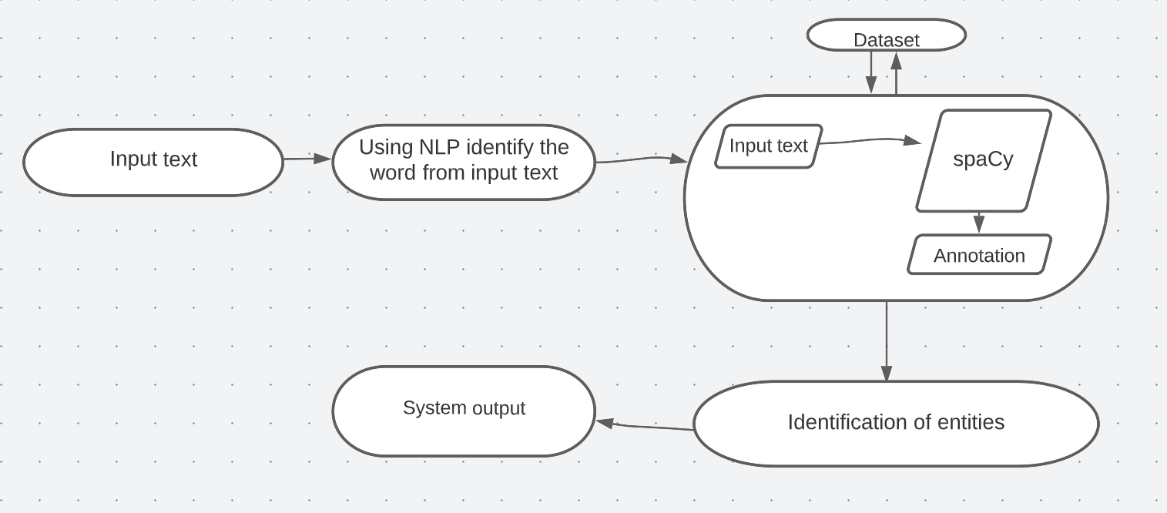
Description

Slide 4
Objectives
To develop a Named Entity Recognition (NER) model that facilitates fast query processing, information retrieval and data preprocessing of Travel and Tourism Domain.
To develop a model that identifies the entities tourist places, location, timings GPE from the data.

Slide 5
Existing System
Some models were introduced based on the Named Entity Recognition applied on the tourism domain.
In the NER applied on Moroccan tourism corpus, natural language processing
transformers classified entities (i.e., Named Entity Recognition) in text that was collected from the Moroccan forum in TripAdvisor.
Different models were created on different countries.
But there is no models applied NER on tourism in Kerala.

Slide 6
Proposed System
In this project, it is supposed to create a model on Named Entity Recognition for tourism domain in Kerala.
The text in the dataset which labelled with tags are trained.
If an input text is given, by using NLP it identifies the word.
By using algorithm, the input text is annotated and classifies the word according to defined classification.
The output is generated.

Slide 7
Modules
Data collection
Data pre-processing
Model training
Model evaluation

Slide 8
spaCy
spaCy is designed specifically for production use and helps you build applications that process and understand large volumes of text. It can be used to build information extraction or natural language understanding systems
The spaCy library is a robust machine learning NLP library developed by Explosion AI, a Berlin based team of computer scientists and computational linguists.
It provides the fastest and most accurate syntactic analysis of any NLP library released to date.
Users of spaCy can take advantage of the predesigned CNN architecture behind the spaCy training process.
In version 3.0 of spaCy due in early 2021, the user will also be able to customize this neural network architecture, expanding spaCy’s utility and customizability.

Slide 9
Dataset
The text in the dataset are from the websites
www.thrillophilia.com
www.wikipedia.org
www.tripadvisor.in
www.holidify.com
www.keralatourism.org
The entities like location, GPE, tourist places, timings are labelled using the spaCy NER annotator.

Slide 10
TOOLS
FRONT END : HTML
BACK END : PYTHON
FRAMEWORK : FLASK
IDE : JUPYTER NOTEBOOK

Slide 11
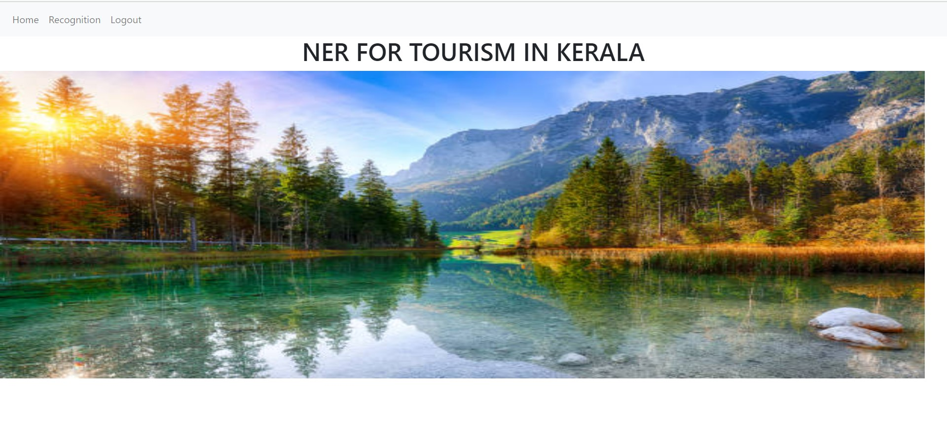
Output
Home page

Slide 12
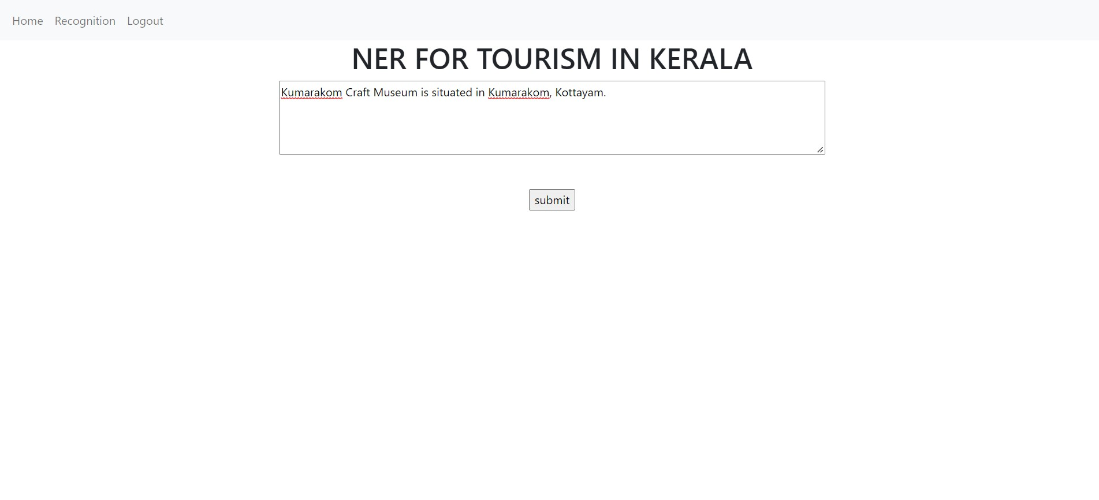

Slide 13
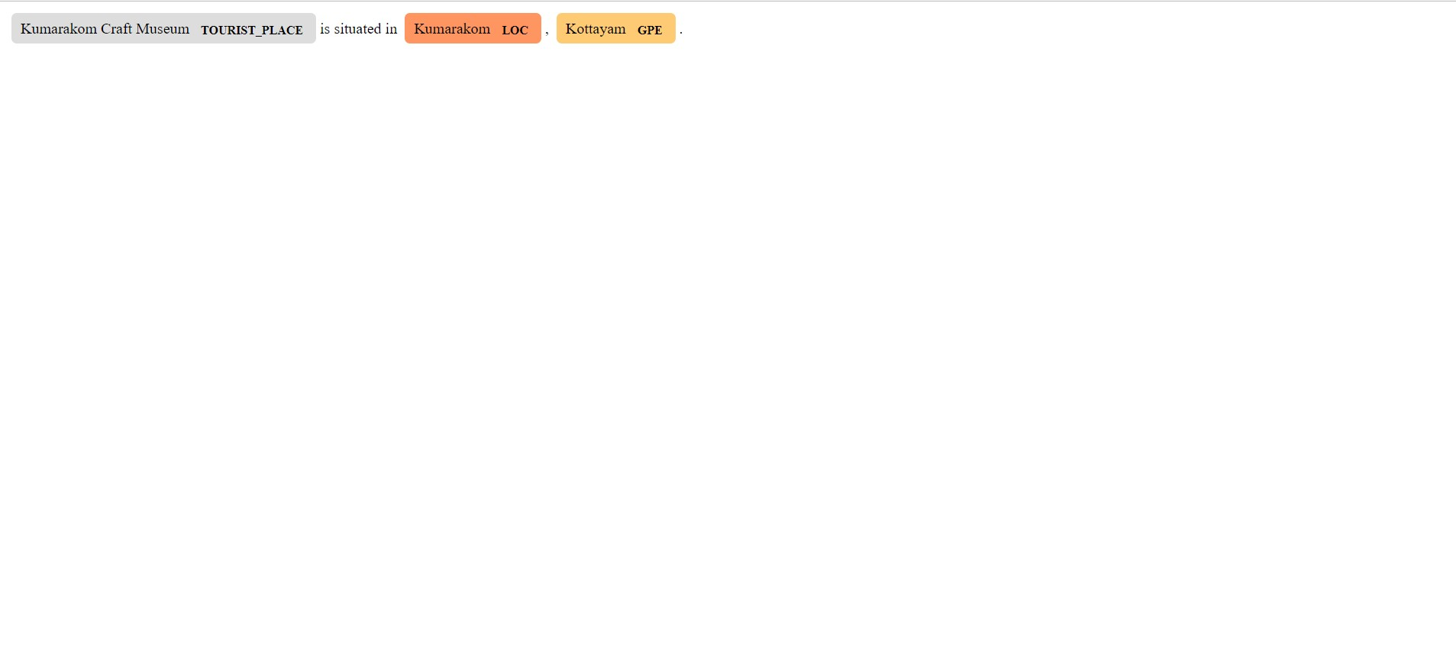

Slide 14
Conclusion
The project recognizes the entities from tourism data.
Created the data set using different tourism websites.
Annotations for the text are done using spaCy NER annotator.
The model framework SpaCy is used to construct the models to perform tasks on the data set: recognizing name entities and text classification.
The performance of the two approaches was discussed.

Slide 15
Future Scope
The project can be trained with large data set.
The project can include more entities other than used in this project.
It can be compared with other frameworks to get more accurate and precise.

Slide 16

Thank you

