Slide 1
Scaling Smarter: SDPA & Quantized Inference for LLMs
Team Members:
Sarang P. Kadakia (sk11634)
Vishwajeet Kulkarni (vk2630)

Slide 2
Executive Summary
P A R T 0 1
Goal: Efficiently optimize large-scale language models like Mistral 7B for faster inference without major loss in output quality.
Solution: We benchmarked and compared 5 model variants using quantization (4-bit, 8-bit) and SDPA. We selected the top 3 performers and fine-tuned further on a new dataset to reduce perplexity.
Value: We achieved ~2× speedup in inference while maintaining or even improving output quality, enabling real-world deployment on constrained hardware (e.g., T4 GPUs).

Slide 3
Technical Challenges
P A R T 0 2
Memory constraints on Kaggle’s T4 GPUs (limited to 16 GB).
Trade-off between inference speed and perplexity while applying quantization.
Need for consistent benchmark pipeline to ensure fairness across models.

Slide 4
Solution Approach (Part 1)
P A R T 0 3
Base Model: Mistral 7B Instruct from HuggingFace.
Variants Created:
- Original Mistral
- 8-bit Quantized
- 4-bit Quantized
- SDPA + 8-bit Quantized
- SDPA + 4-bit Quantized
Tech Stack: PyTorch, HuggingFace Transformers, BitsAndBytes, PyTorch Profiler

Slide 5
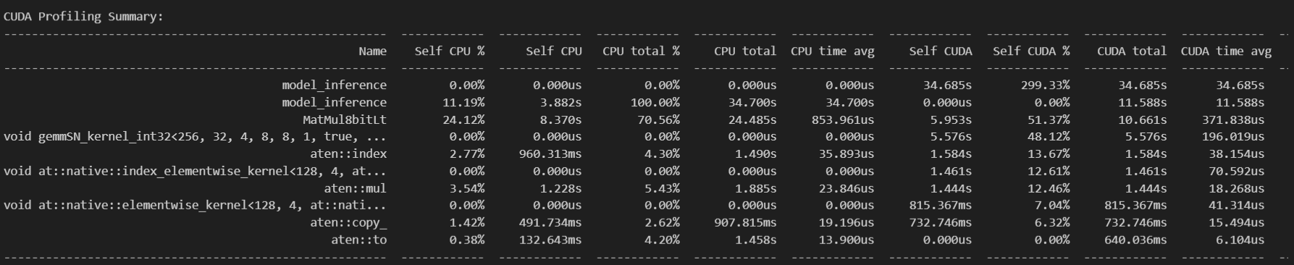
Profiler Output:
Below is a snapshot of one of the instances (Quantized 8-bit Mistral 7B Model) of CUDA kernel-level profiling using the PyTorch Profiler during model inference:

Slide 6
Solution Approach (Part 2)
P A R T 0 4
Quantization:
- Applied using BitsAndBytes (bnb) for 4-bit and 8-bit models.
- Verified memory efficiency and model compatibility.
SDPA (Scaled Dot Product Attention):
- Native PyTorch SDPA used instead of FlashAttention (not compatible with T4).
- Combined with quantized weights for additional performance gains.
Prompt Design:
- Ran multiple prompts with same structure across all models.

Slide 7
DEMO
This demo showcases the practical implementation of our project, "Scaling Smarter: Scaled Dot-Product Attention and Quantized Inference for LLMs." It highlights the optimization techniques applied to the Mistral-7B model, including 4-bit quantization and Scaled Dot Product Attention (SDPA), and demonstrates the resulting improvements in inference performance.
Our Demo:
https://drive.google.com/file/d/1tzEmTt5ryVneVsLHOyY40JrRkDeBcI2k/view?usp=sharing
Key Highlights:
Model Optimization: Application of 4-bit quantization and SDPA to enhance inference efficiency.
2. Performance Metrics: Demonstrated reductions in inference latency and maintenance of model accuracy.
3. Fine-Tuning: Implementation of Parameter-Efficient Fine-Tuning (PEFT) using LoRA on the optimized model with the "Treasure Island" dataset.

Slide 8
Inference Strategy
P A R T 0 6
Reused already-loaded models to avoid skew from reloading overhead.
Ran controlled batch of prompts for all three shortlisted models:
- Original Mistral
- Mistral + 4-bit
- SDPA + 4-bit
Profiling Backend:
Captured all CUDA ops using PyTorch Profiler.
Filtered to show only GPU-bound operations.
Logged top 10 time-heavy CUDA kernels for each model.

Slide 9
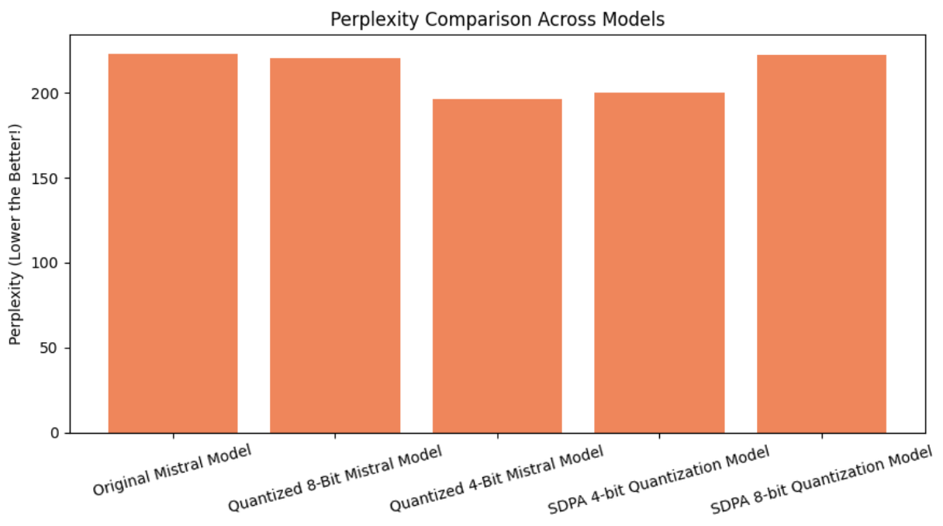
Experimental Evaluation (1/4)
P A R T 0 7
Original & 8-bit models have high perplexity (~223).
4-bit & SDPA+4-bit reduced perplexity significantly (~196–200).
Final optimized model (4-bit + SDPA) achieved perplexity of 10.65 after fine-tuning on Treasure Island dataset.

Slide 10
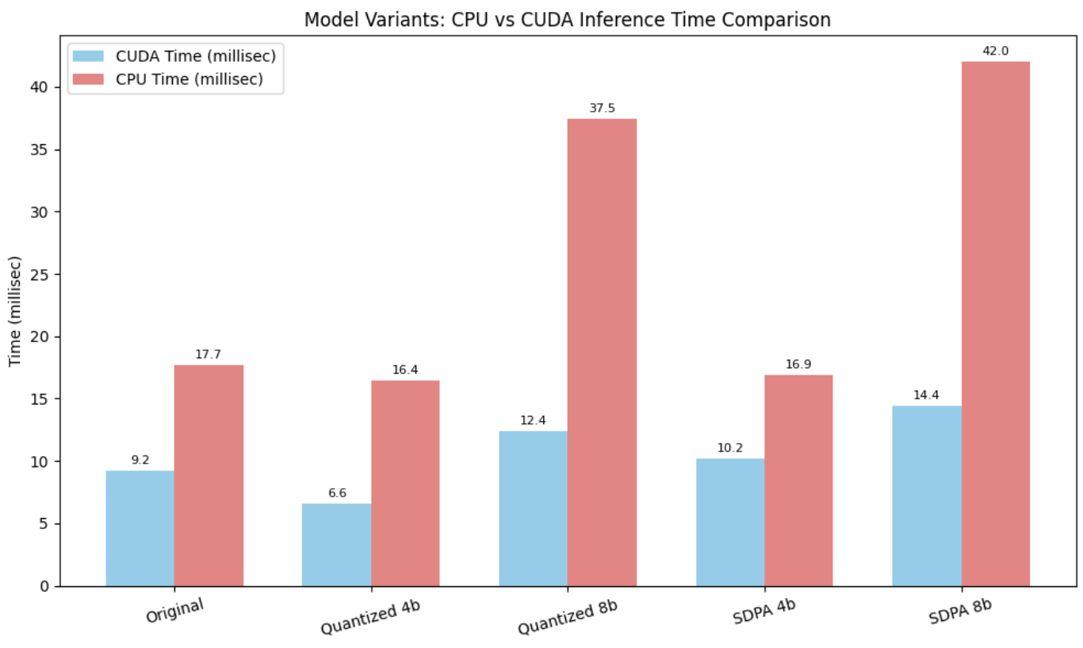
Experimental Evaluation (2/4): CPU vs CUDA Inference Times
P A R T 0 8
4-bit Mistral has lowest CUDA time (6.6 ms)
SDPA adds slight overhead to CUDA time but stays competitive.
8-bit models suffer high CPU usage, limiting real-world gains.

Slide 11
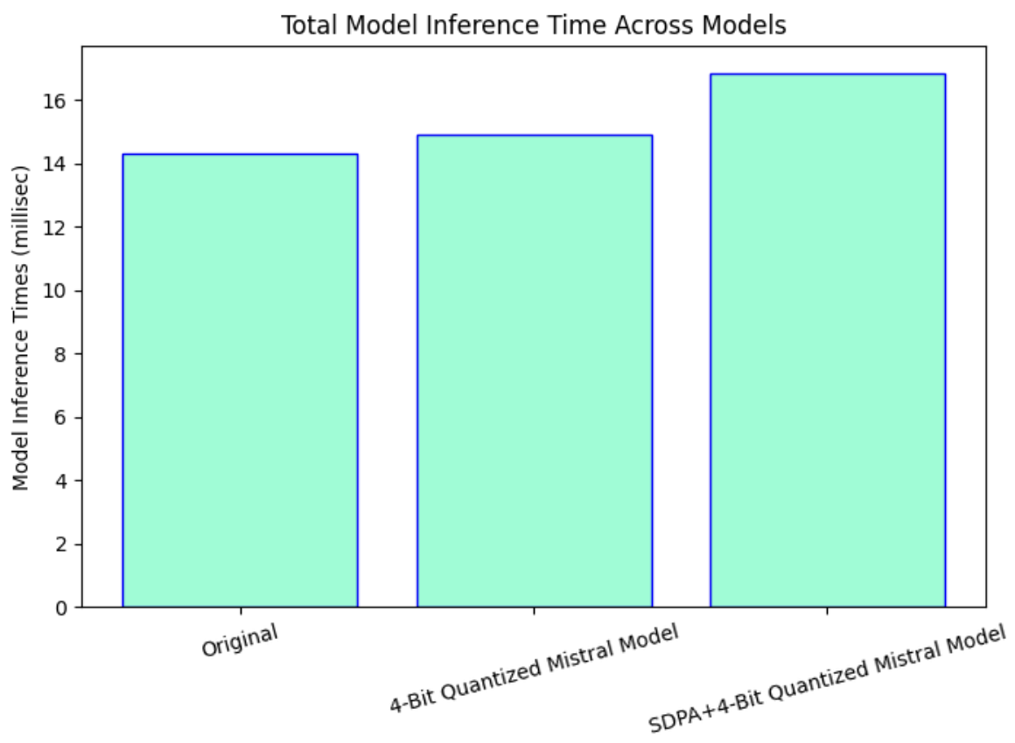
Experimental Evaluation (3/4): Total Inference Time Across Variants
P A R T 0 9
Minimal variance in total inference time (~14–17 ms)
4-bit model gives near-optimal inference without SDPA overhead.

Slide 12
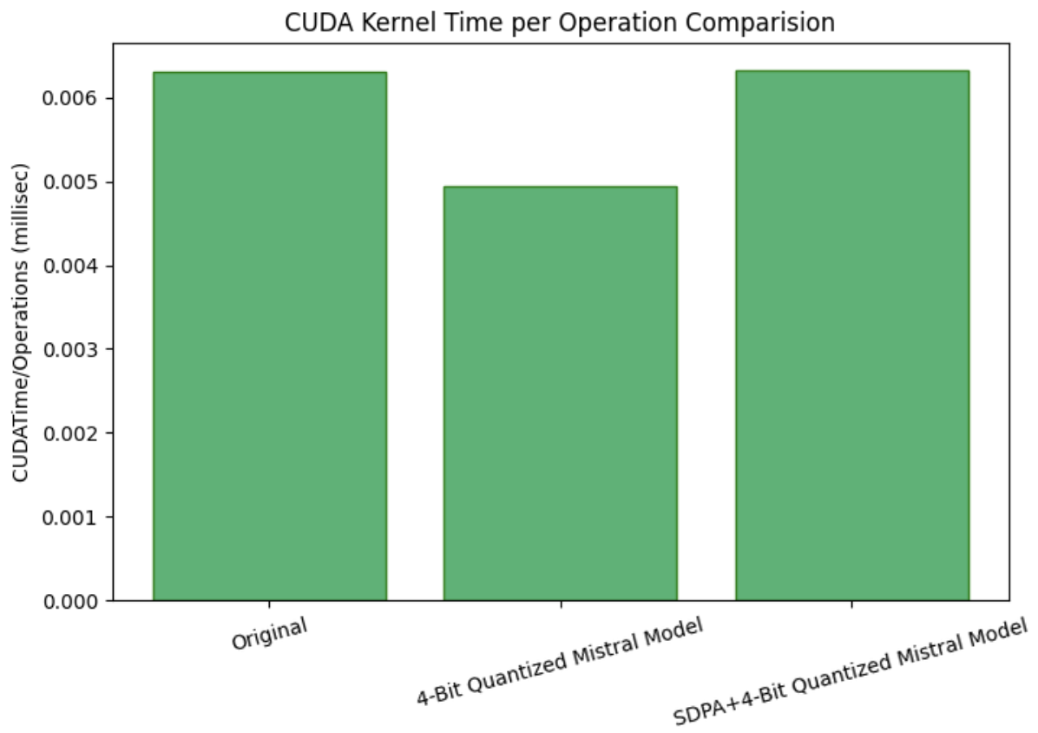
Experimental Evaluation (4/4): CUDA Time per Operation
P A R T 10
4-bit model is most kernel-efficient (~0.0049 ms/op)
SDPA+4bit introduces minor kernel cost, equal to baseline.

Slide 13
Result Summary
P A R T 1 1
4-bit Quantized Mistral: best balance between speed and output quality

Slide 14
Observation & Conclusion
P A R T 1 2
4-bit quantization offers best trade-off: fast inference, low perplexity.
SDPA helps but adds overhead on non-H100 GPUs.
End-to-end profiling helped surface real kernel bottlenecks.
Final model with new dataset: 10x lower perplexity than baseline.
This project demonstrates that inference-time LLM optimization can be both hardware-efficient and language-quality preserving.

Slide 15
GitHub Repository
P A R T 1 3
GitHub Repo: https://github.com/SARANG1018/Scaling-Smarter

Slide 16
Thank You!!

