Slide 1

VEL TECH HIGH TECH Dr. RANGARAJAN Dr. SAKUNTHALA ENGINEERING COLLEGE An Autonomous Institution
Department of Computer Science and Engineering
Project Review-I
MACHINE LEARNING BASED NUTRIENT RECOMMENDATION SYSTEM FOR SOIL FERTILISATION
SARANYA.S (VH10020)
SRIPONBALA.K(VH10027 )
SARANGAM SAI INDU(VH10019 )
SWATHI.A (VH10031)
IV Year, Computer Science Engineering
Date:11.02.2023
Supervisor
J.S.SOWMIYA B.Tech.,M.E
ASSISTANT PROFESSOR
Computer Science Engineering

Slide 2
Content
Introduction
Literature Review
Objectives
Block Diagram
Methodology
Requirements
Project cost/Budget
Workplan
References

Slide 3
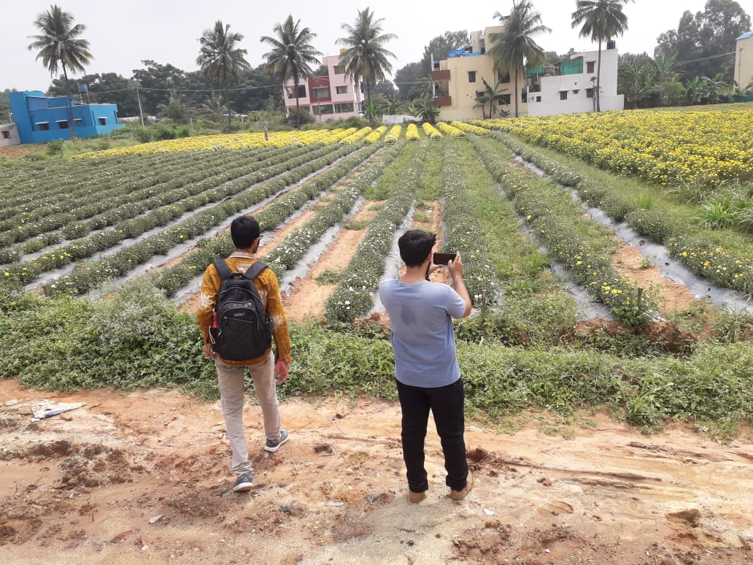
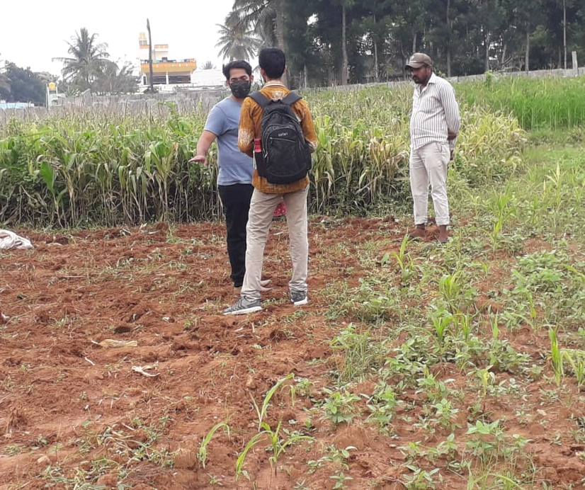
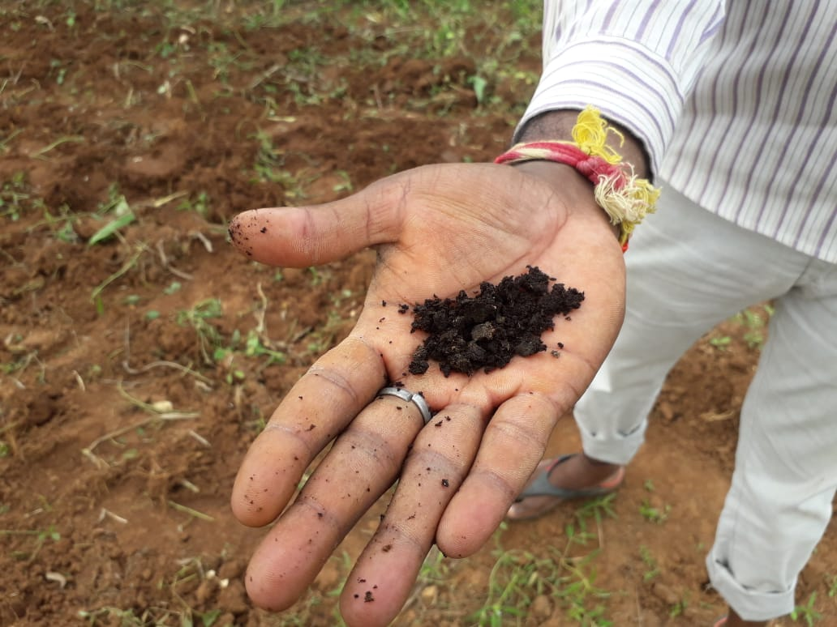

Introduction
1
Farmers need a competent guidance.
2
Connection between rainfall volume and nutrient loss.
3
The problem statements are analyzed and determined based on what is in our study area.
MACHINE LEARNING BASED NUTRIENT RECOMMENDATION SYSTEM FOR SOIL FERTILISATION

Slide 4
Literature Review
S.NO | TITLE | AUTHOR | YEAR | SOFTWARE/HARDWARE | METHODOLOGY | KEYPOINTS | INFERENCE
1. | Improving the prediction accuracy of soil nutrient classification by optimizing extreme learning machine parameters . | M.S. Suchithra, Maya L. Pai | 2022 | Google Colab | The main objective of this work is to classify area wise soil fertility indices based on the village level soil fertility information, which can be used in making a village wise soil fertility index analysis report. | It predicts the fertility index and ph level of soil and mainly focused on kerala region. | This paper suggests solutions to the classification problems of soil nutrient which are solved using the fast learning classification technique known as Extreme Learning Machine (ELM) with different activation functions.
2. | Smart farming using Machine Learning and Deep Learning techniques . | Senthil Kumar Swami Durai, Mary Divya Shamili | 2022 | Pycharm, Jupter notebook | Four modules proposed in this work such as crop recommendation, weed identification, Pesticide recommendation, crop cost estimation. The proposed work is a Web application developed through Django framework. | Crop recommendation achieves an accuracy of 91% . | The purpose of this paper is to help an individual farm be efficient and thus achieve high yield at a low cost. It also helps to predict the total costs required for growth. It will help one to plan ahead Pre-cultivation activities lead to an integrated solution in agriculture.
3. | Agricultural decision system based on advanced machine learning models for yield prediction: Case of East African countries . | Rubby Aworka, Lontsi Saadio Cedric, Wilfried Yves Hamilton Adoni, Jérémie Thouakesseh Zoueu, Franck Kalala Mutombo, Charles Lebon Mberi Kimpolo, Tarik Nahhal, Moez Krichen . | 2022 | Jupyter Notebook | Proposed three non-parametric models for our predictive analysisof crop yield. Two of the models are tree ensembles: Crop Random Forest(CRF) and Crop Gradient Boosting Machine (CGBM). The other modelis linear, which is Crop Support Vector Machine (CSVM). | Predict an annual crop yieldat the country-level of four crops in fourteen East African countries | Crop Random Forest, Crop Gradient Boosting Machine, and Crop Support Vector Machine are three crop prediction models proposed in this paper. The paper makes use of advanced machine learning models to develop a decision system based on climate data, crop production data, and pesticide data.
MACHINE LEARNING BASED NUTRIENT RECOMMENDATION SYSTEM FOR SOIL FERTILISATION

Slide 5
Literature Review
S.NO | TITLE | AUTHOR | YEAR | SOFTWARE/HARDWARE | METHODOLOGY | KEYPOINTS | INFERENCE
4 | Untangling the effect of soil quality on rice productivity under a 16-years long-term fertilizer experiment using conditional random forest | Saheed Garnaik, Prasanna Kumar Samant, Mitali Mandal, Tushar Ranjan Mohanty, Sanat Kumar Dwibedi, Ranjan Kumar Patra, Kiran Kumar Mohapatra, R.H. Wanjari, Debadatta Sethi, Dipaka Ranjan Sena, Tek Bahadur Sapkota, Jagmohan Nayak, Sridhar Patra, Chiter Mal Parihar, Hari Sankar Nayak. | 2022 | Google colab | Evaluate the changes in soil physical, chemical, and biological properties under long-term fertilizer application and establish cause and effect relationship between soil properties and rice productivity using interpretable machine learning. | It is mainly concentrated on eastern coast of india. | The study demonstrated how interpretable machine learning techniques can be used in long-term fertilizer experiments to produce the most meaningful information, and that these techniques can be used in other similar long-term experiments.
5 | Farmer risk preference and fertilizer use | Fang-binQIAOJi-kunHUANG | 2021 | Bio Labs are needed | The degree of risk aversion can have a negative impact on the amount of fertilizer applied. | Focus on fertilizer use in cotton production in China. | This study examines the role of farmers' risk attitudes toward fertilizer use in cotton production.
6 | Precision agriculture using IoT data analytics and machine learning | Raves Akhtar, Shabbir Ahmad Sofi | 2021 | Jupyter notebook | Used the real time data of wireless sensor/IoT nodes as input for linear regression model. User friendly application is developed for farmers to inform about the status of apple orchards. | The main aim of this study was to predict the apple scab that is the most common disease of apple crop. | This paper proposes an apple disease prediction model in apple orchards in Kashmir Valley using data analysis and machine learning in an IoT system. The paper discusses the challenges faced when integrating these technologies into traditional agricultural approaches.
MACHINE LEARNING BASED NUTRIENT RECOMMENDATION SYSTEM FOR SOIL FERTILISATION

Slide 6
Literature Review
S.NO | TITLE | AUTHOR | YEAR | SOFTWARE/HARDWARE | METHODOLOGY | KEYPOINTS | INFERENCE
7. | Crop yield prediction using machine learning. | Thomas van Klompenburga , Ayalew Kassahuna , Cagatay Catal | 2021 | Web browsers. | This paper includes the systematic Research analysis. | Artificial Neural Networks (ANN) is the most used algorithm for crop yield prediction. | Comprehensive method developed to estimate crop sustainability using supervised algorithms that increase crop yields, reduce manual labor, time spent on various agricultural activities and plant recommendations based on certain soil parameters.
8. | Prediction of the production of crops with respect to rainfall.. | Benny Antony | 2021 | Google colab | The regression techniques are evaluated based on their Mean Squared Error . | This paper predicts the production of crops as a function of rainfall for four Indian States for two crops(rice, wheat). | This paper predicts the production of crops as a function of rainfall. This is implemented by generating a rough overview of how the production is based on rainfall and how much can a specific crop production for the amount of rainfall it receives. The proposed method of evaluation is better than other existing methods of evaluation as it evaluates all the regression techniques..
9. | Analysis of agricultural crop yield prediction using statistical techniques of machine learning | Janmejay Pant, R.P. Pant, Manoj Kumar Singh, Devesh Pratap Singh, Himanshu Pant | 2021 | Jupyter notebook, pycharm | This paper used four machine learning algorithms to train the model selected the most accurate crop prediction | Determine the response of crops towards the factors which are responsible for good crop production. | This paper suggests the use of Machine Learning techniques to create a trained model for detecting patterns in data, which we then used to predict crop yields. The application of machine learning to the prediction of four of India's most cultivated yields is considered in this study. Maize, potatoes, rice (paddy), and wheat are among these crops.
MACHINE LEARNING BASED NUTRIENT RECOMMENDATION SYSTEM FOR SOIL FERTILISATION

Slide 7
Literature Review
S.NO | TITLE | AUTHOR | YEAR | SOFTWARE/HARDWARE | METHODOLOGY | KEYPOINTS | INFERENCE
10. | Optimized fertilizer recommendation method for nitrate residue control in a wheat–maize double cropping system in dryland farming . | Zujiao Shi, Donghua Liu, Miao Liu, Muhammad Bilal Hafeez, Pengfei Wen, Xiaoli Wang, Rui Wang, Xudong Zhang, Jun Li | 2021 | Experimental crop land, MATLAB | The optimized fertilizer recommendation method based on SNC, the target yield, and NR is convenient for determining the appropriate amounts of N fertilizer for application in the winter wheat–summer maize double cropping system. | The target yield and NR were generally relatively stable for winter wheat and summer maize when the other production conditions did not change significantly in a specific area. | To optimize the fertilizer recommendation method and reduce nitrate residue levels, this paper establishes the relationships between crop yield, nitrogen requirement, and nitrate residue level under combined N and P fertilizer application.
11. | Crop yield forecasting using Data Mining | Pallavi Kamath , Pallavi Patil , Shrilatha S , Sushma , Sowmya S | 2021 | Pycharm | Random Forest used to forecast the yield of major crops based on historical data. | It yield the accuracy of 92%. | By studying the soil and atmosphere for the specific area, by which increase crop production, optimal crop can be estimated.
12. | Controlled traffic farming effects on productivity of grain sorghum, rainfall and fertiliser nitrogen use efficiency. | A.Hussein Diogenes L. Antille Shreevatsa Kodur GuangnanChen Jeff N.Tullberg | 2021 | MATLAB | The experiment was conducted in two adjacent blocks; namely: CTF and non-CTF . | The overall fertiliser type effect on yield and NUE was small relative to that of traffic . | Enhanced efficiency fertilizers cannot compensate for other stresses caused by compaction.
MACHINE LEARNING BASED NUTRIENT RECOMMENDATION SYSTEM FOR SOIL FERTILISATION

Slide 8
Literature Review
S.NO | TITLE | AUTHOR | YEAR | SOFTWARE/HARDWARE | METHODOLOGY | KEYPOINTS | INFERENCE
13. | A nutrient recommendation system for soil fertilization based on Evolutionary Computation. | Usman Ahmed Jerry Chun-Wei Lin Gautam Srivastava Youcef Djenouri. | 2021 | Google colab | This paper proposes nutrient recommendations through an improved genetic algorithm (IGA) that uses time-series sensor data . | The proposed model can perform better for cotton and groundnuts. | This paper develops a model that enables efficient exploration of correct usage of nutrients (such as N, P and K) for developing a knowledge-based system for the ICT (Information and Communication Technology) environment.
14. | Would fertilization history render the soil microbial communities and their activities more resistant to rainfall fluctuations? | János Kátai Ágnes Oláh Zsuposné Magdolna Tállai Tarek Alshaal | 2020 | Bio Lab | ANOVA test, Levene's Test for Equality of Variances is performed. | High rates of NPK significantly reduced soil dehydrogenase activity. | This paper aims to study the intrinsic changes in the composition of soil populations and their functions due to the interaction between long-term fertilization and rainfall fluctuations, seeing whether fertilization history would render the soil microbial communities and their activities more resistant to water stress or not..
15. | Cropping systems in agriculture and their impact on soil health | TonyYang, Kadambot H.M. Siddique, Kui Liu | 2020 | Experimental crop land and chemical laboratory is needed. | Refine content of soil health and the development of new evaluation standards for ‘soil health and quality’ by combining various soil health indicators into indices in agroecosystems, | This paper reviews the impact of conventional cropping systems on soil health, microbiological indicators. | Significant achievements, including refine content of soil health and the development of new evaluation standards for ‘soil health and quality’.
MACHINE LEARNING BASED NUTRIENT RECOMMENDATION SYSTEM FOR SOIL FERTILISATION

Slide 9
Literature Review
S.NO | TITLE | AUTHOR | YEAR | SOFTWARE/HARDWARE | METHODOLOGY | KEYPOINTS | INFERENCE
16. | Crop Yield Prediction Based on Indian Agriculture using Machine Learning. | Potnuru Sai Nishant Pinapa Sai Venkat Bollu Lakshmi Avinash B. Jabber | 2020 | Google colab | The paper uses advanced regression techniques like Kernel ridge, Lasso and Enet algorithms. | Concept of stacked regression is used to improvise the model. | This paper predicts the yield of almost all kinds of crops in India. This script makes novel by usage of simple parameters like state, district, season, area and the user can predict the yield of the crop in which year he or she wants to.
17. | Rainfall intensification increases nitrate leaching from tilled but not no-till cropping systems in the U.S. Midwest | Laura J.T. Hess Eve-Lyn S. Hinckley G. Philip Robertson Pamela A. Matson | 2020 | MATLAB | Linear mixed models with a nested design used to determine the effects of rainfall intensification and tillage on soil water N conc. | Variation in soil type,structure influence cropping system respond to rainfall intensification. | Rainfall intensification may exacerbate leaching losses of reactive N from cropping systems, and that no-till management may buffer against these losses.
18. | Estimation of NPK requirements for rice production in diverse Chinese environments under optimal fertilization rates | Yulong Yin, Hao Ying Huifang Zheng ,Qingsong Zhang ,Yanfang Xue, Zhenling Cui | 2019 | Chemical laboratory is needed. | Plant samples are oven dried and then milled and digested with concentrated H2SO4 and H2O2. | Estimate rice nutrient requirements. | Objectives of this study were to evaluate the relationship between nutrient requirements and climates or soil chemical properties.
MACHINE LEARNING BASED NUTRIENT RECOMMENDATION SYSTEM FOR SOIL FERTILISATION

Slide 10
Literature Review
S.NO | TITLE | AUTHOR | YEAR | SOFTWARE/HARDWARE | METHODOLOGY | KEYPOINTS | INFERENCE
19. | Fuzzy decision support system for improving the crop productivity and efficient use of fertilizers | G. Prabakaran,D. Vaithiyanathan, Madhavi Ganesan | 2019 | MATLAB | The fuzzy logic system developed in this research as part of the Decision Support System, concentrates on maximizing crop productivity while minimizing fertilizer usage. | Establish feasibility rules for decision support systems for the crops. | This paper explores the process of using fuzzy logic systems to reduce fertilizer consumption and improve crop productivity.
20. | Prediction of Crop Fertilizer Consumption | Krutika Hampannavar, Vijay Bhajantri Shashikumar G. Totad | 2019 | Jupyter notebook | The system consists of phases such as: Image acquisition, converting of input image to gray scale image, plotting of histogram, segregating plants into healthy and nitrogen deficient plants determining the affected region and fertilizer consumption. | The identification of nutrient deficiency is helpful to farmer for proper monitoring of crop growth and optimum usage of fertilizers. | Prediction of fertilizer consumption can prevent the toxicity and deficiency in plants to certain extent and this can help farmers to get proper yield without much wastage.
MACHINE LEARNING BASED NUTRIENT RECOMMENDATION SYSTEM FOR SOIL FERTILISATION

Slide 11

Objectives
1
To provide useful information for fertilizer use in terms of nutrients (NPK) by considering weather forecasts.
2
To reduce water pollution by slowing down the process of leaching.
MACHINE LEARNING BASED NUTRIENT RECOMMENDATION SYSTEM FOR SOIL FERTILISATION

Slide 12
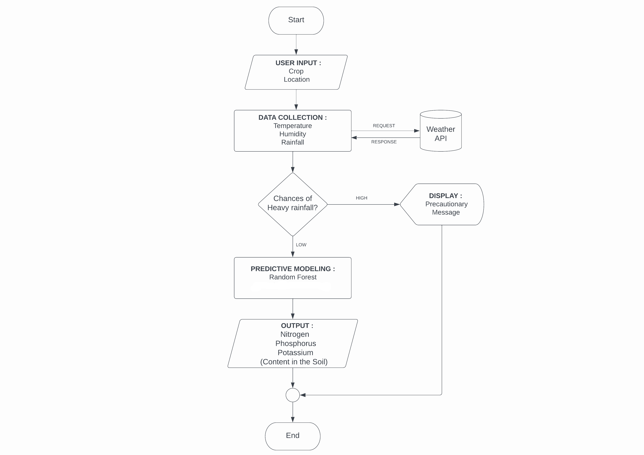
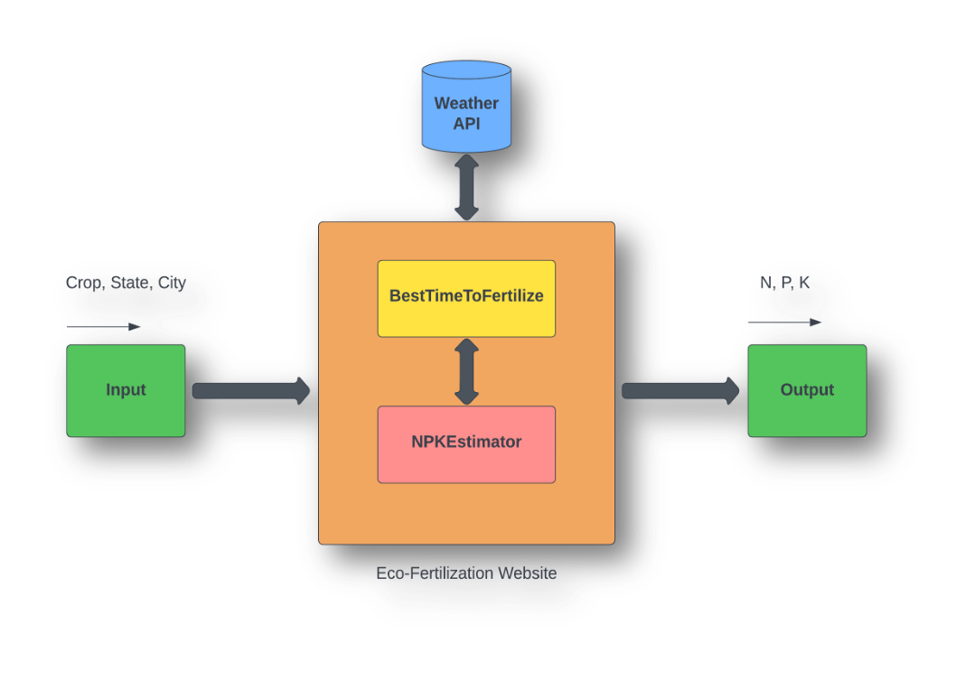
Block Diagram
MACHINE LEARNING BASED NUTRIENT RECOMMENDATION SYSTEM FOR SOIL FERTILISATION

Slide 13
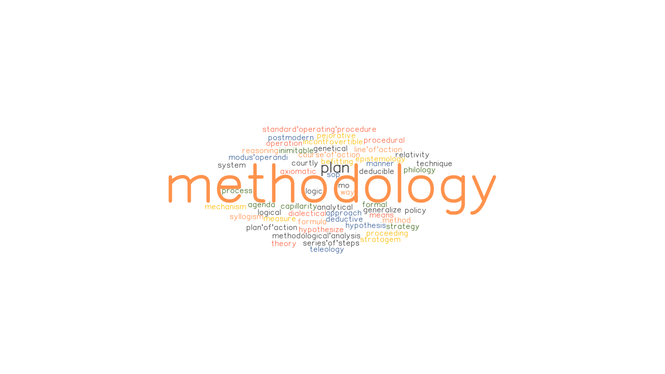
Methodology
In this study, a predictive model for the nutrients required for crops was obtained using Machine learning algorithms.
The algorithm requires input from the user (such as location and cropping). The location is fed to the Weather API which will return certain characteristics (e.g. temperature, humidity, rainfall) and if there is a possibility of heavy rainfall, a precautionary message is displayed to the user, otherwise the proposed algorithm is followed.
MACHINE LEARNING BASED NUTRIENT RECOMMENDATION SYSTEM FOR SOIL FERTILISATION

Slide 14

Requirements
Tools & Technologies :
Jupyter Notebook
Python
Matplotlib
HTML / CSS
Flask
VS Code
MACHINE LEARNING BASED NUTRIENT RECOMMENDATION SYSTEM FOR SOIL FERTILISATION

Slide 15
Project Cost/Budget
S.NO | ACTIVITY | AMOUNT
1. | Open Source Softwares | NIL
MACHINE LEARNING BASED NUTRIENT RECOMMENDATION SYSTEM FOR SOIL FERTILISATION

Slide 16
Work Plan
Period | Activity
February 1st week | Ideation phase(Title identification,Literature survey,Defining problem statement,Methodology,Block diagram)
February 2nd -3rd week | Dataset collection and analysis
February 4th week – March 1st week | Project Development phase – I(coding and module implementation)
March 2nd – 3rd week | Project Development phase – II(Overall implementation and testing)
March 4th week | Documentation and journal paper draft
MACHINE LEARNING BASED NUTRIENT RECOMMENDATION SYSTEM FOR SOIL FERTILISATION

Slide 17
References
[1] Krutika Hampannavar,Vijay Bhajantri,Shashikumar G. Totad , “Prediction of Crop Fertilizer Consumption,” Fourth International Conference on Computing Communication Control and Automation (ICCUBEA), 2018, PP. 1-5
[2] G. Prabakaran,D. Vaithiyanathan, Madhavi Ganesan , “Fuzzy decision support system for improving the crop productivity and efficient use of fertilizers ,” Computers and Electronics in Agriculture, vol-150, 2018, PP. 88-97
[3] Shital Bhojani,Nirav Bhatt, “Data Mining Techniques for Crop Yield Prediction,” Computers and Electronics in Agriculture, vol-6, 2018, PP. 357-358
[4] Yulong Yin, Hao Ying,Huifang Zheng ,Qingsong Zhang ,Yanfang Xue,Zhenling Cui , “Estimation of NPK requirements for rice production in diverse Chinese environments under optimal fertilization rates ,” Agricultural and Forest Meteorology, vol-279, 2019, PP. 1-6
[5] Laura J.T. Hess,Eve-Lyn S. Hinckley,G. Philip Robertson,Pamela A. Matson , “Rainfall intensification increases nitrate leaching from tilled but not no-till cropping systems in the U.S. Midwest ,” Agriculture, Ecosystems & Environment, vol-290, 2020, PP. 1-10
[6] Potnuru Sai Nishant,Pinapa Sai Venkat,Bollu Lakshmi Avinash,B. Jabber , “Crop Yield Prediction Based on Indian Agriculture using Machine Learning,” 2020 International Conference for Emerging Technology (INCET), 2020, PP. 1-4
[7] Tony Yang,Kadambot H.M. ,Siddique,Kui Liu , “Cropping systems in agriculture and their impact on soil health ,” Global Ecology and Conservation, vol-23, year, PP. 1-13
[8] János Kátai,Ágnes Oláh Zsuposné,Magdolna Tállai,Tarek Alshaal, “Would fertilization history render the soil microbial communities and their activities more resistant to rainfall fluctuations? ,” Ecotoxicology and Environmental Safety, vol-201, 2020, PP. 1-11
[9] Usman Ahmed,Jerry Chun-Wei Lin, Gautam Srivastava,Youcef Djenouri , “A nutrient recommendation system for soil fertilization based on Evolutionary Computation,” Computers and Electronics in Agriculture, vol-189, 2021, PP. 1-7
[10] A.Hussein , Diogenes L. Antille , Shreevatsa Kodur , GuangnanChen,Jeff N.Tullberg , “Controlled traffic farming effects on productivity of grain sorghum, rainfall and fertiliser nitrogen use efficiency,” Journal of Agriculture and Food Research, vol-3, 2021, PP. 1-17
[11] Zujiao Shi, Donghua Liu, Miao Liu, Muhammad Bilal Hafeez, Pengfei Wen, Xiaoli Wang, Rui Wang, Xudong Zhang, Jun Li , “Optimized fertilizer recommendation method for nitrate residue control in a wheat–maize double cropping system in dryland farming ,” Field Crops Research , vol-271, 2021, PP. 1-10
MACHINE LEARNING BASED NUTRIENT RECOMMENDATION SYSTEM FOR SOIL FERTILISATION

Slide 18
References
[12] Janmejay Pant, R.P. Pant, Manoj Kumar Singh, Devesh Pratap Singh, Himanshu Pant , “Analysis of agricultural crop yield prediction using statistical techniques of machine learning ,” Materials Today: Proceedings, vol-46, 2021, PP. 1-10
[13] Benny Antony , “Prediction of the production of crops with respect to rainfall.,” Environmental Research, vol-202, 2021, PP. 1-5
[14] Akash Manish Lad, K. Mani Bharathi, B. Akash Saravanan, R. Karthik, “Factors affecting agriculture and estimation of crop yield using supervised learning algorithms ,” Materials Today: Proceedings,, 2022, PP. 1-10
[15] Raves Akhtar, Shabbir Ahmad Sofi, “Precision agriculture using IoT data analytics and machine learning,” Journal of King Saud University - Computer and Information Sciences, 2021, PP. 1-17
[16] Fang-binQIAOJi-kunHUANG, “Farmers' risk preference and fertilizer use,” Journal of Integrative Agriculture,vol-20, PP. 1987-1995
[17] Saheed Garnaik, Prasanna Kumar Samant, Mitali Mandal, Tushar Ranjan Mohanty, Sanat Kumar Dwibedi, Ranjan Kumar Patra, Kiran Kumar Mohapatra, R.H. Wanjari, Debadatta Sethi, Dipaka Ranjan Sena, Tek Bahadur Sapkota, Jagmohan Nayak, Sridhar Patra, Chiter Mal Parihar, Hari Sankar Nayak, “Untangling the effect of soil quality on rice productivity under a 16-years long-term fertilizer experiment using conditional random forest,” Computers and Electronics in Agriculture, vol-197,2022, PP. 1-10
[18] Rubby Aworka, Lontsi Saadio Cedric, Wilfried Yves Hamilton Adoni, Jérémie Thouakesseh Zoueu, Franck Kalala Mutombo, Charles Lebon Mberi Kimpolo, Tarik Nahhal, Moez Krichen, “Agricultural decision system based on advanced machine learning models for yield prediction: Case of East African countries,” Smart Agricultural Technology, vol-3, 2022, PP. 1-9
[19] Senthil Kumar Swami Durai, Mary Divya Shamili, “Smart farming using Machine Learning and Deep Learning techniques,” Decision Analytics Journal, vol-2, 2022, PP. 1-30
[20] M.S. Suchithra, Maya L. Pai, “Improving the prediction accuracy of soil nutrient classification by optimizing extreme learning machine parameters,” Information Processing in Agriculture, vol-7, 2022, PP. 1-11
MACHINE LEARNING BASED NUTRIENT RECOMMENDATION SYSTEM FOR SOIL FERTILISATION

Slide 19

THANK YOU

