Slide 1
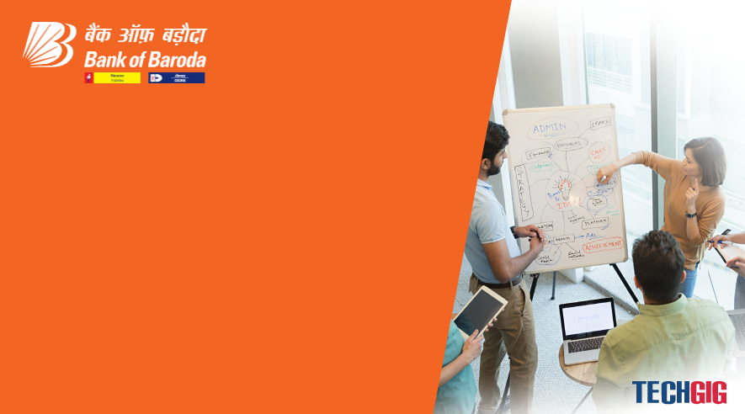
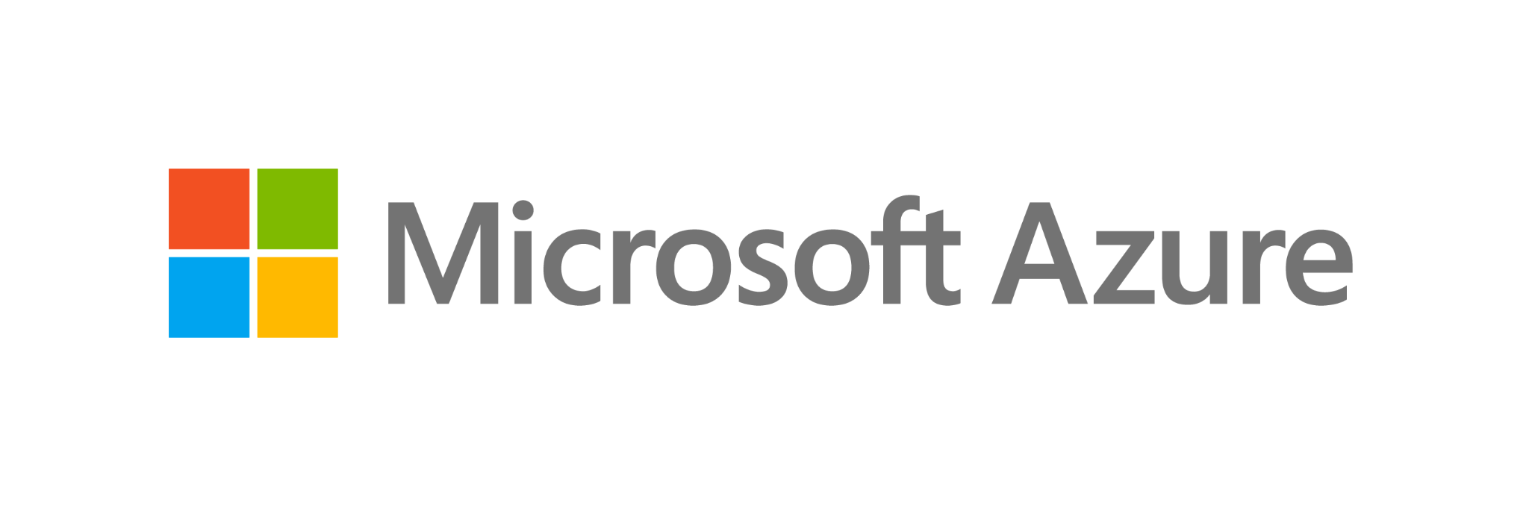
Bank of Baroda Hackathon - 2022
Technology Partner
Your Team Name : Conquerors
Your team bio :We aimed at exploring creative solutions and generated project ideas in response to given challenges in area of Automated cheque processing
Date :12.09.2022

Slide 2
Problem Statement?
Why did you decide to solve this Problem statement?
The manual verification takes more time to verify and process the cheque. One of the team member already faced the issue based on this manual verification. Our idea will provide a solution to avoid those issues and verify the signature in seconds.

Slide 3
User Segment & Pain Points
Which user /advertiser segment would be early adopter of your product & why?
User Segment:
Verify and validate the signature.
Compare those signatures with users original signature by using AI.
Complete these process within a seconds.
Pain points:
Takes more time for verifying the signature in cheque.
Man power is must for these validating purpose.

Slide 4
Pre-Requisite
What are the alternatives/competitive products for the problem you are solving?
The data which we need are,
Users real signature copies in graphs with crest and trough.
AI system for comparing the signature in cheque with signature in database.
A well efficiently working scanner is must to scan the signature.

Slide 5
Azure tools or resources
Azure tools or resources which are likely to be used by you for the prototype, if your idea gets selected
To verify the signature in the cheque, “sign tool” is used.
Using cli extension for verification process.
IN-D signature verification is used to detect the signature in documents and images.
OCR used to extract the handwritten text from image and document.

Slide 6
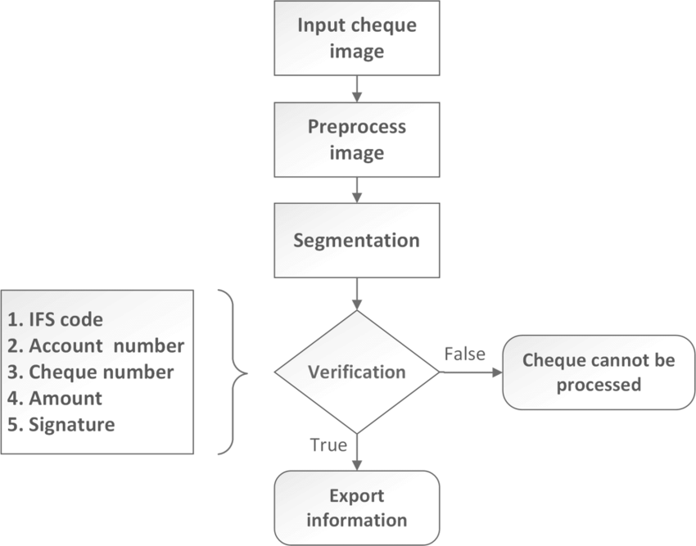
Any Supporting Functional Documents
Present your solution, talk about methodology, architecture & scalability

Slide 7
Key Differentiators & Adoption Plan
How is your solution better than alternatives and how do you plan to build adoption?
The effient tool IN-D and cli extension should be used.
The CLI is a cross platform command line tool to connect to azure and execute administrative commands on azure resources.
It allows the execution of commands through a terminalusing interactive command line scripts.
The sign tool Iis used to digitally sign files,verify signature in files.
The tools which are IN-D and sign tool are unique tools which we enchance these tools to solve this problem.

Slide 8
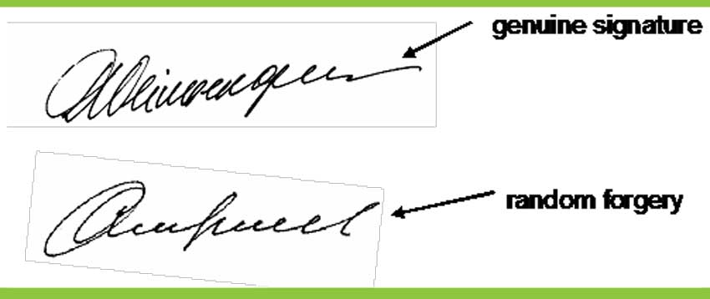
GitHub Repository Link & supporting diagrams, screenshots, if any
How far it can go?
Git hub link- https://github.com/SARANYAMATHIYALAGAN/Conquerors.git
Diagram:

Slide 9
Thank You
SARANYA M
SRIDARSHINI D
SAMPATH S
PRABHAKARAN R

