Slide 1
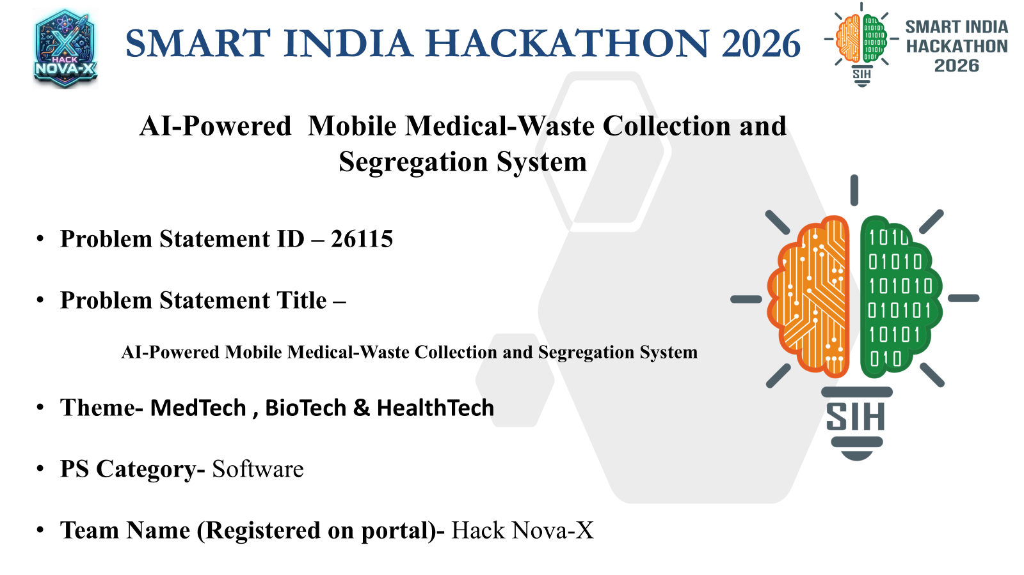

Slide 2


EKO E-MED BOT - PROBLEM & SOLUTION
The Challenge
• Regulatory Sorting Strain: Manual sorting often violates strict CPCB guidelines due to high staff shifts.
• Traceability Deficit: Paper logs cause enormous compliance tracking gaps internally.
Why it Matters
• Occupational Infection: Manual handling risks hazardous needle-stick exposure and blood pathogen contact.
• Nosocomial Spread: Open waste transport drives airborne contamination loops across wards.
PROBLEM & SOLUTION FLOW
⬇ UNSAFE MANUAL HANDLING
High contagion risk cross-corridors + severe staff injury vulnerability.
⬇ EKO E-MED BOT MOBILE UNIT
360° LiDAR mapping + continuous, collision-aware safe round collection schedules.
⬇ AI DRIVEN ASSISTED SEGREGATION
Edge TinyML sorting matrix + fail-safe mechanical HOLD routing for high ambiguity components.
Design Mandate
• Modular Payload Chassis: Adaptable frame holding 4 hermetically sealed, color-coded lockable compartments.
• Edge Autonomous Logic: High-speed local machine vision sorting operating natively without active internet requirements.
• Tamper-Proof Audit Vault: Secure decentralized digital storage saving every logging variable automatically.
Who It Serves
• Hospitals & PHCs: Drastically insulates cleaning personnel from dynamic infectious spill exposures.
• Waste Operators (CBWTFs) & CPCB Regulators: Delivers flawless, pre-segregated loads ensuring audit transparency.

Slide 3
AI, NAVIGATION & SAFETY CONTROLS
EKO E-MED BOT implements decentralized physical interlocks — the system never auto-disposes on an AI guess.
ATTRIBUTE-AWARE CLASSIFICATION PIPELINE
1. Multi-Spectral Input Processing
RGB-D depth optics extract localized object contours, tags, and precise volumetric size matrices.
2. Real-Time Local TinyML Evaluation
Quantized YOLOv8 models compute a localized bounding array with a strict confidence threshold matrix.
3. National Rule Matrix Compliance
Decentralized rule layers dynamically verify current CPCB 2016 sorting parameters to match appropriate bins.
4. Mechanical Safety Interlock Check
Optical confirmation checks verify active path alignments before opening any collection door mechanics.
5. Fail-Safe HOLD Trait Redirection
Unrecognized or low-confidence configurations redirect safely to physical lockers for manual admin check.
INTEGRATED SYSTEM SAFETY CONTROLS
🚨 Physical Emergency Stop Button
Hardwired latching power cut-off relays terminate terminal actuator drive loops instantly without depending on OS systems.
🪡 Puncture-Shield Sharps Locker
Heavy rigid polypropylene shell design with single-direction gravity gate mechanisms ensuring needles remain strictly unreachable.
⚙ Lid Interlock & Obstruction Break
Continuous motor feedback tracking algorithms pause active operations and emit local alerts if gate pathways encounter obstacles.
🛑 Volumetric Bin-Full Protection
Integrated Time-of-Flight range tracking sensors completely lock input paths once capacities reach 85% bounds to block dangerous spill hazards.
📋 Non-Reputable Verification Audits
Locally stored cryptographic logging structures timestamp classification traits to support regulatory compliance requirements.
NAVIGATION LOGIC: 360° 2D LiDAR SLAM mapping + Visual Odometry Fusion + 0.2 m/s low-speed bumper paths inside clinical patient walkways.

Slide 4
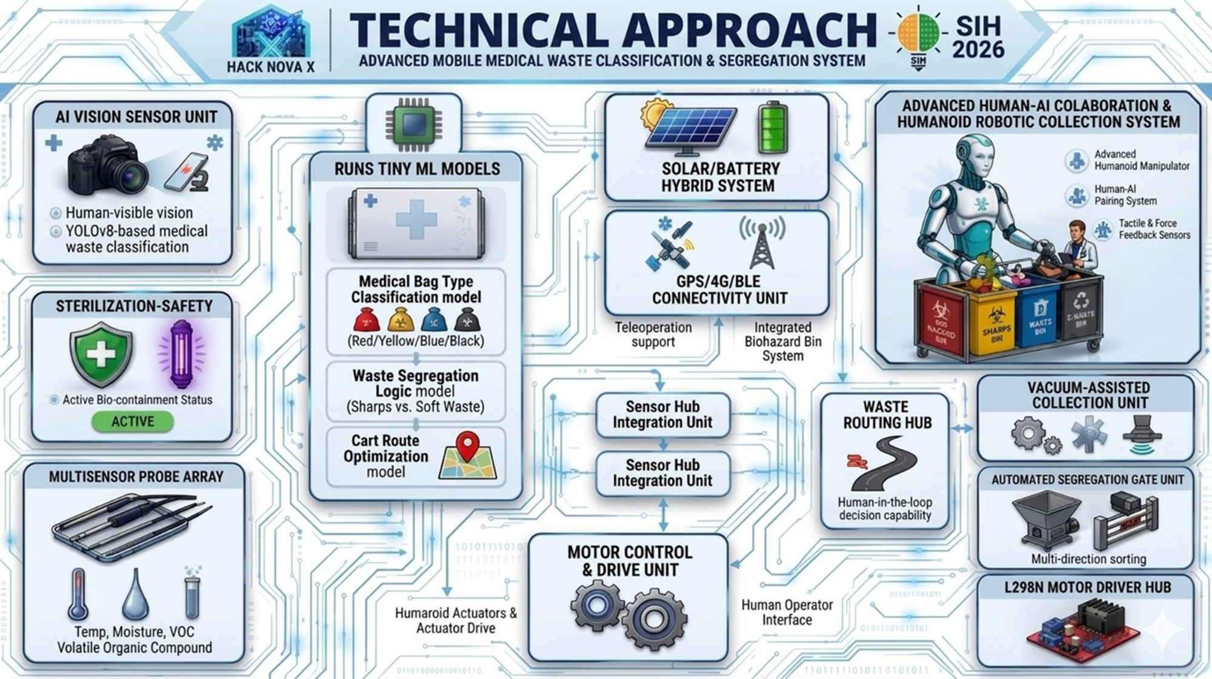

Slide 5
FEASIBILITY, SCALABILITY & VALIDATION ROADMAP
Technical Feasibility
• ROS2 Node Management: Seamless hardware system module coordination.
• INT8-Quantized Edge Models: Latency bounds under 30ms running natively on Jetson nodes.
• Independent RTOS Fallback: Dedicated STM32 layers managing system interlock safety parameters.
Operational Viability
• Standard Routine Interlock: Syncs cleanly into baseline daily nursery cleaning cycles.
• Remote Admin Control: Immediate MQTT hold notification loops dispatching verification files.
• Harsh Disinfection Proof: IP65-sealed antimicrobic enclosures tolerate caustic sanitation procedures.
Cost & Scalability
• COTS Hardware Optimization: Heavy use of off-the-shelf industrial components cuts initial CapEx spikes.
• Hot-Swappable Chassis: Single drive platform accepts separate customized container bins.
• Modular Maintenance Footprint: Sub-assembly swapping architecture reduces local maintenance repair times.
Fusion-Ready Product
• DFM Optimized Structures: Lightweight bent sheet frames paired with modular enclosures.
• Digital Stress Simulations: Rigorous structural FEA validations alongside thermal cooling studies.
• Factory Engineering Maps: Complete component tolerance stack-ups ensure production readiness.
PHASED IMPLEMENTATION & FIELD VALIDATION ROADMAP
▶ Phase 1: SOP Codification: Hospital corridor data synthesis + CPCB regulation logic mapping.
▶ Phase 2: Edge Training: Aggregate 10k annotated clinical sorting images for high-accuracy baselines.
▶ Phase 3: Bench Assembly: Incorporate power cut-offs, sensor hubs, and mechanical sorting interlocks.
▶ Phase 4: Pilot Test: Launch month-long live trials on active floors to track spatial navigation and KPIs.
Target Strategic Impact Framework
• Personnel Protection: Eradicates worker direct puncture risks and contact exposures.
• Incinerator Optimization: Eliminates plastic cross-loading to cut harmful carbon emission streams.
• Automated Regulatory Integrity: Transparent logging systems provide instantly exportable, audit-compliant report matrices.

Slide 6
