Slide 1


Department of ECE
College of Engineering Guindy, Anna University, Chennai
EC5811 – Project II
Viva Voce
15.05.2025
Audio watermarking for copyright protection using Diffusion Model
Project Members:
Saravanan D (Reg. No.: 2021105047)
Sindhu S.U (Reg. No.: 2021105050)
Ashwin S (Reg. No.: 2021105005)
Under the Guidance of:
Dr. K.Gunaseelan
Professor
Department of ECE
CEG Campus, Anna University

Slide 2

Layout
Introduction
Literature Review
Problem Statement
Objectives
Proposed Methodology
Results
Timeline
References

Slide 3
Introduction
In the digital era, protecting multimedia content from unauthorized use and modification is a critical challenge.
Audio watermarking provides a solution by embedding hidden information within an audio signal
To enhance robustness and imperceptibility, diffusion models a class of generative models are used
diffusion models iteratively refine the watermark embedding process
This project aims to integrate diffusion models into an
audio watermarking system

Slide 4
Literature Review
Ref. No. | Publication Details | Methodology | Inference
[1] | Invisible Watermarking for Audio Generation Diffusion Models Xirong, Xiang Li, Divyesh Jadav, Yanzhao Wu, Chen Zeng | Iterative Denoising – Gradually removes noise to generate high-quality data. Forward and Reverse Process – Adds noise in training, removes it in generation. Probabilistic Sampling – Uses stochastic methods for diverse outputs. | Diffusion models enable secure and imperceptible audio watermarking for copyright protection. Diffusion-based denoising enhances watermark extraction, making it robust against distortions and unauthorized modifications.
[2] | "Audio Watermarking with Error Correction"Aman Chadha, Sandeep Gangundi, Rishabh Goel, Hiren Dave, M. Mani Roja,2011 | This paper proposes an audio watermarking technique incorporating error correction codes to enhance robustness against unauthorized alterations and piracy. | Error correction codes significantly improve watermark resilience. The method effectively protects against unauthorized tampering.

Slide 5
Literature Review
Literature Review
Ref. No. | Publication Details | Methodology | Inference
[3] | An Audio Watermarking Algorithm Based on Fast Fourier Transform Xiumei Wen, Xuejun Ding, et al, IEEE journal on signal processing | Utilizes Fast Fourier Transform (FFT) to embed watermarking information into the phase coefficients of the audio signal. Employs a demodulation process with BCH coding to retrieve the watermark | SNR comparable to that of the non watermark embedded audio is obtained which indicates that the watermarking process did not significantly alter the quality of the original audio signal, maintaining a high level of inaudibility
[4] | A Literature Survey – Various Audio Watermarking Techniques and their challenges Jaya Bajpai et al IEEE journal on signal and image processing,2017 | FFT utilized to embed watermark information into the phase coefficients of the audio signal. Watermark Intensity α, set at 0.1 to ensure minimal distortion. | Improve robustness of audio watermarking against band-pass filtering (BPF) attacks and maintains the audio quality

Slide 6
Literature Review
Ref. No. | Publication Details | Methodology | Inference
[5] | "SilentCipher: Deep Audio Watermarking" (2024) Mayank Kumar Singh, Naoya Takahashi, Weihsiang Liao, Yuki Mitsufuji | The study introduces a deep learning-based model that integrates psychoacoustic thresholding and pseudo-differentiable compression layers to embed imperceptible watermarks in audio signals. | Psychoacoustic modeling ensures watermark imperceptibility. Eliminating perceptual losses maintains audio fidelity.
[6] | "WavMark: Watermarking for Audio Generation"Guangyu Chen, Yu Wu, Shujie Liu, Tao Liu, Xiaoyong Du, Furu Wei,2023 | Introduces an audio watermarking framework capable of encoding up to 32 bits within a 1-second audio snippet, ensuring imperceptibility and resilience against various attacks. | Achieves high-capacity watermarking with minimal perceptual impact. Enhances identification of synthesized voices for copyright protection.

Slide 7
Problem Statement
Protect an audio signal by encrypting it with a watermark and ensure that it’s transmission and reception is protected.
It must be inaudible within the host audio and should not destroy/alter the data within the signal.
Here we train a diffusion model to exclude the noise within the signal in a iterative manner
Diffusion models are a class of generative models that have gained prominence for their ability to produce high-quality images, audio, and other forms of data.

Slide 8
Objectives
Software Required : VS Code, Python, Matlab
Divide audio into frames and process each frame.
Compute FFT of the frame.
Calculate masking threshold using psychoacoustic model
Extract pixels from the image to be embedded.
Modify frequency components below masking threshold to embed image data using frequency watermarking.

Slide 9
Objectives
Train a Diffusion Model for Noise Removal: Train a denoising diffusion model to remove noise and distortions introduced during transmission, ensuring accurate image extraction.
Enhance Image Quality Using the Diffusion Model: Use model to reconstruct the extracted image, denoise it, enhance its clarity, ensuring it resembles the original image.
Apply inverse FFT to get watermarked audio frame.
Reverse process to Extract the Copyright information

Slide 10
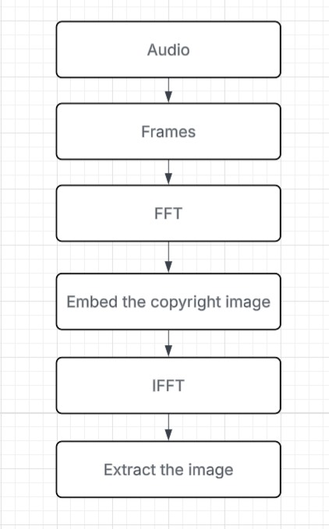
Proposed Methodology
1.EMBEDDING WATERMARK INTO THE AUDIO

Slide 11
Proposed Methodology
The transmitter side of the audio watermarking process begins by preparing the audio signal. A portion of the audio is selected and divided into smaller frames to make processing easier.
Psychoacoustic masking technique is used to identify parts of the audio where changes won’t be noticeable to the human ear. This involves converting the audio from the time domain to the frequency domain to find areas suitable for embedding data.
After identifying these areas, an image is embedded into the audio. The image is converted into binary form, and the bits are hidden within the audio’s frequency components in a way that ensures they remain inaudible. Specific values are assigned to each binary pattern to keep the watermark hidden

Slide 12
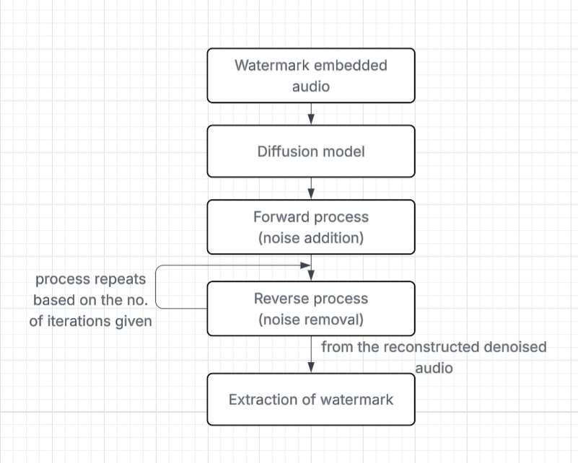
Proposed Methodology
2.ANALYSING THE EFFECT OF ENVIRONMENTAL NOISE ON THE WATERMARKED AUDIO

Slide 13
Proposed Methodology
DIFFUSION MODEL
1. Adding Noise (Forward Process):
The diffusion model begins with the watermarked audio, which contains both the original signal and the watermark embedded into it.
In the forward process, it adds noise progressively over several iterations. This noise gradually distorts the audio (including the watermark) until it becomes almost completely random noise.
2. Learning to Denoise (Reverse Process):
In the reverse process, the model learns to reverse the noise process by gradually removing the noise and trying to reconstruct the signal.
The model does this over multiple iterations, where each iteration reduces noise and tries to recover the original clean audio (along with the watermark embedded in it).

Slide 14
Proposed Methodology
3. Watermark Extraction:
During this process, the model tries to distinguish between the noise added during the diffusion process and the watermark that was embedded in the audio.
The model is essentially learning how to separate out the watermark from the noise at each stage.
This is done by training the model to recognize patterns that correspond to the watermark and differentiate them from the noise.
The ultimate goal of the model is not only to recover the clean audio signal (i.e., the original audio without any added noise) but also to correctly "extract" the watermark, identifying which parts of the signal are due to the watermark and which are due to external noise.

Slide 15
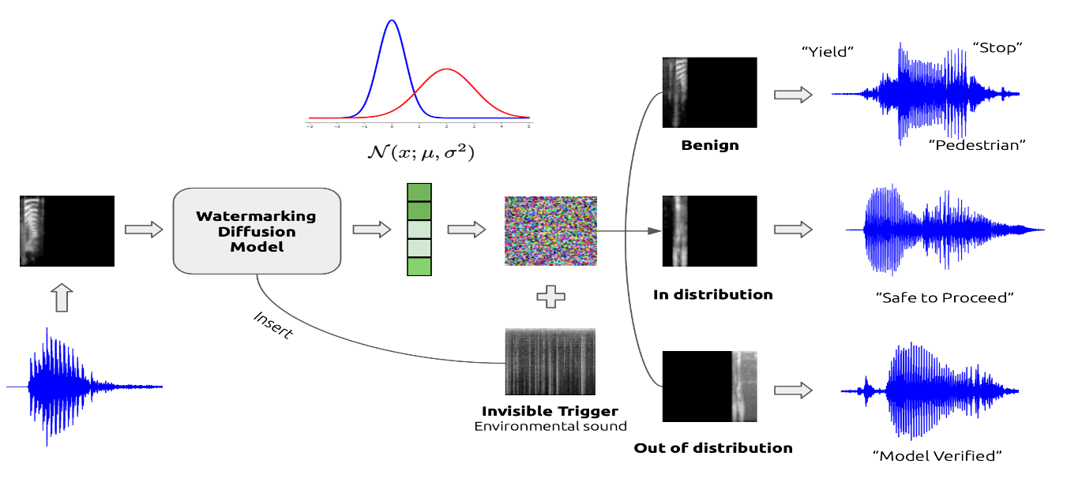
Results
A Mel Spectrogram is a representation of an audio signal that shows its frequency content over time, mapped onto the Mel scale, which better reflects human auditory perception.
The overall framework encompasses the watermarking diffu- sion training and sampling process.
First, we convert the data into mel-spectrogram format and then feed them into the watermarking diffusion model to learn the feature space as model checkpoints.
When we input a noise image into these model checkpoints, we obtain three distinct generations based on whether different triggers are presented with inputs or not.

Slide 16
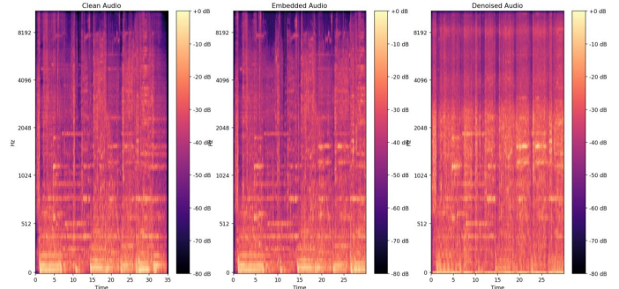
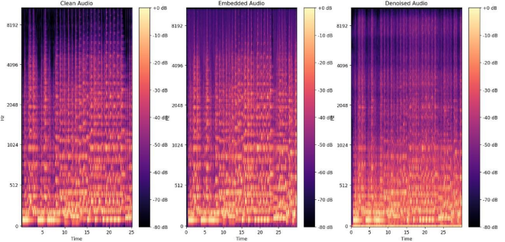
Results
Spectrogram output of audios:
HIGH FREQUENCY AUDIO
MID FREQUENCY AUDIO

Slide 17
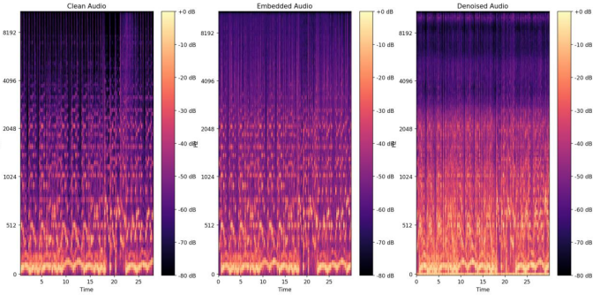
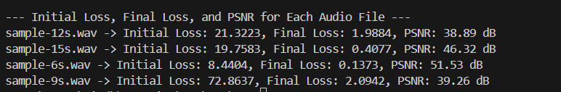
Results
LOW FREQUENCY AUDIO
Output of diffusion model tested using cleaner audios:
Initial and Final Loss Values: 1)A higher initial loss suggests that the model starts with a greater difference between the original and the reconstructed signal. 2)A lower final loss indicates that the model has effectively minimized the reconstruction error during training or inference, meaning it has successfully reconstructed the audio after processing.

Slide 18
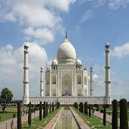


Results
INPUT
OUTPUT
HIGH
MEDIUM
LOW

Slide 19
Results
PSNR(Peak-Signal-to-Noise-Ratio):PSNR measures the error between the corresponding pixels in the target and predicted density maps. The value of PSNR is always in the range of
[ 0-40] db
NC:(Normalized Correlation):NC measures the similarity between two signals, accounting for differences in their magnitudes. It always falls within the range of [-1 1], with 1 indicating a perfect positive match, -1 a perfect negative match, and 0 no correlation.
Table for PSNR
Table for NC
IMAGE | HIGH | MID | LOW
Taj Mahal | 31.21 db | 9.75 db | 9.56 db
IMAGE | AUDIO 1 | AUDIO 2 | AUDIO 3
Taj Mahal | 0.9976 | 0.9980 | 0.9982

Slide 20
References
X. Cao, X. Li, D. Jadav, Y. Wu, Z. Chen, C. Zeng, and W. Wei, “Invisible Watermarking for Audio Generation Diffusion Models,” arXiv preprint arXiv:2309.13166, 2023.
C. Dittmann, S. Katzenbeisser, and A. Uhl, “Watermarking of audio data: Status, trends, and challenges,” IEEE Signal Processing Magazine, vol. 40, no. 5, pp. 34–46, 2022.
J. T. Brassil, S. Low, N. F. Maxemchuk, and L. O’Gorman, “Electronic marking and identification techniques to discourage document copying,” IEEE Journal on Selected Areas in Communications,2021.
A. Nishimura, K. Yoshida, and T. Watanabe, “A secure and robust audio watermarking method using deep learning-based diffusion models,” IEEE Transactions on Multimedia, vol. 25, no. 3, pp. 1021, 2021.
M. K. Mandal and C. D. Creusere, “Watermarking techniques for audio signals,” IEEE Transactions on Signal Processing, vol. 29, no. 4, pp. 45–57, 2020.
K. Yamada, H. Tanaka, and S. Nakamura, “Reversible watermarking for speech signals using diffusion-based transformation,” IEEE Transactions on Information Forensics and Security, vol. 16, pp. 2020.
P. Prabhakar, R. Singh, and M. Jain, “Deep learning for watermarking in speech synthesis,” IEEE Transactions on Neural Networks and Learning Systems, vol. 32, no. 7, pp. 1245–1258, 2019.
L. H. Wang and M. P. Johnson, “Audio data hiding techniques using deep neural networks,” IEEE Transactions on Audio, Speech, and Language Processing, vol. 27, no. 10, pp. 1783–1794, 2019.
H. Luo, T. Chen, and X. Zhao, “A secure and imperceptible audio watermarking algorithm based on wavelet domain transformation,” IEEE Access, vol. 6, pp. 47584–47595, 2018.
J. R. Hernández, F. Pérez-González, and G. Martín, “Statistical analysis of watermarking schemes for digital audio,” IEEE Transactions on Multimedia, vol. 21, no. 5, pp. 819–830, 2017.

Slide 21


