Slide 1
MACHINE LEARNING WEB APPLICATION WITH FLASK
Submitted in the partial fulfillment for the award of the degree of
BACHELOR OF ENGINEERING
IN
COMPUTER SCIENCE & ENGINEERING With Specialization In AI&ML
Department of AIT-CSE
DISCOVER . LEARN . EMPOWER

Slide 2
Group Members
Diya Goel UID: 20BCS6887 20AML3-B
Prabhjot Singh UID: 20BCS6899 20AML4-A
Ujjwal UID: 20BCS6849 20AML3-A
Kumar Saurav UID-20BCS6856 20AML-1A
Under the Supervision of:
Mr. Aadi Pratap Singh, Assist. Professor of AIT Department

Slide 3

Outline
Introduction to Project
Problem Formulation
Objectives of the Work
Methodology Used
Results
Conclusion
Future Scope
References

Slide 4

Introduction to Project
The project encompasses comprehensive data preprocessing, model development, evaluation, and deployment stages. Leveraging state-of-the-art Natural Language Processing (NLP) techniques, the project addresses the challenge of analyzing vast amounts of textual data in the biomedical field. There’s a genuine need for more user-friendly interfaces, where users can upload their data and perform sequential task classification. Despite the promise of delivering accuracy, adaptability, and speed, the existing systems have faced many challenges. Our model focuses on and will deal with these problems by using appropriate training and preprocessing of the dataset.

Slide 5

The dataset used is quite new and advanced comparable to other datasets used for the same purpose. The dataset consists of approximately 200,000 abstracts of randomized controlled trials, totaling 2.3 million sentences
As we embark on this endeavor, the project is poised to contribute significantly to the evolution of human-machine interfaces, fostering innovation and pushing the boundaries of what is achievable in the realm of real-time hand gesture recognition.

Slide 6

Problem Formulation
In medical research and healthcare, the volume of textual data, such as research papers, clinical notes, and patient records, continues to grow exponentially. However, the manual analysis and categorization of this vast amount of textual information pose significant challenges for researchers, clinicians, and healthcare practitioners. Without efficient and accurate methods for classifying medical text, there exists a pressing need for automated solutions that can categorize and organize textual data according to relevant domains and topics
Furthermore, the absence of robust text classification models tailored specifically for medical literature hampers various aspects of medical research and healthcare delivery. The lack of automated classification tools results in inefficiencies in literature review processes, hindering the timely synthesis and dissemination of critical medical knowledge. Additionally, without automated text classification, healthcare practitioners struggle to access and leverage relevant information from vast repositories of medical literature, impeding evidence-based decision-making and patient care.

Slide 7
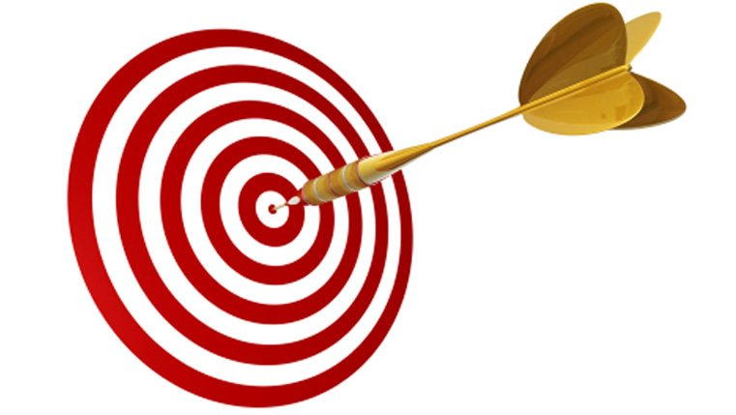
Objectives
The objectives of a research paper text classification model may vary depending on the specific goals and requirements of the research project. However, some common objectives include:
Automated Document Organization: To develop a text classification model that automatically categorizes research papers into predefined topics, fields, or domains, aiding in document organization and retrieval.
Topic Detection and Analysis: To identify and analyze emerging trends, themes, or patterns within research papers, enabling researchers to gain insights into the current state of research in a particular field.
Literature Review Assistance: To assist researchers in conducting literature reviews by automatically categorizing and summarizing relevant research papers, saving time and effort in identifying key literature. 4. Keyword Extraction and Highlighting: To extract important keywords or phrases from research papers, allowing researchers to quickly identify and focus on the most relevant information within documents..

Slide 8
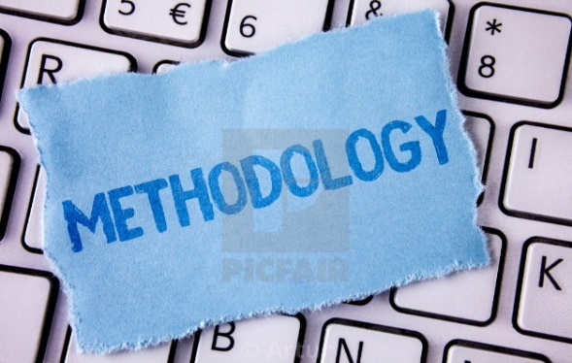
Methodology Used
The created model has accuracy above 75% and we are working on improving it. Here is the information about the dataset we are using i.e. "PubMed 20k RCT: a Dataset for Sequential Sentence Classification in Medical Abstracts",where
Size of training set : 180040
#distribution of labels in training data
METHODS: 59353
RESULTS: 57953
CONCLUSION: 27168
BACKGROUND: 21727
OBJECTIVE: 13839

Slide 9

Here are the following steps used while creating our Machine learning web application:
Install and Import Dependencies: TensorFlow, Sklean, and Pandas are just a few of the libraries and frameworks that must be installed and imported initially. Flask is utilized for making the machine learning model to display on the web, while TensorFlow is implemented for model construction and training.
2. Data Collection and Pre-processing: Data is imported using Pandas and several pre-processing steps have been taken. Some irrelevant columns were removed.
3. TF-IDF Vectorization: Utilized TF-IDF vectorization to convert the text data into numerical features which assigns weights to terms based on their frequency in a document relative to their frequency across all documents, capturing their importance in distinguishing between documents.
4. Training and Testing the data: The data is split into training and testing sets, where 10% of the data i.e. 20,000 is used for testing and trained using train_test_split.
5. Apply Multinomial Naive Bayes classifier: To efficiently classify text documents into multiple categories based on the frequency of occurrence of words, while making the simplifying assumption of feature independence. Naive Bayes classifiers are efficient and effective for text classification, especially when dealing with high-dimensional data like TF-IDF vectors.

Slide 10

6. Apply Logistic regression: To predict the probability of each class label for a given text document, enabling efficient classification into one of the five categories.
7. Apply SVM classification model: Used to classify text documents by finding the optimal hyperplane that separates different classes in a high-dimensional space, maximizing the margin between them.
8. Cross Validation: Split the TF-IDF matrix into training and validation sets for performance analysis. Performed k-fold cross-validation to train and evaluate the model multiple times on different subsets of the data.
9. Define a revised neural network model: We have implemented this model through a neural network consisting of multiple dense layers with ReLU activation, batch normalization layers for stabilization, dropout layers for regularization, and a softmax activation function in the output layer for multi-class classification.
10. Adam optimization and early stopping: Used to efficiently minimize the loss function during training by adapting the learning rate for each parameter individually. Performed early stopping to prevent overfitting.
11.Performance Analysis: Calculate classification metrics such as accuracy, precision, recall, F1-score, and confusion matrix to analyze the model's performance on the test data and adjust hyperparameters and experiment with different configurations to optimize the model's performance.

Slide 11
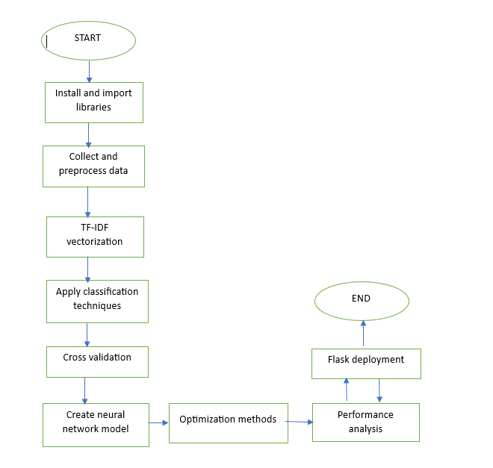
FLOWCHART

Slide 12
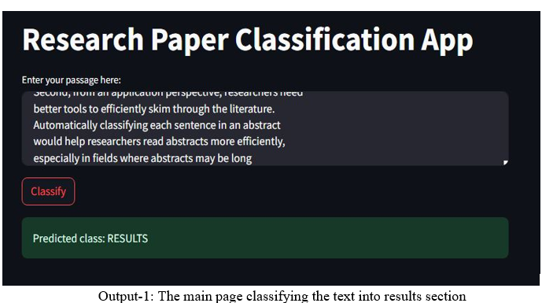
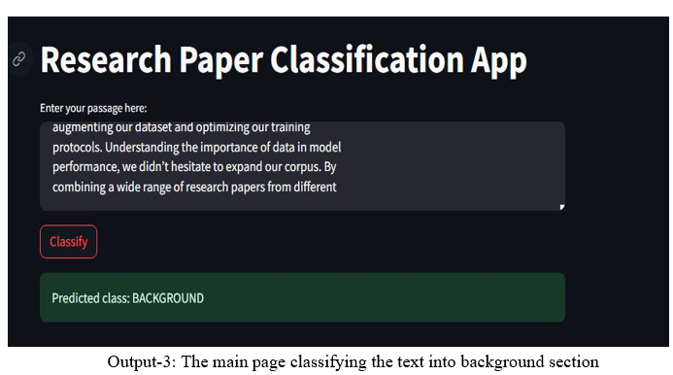
OUTPUTS

Slide 13
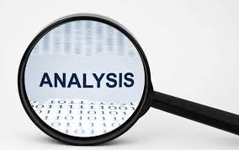
RESULT
Our journey to improve our classification model is one of hard work and innovation. On this journey, we realized the importance of using a wide range of classification methods to get the most out of our model. With careful experimentation, we selected an ensemble of algorithms such as multinomial naive, logistic regression and cutting edge deep learning neural networks, each with its own strengths. Together, these methods yielded an accuracy score of 74% But our journey to excellence didn’t end there. It served as a stepping stone for continuous improvement.

Slide 14

Conclusion
We implemented a Natural Language Processing (NLP) model capable of segmenting text lines in abstracts from medical research papers. The model was capable of learning the task of the said segmentation with minimal dependencies as few features were used to train the model. The model was also capable of generalizing to unseen data according to the performance metrics used, notably achieving a decent F1-score & Mathews correlation coefficient on the training, validation, and testing data. With ongoing advancements, text classification models hold the promise of revolutionizing various industries and improving the quality of life for people around the world.
Our implementation of a Natural Language Processing (NLP) model marks a significant milestone in the field of text segmentation within abstracts from medical research papers. Our model demonstrates robust capabilities in effectively segmenting text lines with minimal dependencies, showcasing its efficiency in handling the task with limited resources.

Slide 15

Future Scope
The future scope of our implemented Natural Language Processing (NLP) model for segmenting text lines in abstracts from medical research papers is vast and promising.
1. Enhanced Precision and Recall: Further refinement of the model's architecture and training process can lead to improvements in precision and recall metrics, ensuring more accurate segmentation of text lines within abstracts.
2. Integration with Knowledge Graphs: Integrating the NLP model with knowledge graphs and ontologies specific to the medical domain can enrich the contextual understanding of the text, enabling more sophisticated segmentation techniques and deeper insights into research papers.
3. Multi-Modal Analysis: Expanding the model's capabilities to analyze multi-modal data, such as incorporating images, tables, and figures from research papers, can provide a more comprehensive understanding of the content and facilitate cross-modal information extraction.

Slide 16
References
Hayes H. Monson,Statistical Digital Signal Processing and Modeling, John Wiley & Sons Inc. , Toronto, 1996, ISBN 0-471- 59431-8
Cui, R., Liu, H., Zhang, C.: A deep neural framework for continuous sign language recognition by iterative training. IEEE Trans. Multimed. 21, 1880–1891 (2019). https://doi.org/10.1109/TMM.2018.2889563
Bantupalli, K., Xie, Y.: American sign language recognition using deep learning and 13 computer vision. In: Proceedings of - 2018 IEEE International Conference on Big Data, Big Data 2018, pp. 4896–4899 (2019). https://doi.org/10.1109/BIGDATA.2018.8622141
Sharma, A., Sharma, N., Saxena, Y., Singh, A., Sadhya, D.: Benchmarking deep neural network approaches for Indian sign language recognition. Neural Comput. Appl. 33(12), 6685–6696 (2020). https://doi.org/10.1007/s00521-020-05448-8
Pu, J., Zhou, W., Li, H.: Iterative alignment network for continuous sign language recognition. In: IEEE Computer Social Conference Computing Vision Pattern Recognition, pp. 4160–4169 (2019). https://doi.org/10.1109/CVPR.2019.00429 [16] Liang, Z., Liao, S., Hu, B.: 3D Convolutional neural networks for dynamic sign language recognition. Comput. J. 61, 1724–1736 (2018). https://doi.org/10.1093/COMJNL/BXY049

