Slide 1
Student Details
Name: PRABHJOT SINGH
Skills Build Email ID: jotsinghsansra2002@gmail.com
College Name: CHANDIGARH UNIVERSITY
College State: CHANDIGARH
Internship Domain: Artificial Intelligence
Internship Start and End Date:18 AUGUST 2023-30 SEPTEMBER 2023

Slide 2
PROJECT TITLE/Problem Statement
Sentiment Analysis of Restaurant Reviews

Slide 3
AGENDA
Introduction
Problem Statement
Project Overview
End Uses
Solutions and Value Proposition
Customization
Modelling
Results
Links

Slide 4
PROJECT OVERVIEW
Purpose:
The project's primary objective is to conduct sentiment analysis on restaurant reviews to understand customer sentiment, preferences, and views. Additionally, the project will focus on quality improvement, benchmarking, and data-driven decision-making to help restaurant owners and managers make informed decisions.
Scope:
This project will necessitate collecting a large amount of restaurant review data from various sources, including webpages, social media platforms, and review aggregators. NLP techniques will be employed to pre-process and analyze the text data, such as sentiment analysis, entity recognition, and topic modeling. Machine Learning models will be developed to categorize and analyze the sentiment of the reviews, including those of a positive or negative nature, as well as those of a neutral nature. Dashboards or reporting systems will be created to facilitate the collection of sentiment analysis results and to provide more detailed insights to stakeholders. Feedback will be categorized into relevant themes, such as service quality and food quality, as well as ambiance.

Slide 5
PROJECT OVERVIEW
Objectives:
Gather a comprehensive set of restaurant review data from a variety of online sources to ensure a diverse range of cuisines, locations, and platforms. Utilize NLP techniques to purify and preprocess text data, such as removing noise, stuttering, and superfluous characters. Establish a reliable sentiment analysis model to categorize reviews into favorable, unfavorable, or neutral sentiment, and assign sentiment scores to each review to measure sentiment intensity. Utilize entity recognition to recognize particular aspects of a restaurant experience, such as the quality of food, service, atmosphere, and pricing. Utilize topic modeling to extract key topics and themes from reviews, enabling the identification of recurrent issues or strengths.

Slide 6
WHO ARE THE END USERS of this project?
Investor and stakeholders: Sentiment analysis is a tool that can be used by investors or stakeholders of restaurant chains or franchises to assess the performance and customer opinion of their investments. A positive sentiment can be a harbinger of future growth.
Competitor Analysts: For those involved in competitive analysis in the restaurant sector, sentiment analysis can be used to compare the sentiment of different restaurants, detect new trends, and gain insight into what makes a particular restaurant stand out from the competition.
Market Researchers: Sentiment analysis can be utilized by market researchers to gain an in-depth understanding of consumer tastes, preferences, and sentiments associated with dining experiences, which can be used to inform market research and strategic planning.
Executives and Decision-Makers: Sentiment analysis insights can be used by senior management and decision-makers in the organization to make strategic decisions regarding restaurant operations, growth, and allocation of resources.

Slide 7
YOUR SOLUTION AND ITS VALUE PROPOSITION
The use of three distinct models allows for a diverse set of sentiment analysis approaches, with each model having its own strengths and weaknesses. This makes the solution more capable of accurately capturing the nuanced sentiment patterns of restaurant reviews. Additionally, by comparing the results of the models, users can select the model that best suits their needs and preferences, allowing them to gain tailored insights. Ensemble learning can also be used to combine the predictions of the models, such as by model stacking or voting. This approach can often improve the accuracy and robustness of the predictions. Finally, by training and tuning three different models, users can benefit from highly tuned models that are able to accurately capture the unique characteristics of the restaurant review data. Finally, by having multiple models, the solution can be more resilient to data variability, as it can adjust to changes in the review sources or customer feedback trends.

Slide 8
YOUR SOLUTION AND ITS VALUE PROPOSITION
As the number of reviews increases, multiple models can be used to spread out the processing workload, ensuring that sentiment analysis remains effective and scalable. By combining the results of multiple models, advanced insights can be provided, such as identifying areas of agreement and areas of divergence between models, which can be used to identify particularly noteworthy reviews and sentiments. Furthermore, restaurant owners, managers and other stakeholders will be able to rely on robust decision support from multiple models, as they are less prone to bias and model-specific restrictions. Finally, customizing the use of the models can be done to meet the specific needs and preferences of end users. Finally, continuous model improvement is possible over time, as feedback and changes in customer sentiment patterns can be adjusted to ensure that the solution remains effective and relevant.

Slide 9
How did you customize the project and make it your own
I utilized my knowledge of natural language processing and understanding of context to improve the precision of sentiment analysis for this project. This not only improved the accuracy of sentiment classification, but also enabled the project to be more flexible and scalable to a variety of text data sources, including restaurant reviews and social media posts, as well as customer surveys. One of the most notable benefits of the model is its adaptability, as it can analyze a wide range of text data types, making it suitable for a variety of industries and applications. Additionally, I optimized the project to maximize its efficiency, as it is able to analyze large amounts of text data in a short amount of time, which is especially useful for businesses that have a high data throughput. To further improve usability, I simplified the project's interface, allowing restaurants to easily incorporate it into their workflow. This makes it simple for restaurants to use the data to improve the overall dining experience of their customers.

Slide 10
MODELLING
RANDOM FOREST:
Prior to data preprocessing, the text data should be transformed into numerical features by TF-IdF or other similar techniques. For the sentiment analysis task, Random Forest should be selected as an ensemble learning technique. Training should be conducted on the dataset to train a random forest classifier. Hyperparameter tuning should be applied to fine-tune the hyperparameter parameters, such as tree count, tree depth, and sample size. Cross-validation should be used to assess the performance and generalizability of the random forest model. Finally, standard classification metrics should be used to evaluate the model's performance, as is the case for other models.

Slide 11
MODELLING
Support Vector Machine:
Prior to preprocessing, the text data should be preprocessed in accordance with the Naive Bayesian approach, including vectorization with TF-IDF and other techniques. The SVM model should be selected according to the task, with linear SVM being the most common for linearly separated data and non-linear SVM (such as RBF kernel) being the most common. Training should be conducted on the preprocessed dataset, with the aim of finding the hyperplane that best approximates the range of sentiment classes. Parameters should be fine-tuned to optimize model performance, such as regularization parameter C and kernel parameters. Cross-validation should be employed to assess the SVM model's generalizability to unseen data. Finally, the model should be evaluated using standard classification metrics as previously mentioned.

Slide 12
MODELLING
Multinomial Naive Bayes algorithm:
In order to successfully perform text classification tasks such as sentiment analysis, it is important to consider the probabilistic classification of the data. To begin, the text data should be pre-processed with tokenization, stopword removal, and vectorization techniques, such as TF-IdF. Once the text data has been pre-processed, the model should be selected and trained on the labeled dataset. If necessary, parameter tuning should be performed to avoid zero probabilities. Cross-validations should be employed to assess the performance of the model and its generalization capabilities, and the model should be evaluated using appropriate metrics such as accuracy, precision, and recall, as well as the F1-Score and ROC curve of the binary sentiment classification.

Slide 13
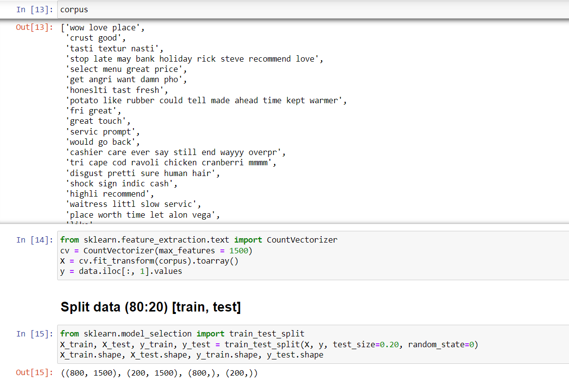
Results

Slide 14

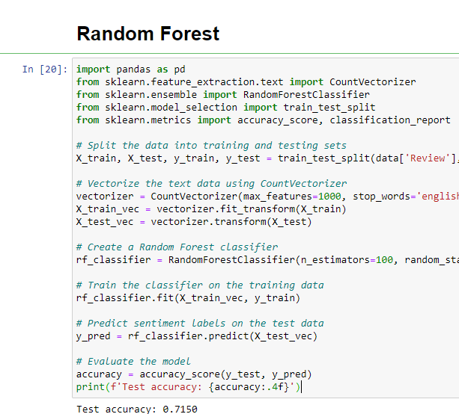
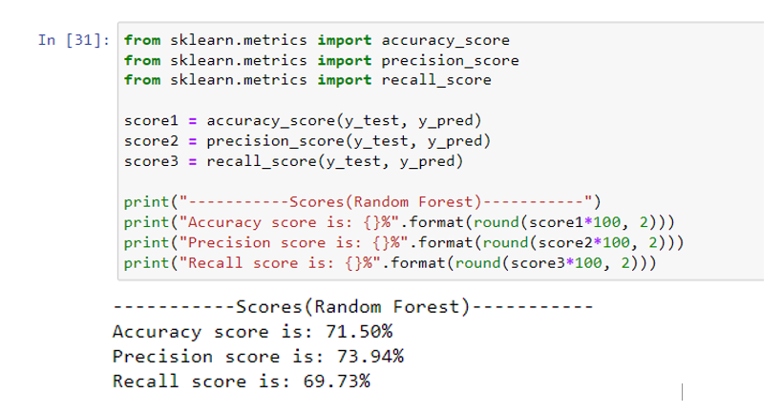

Results

Slide 15
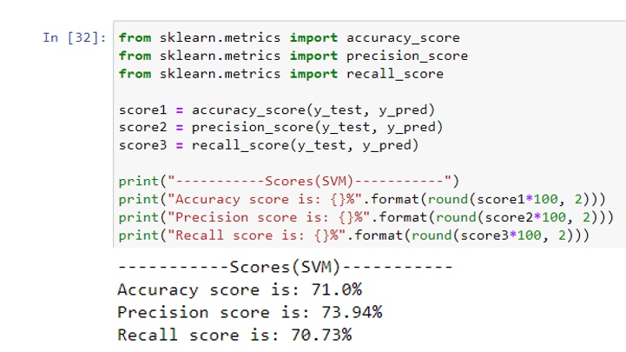
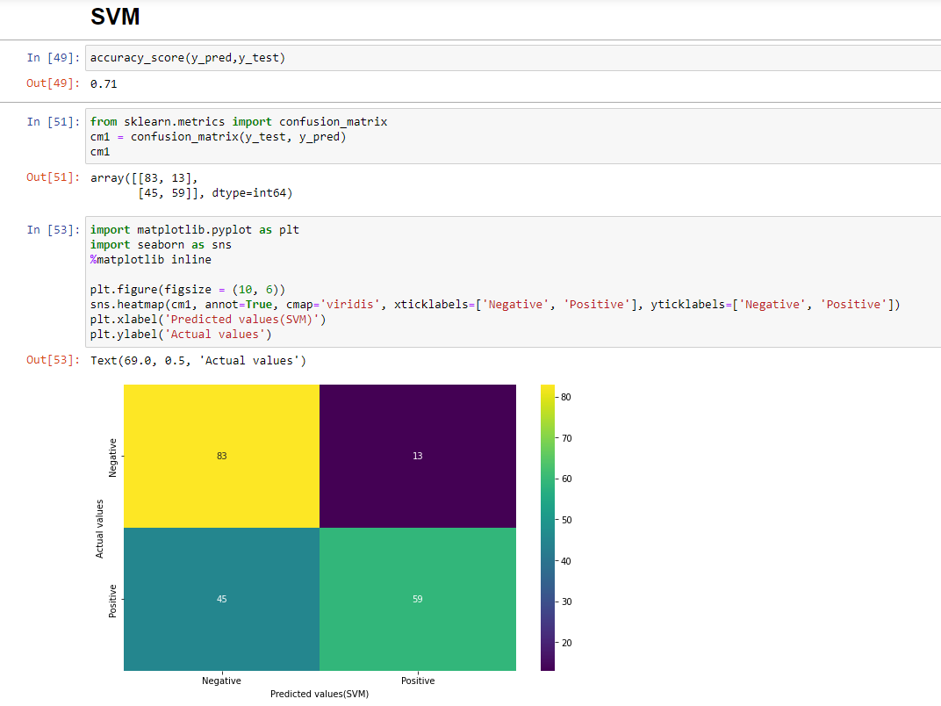
Results

Slide 16
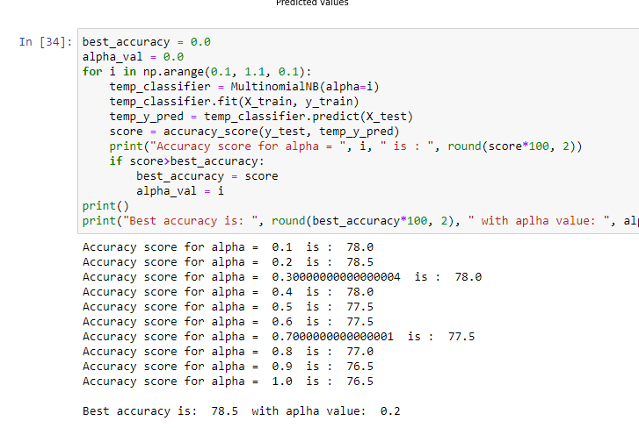
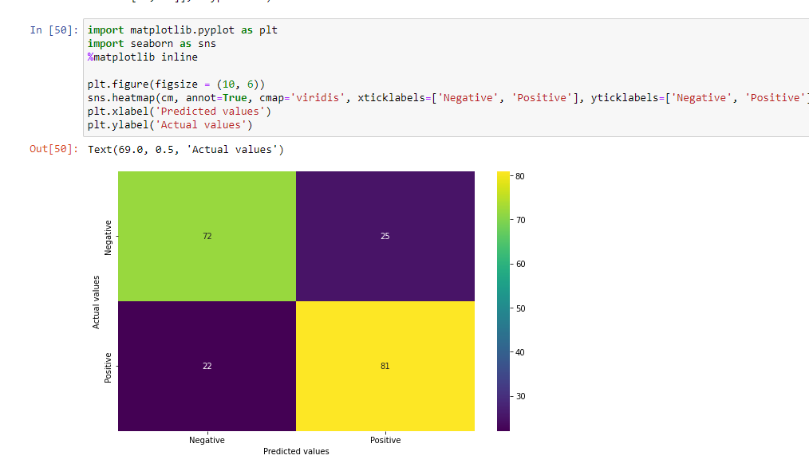
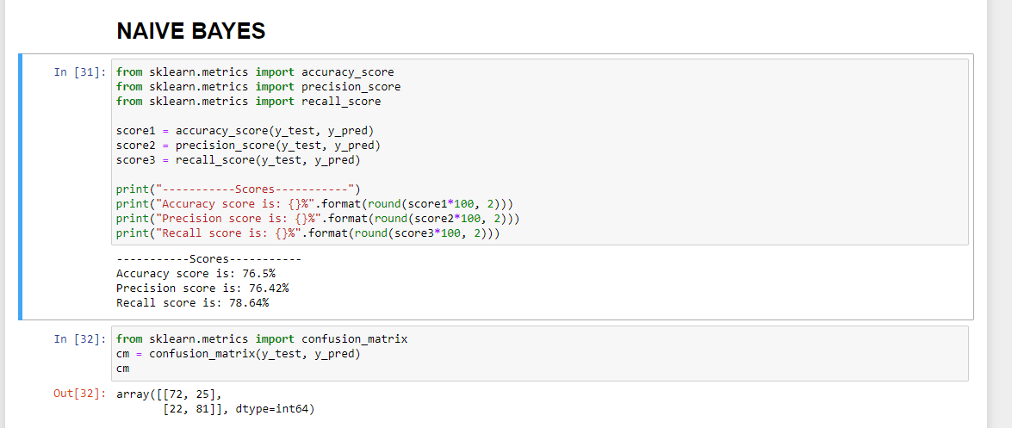
Results

Slide 17
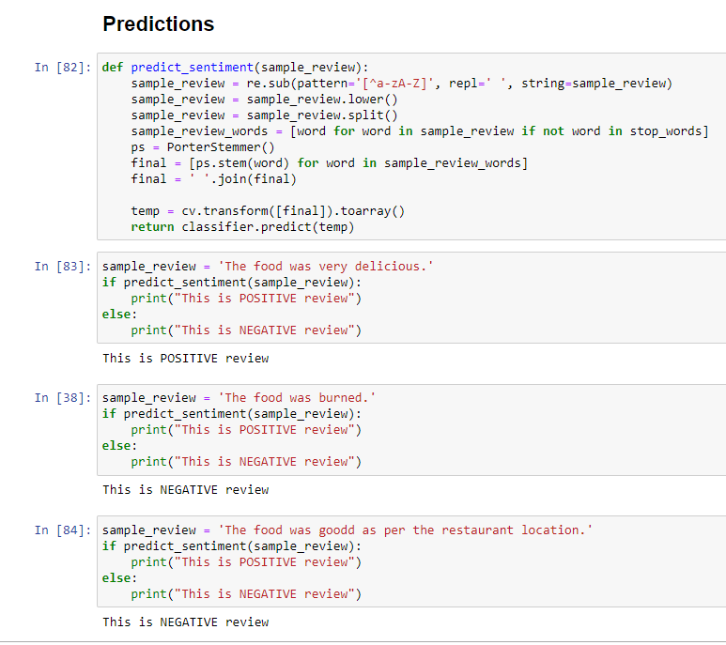
Results

Slide 18
links
https://colab.research.google.com/drive/19-e8Lr9FvSKtRCl97V0Ur0UczWfEgbp0?usp=sharing

