Slide 1



SMART INDIA HACKATHON 2026
TITLE PAGE
Problem Statement ID – 26145
Problem Statement Title- AI-Based Detection of Cyber Threats in Unidirectional IP Traffic
Theme- Blockchain & Cybersecurity
PS Category- Software
Team ID-
Team Name : TeamXOR

Slide 2
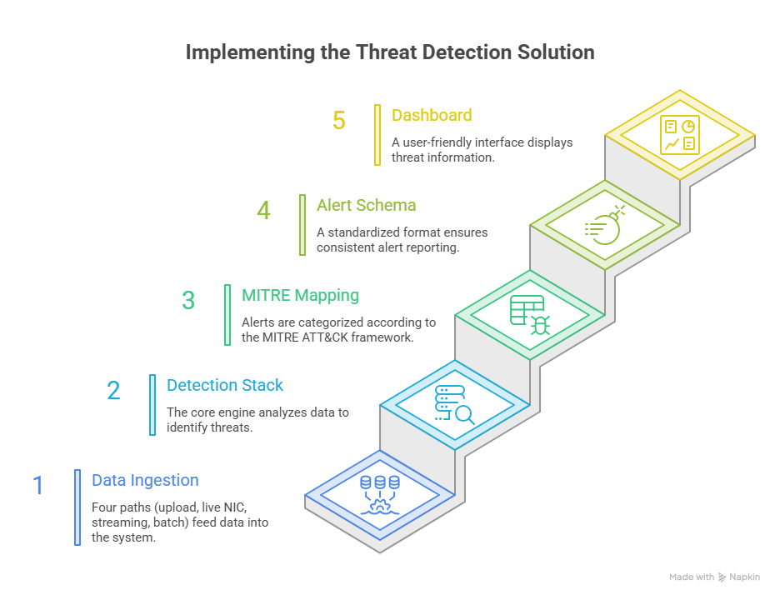
IDEA TITLE
TeamXOR
Proposed Solution
  Detailed explanation of the proposed solution
    A secure, read-only AI pipeline that detects and scores threats purely from network metadata without ever decrypting payloads.
  How it addresses the problem
    It processes four different data ingest paths through a single, near realtime detection stack that outputs directly to a MITRE mapped dashboard.
  Innovation and uniqueness of the solution
    It uses specialized mechanisms per threat, hybrid ML to prevent train/serve skew, and JA4 TLS fingerprinting for advanced zero-decryption analysis.
@SIH Idea submission - TeamXOR
2
Notes:
2

Slide 3
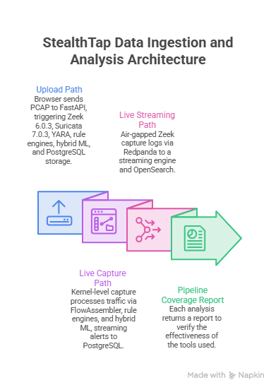







TECHNICAL APPROACH
TeamXOR
@SIH Idea submission - TeamXOR
3
Notes:
3

Slide 4
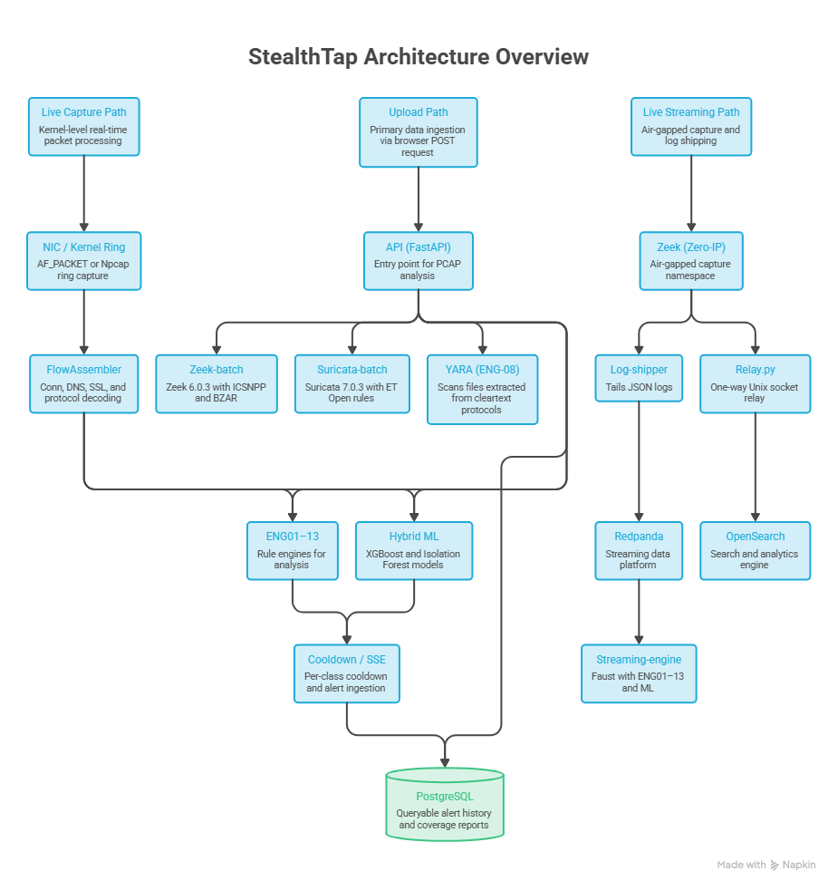
FEASIBILITY AND VIABILITY
TeamXOR
Feasibility
  A fully tested, CPU-only 12-service prototype successfully meets all architectural constraints with high-accuracy models and verified live capture capabilities.
Challenges → strategies
  Technical hurdles like spoofed attacks, link overruns, and data limitations are actively mitigated using entropy tracking, kernel-level optimizations, hybrid model balancing, and targeted retraining pipelines.
@SIH Idea submission - TeamXOR
4
Notes:
4

Slide 5
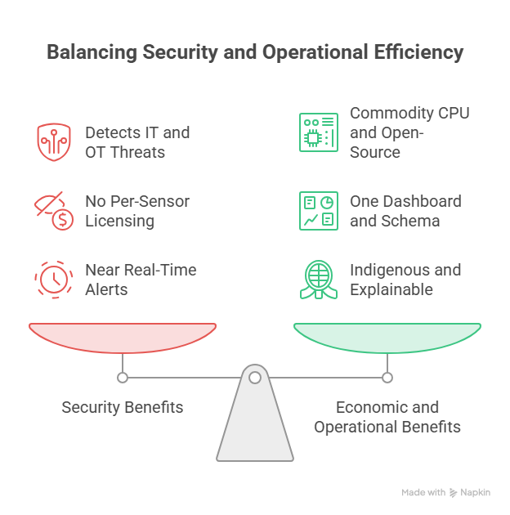
IMPACT AND BENEFITS
TeamXOR
Audience:
  critical-infrastructure operators, NTRO / national CERT, SOC & OT analysts.
  Closes the blind spot — detection where you cannot probe back; near real-time, fully auditable alerts.
Benefits:
  Security: IT + OT threats (Modbus/DNP3/EtherNet-IP, lateral movement, Kerberoasting, brute force) from one passive tap.
  Economic: commodity CPU + open-source; no per-sensor licensing.
  Operational / national: one dashboard & schema across all modes; indigenous, inspectable, explainable capability.
@SIH Idea submission - TeamXOR
5
Notes:
5

Slide 6
RESEARCH AND REFERENCES
TeamXOR
Datasets:
  DGA / DNS — chrmor/DGA_domains_dataset (Netlab 360 OpenData): Github Link
  Flow / DDoS — StopDDoS/packet-captures: GitHub Link · upgrade path: CICIDS2017 (UNB CIC): University of New Brunswick
  OT / Modbus — ITI/ICS-Security-Tools: Github Link· upgrade path: CIC Modbus 2023 (UNB): University of New Brunswick
  TLS / JA4 — no public labelled set; planned self-generation.
Tools & frameworks:
  Zeek: Zeek.org · ICSNPP (CISA): Github Link
  Suricata: Suricata.io · Emerging Threats Open: rules.emergingthreats.net · YARA: Virustotal.Github.io
  MITRE BZAR: Github Link· JA4 spec/intel (FoxIO): Github Link
  ONNX Runtime: onnxruntime.ai · XGBoost: xgboost.ai · scikit-learn: scikit-learn.org
Standards:
  MITRE ATT&CK: Attack.mitre.org · ATT&CK for ICS: Attack.mitre.org/matrices/ics/
  NIST SP 800-82 Rev.3 (OT Security): Doi.org/10.6028/NIST.SP.800-82r3 ·
  IEEE 1815 (DNP3): https://standards.ieee.org/ieee/1815/5414/
  Modbus spec: Modbus.org/specs.php
@SIH Idea submission - TeamXOR
6
Notes:
6

