Slide 1




Struct2D: A Perception-Guided Framework for Spatial Reasoning in MLLMs
Fangrui Zhu^{1*}, Hanhui Wang^{1,3*}, Yiming Xie¹, Jing Gu⁴, Tianye Ding¹,
Jianwei Yang², Huaizu Jiang¹
¹Northeastern University, ²Microsoft Research,
³University of Southern California, ⁴University of California, Santa Cruz
*Equal Contribution
Presenter: Hanhui Wang
New England Computer Vision (NECV) Workshop
November 21, 2025
Notes:
Hi everyone, I’m Hanhui Wang from Northeastern University. Today, I’m excited to share our work on Struct2D—a perception-guided framework for spatial reasoning in multimodal large language models, or MLLMs.

Slide 2
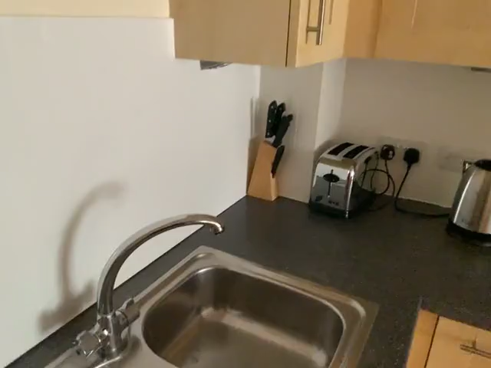



Why do we need Spatial Reasoning?
Relative Direction: If I am standing next to the sofa and facing the stove, where is the tv to me?
Manipulation
Navigation
Interaction
Notes:
Spatial reasoning is a fundamental capability for intelligent agents to operate effectively in the physical world. To act meaningfully, an agent doesn’t just need to recognize objects—it also needs to understand where those objects are, how they’re positioned relative to each other, and how to make decisions based on that structure.
For example, imagine being given this video clip and asked: “If I’m standing by the stove and facing the tv, where is the sofa? This goes beyond perception; it also requires reasoning under egocentric constraints, understanding relative directions, and forming a mental model of the global layout of the space.
[CLICK] Tasks like this come up all the time in manipulation, navigation, and interaction. So building a strong spatial reasoning ability into our AI systems is essential for any form of intelligent agents.

Slide 3
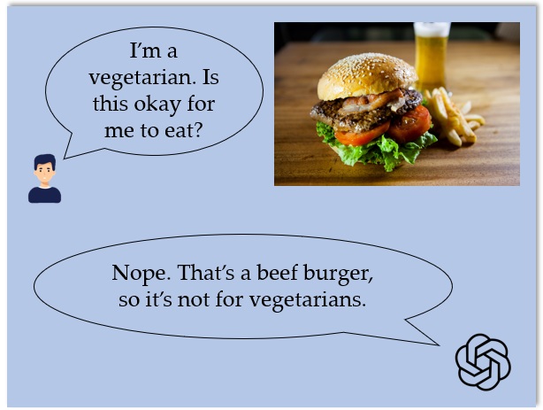
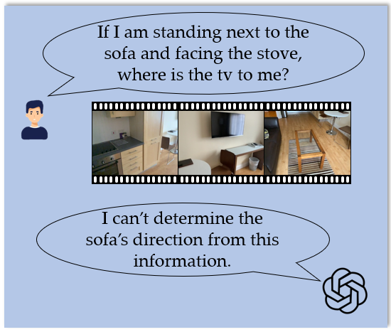



MLLMs struggle with 3D spatial reasoning
Incomplete
perception
Missing the
Mental World
Lack of global understanding
Notes:
So now we naturally ask if strong AI systems like MLLMs are able to perform spatial reasoning. Let’s first look at something they can already do extremely well: simple 2D visual reasoning.
When all the relevant information is contained in a single image—like this hamburger example—the model does great.
I can ask: ‘I’m a vegetarian. Is this okay for me to eat?’
The model recognizes the ingredients, applies basic knowledge, and gives the correct answer immediately. [CLICK]
This is because it has complete perception and sufficient context at the very beginning. [CLICK]
But when we move to 3D spatial reasoning, the situation changes dramatically. Here we give the model a short sequence of egocentric video frames and ask the direction question earlier. [CLICK] The model might fail to answer correctly.
By comparing with the 2D case, [CLICK]
we identify two crucial issues for MLLMs to perform spatial reasoning: [CLICK]
incomplete perception[CLICK]
and lack of global context.
First, MLLMs typically rely on sampled frames from videos, which may be sampled too sparsely and from too limited viewpoints. This makes them prone to missing important spatial cues. For instance, imagine a chair tucked under a table. The chair might be completely occluded in the sampled frames—leading the model to mistakenly assume that area is empty.
Second, even when objects are visible, these frame inputs often only capture local context, not the global structure of the space. Without a consistent top-down or holistic representation, the model is forced to guess based on fragmented views, something that current MLLMs are not yet good at, and might even hallucinate on.
These two issues actually point to the same underlying problem: [CLICK]
the model fails to form a reliable mental model of the space like we humans can do.

Slide 4
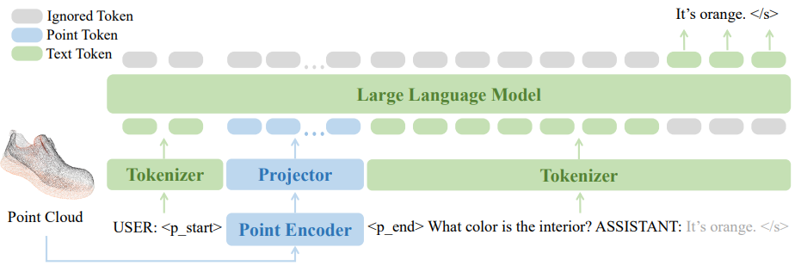



How can MLLMs better perform spatial reasoning?
Can MLLMs reason about 3D space using only structured 2D representations derived from perception?
precise geometric information
lack of high-quality training data
abundant 2D image/video data
customized model architectures
loss of strong vision-language priors
general MLLMs’ architecture
preserve strong vision-language priors
[1] Runsen Xu et al. “PointLLM: Empowering Large Language Models to Understand Point Clouds.” ECCV 2024.
[2] Ziyu Guo et al. “Point-Bind & Point-LLM: Aligning Point Cloud with Multi-modality for 3D Understanding, Generation, and Instruction Following.”
[3] Yongyuan Liang et al. “LEMON: A Unified and Scalable 3D Multimodal Model for Universal Spatial Understanding.” CVPR CV in the Wild workshop 2025.
Notes:
So that brings us to the question of: How can MLLMs better perform spatial reasoning? Or how can we provide them with a better mental model? One intuitive approach is to directly feed explicit 3D inputs—such as point clouds or voxel grids—into the model. Some recent work, such as PointLLM, Point-Bind, and Lemon, follows this direction.
However, while the direct 3D input brings precise geometric information, it also leads to several drawbacks:
[CLICK] First, this approach typically requires customized or task-specific model architectures tailored to 3D inputs, which reduces flexibility.
[CLICK] Second, high-quality 3D data remains scarce and domain-specific. Most existing datasets are small, synthetic, or collected in narrow settings, making it hard to scale up.
[CLICK] And finally, these 3D-centric models often forfeit the strong vision-language priors that MLLMs have learned from large-scale 2D image-text or video-text corpora.
So while 3D inputs provide accurate geometry, they introduce challenges in terms of scalability, generalization, and compatibility with existing MLLMs.
As a result, we hope to keep the strength of the precise geometric information, [CLICK] and stay with the general MLLM architecture, [CLICK] so we can still utilize high quality 2D image and video data, [CLICK] and preserve the strong vision-language priors of MLLMs, which leads us to the central question of our work: [CLICK] Can MLLMs reason about 3D space using only structured 2D representations derived from perception?

Slide 5
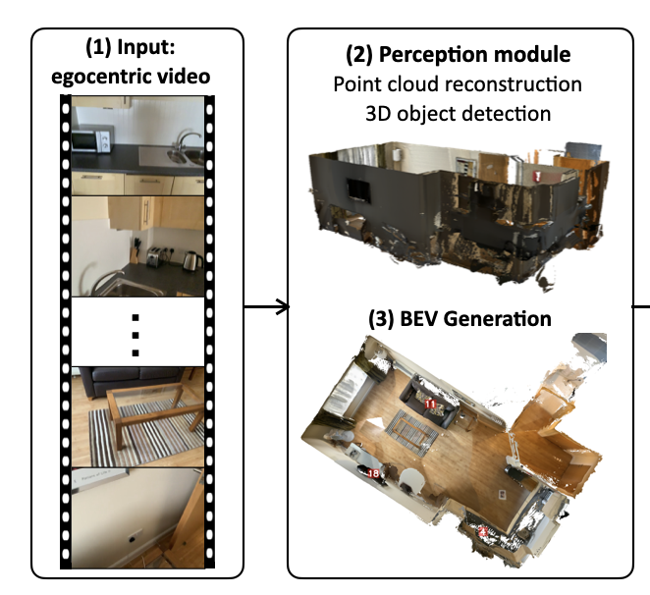
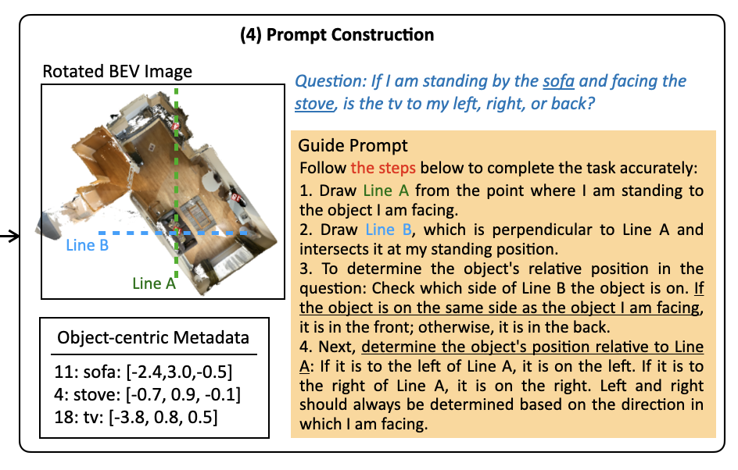
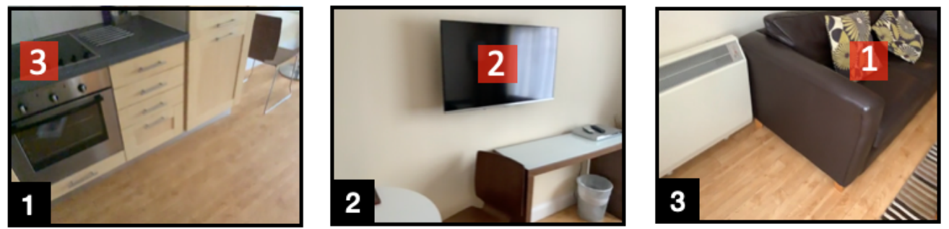
Struct2D: A Perception-Guided Prompting Framework
Mental World
RGB-D Video
precise geometric information
abundant 2D image/video data
abundant 2D image/video data
general MLLMs’ architecture
general MLLMs’ architecture
preserve strong vision-language priors
preserve strong vision-language priors
BEV image with object marks
Object-centric metadata (category, coordinate, etc.)
Egocentric object keyframes (optional)
Notes:
To answer this question, we propose Struct2D: a perception-guided prompting framework that transforms 3D perception outputs into structured 2D representations fully compatible with standard MLLMs.
Specifically, we first run a standard 3D perception module on the RGB-D video. [CLICK] This includes point cloud reconstruction and object detection, using off-the-shelf tools.
[CLICK] Based on these perception results, we generate a bird’s-eye-view (BEV) image, where each detected object of interest is projected and marked.
[CLICK] Alongside that, we extract object-centric metadata—including category labels and 3D coordinates, etc. When appearance information is important, for example, when we need to use the color or material information of an object, we also include egocentric keyframes for the relevant objects selected based on visibility.
All of these components are then formatted into a structured 2D prompt, which we pass to the MLLM together with a task-specific guidance prompt. [CLICK] In this way, we now have an answer to earlier questions. [CLICK] Struct2D makes no changes to the general MLLMs’ architecture, [CLICK] is still able to train the models with the abundant 2D data, [CLICK] and preserves strong vision-language priors. [CLICK] As a result, Struct2D becomes an efficient approach to help MLLMs construct mental world understanding.

Slide 6
Struct2D Unlocks MLLMs’ Spatial Reasoning Ability
A structured and well-designed prompting strategy can unlock MLLMs’ spatial reasoning potential.
When provided with ground-truth object metadata, Struct2D enables GPT-o3 to achieve near-human performance across most spatial reasoning tasks.
Notes:
To evaluate the effectiveness of our approach, we apply Struct2D prompting to GPT-o3 in a zero-shot setting on the VSI-Bench subset, a strong spatial reasoning benchmark developed by the NYU and Stanford teams led by Saining Xie. It covers a diverse set of spatial reasoning tasks, especially complicated ones like relative distance comparison, relative direction determination, and route planning.
As you can see, when using noisy object detections, GPT-o3 is already reaching 60% overall accuracy with our Struct2D prompting. [CLICK] But more importantly, when we input ground-truth object metadata, GPT-o3 achieves near-human performance across multiple spatial reasoning tasks.
This demonstrates that GPT-o3—and more broadly speaking, MLLMs—do possess spatial reasoning abilities. [CLICK] What they need is a structured and well-designed prompting strategy that unlocks their spatial reasoning potential.

Slide 7
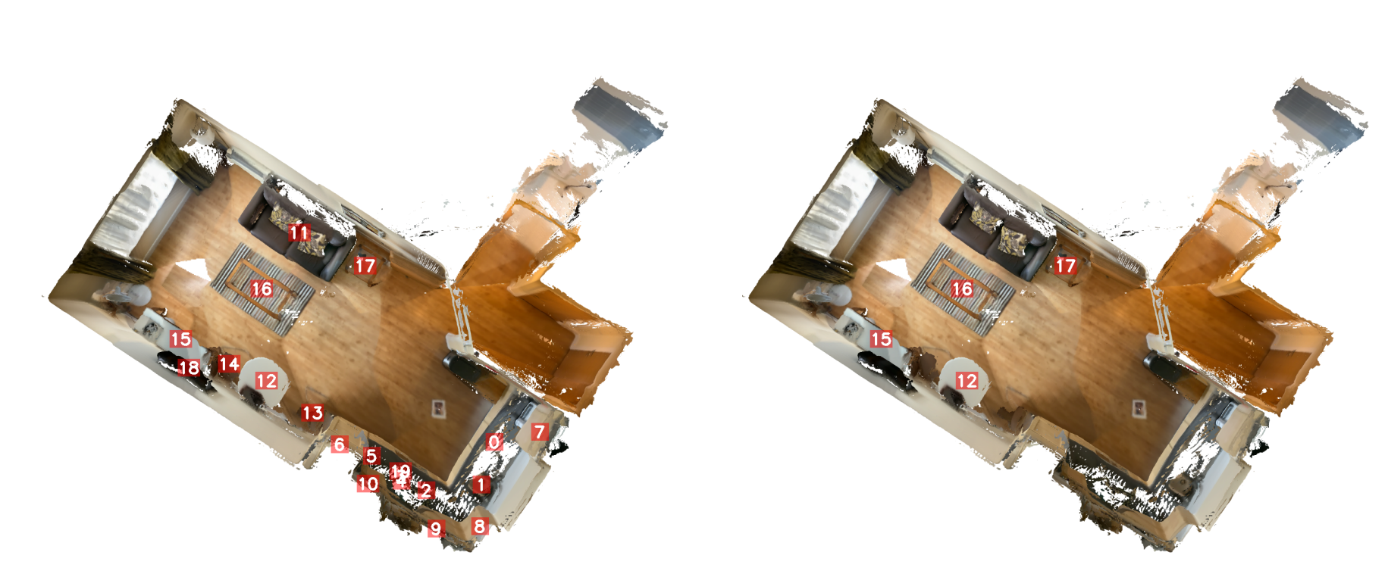
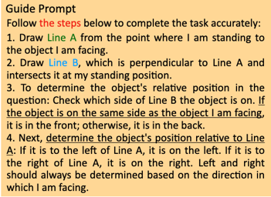
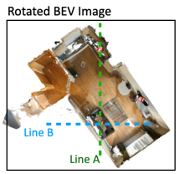
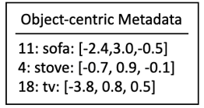
Importance of a Good Prompting Strategy
Notes:
To better understand what makes Struct2D prompting effective, we conducted ablation studies on several key design choices.
We first analyze two perception-side components: [CLICK] adding object-centric metadata, [CLICK] and filtering out cluttered or redundant object marks in the BEV. Both help individually, but the best performance comes from using them together—where metadata provides precise grounding, and filtering helps the model focus on relevant context. [CLICK]
We then study the impact of how we format the prompt. [CLICK] The guide prompt gives the model a structured reasoning flow—leading to clear gains in complex spatial task. [CLICK] And aligning the BEV to the same egocentric viewpoint helps reduce ambiguity in relative direction reasoning.
So overall, even with a strong MLLM backend like GPT-o3, a carefully crafted prompt can make the difference between random guessing and near-human spatial reasoning.

Slide 8
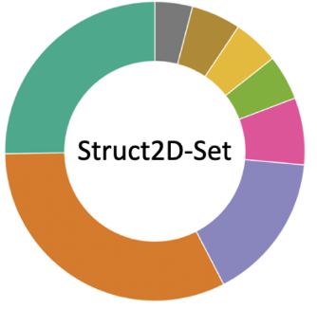
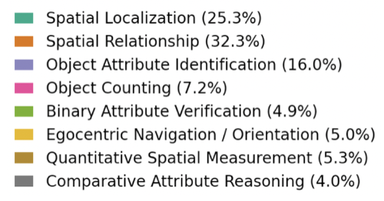
Unlocking open-source MLLMs’ spatial reasoning
Struct2D-Set:
~6000 3D indoor scenes;
~200K QA pairs;
8 QA categories.
Notes:
Based on the zero-shot analysis and insights, we want to take a step further—Can we apply the same Struct2D strategy to open-source MLLMs, and improve their spatial reasoning ability through instruction tuning? To support this, we curated Struct2D-Set, a large-scale instruction tuning dataset that pairs structured 2D scene representations with a wide range of spatial reasoning tasks.
The dataset includes over 200,000 QA pairs automatically generated from around 6000 annotated 3D indoor scenes. It consists of 8 specific categories that cover spatial reasoning and 3D scene question-answering tasks.
Specifically, for complex reasoning tasks like spatial relationship and comparative reasoning, each qa pair includes a short answer directly inferred from the 3D geometry, and an augmented answer with detailed reasoning generated by ChatGPT.

Slide 9

Unlocking open-source MLLMs’ spatial reasoning
Instruction tuning with Struct2D-Set is highly effective for Qwen2.5-VL.
Struct2D is NOT only a powerful prompting strategy; it also provides a strong training interface.
6.7%
11.2%
Struct2D prompting is more efficient and informative than raw video inputs.
Notes:
We fine-tune the Qwen2.5-VL-3B model using our Struct2D-Set dataset, and evaluate the resulting models on VSI-Bench.
First, Zero-shot refers to directly evaluating the base model with no finetuning and no Struct2D prompting—[can skip ]just the raw model as-is. [CLICK]
Second, Struct2D Zero-shot uses the same base model, but now we apply our Struct2D prompting strategy, [can skip] isolating the effect of prompting alone. [CLICK]
Third, SFT Video format fine-tunes the model on our Struct2D-Set dataset using 16 uniformly sampled video frames as inputs. [can skip] This serves as the standard video-based training baseline. [CLICK]
Finally, SFT Struct2D format fine-tunes the model using our Struct2D input format. [can skip] This setting evaluates the full benefit of Struct2D both as a prompting strategy and as a training interface.
What’s especially interesting is the relative comparison across these settings.
[CLICK]
When compared to our Struct2D zero-shot prompting baseline, finetuning with Struct2D-Set brings a significant boost. This confirms that instruction tuning with Struct2D-Set is highly effective for open-source MLLMs.
[CLICK]
When we compare it with the conventional baseline, finetuning with Struct2D format inputs still performs better. This suggests that the structured 2D representation is more efficient and informative than raw video input—both at inference time and at training time.
[CLICK]
So overall, Struct2D is not only a powerful prompting strategy for zero-shot reasoning; it also provides a strong training interface that helps open-source MLLMs build more reliable spatial understanding.

Slide 10
Conclusions and Takeaways
3D spatial reasoning requires a reliable mental model of the space
Struct2D injects an efficient mental model into MLLMs
Finetuning on Struct2D-Set unlocks the reasoning potential for open-source MLLMs
Notes:
To conclude, [CLICK]
we identified that a reliable mental model is crucial for MLLMs to perform 3D spatial reasoning because raw video frames only provide partial glimpses, and the model never sees a coherent global structure.
[CLICK]
Struct2D solves this by giving the model a structured 2D representation that encodes exactly the spatial cues needed for building such a mental model—geometry, layout, and egocentric alignment.
[CLICK]
The finetuned models on Struct2D-Set further demonstrates that Struct2D works in two complementary ways: as a zero-shot prompting strategy, and as a training interface.

Slide 11
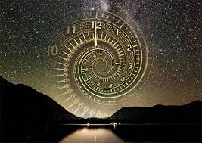
Limitations and Future Directions
Perception Bottleneck
Remaining
Peformance Gap
Lack of Temporal Reasoning
Notes:
“Now I’ll end with a few limitations and future directions.”
[CLICK]
“First, perception remains a key bottleneck. Our pipeline relies on offline reconstruction and object detection, and as shown on the left, noisy detections lead to a large drop in performance compared with ground-truth metadata. Improving the perception front-end is essential future step for stronger spatial reasoning.”
[CLICK]
“Second, even with Struct2D prompting and Struct2D-Set finetuning, there is still a noticeable gap between open-source models and the best proprietary systems. Future work may explore reinforcement learning or more advanced training strategies to further enhance open-source MLLMs’ reasoning abilities.”
[CLICK]
“Finally, Struct2D focuses on static scenes. It does not yet reason about temporal dynamics—such as moving objects or changes across views. Extending Struct2D to temporal spatial reasoning is an important future direction.”
So in summary, improving perception, boosting open-source reasoning capabilities, and incorporating temporal reasoning are the three main opportunities going forward.

Slide 12

Thank you!
Code
Notes:
And that wraps up my talk. Thanks so much for your attention! I’m happy to take any questions—and feel free to stop by our poster if you'd like to chat more.

Slide 13
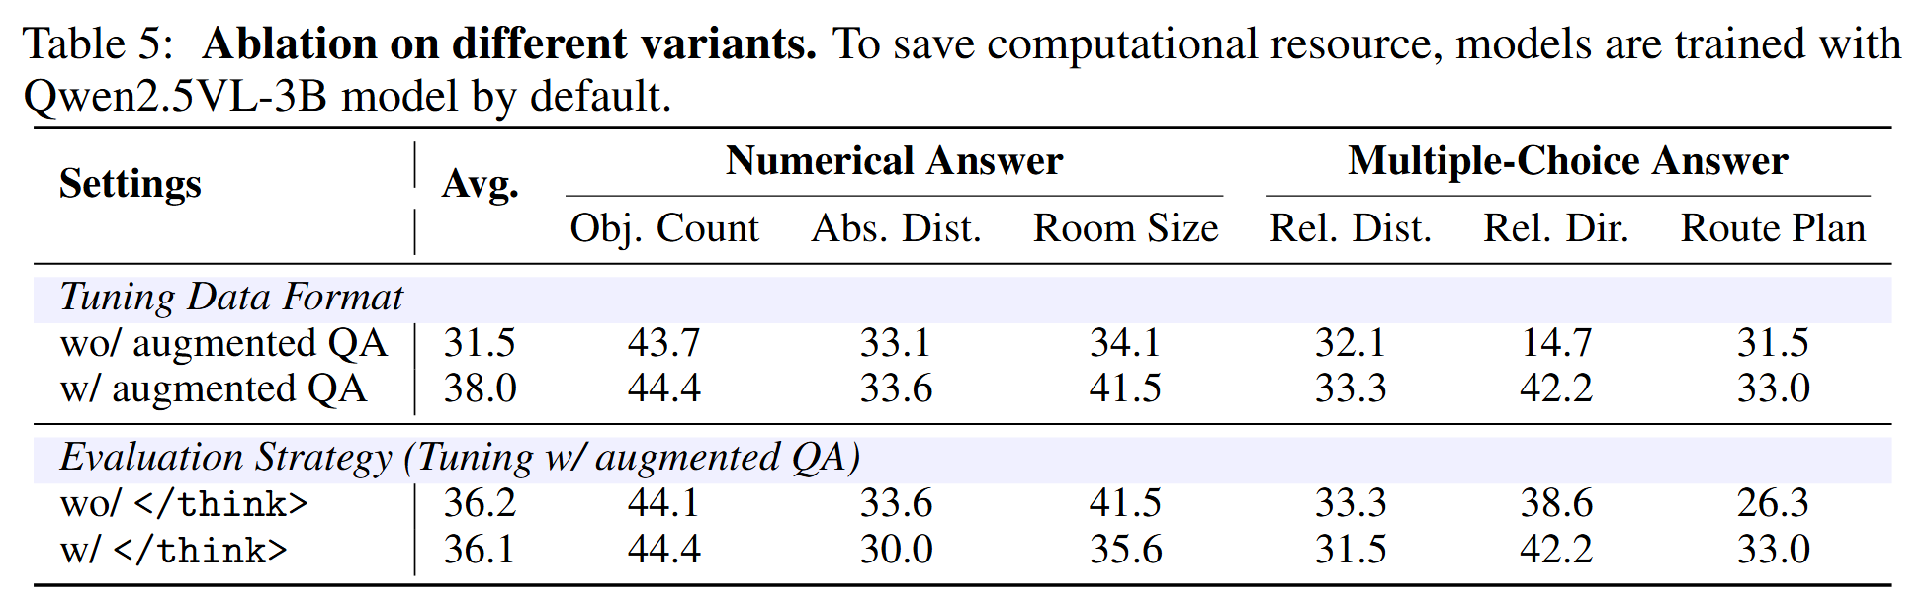
Large-Scale Instruction Tuning with Struct2D-Set
Tuning the model with augmented reasoning trajectories
Inferencing with </think> mode enabled (CoT) on complex reasoning tasks
Really makes a difference!
Notes:
Here, we show some ablation studies to better understand what design choices helped the most during tuning and evaluation.
First, in the tuning phase, we compare using regular QA pairs versus using augmented QA that explicitly include a reasoning process before the answer. Note that for the regular QA tuning, we infer without the think mode. As shown on the top row, adding reasoning-style QA provides a clear boost across all tasks—especially in relative direction, where performance jumps from 14.7 to 42.2.
This confirms that giving the model access to structured reasoning chains during training helps it learn much better for spatial reasoning tasks.
Second, in the evaluation phase, we look at whether encouraging the model to "think first, then answer"—by adding a <think> instruction—makes a difference.
While the average score stays roughly the same, we do observe consistent gains on spatially reasoning demanding tasks like relative direction and route planning. So even though this strategy doesn’t boost all metrics, it’s still a useful option when dealing with more complex examples.
Overall, these insights show that both how we teach the model and how we ask questions matter a lot when it comes to enabling spatial reasoning in MLLMs.

