Slide 1
Menu Layout
Coffee Shop Layout

Slide 2
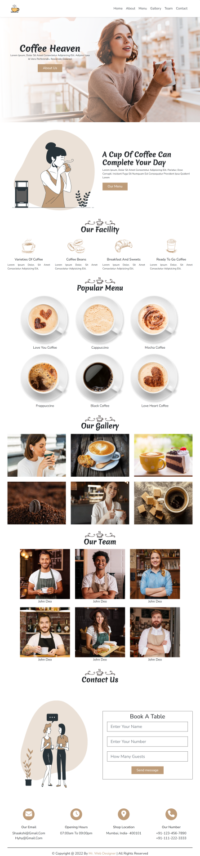
Layout Design
Components
Total number of Components
Parent Containers of Any website
Number of Components in Coffee Shop Website
1.navBar
1. header
2.heroSection
2. main
3.about
3. footer
4.facility
5.menu
6.gallery
7.team
8.contact
9.contactIcons

Slide 3
Layout Design
Components
Total number of Components
Parent Containers & Components
1. header
1.navBar
2.heroSection
2. main
3.about
4.facility
5.menu
6.gallery
7.team
3. footer
8.contact
9.contactIcons

Slide 4
Layout Design
Menu

Slide 5
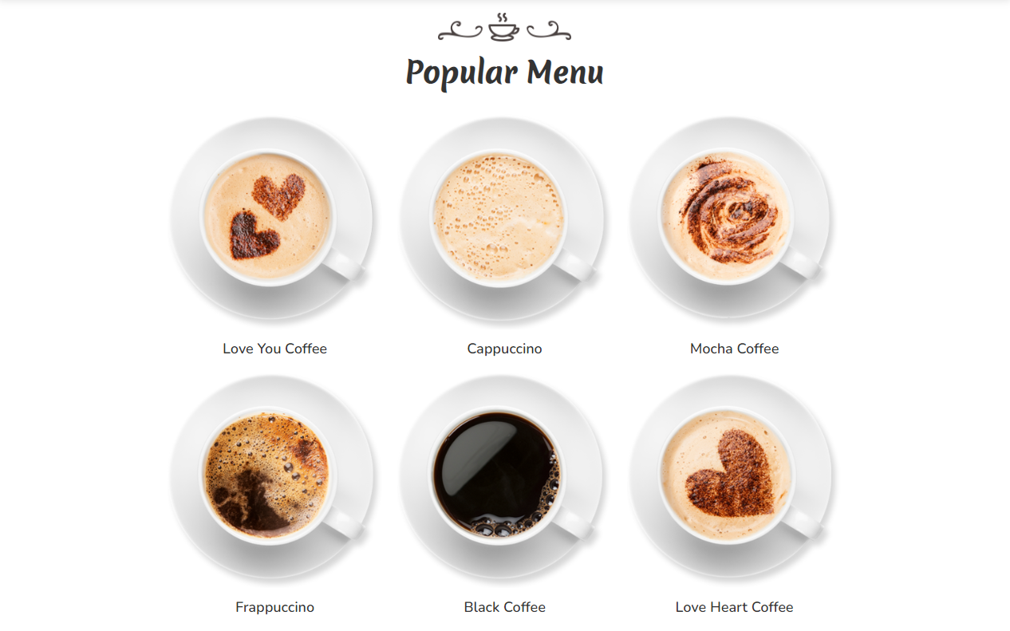
Layout Design

Slide 6
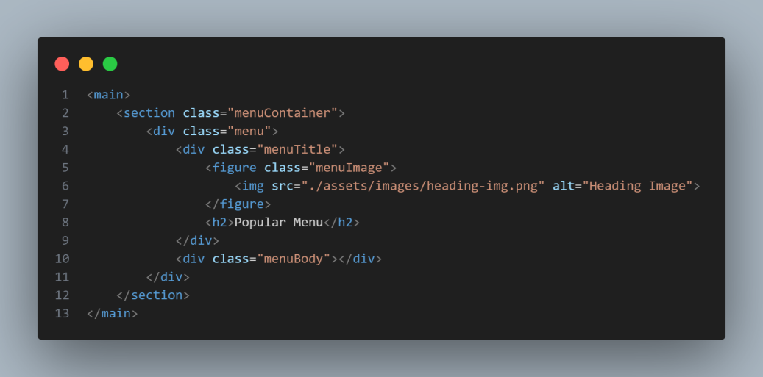
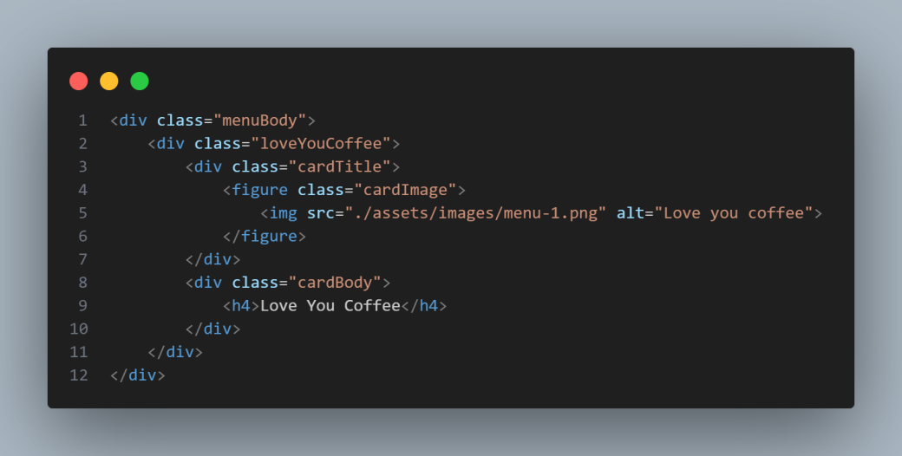
Layout Design
menu
<figure>
<h2>
<figure>
<figure>
<figure>
<h2>
<h2>
<h2>
<figure>
<figure>
<figure>
<h2>
<h2>
<h2>

Slide 7
Layout Design
STEP BY STEP PROCEDURE

Slide 8
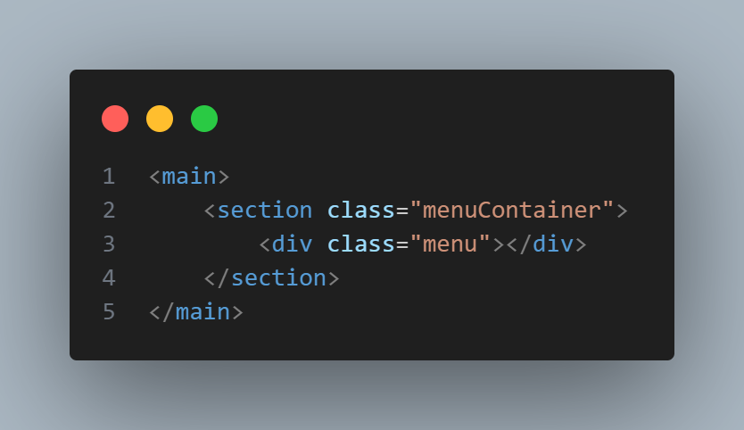
Layout Design
menu
main
menuContainer
menu

Slide 9
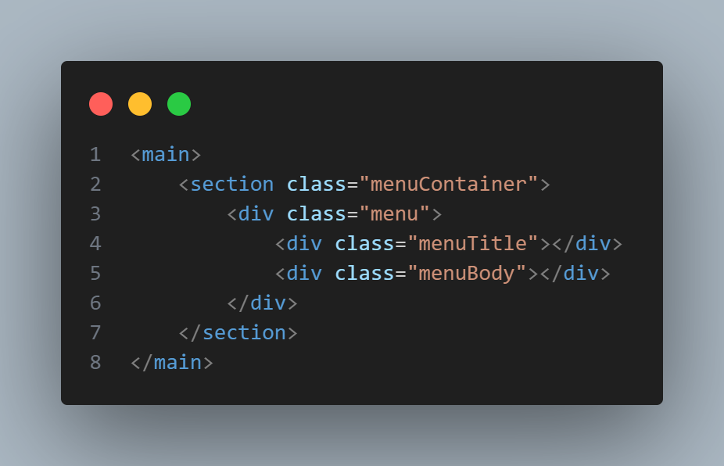
Layout Design
menu
main
menuContainer
menu
menuTitle
menuBody

Slide 10
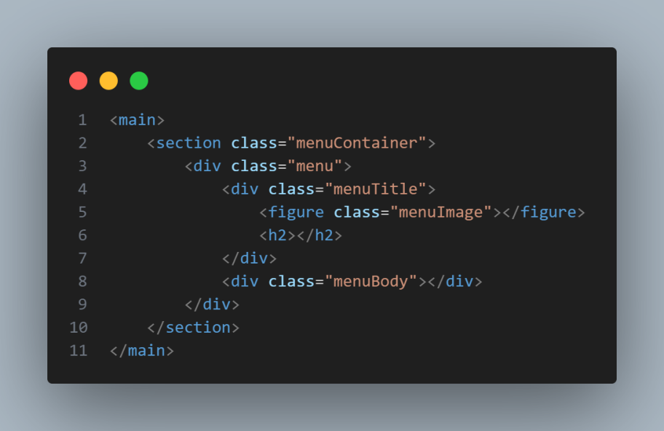
Layout Design
menu
main
menuBody
menuContainer
figure
menu
h2
menuTitle

Slide 11

Layout Design
menu
<img>
<h2>
main
menuBody
menuContainer
figure
menu
h2
menuTitle

Slide 12
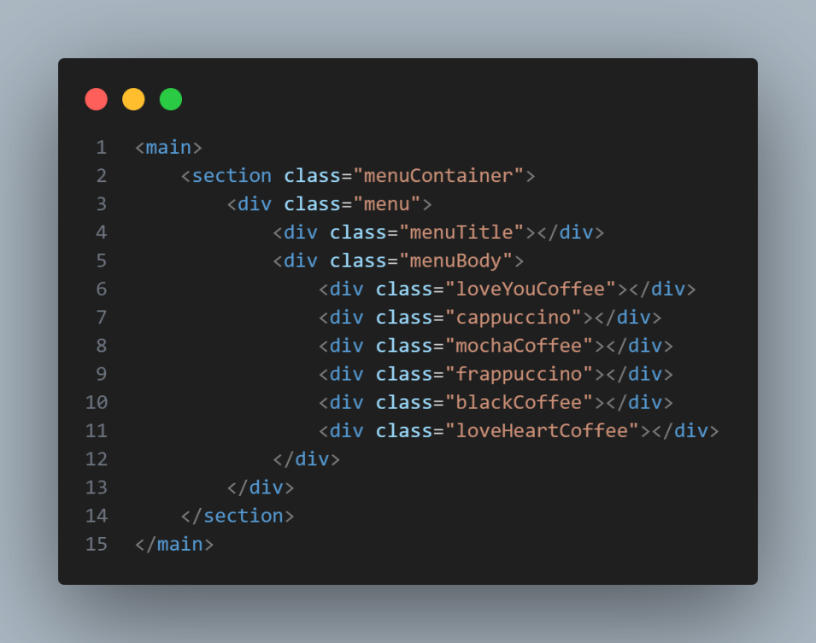
Layout Design
menu
main
menuTitle
h2
menuContainer
menuBody
div
menu
figure
menuTitle

Slide 13
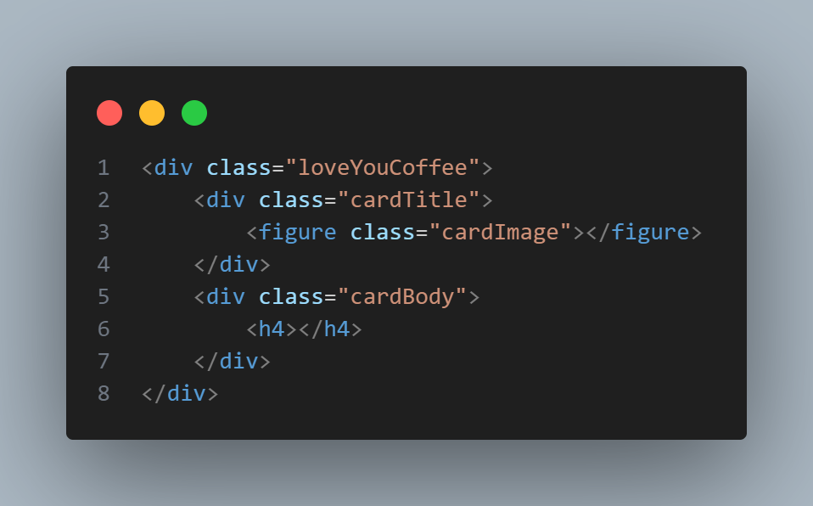
Layout Design
menu
main
menuTitle
h2
menuContainer
menuBody
div
menu
figure
Figure,h2

Slide 14
Layout Design
menu
<figure>
<h2>
<figure>
<figure>
<figure>
<h2>
<h2>
<h2>
<figure>
<figure>
<figure>
<h2>
<h2>
<h2>

Slide 15
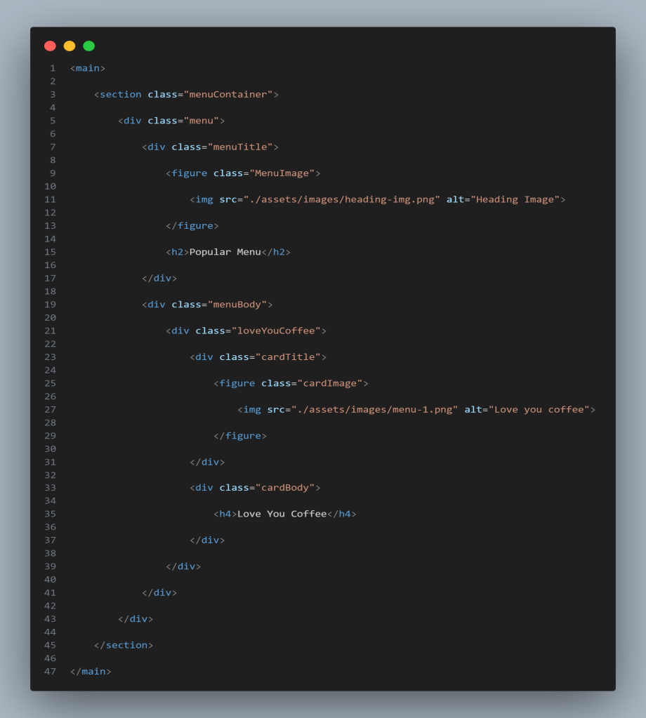
Html Structure
Menu
parentContainer
componentContainer
component
componentChild
childOfChild
childOfChild
content
Container
content
Container
content
content
parent
Container
component
Container
component
componentChild
childOfChild
Content
Container
childOfChild

