Slide 1
Gallery Layout
Coffee Shop Layout

Slide 2
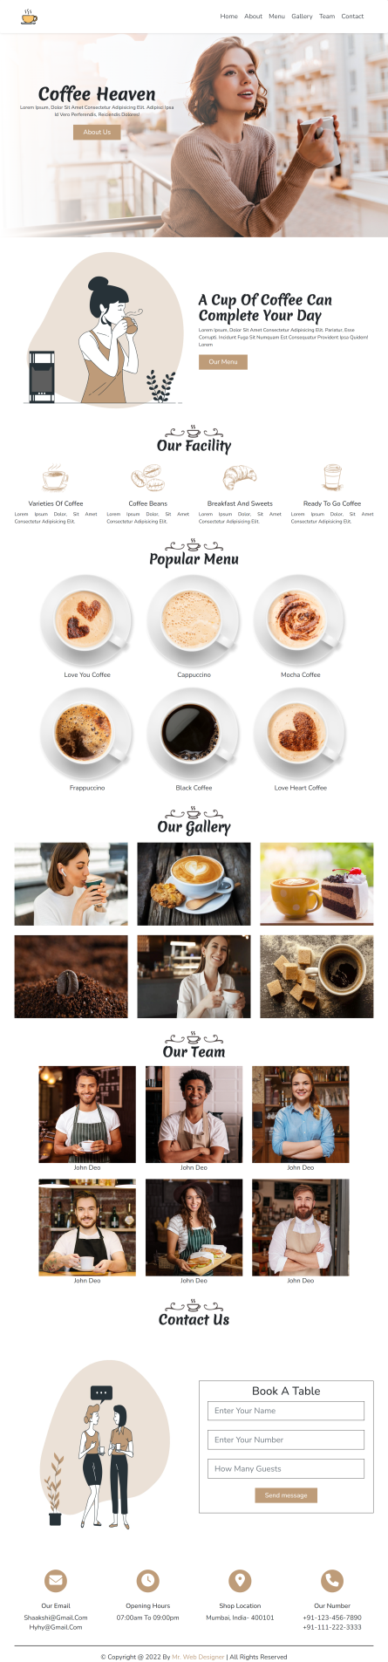
Layout Design
Components
Total number of Components
Parent Containers of Any website
Number of Components in Coffee Shop Website
1.navBar
1. header
2.heroSection
2. main
3.about
3. footer
4.facility
5.menu
6.gallery
7.team
8.contact
9.contactIcons

Slide 3
Layout Design
Components
Total number of Components
Parent Containers & Components
1. header
1.navBar
2.heroSection
2. main
3.about
4.facility
5.menu
6.gallery
7.team
3. footer
8.contact
9.contactIcons

Slide 4

Layout Design

Slide 5
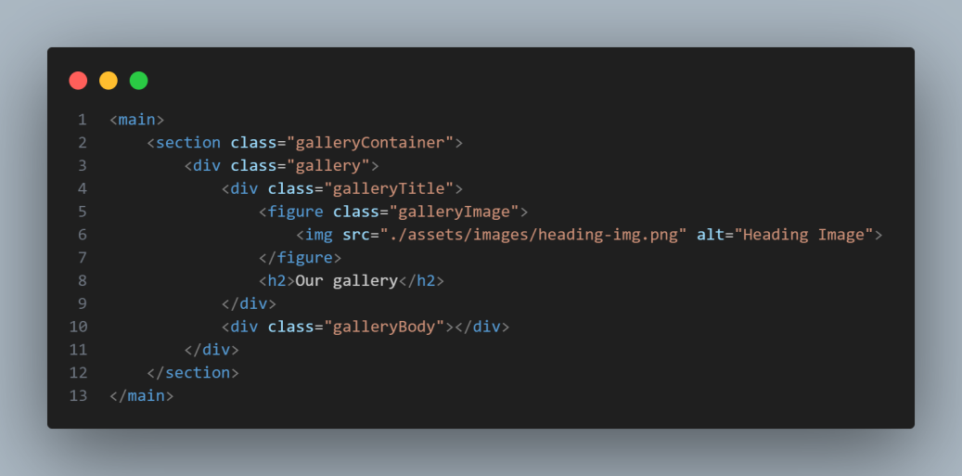
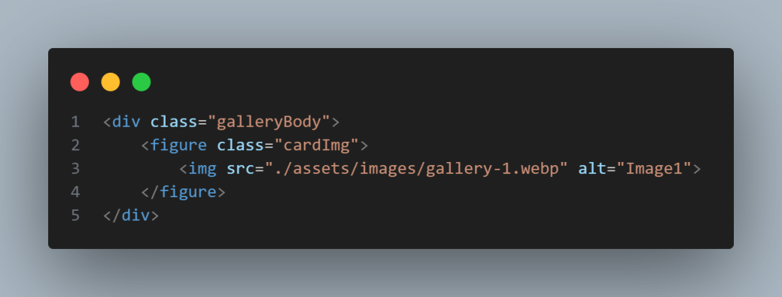
Layout Design
gallery
<figure>
<h2>
<img>
<img>
<img>
<img>
<img>
<img>

Slide 6
Layout Design
STEP BY STEP PROCEDURE

Slide 7
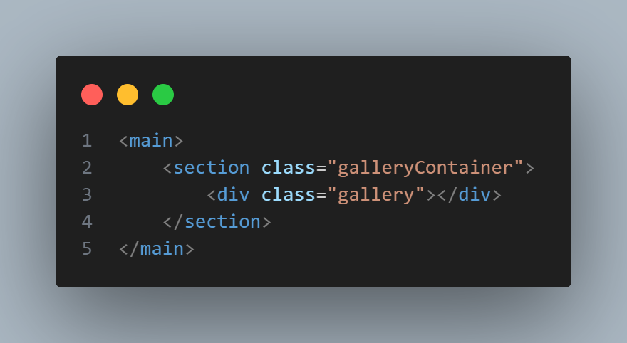
Layout Design
gallery
main
galleryContainer
gellery

Slide 8
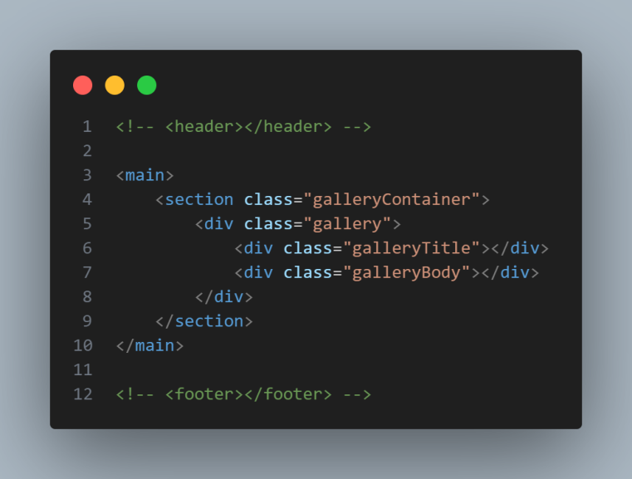
Layout Design
gallery
main
galleryContainer
gallery
galleryTitle
galleryBody

Slide 9
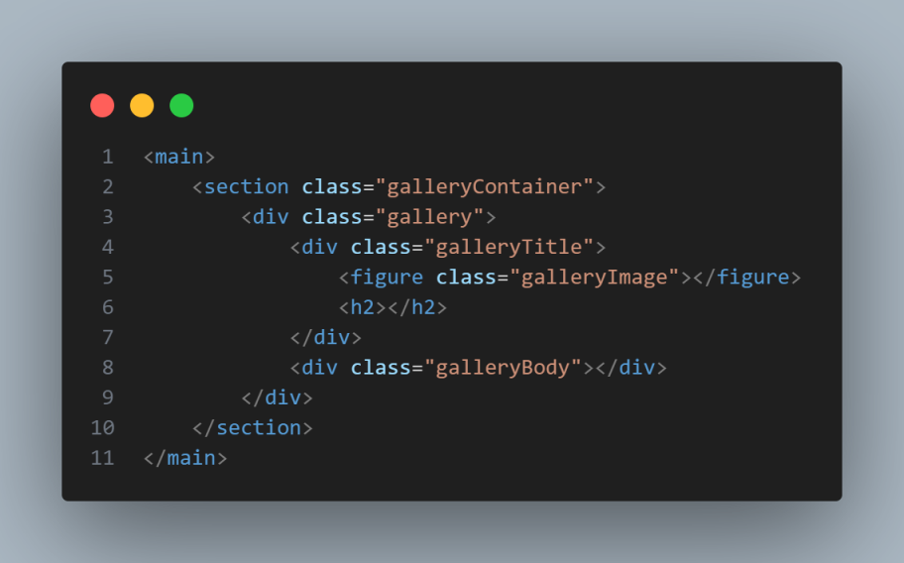
Layout Design
gallery
main
galleryContainer
gallery
galleryTitle
galleryBody
figure
h2

Slide 10

Layout Design
gallery
<img>
main
<h2>
menuContainer
menu
menuTitle
menuBody
figure
h2

Slide 11
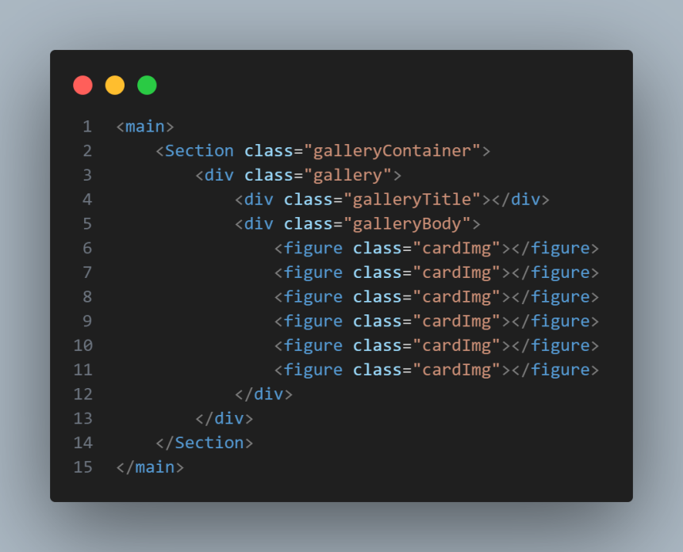
Layout Design
gallery

Slide 12

Layout Design
Gallery

Slide 13
Layout Design
gallery
<figure>
<h2>
<img>
<img>
<img>
<img>
<img>
<img>

Slide 14
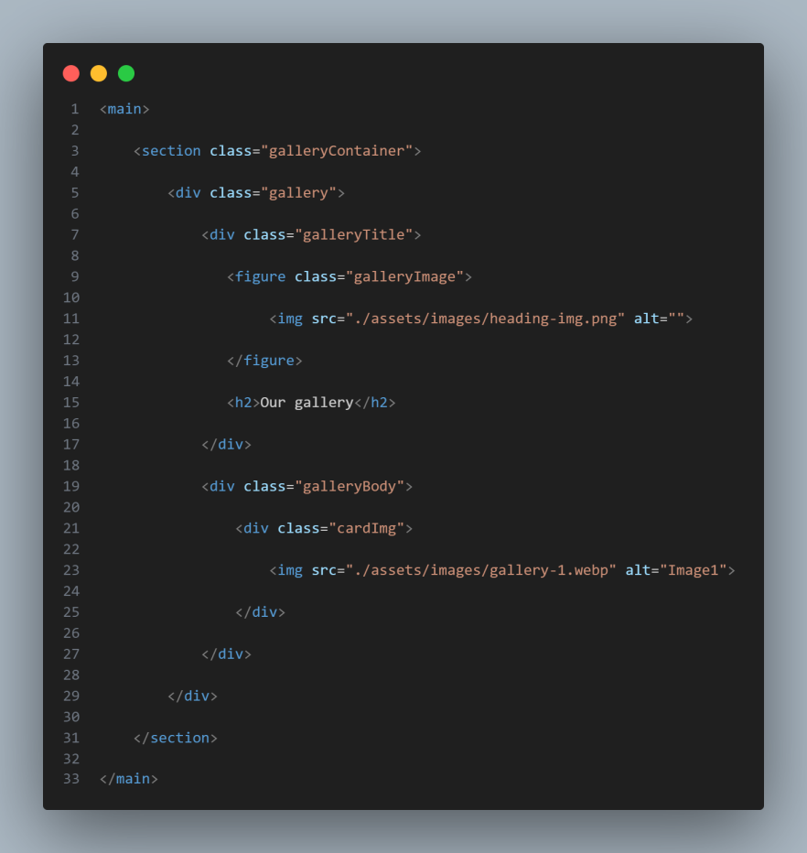
Html Structure
gallery
parentContainer
componentContainer
component
componentChild
childOfChild
childOfChild
content
Container
content
Container
ChildOfChild
ChildOfChild
parent
Container
component
Container
component
componentChild
childOfChild
Content
Container
childOfChild

Slide 15
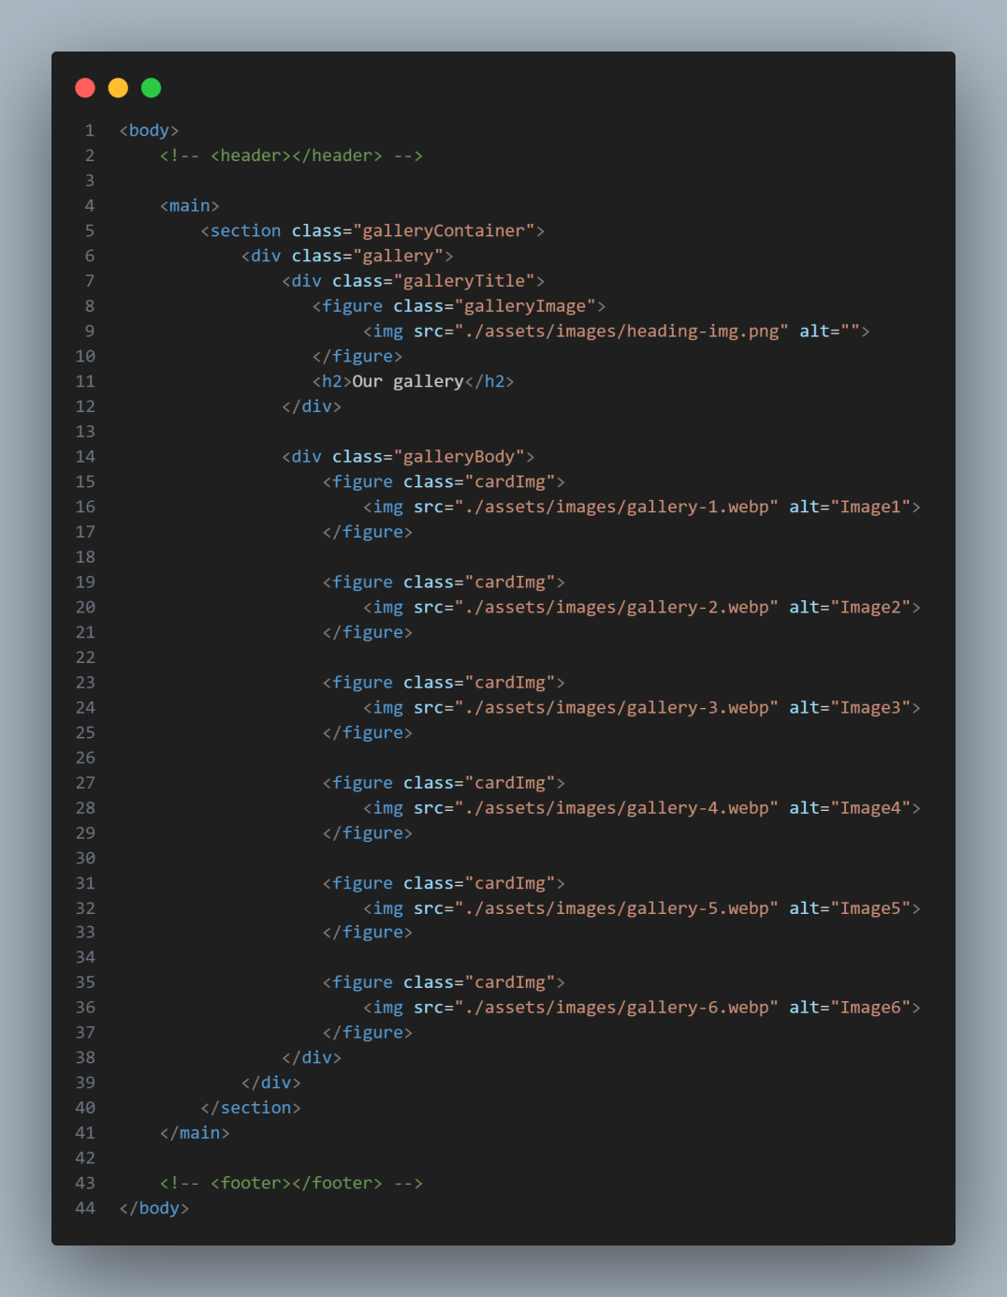
Layout Design
gallery

