Slide 1
Team Layout
Coffee Shop Layout

Slide 2
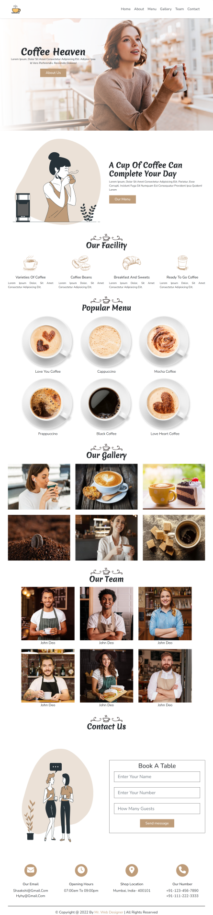
Layout Design
Components
Total number of Components
Parent Containers of Any website
Number of Components in Coffee Shop Website
1.navBar
1. header
2.heroSection
2. main
3.about
3. footer
4.facility
5.menu
6.gallery
7.team
8.contact
9.contactIcons

Slide 3
Layout Design
Components
Total number of Components
Parent Containers & Components
1. header
1.navBar
2.heroSection
2. main
3.about
4.facility
5.menu
6.gallery
7.team
3. footer
8.contact
9.contactIcons

Slide 4

Layout Design

Slide 5
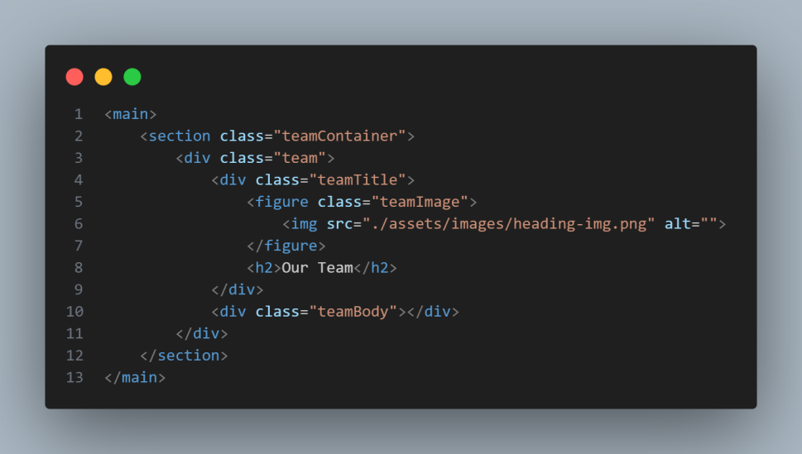
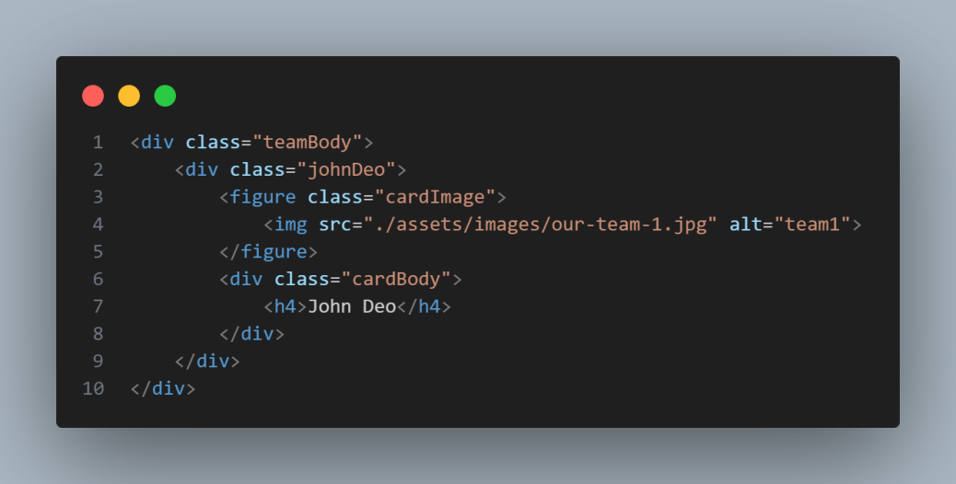
Layout Design
Team
<figure>
<h2>
<figure>
<figure>
<figure>
<h4>
<h4>
<h4>
<figure>
<figure>
<figure>
<h4>
<h4>
<h4>

Slide 6
Layout Design
STEP BY STEP PROCEDURE

Slide 7
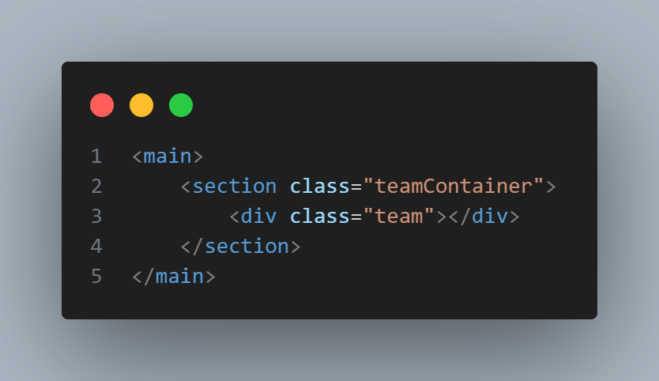
Layout Design
Team
main
teamContainer
team

Slide 8
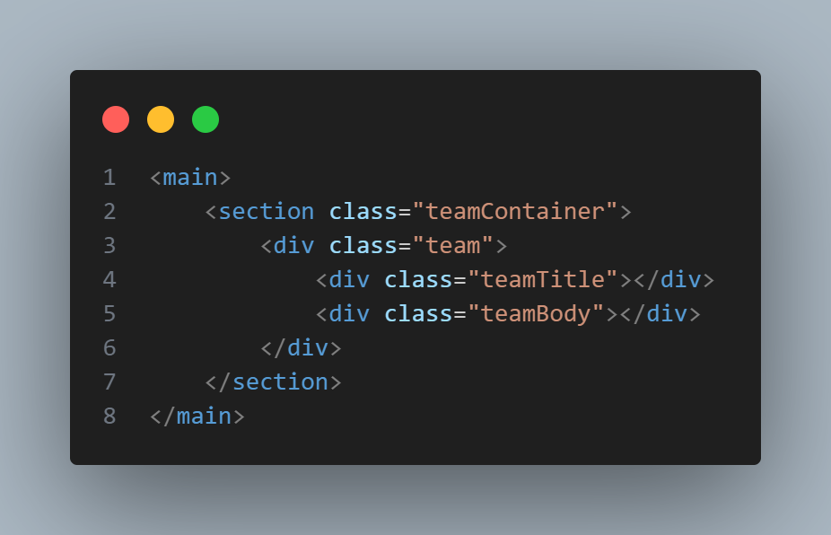
Layout Design
Team
main
teamContainer
team
teamTitle
teamBody

Slide 9
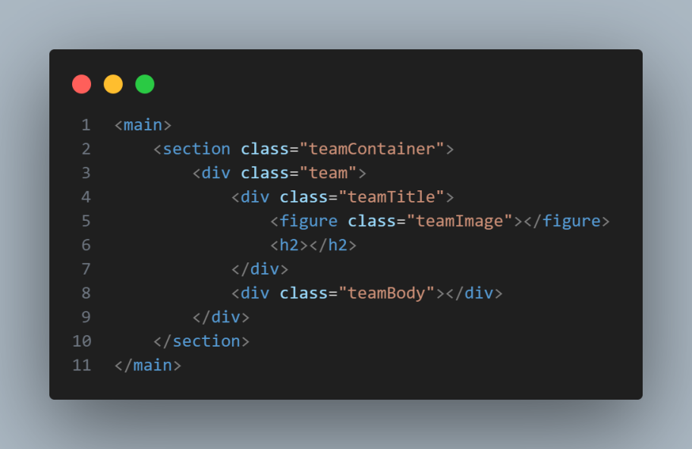
Layout Design
Team
main
teamBody
teamContainer
figure
team
h2
teamTitle

Slide 10

Layout Design
Team
<img>
<h2>
main
teamBody
teamContainer
figure
team
h2
teamTitle

Slide 11
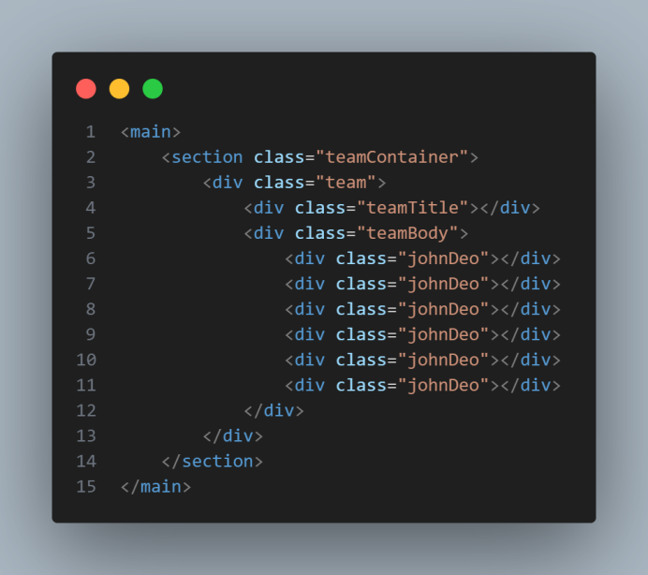
Layout Design
Team
main
teamTitle
teamContainer
teamBody
team
div

Slide 12
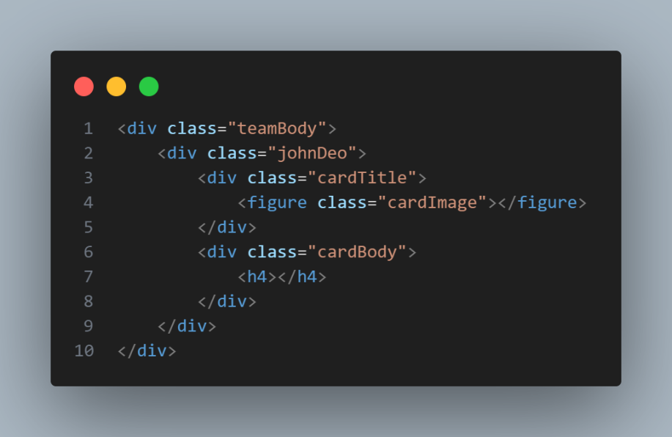
Layout Design
Team
main
teamBody
teamContainer
div
team
figure , h4
teamTitle

Slide 13
Layout Design
Team
<figure>
<h2>
<figure>
<figure>
<figure>
<h4>
<h4>
<h4>
<figure>
<figure>
<figure>
<h4>
<h4>
<h4>

