Slide 1

Improving Digital Forensic Security
by
B.THANU SREE
Roll No. 224G1A0592
A.GOVARDHAN
Roll No. 224G1A05C7
S.A.ROSHINI
Roll No. 224G1A0586
Under the guidance of
Mrs. M.Sowmya , M.Tech., Ph.D.
Department of Computer Science and Engineering
Srinivasa Ramanujan Institute of Technology
Autonomous
Rotarypuram Village, B K Samudram Mandal, Ananthapuramu – 515701.
2025-2026

Slide 2
Contents
Improving Digital Forensic Security
Title Justification
Abstract
Problem statement
Objectives of Project
Literature survey for objectives
Proposed Work -(Methods to be followed for proposed system)
References
GitHub Link
Queries
Srinivasa Ramanujan Institute of Technology

Slide 3
Title Justification
Improving Digital Forensic Security
The title is justified because digital forensic evidence must be stored securely to maintain its confidentiality and integrity.
Increasing cybercrimes require reliable and tamper-proof forensic storage systems.
Traditional centralized storage systems are vulnerable to unauthorized access and manipulation.
The proposed system uses authentication, optimal key generation, encryption, and blockchain.
These technologies together ensure secure, decentralized, and trusted forensic data storage.
DFA-AOKGE provides a secure, decentralized, and reliable forensic storage architecture.
Srinivasa Ramanujan Institute of Technology

Slide 4
Abstract
Improving Digital Forensic Security
The project proposes a Secure Digital Forensic Storage Model (DFA-AOKGE)Uses authentication, optimal key generation, and encryption for protecting forensic data.
Blockchain-based distributed architecture is used for decentralized evidence storage.
Enhanced Equilibrium Optimizer (EEO) generates strong cryptographic keys.
Multi-Key Homomorphic Encryption (MHE) ensures data confidentiality and privacy.
The system shows better performance compared to existing forensic security methods.
The system uses strong authentication mechanisms to allow only authorized users.
Optimal cryptographic keys are generated using the Enhanced Equilibrium Optimizer (EEO)Forensic data is encrypted using Multi-Key Homomorphic Encryption (MHE).
Blockchain technology ensures tamper-proof and transparent evidence storage.
Srinivasa Ramanujan Institute of Technology

Slide 5
Problem Statement
Improving Digital Forensic Security
Digital forensic evidence is often stored in centralized cloud systems.
Such systems are prone to data tampering, unauthorized access, and integrity loss.
Existing forensic solutions lack optimized key generation and strong authentication.
Maintaining the chain of custody in cloud environments is difficult.
Centralized forensic storage reduces reliability and trust.
Existing systems lack:
Optimized key generation.
Strong authentication mechanism.
Tamper-proof evidence tracking.
A secure, decentralized, and authenticated storage system is required.
Hence, a secure, decentralized, and authenticated forensic storage system is required.
Srinivasa Ramanujan Institute of Technology

Slide 6
Objectives of Project
Improving Digital Forensic Security
The objective of this project is to enhance the security of digital forensic evidence
To design a secure digital forensic storage architecture.
To implement strong authentication for authorized access.
To generate optimal cryptographic keys using the EEO algorithm.
To encrypt forensic data using Multi-Key Homomorphic Encryption.
To ensure tamper-proof evidence storage using blockchain technology.
To enhance data confidentiality, integrity, and availability.
To provide secure authentication for forensic investigators.
To generate optimal encryption keys using an optimization algorithm.
To encrypt forensic data before cloud storage.
To ensure tamper-proof evidence tracking using blockchain technology.
Srinivasa Ramanujan Institute of Technology

Slide 7
Literature survey for objectives
Improving Digital Forensic Security
Existing research focuses on cryptography and blockchain for forensic security.
Some systems provide authentication but lack decentralized storage.
Other approaches use blockchain but suffer from high computational cost.
Many techniques do not use optimized key generation.
These limitations motivated the development of the DFA-AOKGE model.
Research gaps:
Need for decentralized forensic storage.
Strong key generation using optimization algorithms.
Robust authentication integrated with encryption.
DFA-AOKGE addresses these gaps using Blockchain + EEO + MHE.
Limitations identified:
High computational overhead.
Lack of decentralized architecture.
Weak or non-optimized key generation.
Srinivasa Ramanujan Institute of Technology

Slide 8
Proposed System
Improving Digital Forensic Security
Users are first registered and authenticated using Secure Block Verification Mechanism.
Secret encryption keys are generated using the Enhanced Equilibrium Optimizer.
Generation of secret keys using Enhanced Equilibrium Optimizer (EEO).
Digital forensic data is encrypted using Multi-Key Homomorphic Encryption.
Encrypted evidence is stored securely in the cloud server.
Encryption of forensic data using Multi-Key Homomorphic Encryption
Blockchain is used to record evidence metadata to prevent tampering.
Blockchain-based evidence collection and storage.
Blockchain ledger maintains immutability and traceability.
SDN and blockchain help in secure evidence collection and storage.
Secure storage of encrypted data in cloud servers.
Software Defined Networking (SDN) used for evidence gathering.
Srinivasa Ramanujan Institute of Technology

Slide 9
References
Improving Digital Forensic Security
IEEE Access Journal – Digital Forensic Security.
Blockchain-based Cloud Forensics Research.
Cryptographic Key Generation using Optimization Algorithms.
Multi-Key Homomorphic Encryption Studies.
Secure Authentication Models for Cloud Forensics .
Srinivasa Ramanujan Institute of Technology

Slide 10

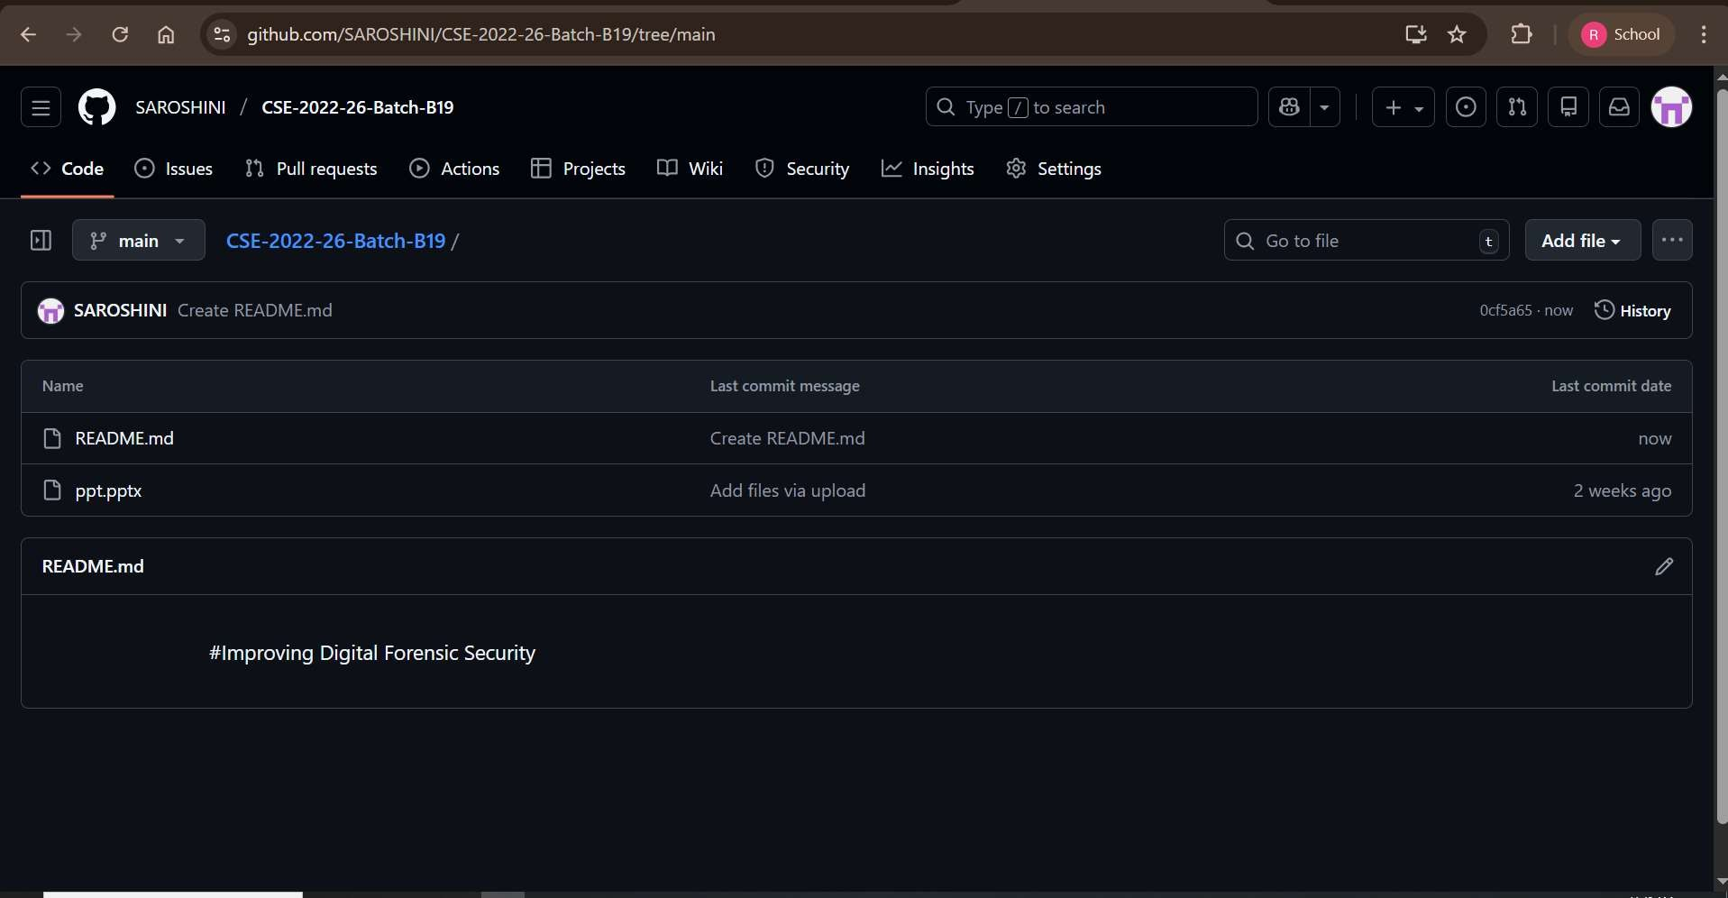
Git Hub Dashboards of each student
Improving Digital Forensic Security
Github Link: https://github.com/SAROSHINI/CSE-2022-26-Batch-B19
Srinivasa Ramanujan Institute of Technology

Slide 11
Any Queries?
Improving Digital Forensic Security
Srinivasa Ramanujan Institute of Technology

