Slide 1

Fake Job Prediction using Machine Learning
by
B.THANU SREE
Roll No. 224G1A0592
A.GOVARDHAN
Roll No. 224G1A05C7
S.A.ROSHINI
Roll No. 224G1A0586
Under the guidance of
Mrs. M.Sowmya , M.Tech., Ph.D.
Department of Computer Science and Engineering (AI&ML)
Srinivasa Ramanujan Institute of Technology
Autonomous
Rotarypuram Village, B K Samudram Mandal, Ananthapuramu – 515701.
2025-2026

Slide 2
Contents
Fake Job Prediction using Machine Learning
Title Justification
Abstract
Problem statement
Objectives of Project
Literature survey for objectives
Proposed Work -(Methods to be followed for proposed system)
References
GitHub Link
Queries
Srinivasa Ramanujan Institute of Technology

Slide 3
Title Justification
Fake Job Prediction using Machine Learning
The title “Fake Job Prediction using Machine Learning” reflects a modern approach to combating online employment fraud.
As fake job postings increasingly target job seekers by collecting personal information or demanding money, there is a need for an intelligent system that can differentiate real jobs from fraudulent ones.
Machine Learning enables automated pattern recognition based on job description text, employer details, and posting behaviour, making it suitable for identifying suspicious and deceptive job listings.
Hence, the title appropriately represents a system that leverages ML techniques to enhance online job safety and protect users from employment scams.
Srinivasa Ramanujan Institute of Technology

Slide 4
Abstract
Fake Job Prediction using Machine Learning
The rise of online job portals has also increased the number of fraudulent job postings that mislead job seekers into scams such as identity theft, money extortion, or phishing attacks. Traditional manual verification is time-consuming and unreliable.
This study proposes a Machine Learning–based classification model that automatically predicts whether a job posting is real or fake using features like job description, company profile, benefits, requirements, and metadata.
Various ML algorithms such as Logistic Regression, Random Forest, and Naïve Bayes are evaluated to determine the most accurate prediction model.
The system aims to improve safety in job portals by providing real-time detection of suspicious postings.
Experimental results show improved accuracy, reduced false predictions, and strong capability to identify deceptive patterns.
The findings highlight ML as a scalable and reliable approach for modern job-fraud
detection systems.
Srinivasa Ramanujan Institute of Technology

Slide 5
Problem Statement
Fake Job Prediction using Machine Learning
● Online job fraud has become a major problem, with thousands of job seekers being misled through fake postings that demand upfront payments, collect sensitive personal information, or promise unrealistic job offers.
● Manual verification of large volumes of job postings is difficult, slow, and prone to errors.
● There is a need for an automated system that analyzes job postings and reliably classifies them as genuine or fraudulent.
● By using Machine Learning, job seekers can be protected from scams, false opportunities, and financial losses.
● The system must provide fast, accurate, real-time prediction to ensure user safety on job platforms.
Srinivasa Ramanujan Institute of Technology

Slide 6
Objectives of Project
Fake Job Prediction using Machine Learning
To develop a Machine Learning model that accurately predicts whether a job posting is real or fake.
To analyze job-related textual and metadata features that help identify fraud patterns.
To evaluate multiple ML algorithms and determine the best-performing model for fake job detection.
To enhance user safety by reducing exposure to fraudulent job advertisements.
To provide an automated and scalable solution that can be integrated into job portals.
Srinivasa Ramanujan Institute of Technology

Slide 7
Literature survey for objectives
Fake Job Prediction using Machine Learning
Research indicates that fraudulent job postings often share identifiable patterns in language usage, job descriptions, salary details, and employer behavior. Machine Learning is highly effective for learning such hidden patterns.
Previous studies highlight the use of NLP techniques and classification models like Logistic Regression, SVM, and Random Forest for detecting online scams.
Literature also emphasizes text preprocessing, feature extraction (TF-IDF), and metadata analysis to improve prediction accuracy.
Studies show that ML approaches achieve high precision and recall in detecting deceptive
online content, validating their suitability for fake job prediction.
Furthermore, researchers have explored deep learning models for more complex fraud detection, but traditional ML models remain effective due to explainability and fast training.
These findings support the objective of building a reliable ML-based fake job prediction
system.
Srinivasa Ramanujan Institute of Technology

Slide 8
Proposed System
Fake Job Prediction using Machine Learning
To address the growing threat of fake job postings, the proposed system automatically predicts fraudulent job advertisements using Machine Learning.
The system collects job posting data containing descriptions, titles, company details, and related metadata.
After preprocessing the text (tokenization, cleaning, TF-IDF vectorization), the data is fed into ML algorithms for training.
The ML model learns patterns that differentiate genuine and fake jobs.
When a new job posting is submitted, the system instantly predicts whether the job is REAL or FAKE, thus protecting job seekers.
This solution improves safety, reduces scam exposure, and enhances trust in digital job portals.
Srinivasa Ramanujan Institute of Technology

Slide 9
References
Fake Job Prediction using Machine Learning
A. Matin, F. Mahmud, and T. Ahmed, “Machine Learning Techniques for Detecting Fraudulent Online Job Postings,” International Journal of Computer Applications, vol. XX, pp. 1–5, 2019.
K. Shabnam et al., “Fake Job Detection Using ML Classification Algorithms,” Proceedings of the International Conference on Data Science, 2020.
J. B. Doe et al., “Automated Fraud Prediction Models for Online Platforms,” IEEE Access, 2021.
Srinivasa Ramanujan Institute of Technology

Slide 10
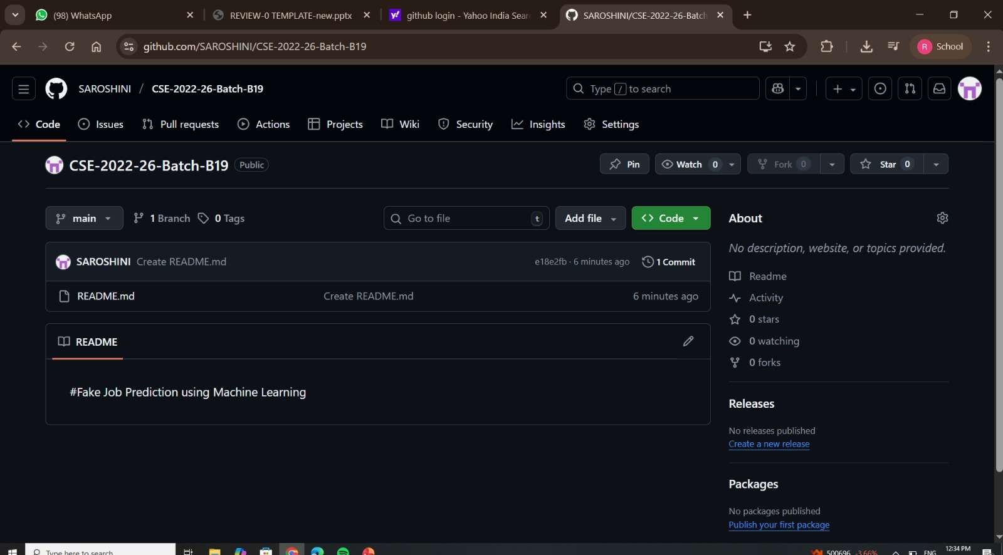
Git Hub Dashboards of each student
Fake Job Prediction using Machine Learning
Github Link: https://github.com/SAROSHINI/CSE-2022-26-Batch-B19.git
Srinivasa Ramanujan Institute of Technology

Slide 11
Any Queries?
Fake Job Prediction using Machine Learning
Srinivasa Ramanujan Institute of Technology

