Slide 1


| Tech Management, SRI-B
CLAWS
CLASH OF THE
R.V.College of Engineering_Crashers
Your Autonomous AI Research Analyst
Priyam Patel Samarth Bohra Bedant Shaurya Sarthak Chavare

Slide 2
Idea
Problem Statement
Why We Selected This Theme — GenAI Research
The Problem
AI research is growing faster than humans can consume it.
Every single day:
200+ new AI papers are published on ArXiv
Dozens of AI repositories trend on GitHub
Important AI news gets buried in noise
Students and researchers spend hours filtering information manually
Who Faces This Problem?
🎓 Students
Cannot keep up with latest LLM and GenAI advancements
👨‍💻 Developers
Miss important open-source tools and frameworks
🧠 Researchers
Waste time filtering irrelevant papers
👔 Tech Leads
Need concise weekly updates instead of information overload

Slide 3
Idea
Problem Statement
Why We Selected This Theme — GenAI Research
Why This Problem Matters
AI evolves weekly
Missing trends means falling behind
Reading full papers is time-consuming
Existing newsletters are generic and not personalized
💡 Opportunity
Build an autonomous AI agent that:
Tracks research automatically
Summarizes papers intelligently
Highlights important innovations
Delivers concise weekly digests

Slide 4
Idea
Current Solution & Gaps
🔍 Existing Solutions
Current Platforms:
ArXiv
GitHub Trending
PapersWithCode
AI newsletters
Twitter/X AI communities
❌ What’s Missing?
Problems with Existing Solutions
Information Overload
Too many papers, no prioritization
No Personalization
Generic newsletters for everyone
No Cross-Platform Intelligence
Papers, repos, and news are disconnected
No Actionable Summaries
Users still need to read long abstracts
Manual Effort
Requires constant checking across platforms
🚨 Gap in the Market
There is no autonomous AI-powered system that:
Curates AI research
Summarizes papers
Tracks GitHub trends
Maintains memory
Delivers multi-channel digests automatically

Slide 5
Idea
⭐ Key Features
🔍 Smart Research Tracking
Tracks:
LLMs,AI Agents, RAG, Diffusion Models, RLHF, Efficient AI
🧠 Groq LLM Summarization
Every paper gets:
What?
How?
Why it matters?
Novelty score
⭐ “Top Pick” Recommendation
AI selects the most impactful paper automatically
💾 Memory System
Avoids duplicate papers using persistent tracking
📄 Professional DOCX Digest
Auto-generated research report
📬 Multi-Channel Delivery
Telegram
Gmail
(Future: WhatsApp)
Your Solutions
✅ What We Built — ResearchRadar
📡 ResearchRadar
An autonomous AI-powered research digest agent.
It:
Fetches latest AI papers from ArXiv
Tracks trending GitHub repositories
Collects AI news headlines
Uses Groq LLMs to summarize research
Generates professional DOCX digests
Delivers updates through Telegram & Email
🧠 Core Idea
Instead of making users search for information, ResearchRadar brings curated intelligence directly to them.

Slide 6
Idea
Demo/Product Walkthrough
🎥 Product Walkthrough
Step 1 — Autonomous Trigger
Every Monday at 8 AM, OpenClaw HEARTBEAT automatically starts the pipeline
Step 2 — Data Collection
ResearchRadar fetches:
Latest ArXiv papers
Trending GitHub repos
AI news headlines
Step 3 — AI Processing
Groq LLM:
Summarizes papers
Scores novelty
Selects Top Pick
Step 4 — DOCX Generation
Professional digest generated automatically:
Top Pick
Paper summaries
GitHub repos
News headlines
Step 5 — Delivery
Digest delivered instantly through:
Telegram bot
Gmail attachment

Slide 7
Idea
Tech & Architecture
Component | Technology
Language | Python
LLM | Groq llama-3.3-70b
Document Builder | python-docx
APIs | ArXiv API, GitHub API, Google RSS
Messaging | Telegram Bot API
Email | Gmail SMTP
Scheduling | OpenClaw HEARTBEAT
Memory | JSON Persistence

Slide 8
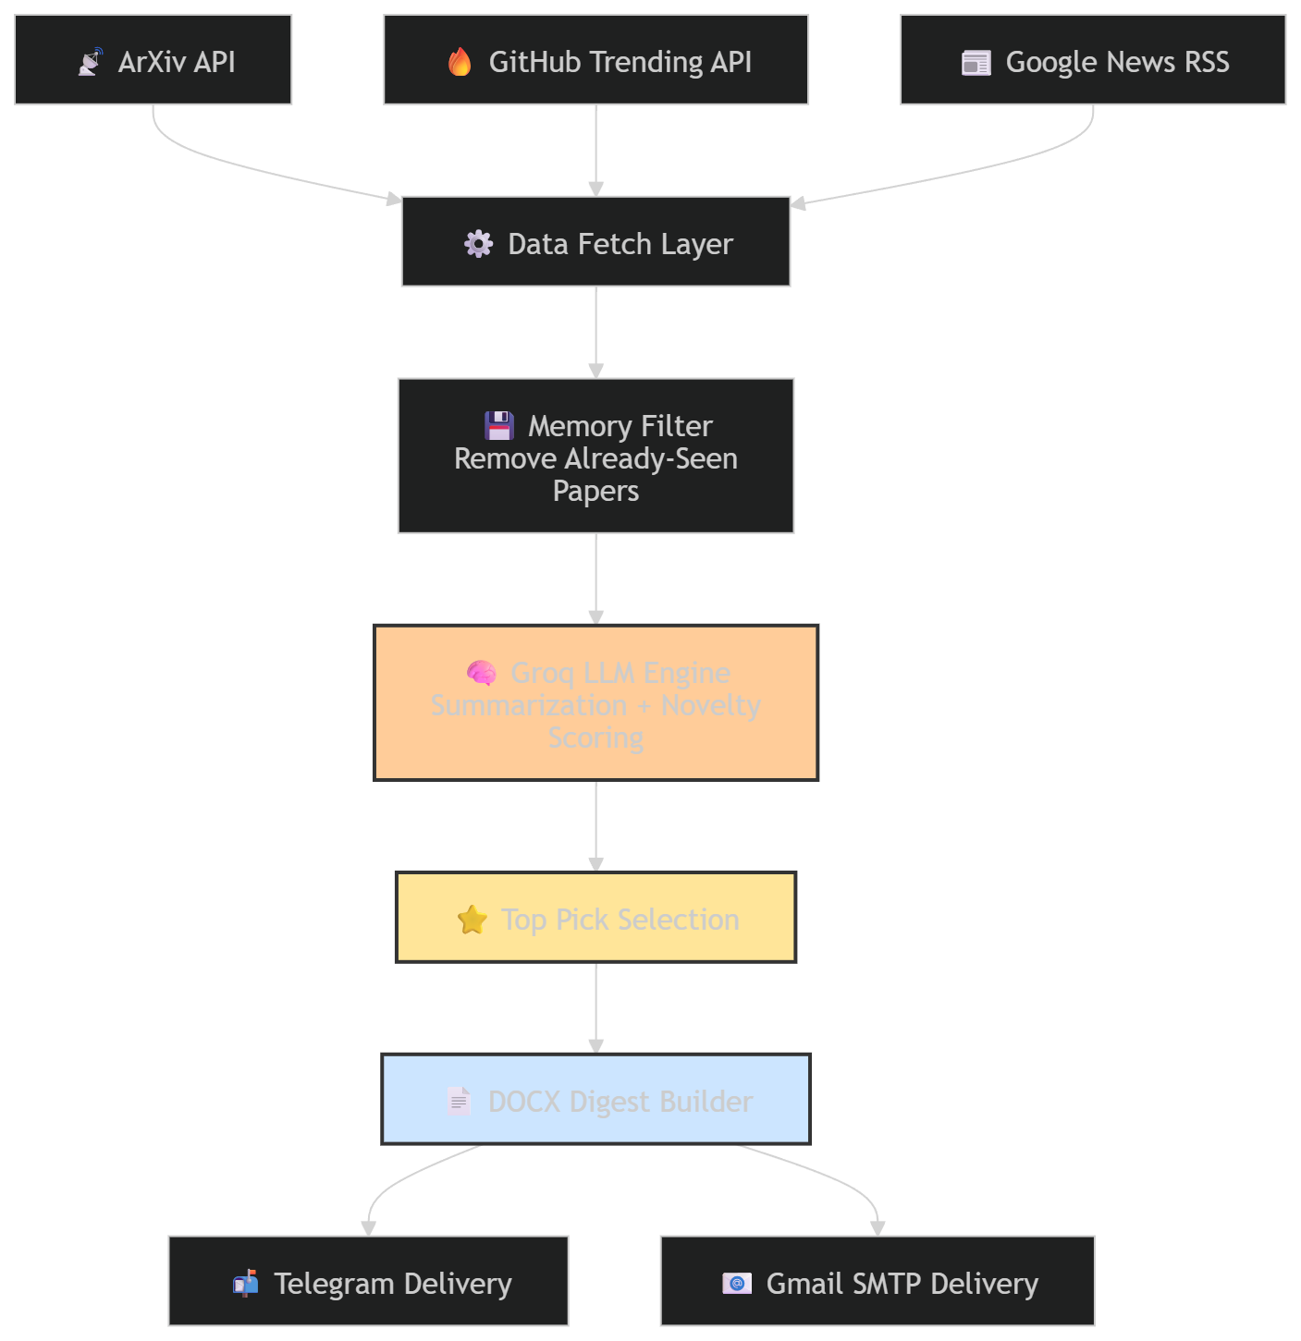
Idea
Tech & Architecture
SYSTEM FLOW

Slide 9
📈 Scale Potential
Future possibilities:
Personalized feeds
Enterprise research dashboards
Team collaboration
Semantic paper search
Multi-user SaaS platform
Idea
Impact & Use cases
🌍 Real-Life Impact
🎓 Student Use Case
A student receives weekly AI summaries instead of reading 200+ papers manually.
Time saved: ~5–7 hours/week
👨‍💻 Developer Use Case
Developers discover trending open-source AI tools early.
Result: Faster innovation adoption
🧠 Research Team Use Case
Labs stay updated on latest research directions.
Result: Better research prioritization
👔 Startup/Tech Lead Use Case
Tech leads get concise AI trend intelligence.
Result: Better product & technology decisions

Slide 10
Idea
Differentiation
🚀 Why ResearchRadar Stands Out
🔥 Strong MOAT #1 — Autonomous Intelligence Pipeline
Unlike newsletters, ResearchRadar:
Fetches
Filters
Summarizes
Ranks
Delivers
fully autonomously.
No manual curation required.
🔥 Strong MOAT #2 — AI + Memory + Multi-Source Fusion
ResearchRadar combines:
AI summarization
Persistent memory
Research tracking
GitHub intelligence
News aggregation
inside one unified system.
Most tools solve only ONE of these problems.
💡 Additional Advantage
Completely free stack
Zero API cost
Lightweight architecture
Easy to scale

Slide 11
Idea
Demo Link
GitHub Repo Demo Link Document submitted

Slide 12
Idea
<Brownie Slide>
🍪 Why Judges Will Remember ResearchRadar
What Makes It Special?
✅ Solves a REAL problem ✅ Fully autonomous workflow ✅ Real AI integration ✅ Multi-channel delivery ✅ Production-style architecture ✅ Zero-cost scalable stack ✅ Actually useful beyond the hackathon
📡 ResearchRadar
“Because no researcher should drown in information.”
Thank You 🙌

