Slide 1
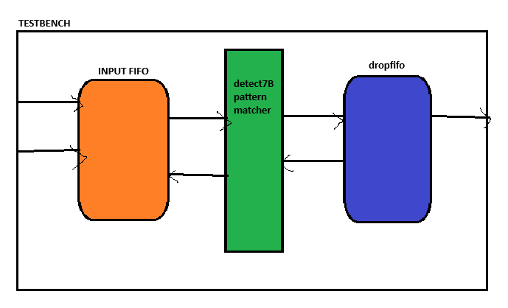

Slide 2
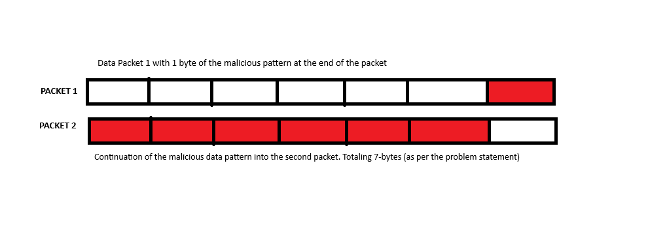
Byte 1 of malicious pattern
Bytes 2 -7 of malicious pattern

Slide 3
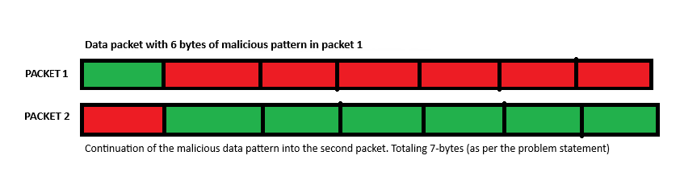

Slide 4
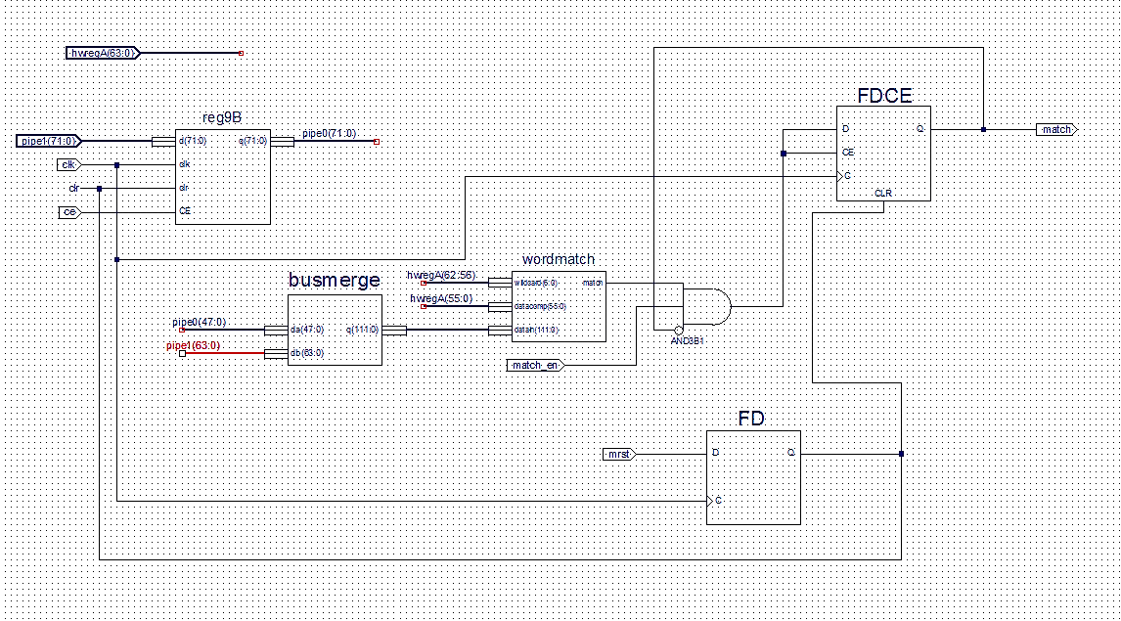
Detect7B

Slide 5
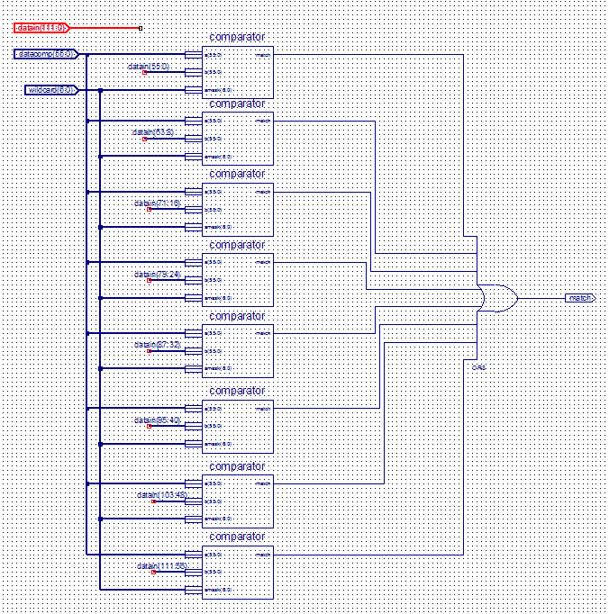
wordmatch

Slide 6
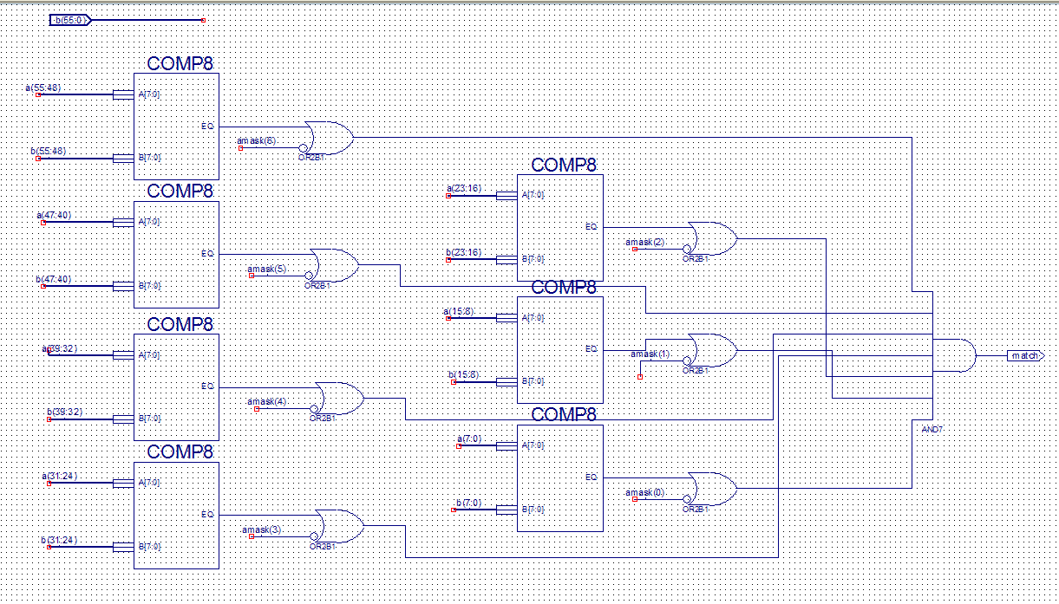
comparator

Slide 7
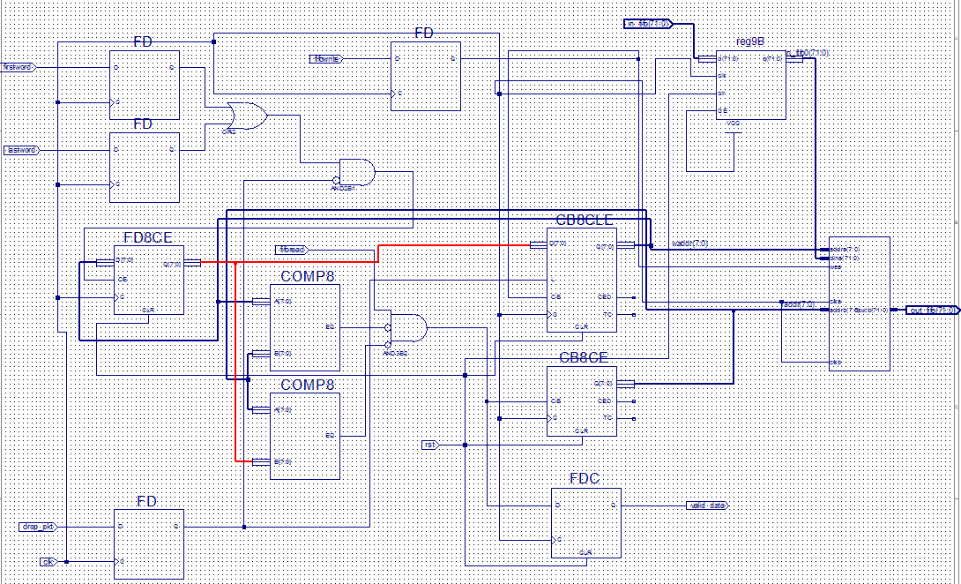
WR Pointer history
WR pointer incrementing
dropfifo

