Slide 1
Facial Emotion Detection using CNN
Team Members
1.Sarthak Jain (191IT145)
2.Gaurav Kumar(191IT114)
Notes:
We designed this template so that each member of the project team has a set of slides with its own theme. Members, here’s how you add a new slide to just your set:
Mark where you want to add the slide: Select an existing one in the Thumbnails pane, click the New Slide button, then choose a layout. The new slide gets the same theme as the other slides in your set.
Careful! Don’t annoy your fellow presenters by accidentally changing their themes. That can happen if you choose a different theme from the Design tab, which changes all of the slides in the presentation to that look.

Slide 2
Introduction
The facial expression of human emotion is one of the major topics in facial recognition, and it can generate both technical and everyday application beyond laboratory experiment .
Emotion detection can give people more affinities and help to provide personalized service to people depending on their moods.
This projection constructs a system of deep learning model to classify a given image of human facial emotion into one of the seven basic human emotions .
and the testing result will be evaluated based on accuracy of the model.

Slide 3
Objective and Motivation
There are several areas where the emotion recognition technique are used ,like in digital Cameras to automatically take pictures when the user smiles .
However, the most promising applications involve the humanization of artificial intelligent systems.
If computers are able to keep track of the mental status of the user, robots can react upon this and behave appropiately.
Emotion recognition therefore plays a key-role in improving human machine interaction.

Slide 4
Methodology
The Methods:
1.Convolutional Neural Networks (CNNs)
In this project, we use a deep learning technique called Convolutional Neural Networks(CNNs) to establish a classification model that combines feature extraction with classification.
CNN model is built using keras library, optimiser used is adam and loss function used is categorical.

Slide 5
Procedure
• Developing a CNN model
• Training and testing on very large dataset (FER-2013 used for this project)
• Taking image of any dimension from user.
• Predicting emotion of input image .
• We did GPU enabled training of our model (since it has 35000 + images)
• for creating model we used python libraries tensorflow, keras.
• other python libraries used are numpy, scipy, pandas etc.

Slide 6
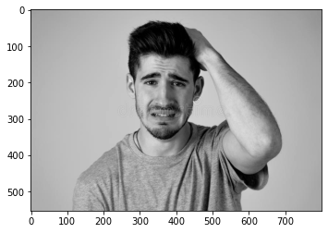
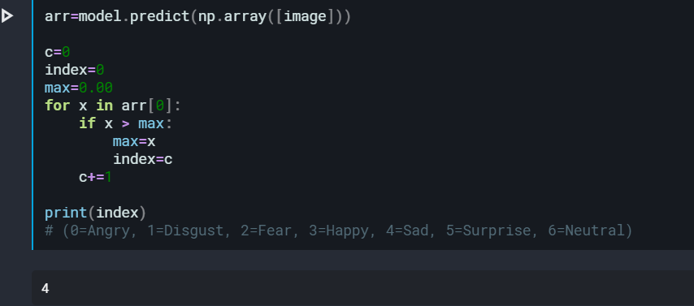
Result and analysis
Input image
result

Slide 7
Conclusion
Our project aims at detection of facial emotions. Our program classifies image given as input to one of the seven classes/emotions.(0=Angry, 1=Disgust, 2=Fear, 3=Happy, 4=Sad, 5=Surprise, 6=Neutral)
We have used keras library of python for building our model and the dataset we used is FER2013.Images are downgraded to 48 x 48 since the images present in our dataset were of this dimensions. Although this is lossy downgrading in future we would like to extend our work by using various image compression techniques to get more better results.

Slide 8
Thank You
Notes:
We designed this template so that each member of the project team has a set of slides with its own theme. Members, here’s how you add a new slide to just your set:
Mark where you want to add the slide: Select an existing one in the Thumbnails pane, click the New Slide button, then choose a layout. The new slide gets the same theme as the other slides in your set.
Careful! Don’t annoy your fellow presenters by accidentally changing their themes. That can happen if you choose a different theme from the Design tab, which changes all of the slides in the presentation to that look.

